Slide 1
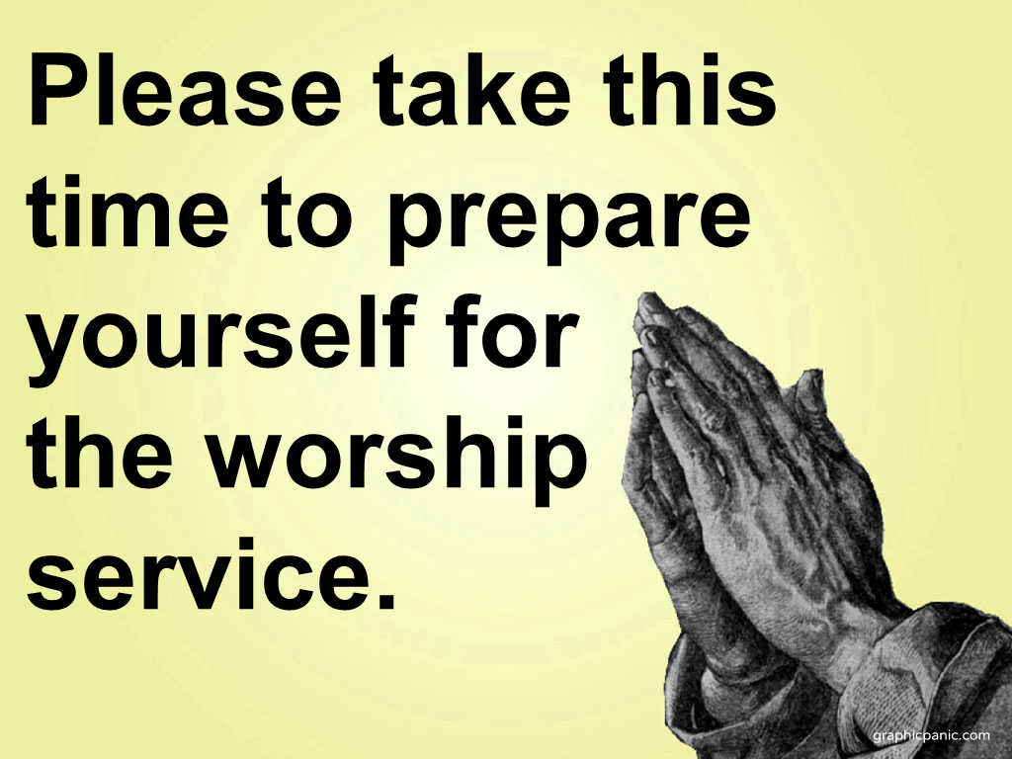

Slide 2
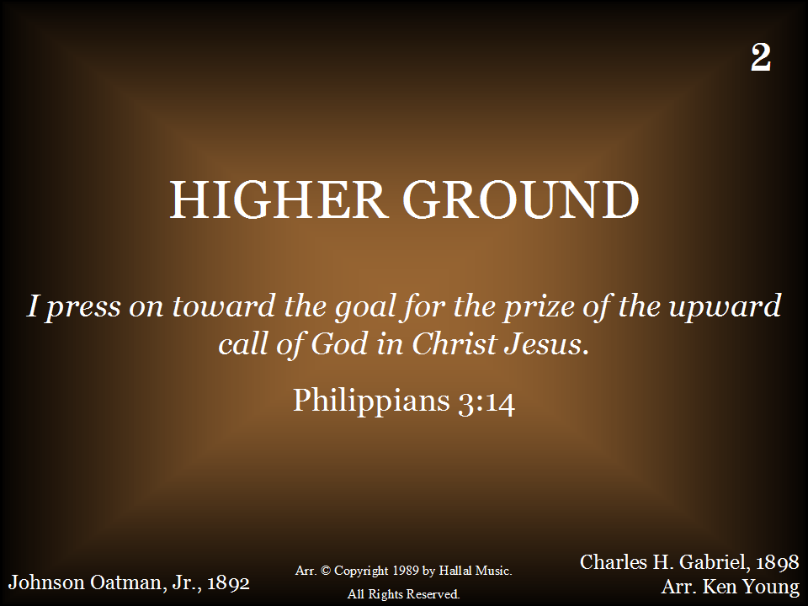
002 - Higher Ground - Title

Slide 3
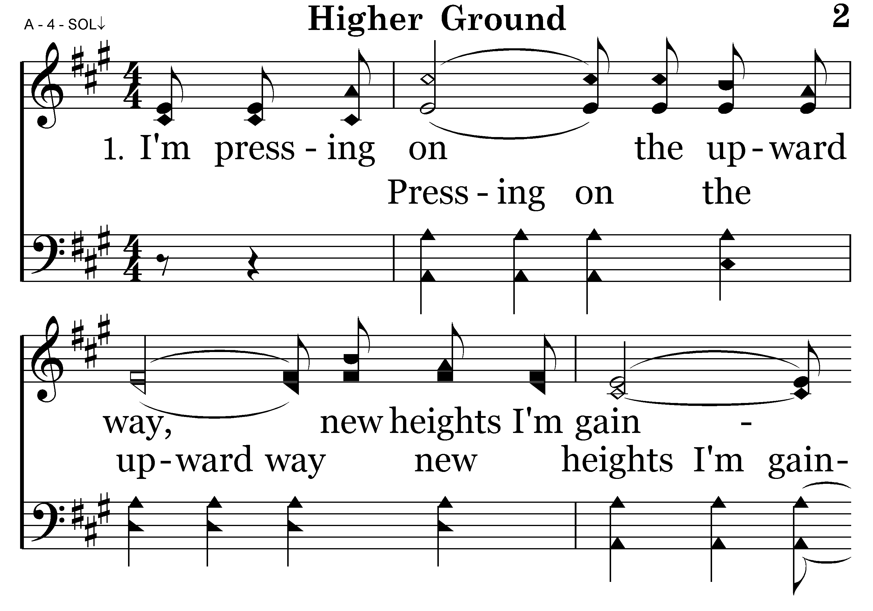
002 - Higher Ground - 1.1

Slide 4
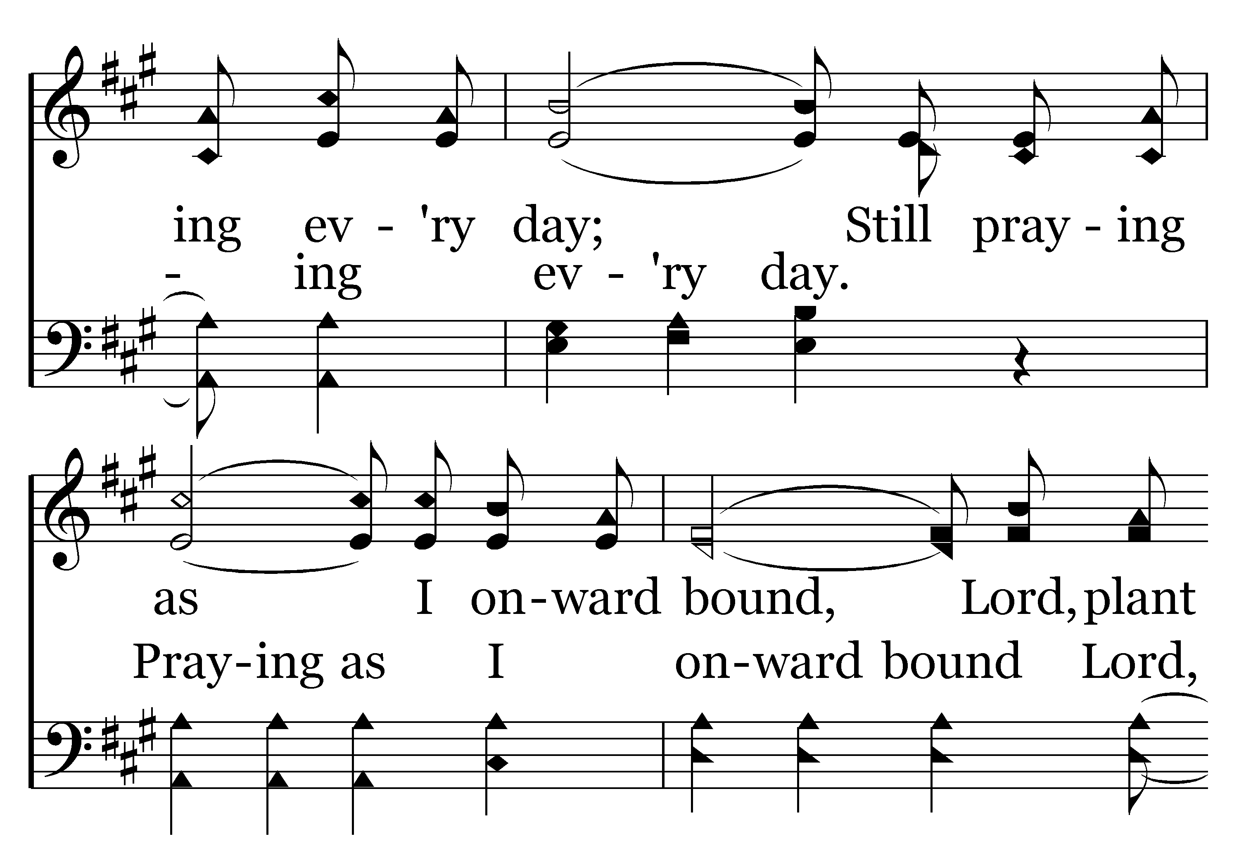
002 - Higher Ground - 1.2

Slide 5
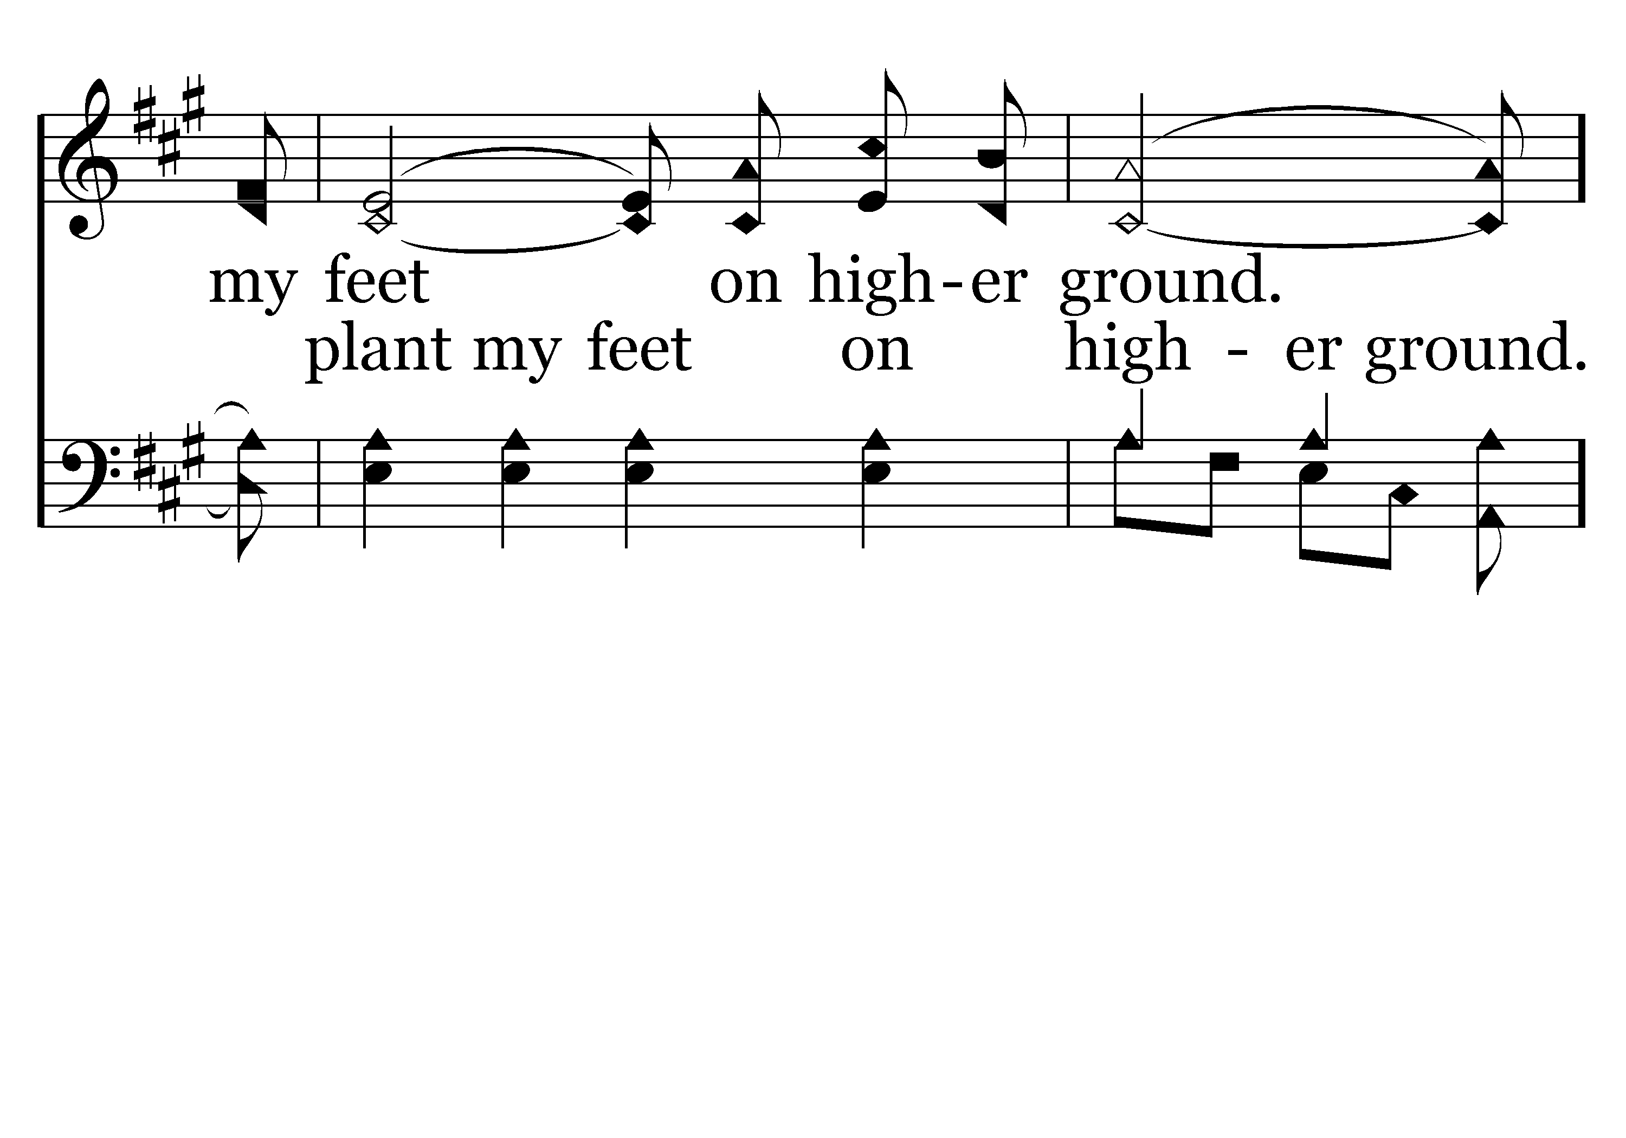
002 - Higher Ground - 1.3

Slide 6
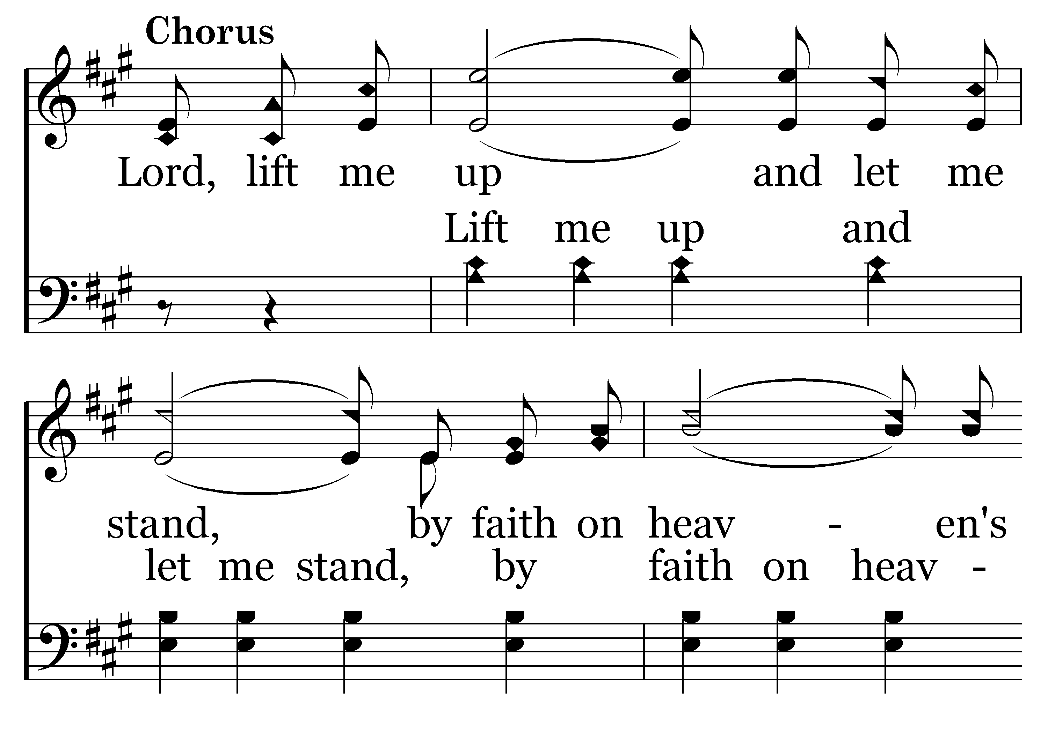
002 - Higher Ground - C.1

Slide 7
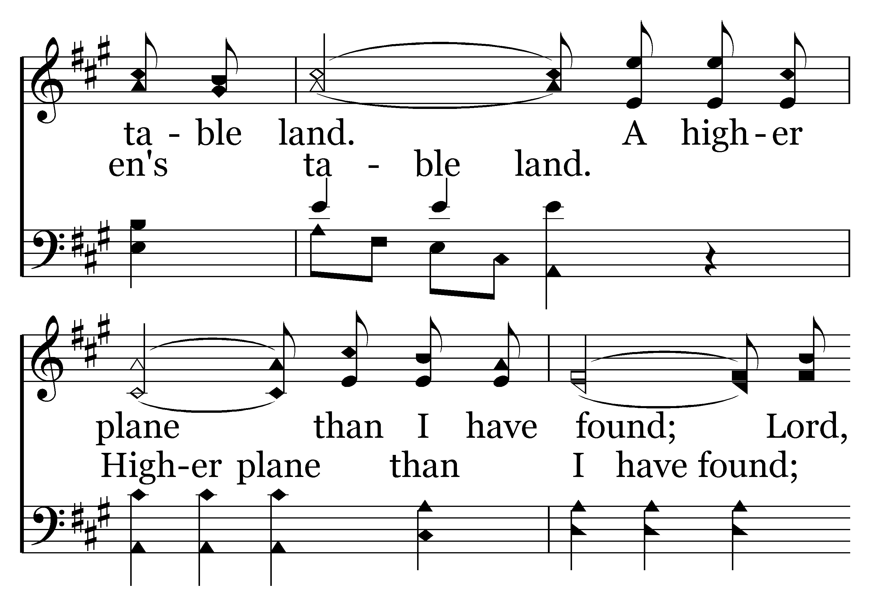
002 - Higher Ground - C.2

Slide 8
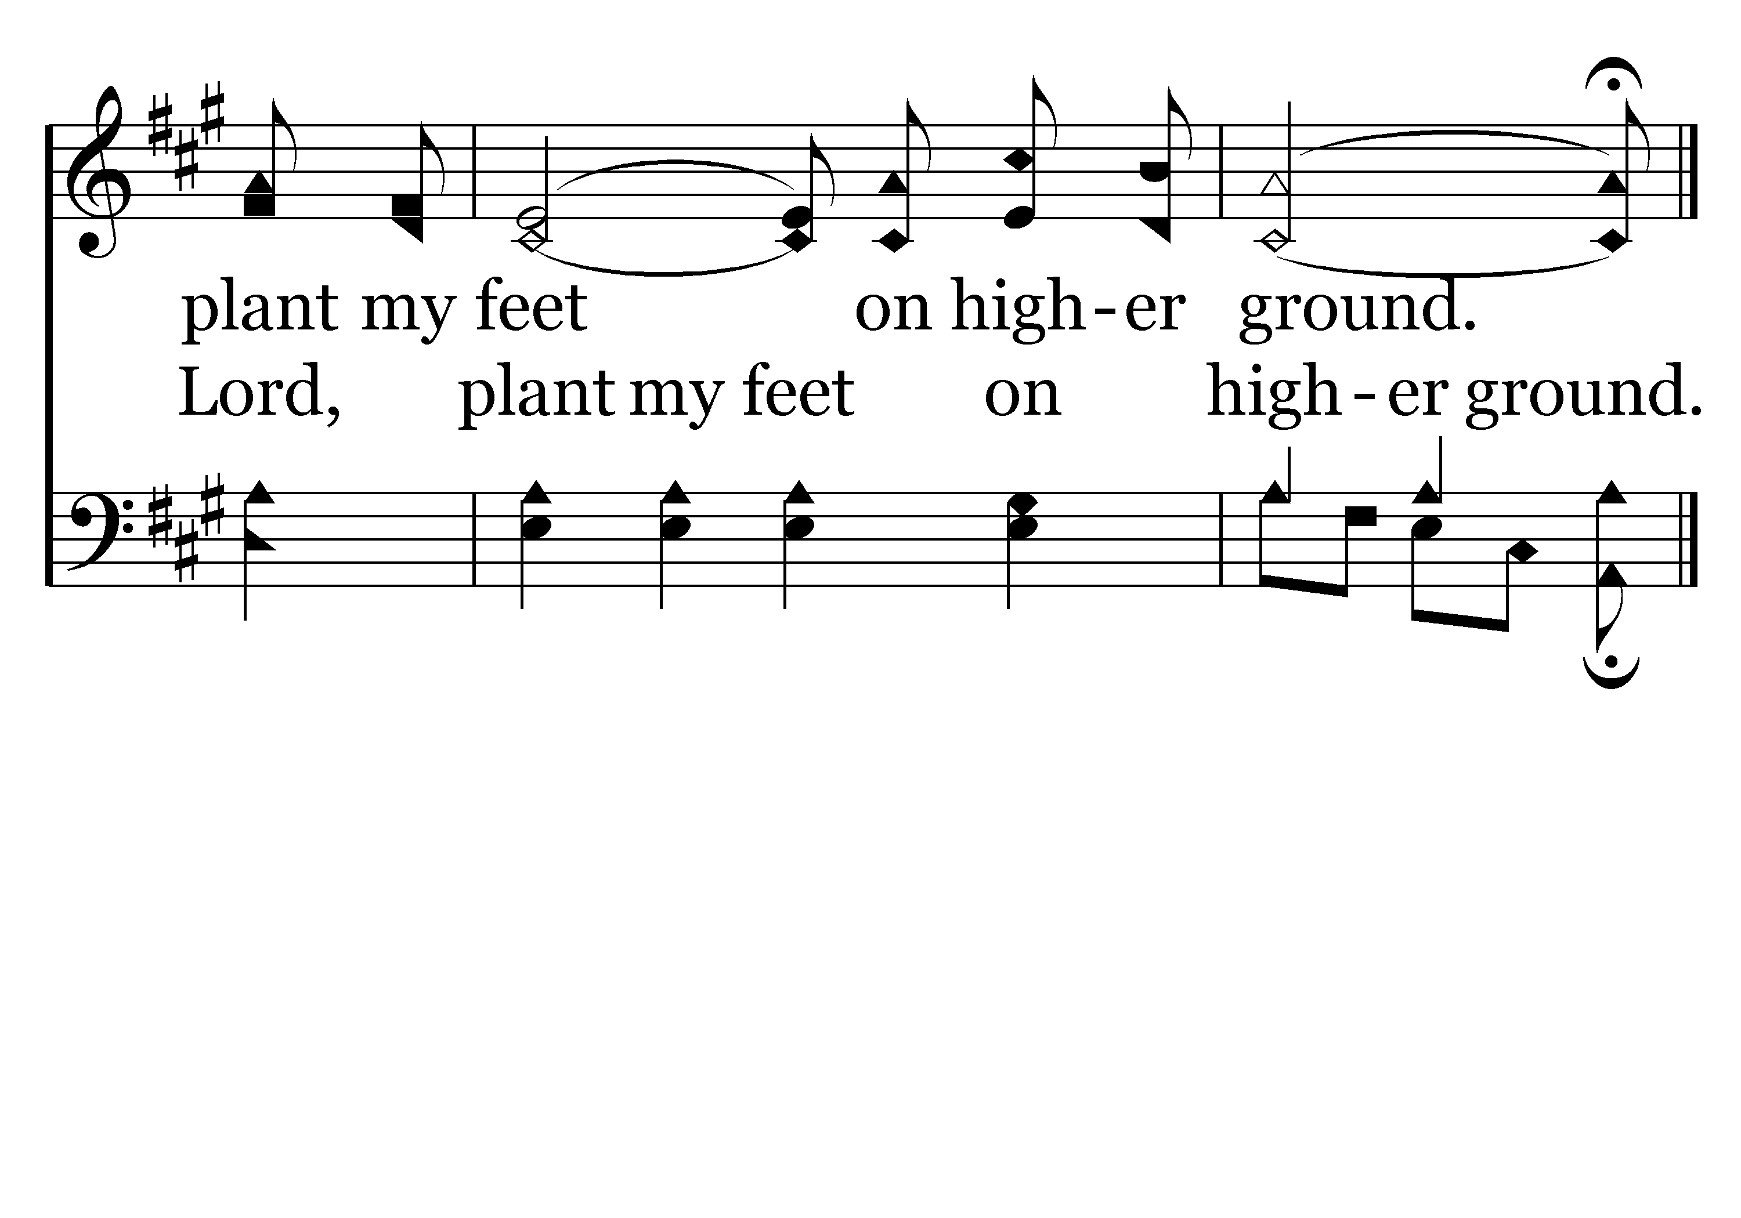
002 - Higher Ground - C.3
End of Verse 1

Slide 9
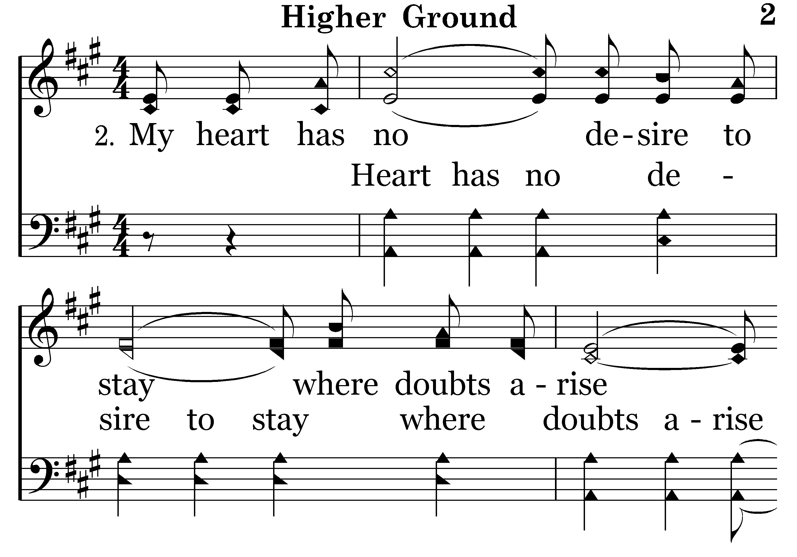
002 - Higher Ground - 2.1

Slide 10
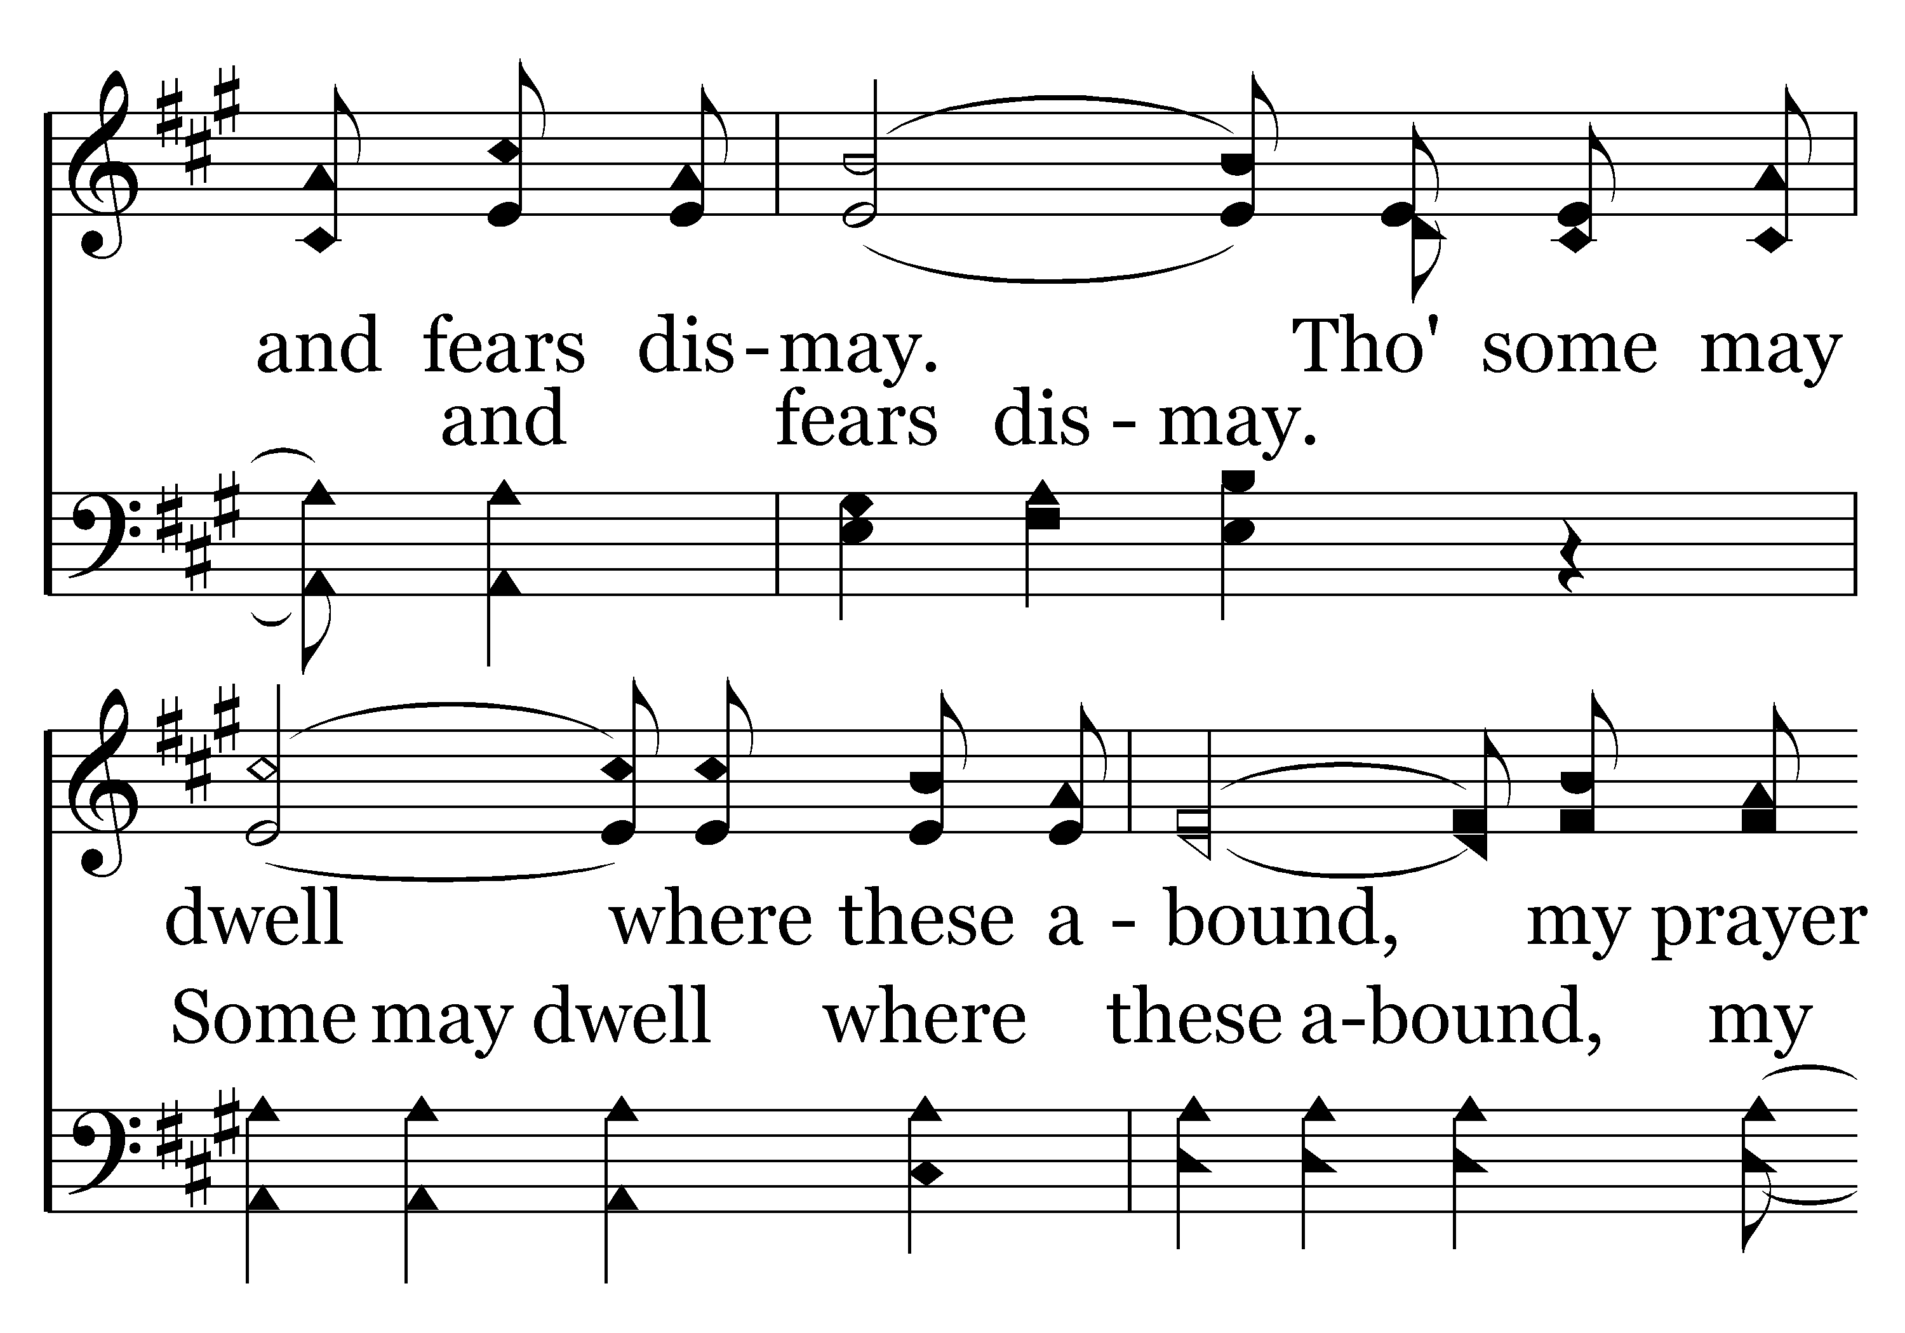
002 - Higher Ground - 2.2

Slide 11
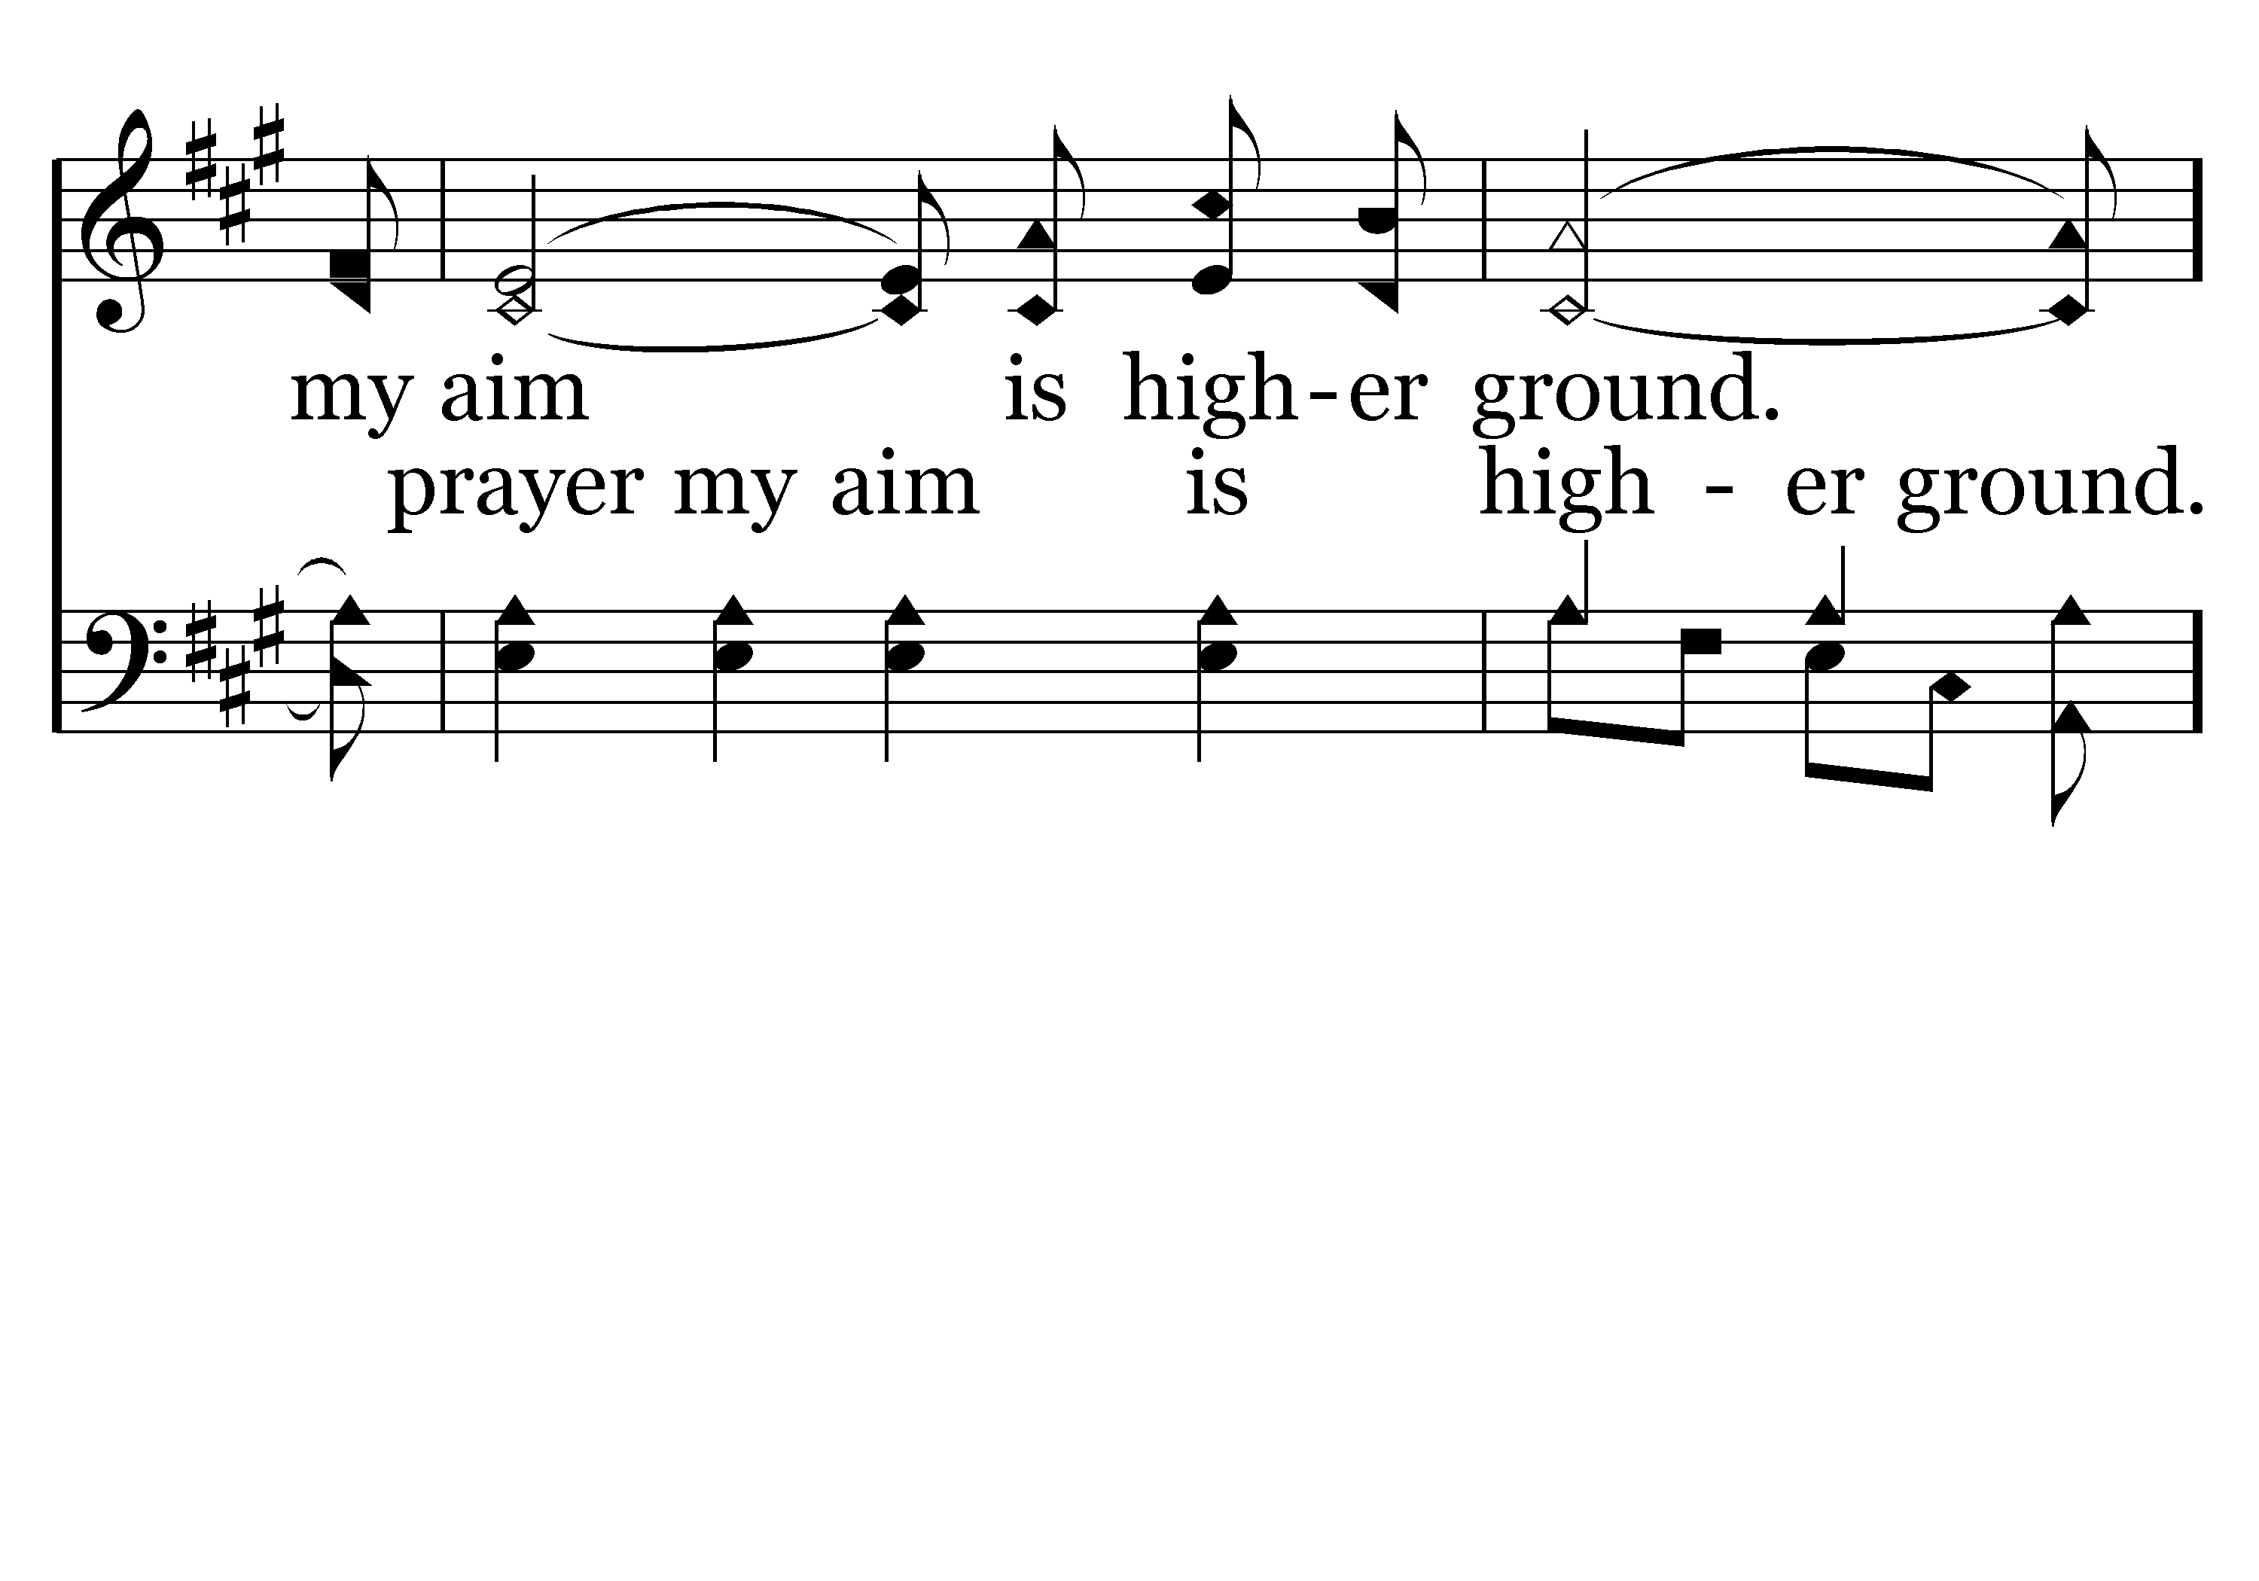
002 - Higher Ground - 2.3

Slide 12
002 - Higher Ground - C.1

Slide 13
002 - Higher Ground - C.2

Slide 14
002 - Higher Ground - C.3
End of Verse 2

Slide 15
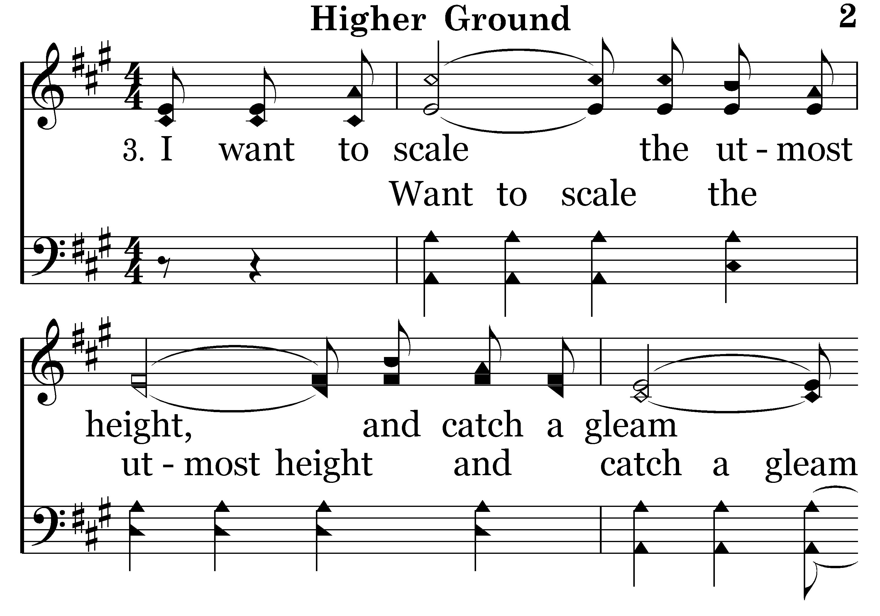
002 - Higher Ground - 3.1

Slide 16
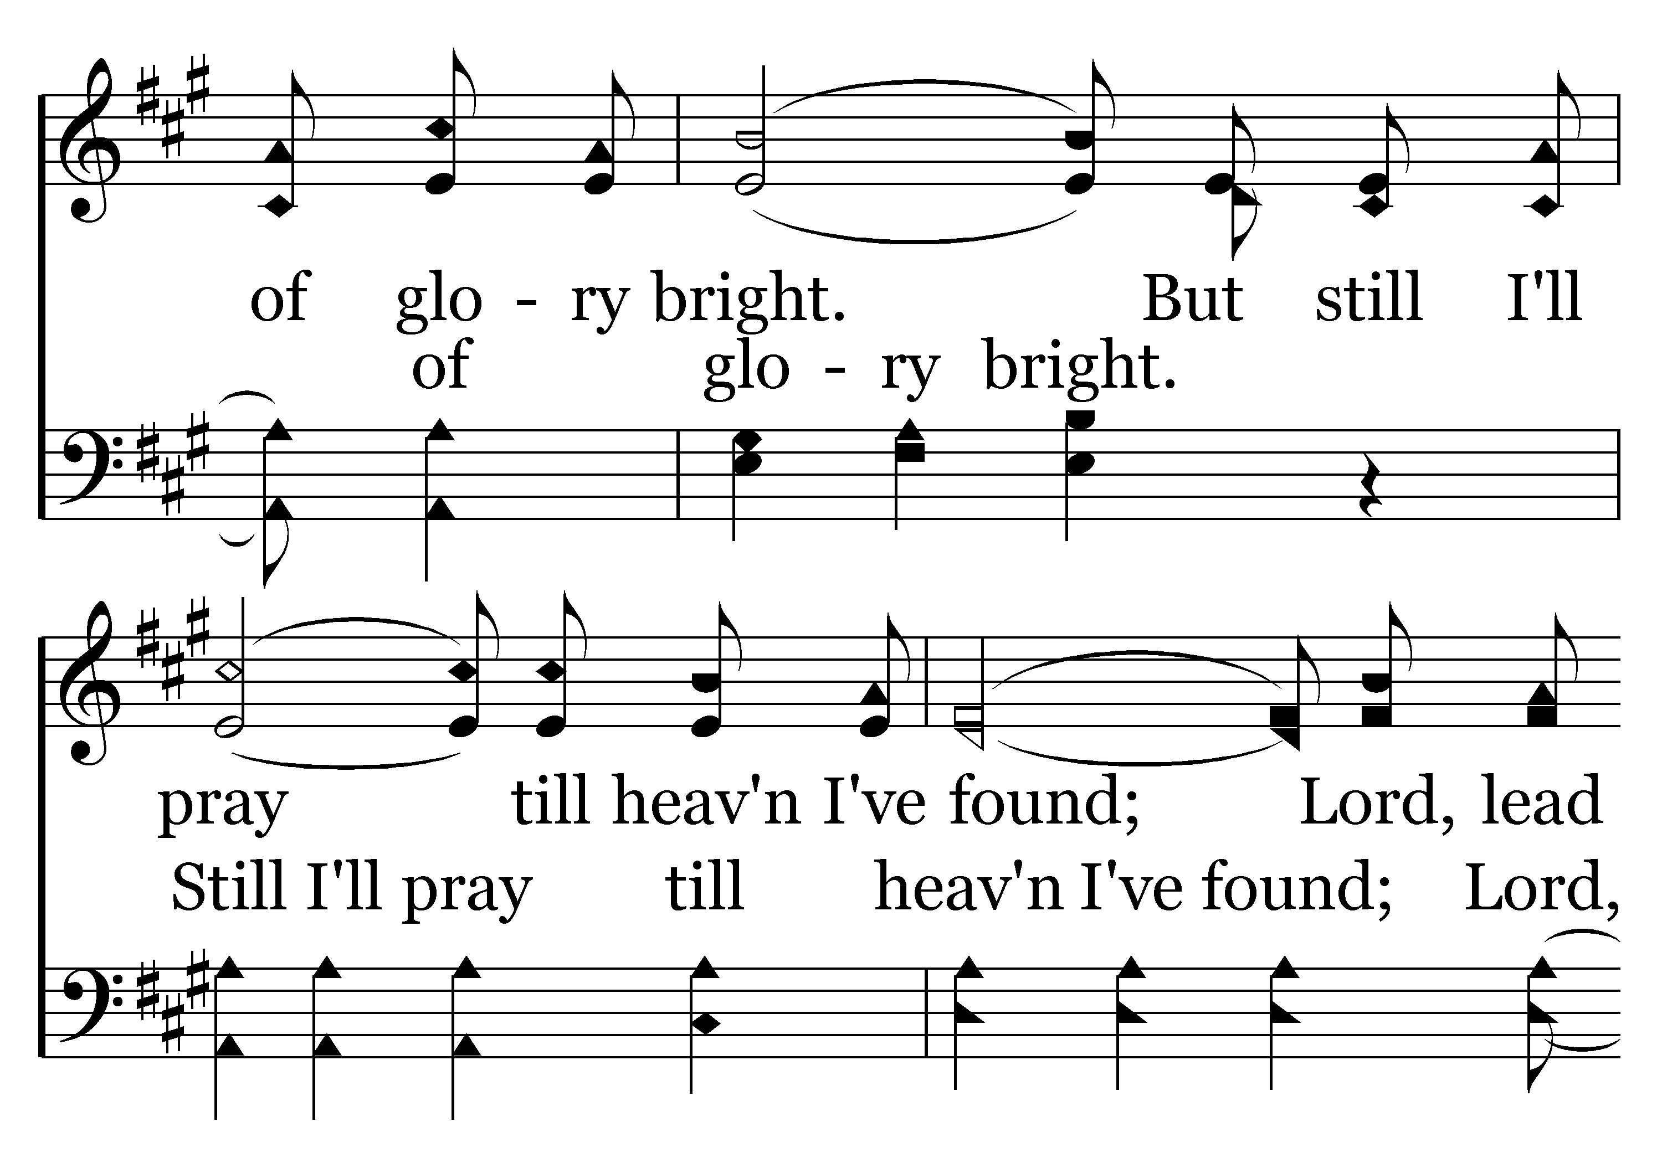
002 - Higher Ground - 3.2

Slide 17
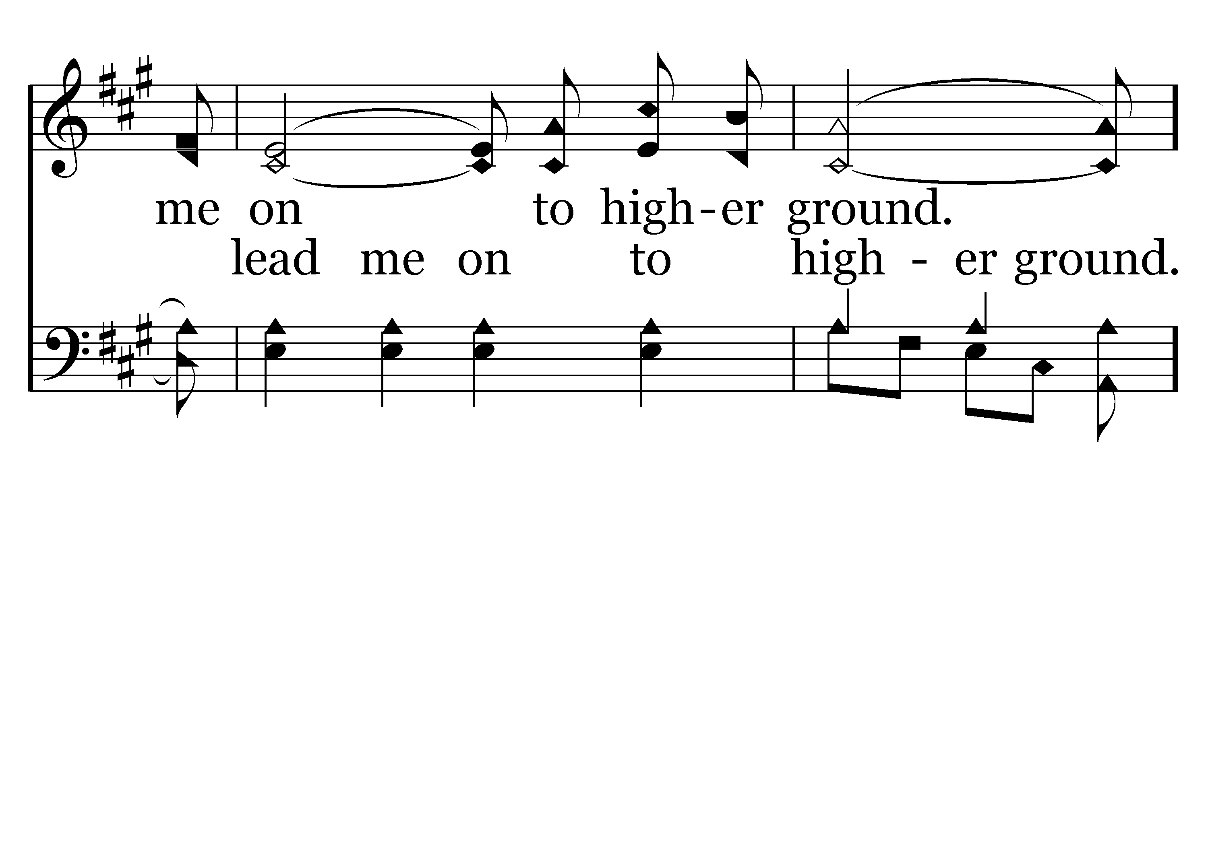
002 - Higher Ground - 3.3

Slide 18
002 - Higher Ground - C.1

Slide 19
002 - Higher Ground - C.2

Slide 20
002 - Higher Ground - C.3
End of Song

Slide 21
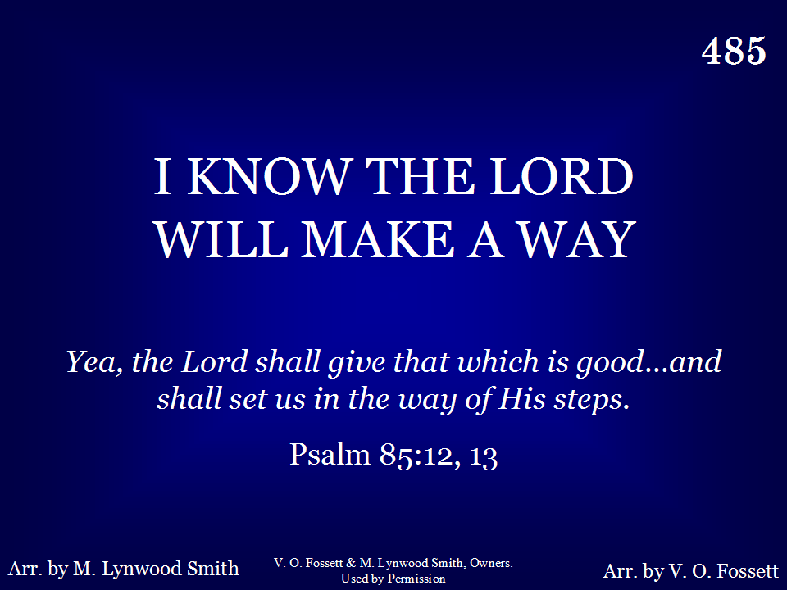
485 - I Know The Lord Will Make A Way - Title

Slide 22
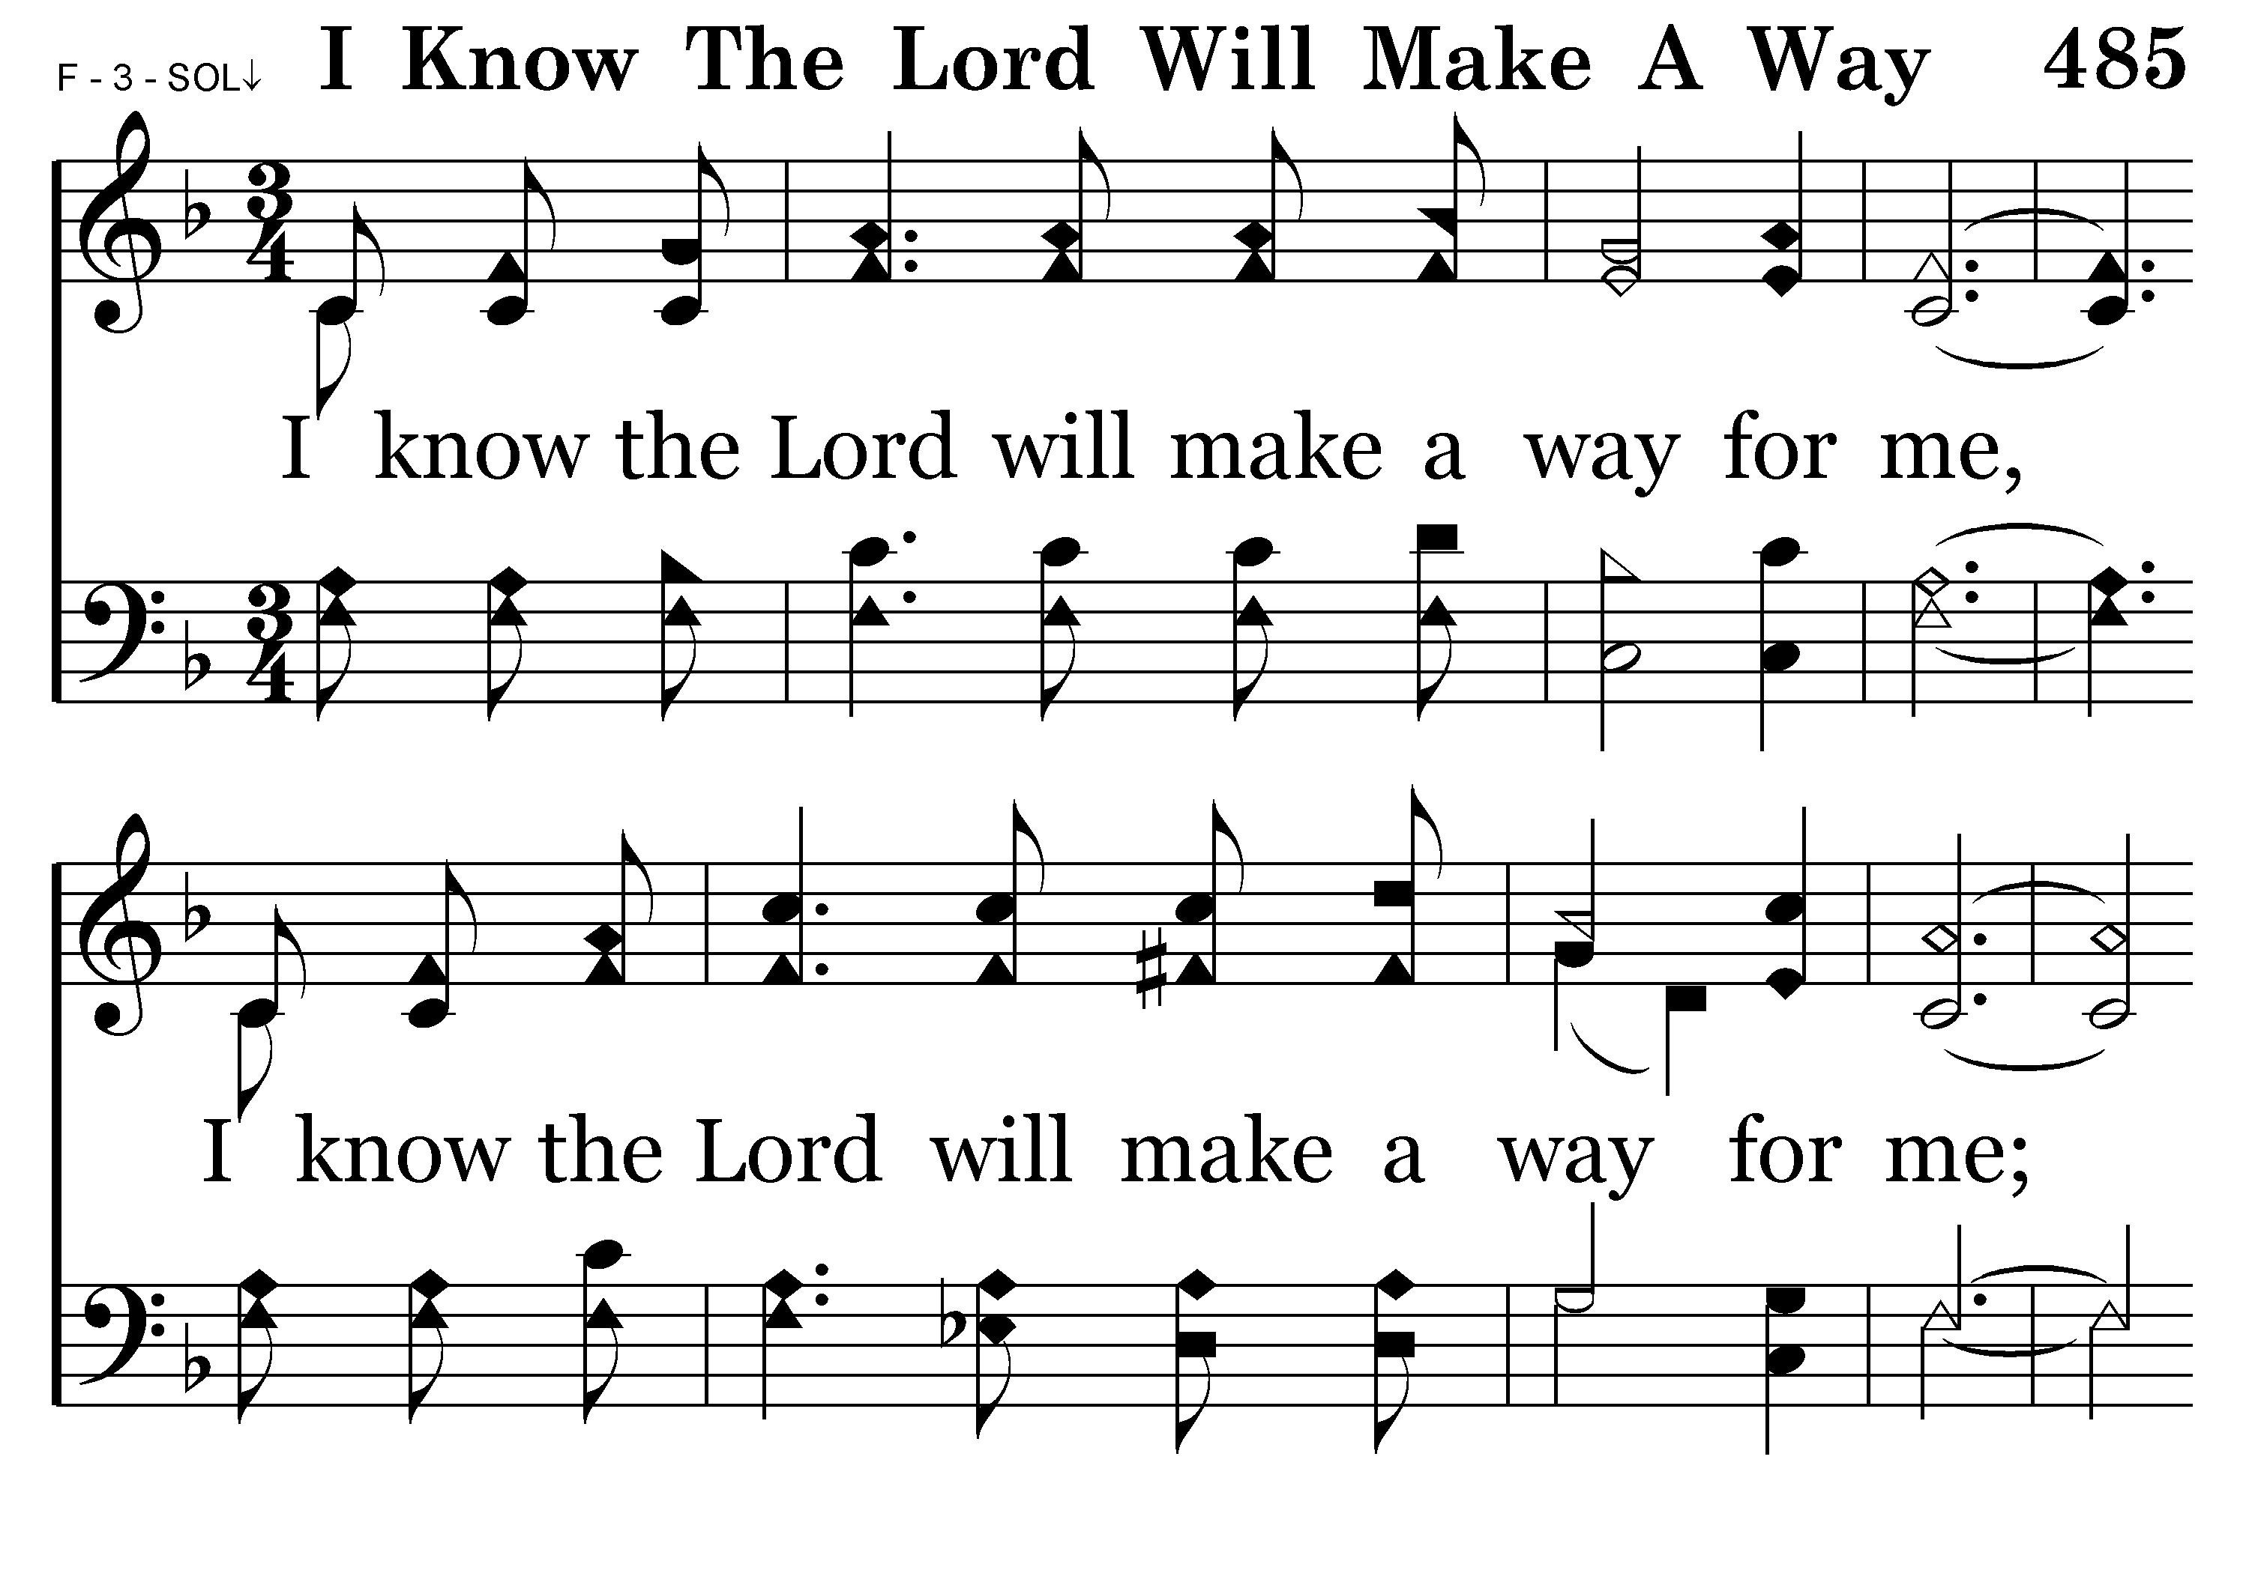
485 - I Know The Lord Will Make A Way - 1.1

Slide 23
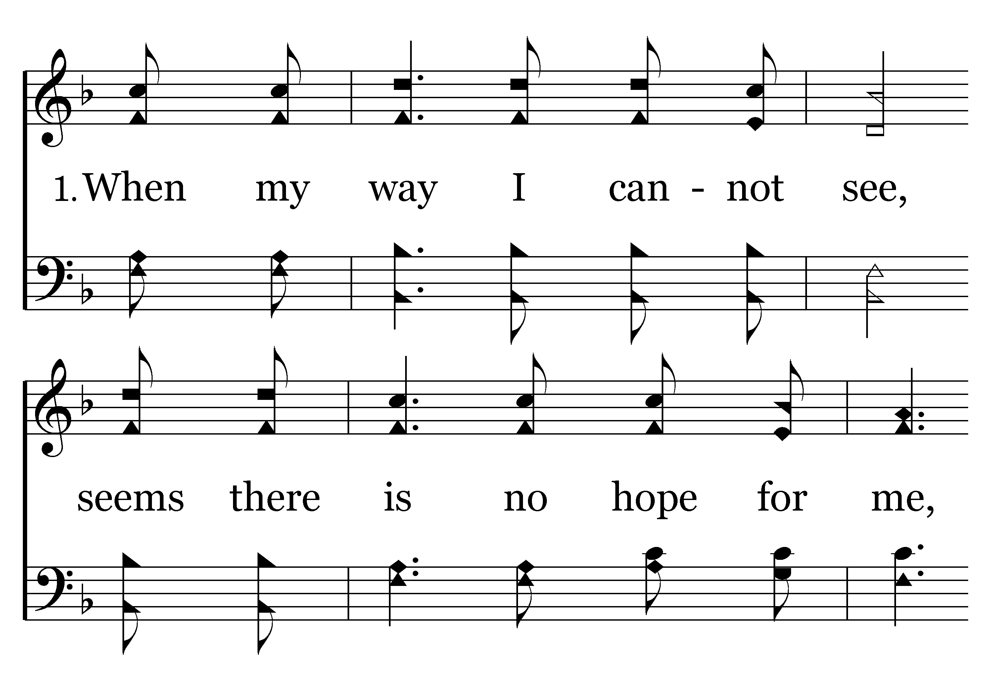
485 - I Know The Lord Will Make A Way - 1.2

Slide 24
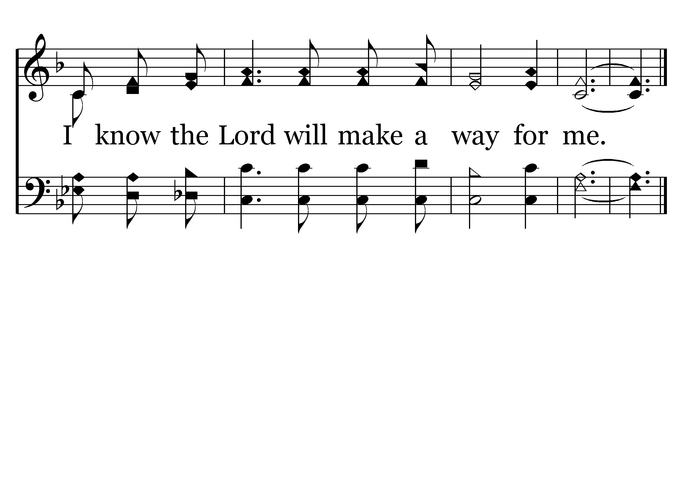
485 - I Know The Lord Will Make A Way - 1.3
End of Verse 1

Slide 25
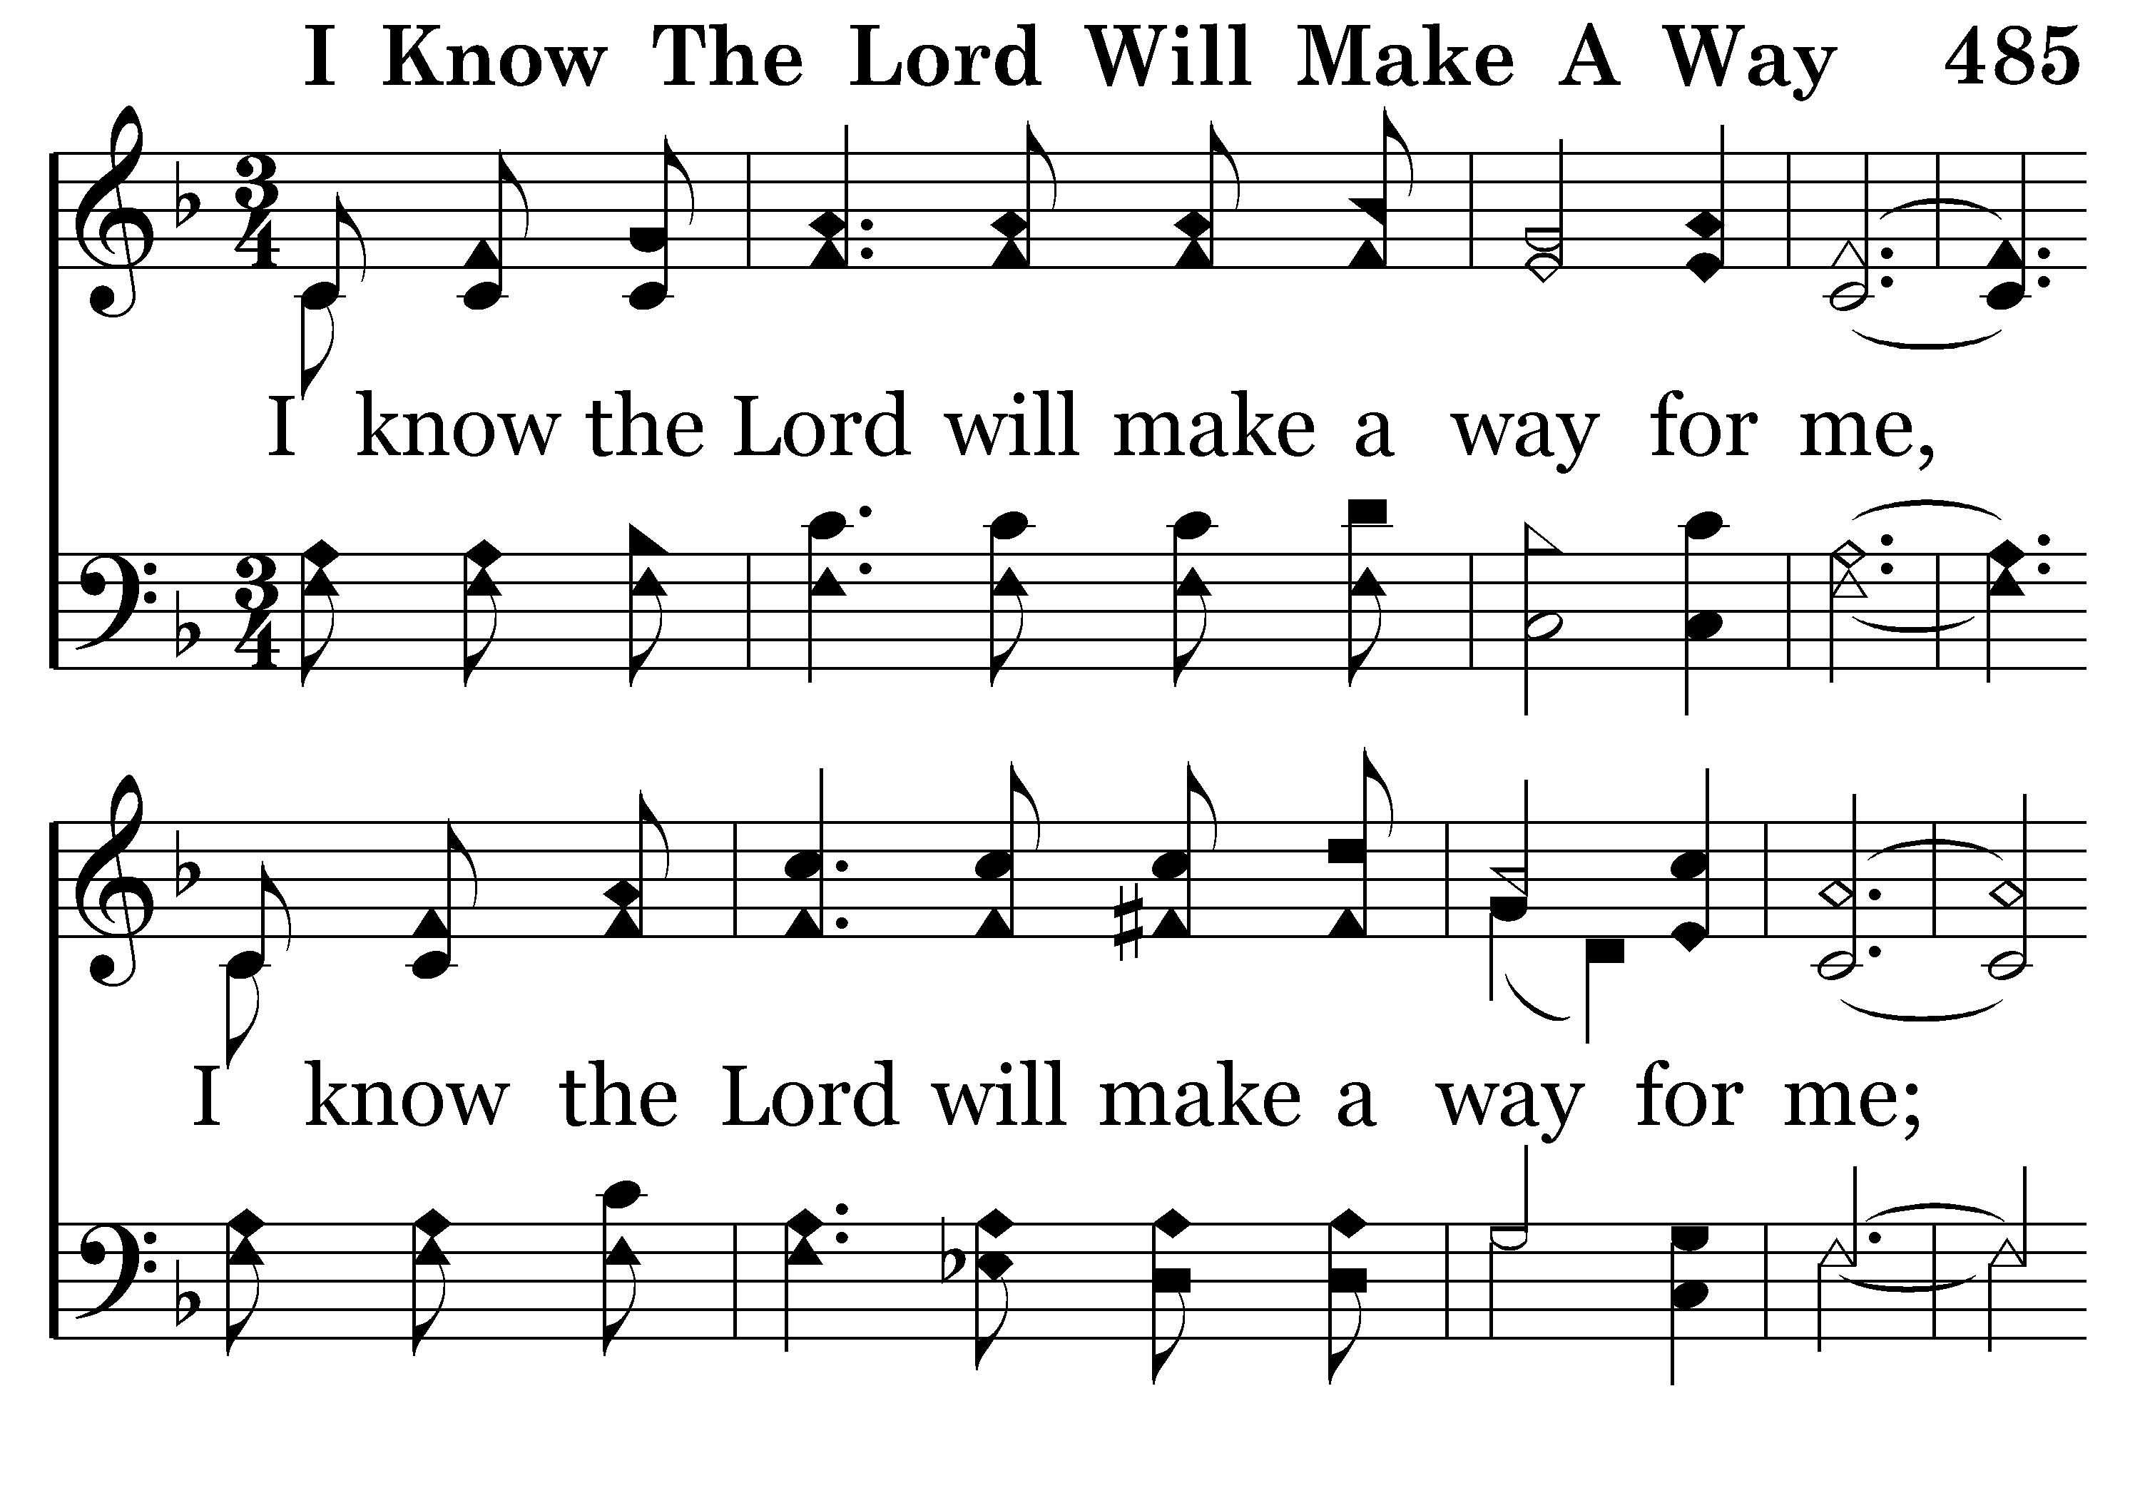
485 - I Know The Lord Will Make A Way - 2.1

Slide 26
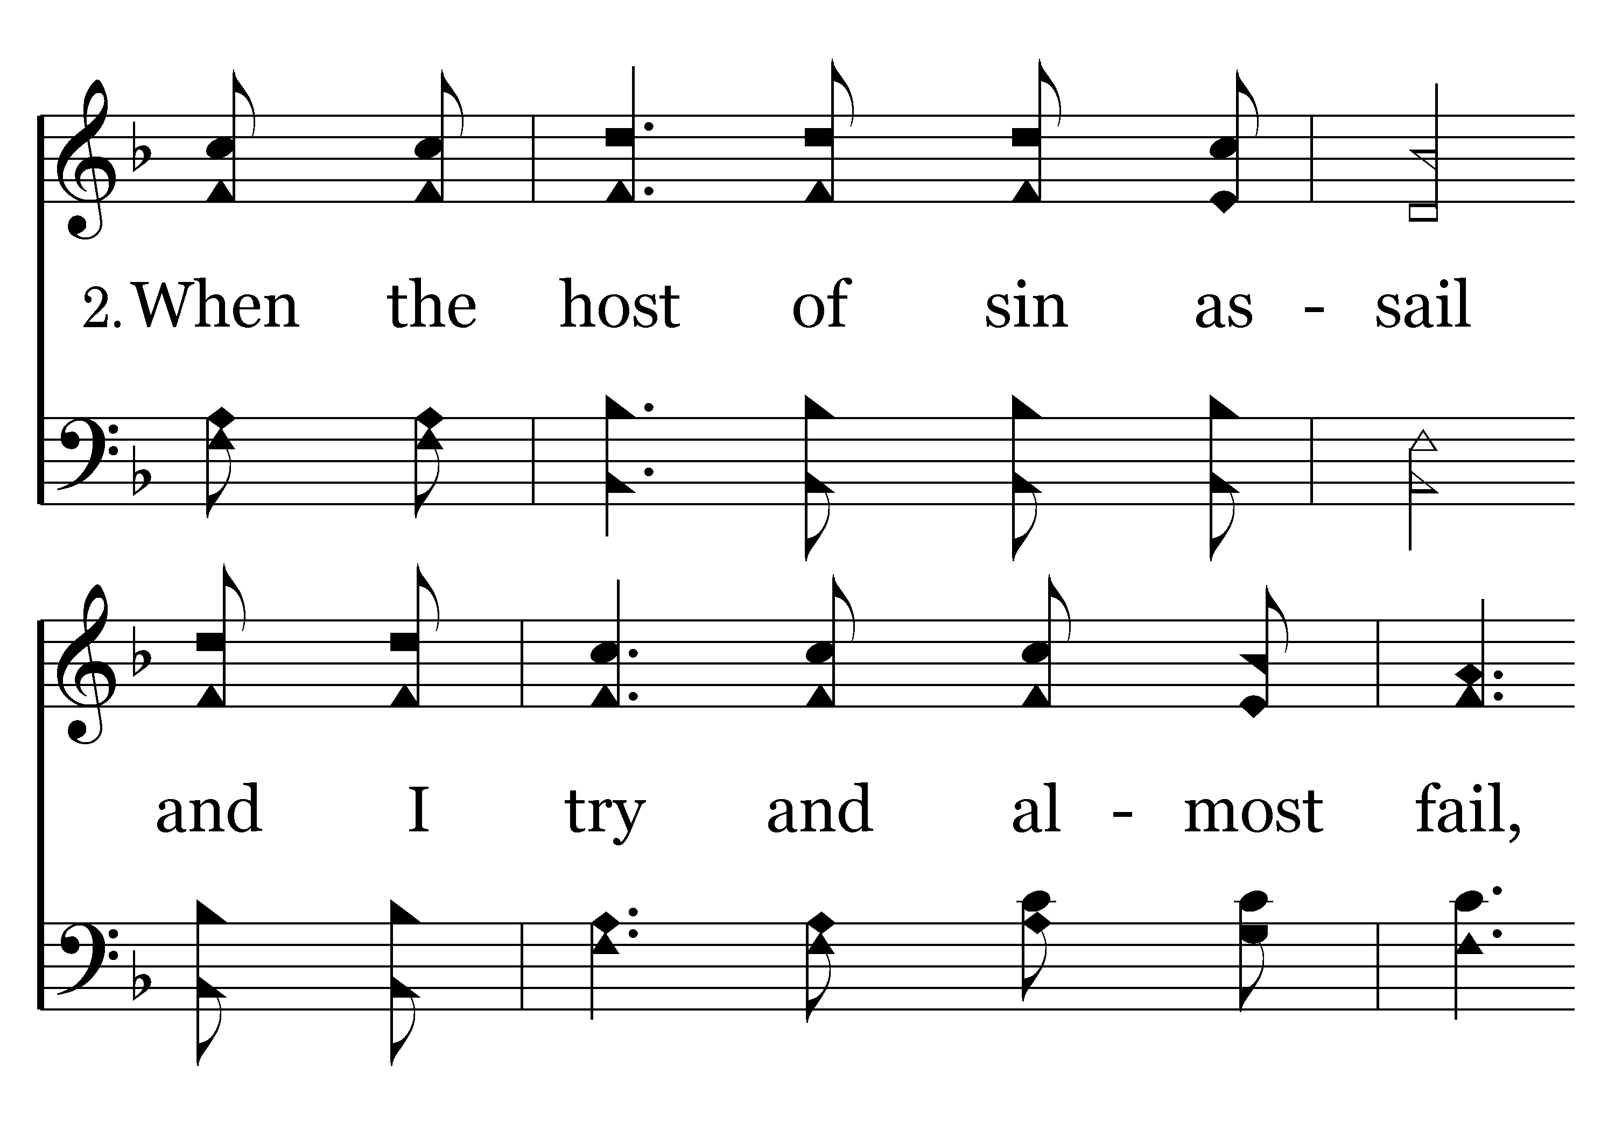
485 - I Know The Lord Will Make A Way - 2.2

Slide 27
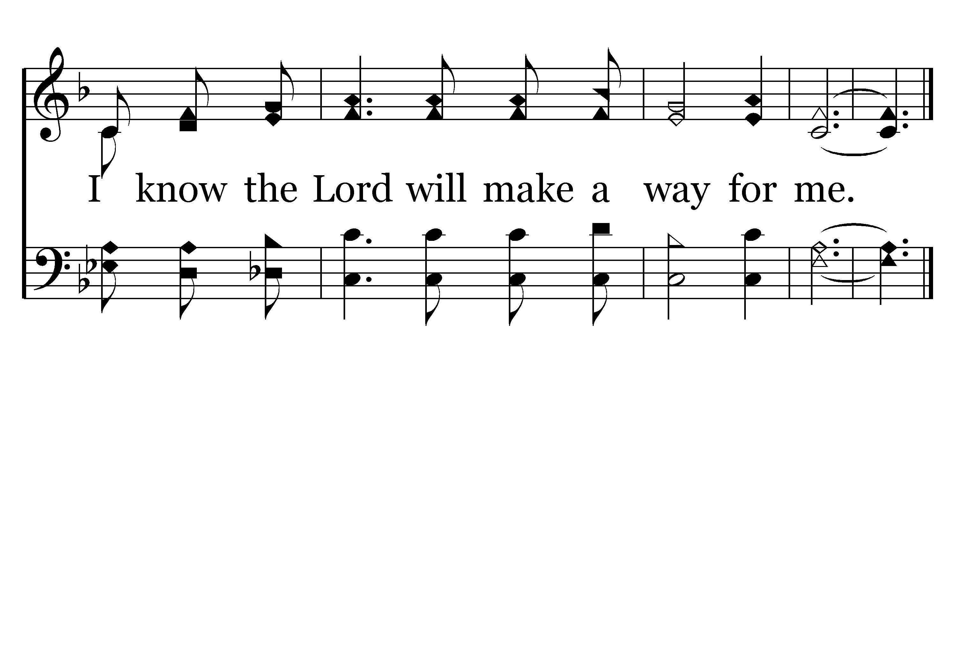
485 - I Know The Lord Will Make A Way - 2.3
End of Verse 2

Slide 28
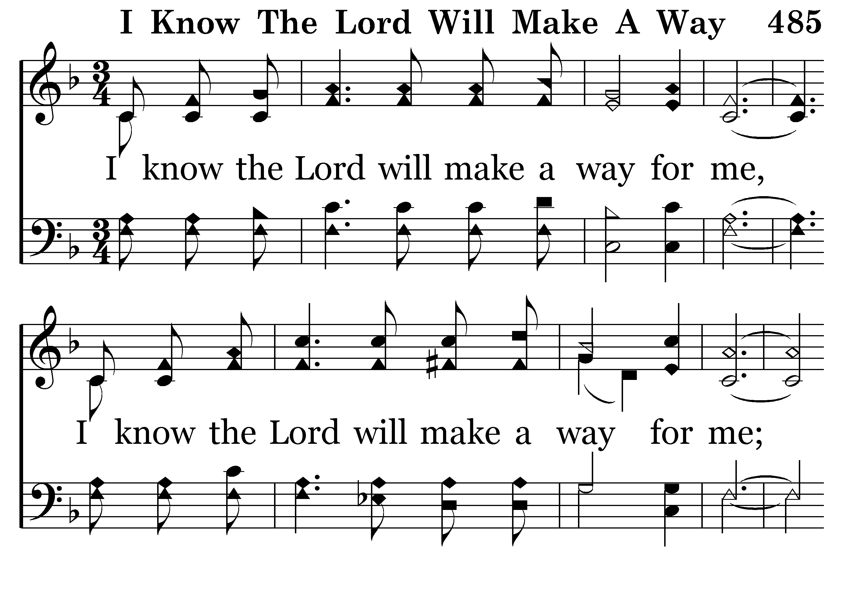
485 - I Know The Lord Will Make A Way - 3.1

Slide 29
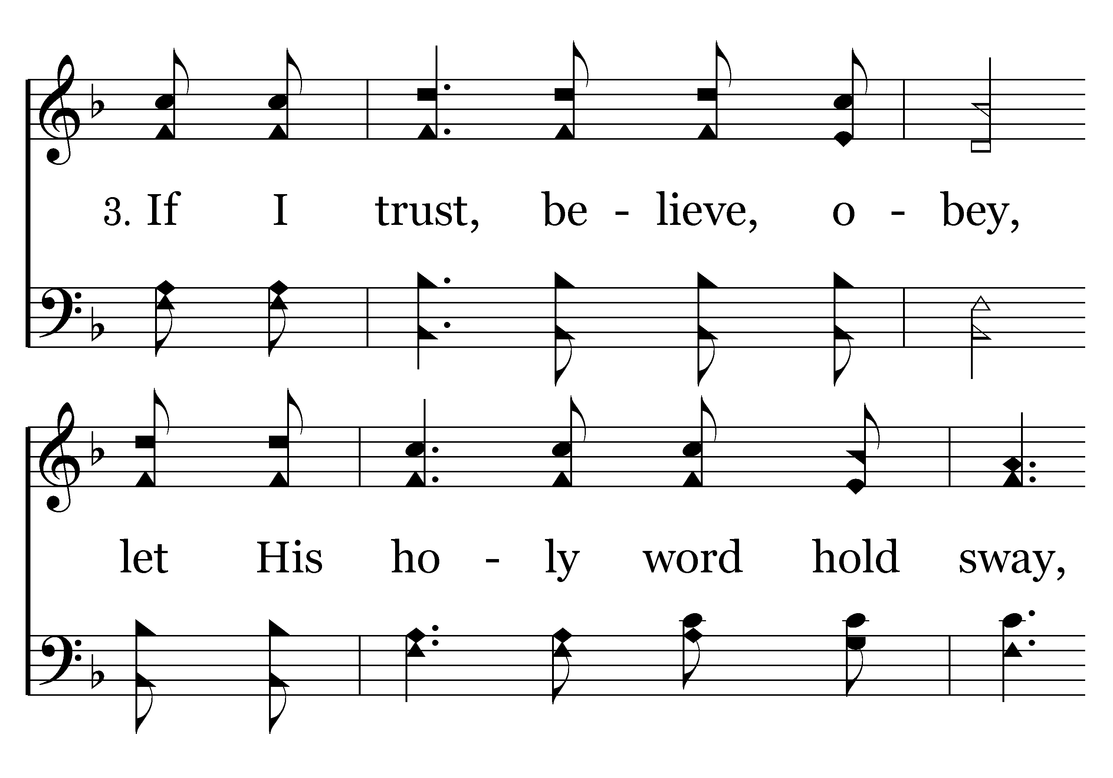
485 - I Know The Lord Will Make A Way - 3.2

Slide 30
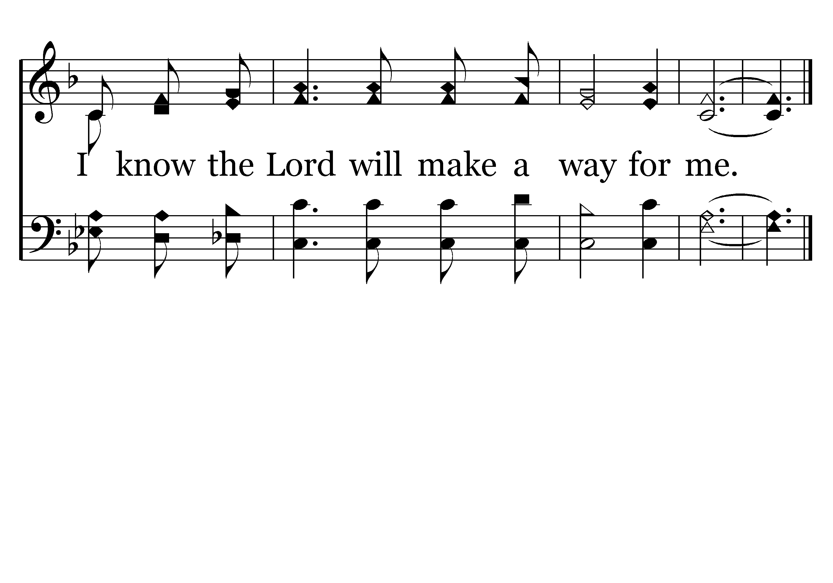
485 - I Know The Lord Will Make A Way - 3.3
End of Song

Slide 31
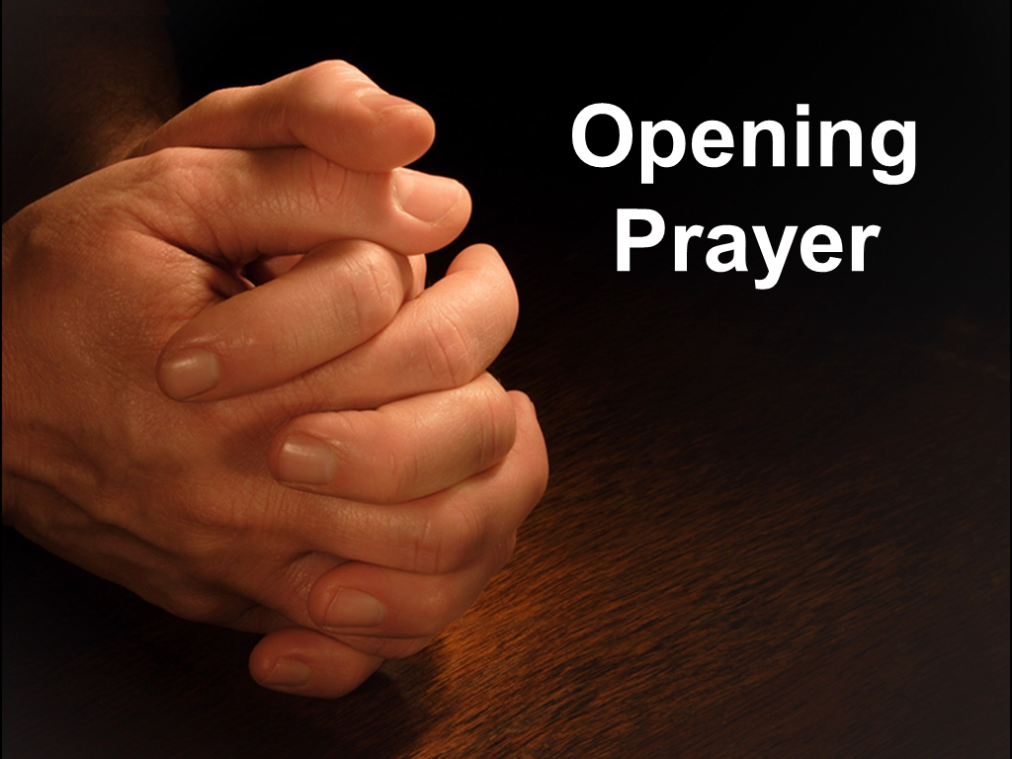

Slide 32
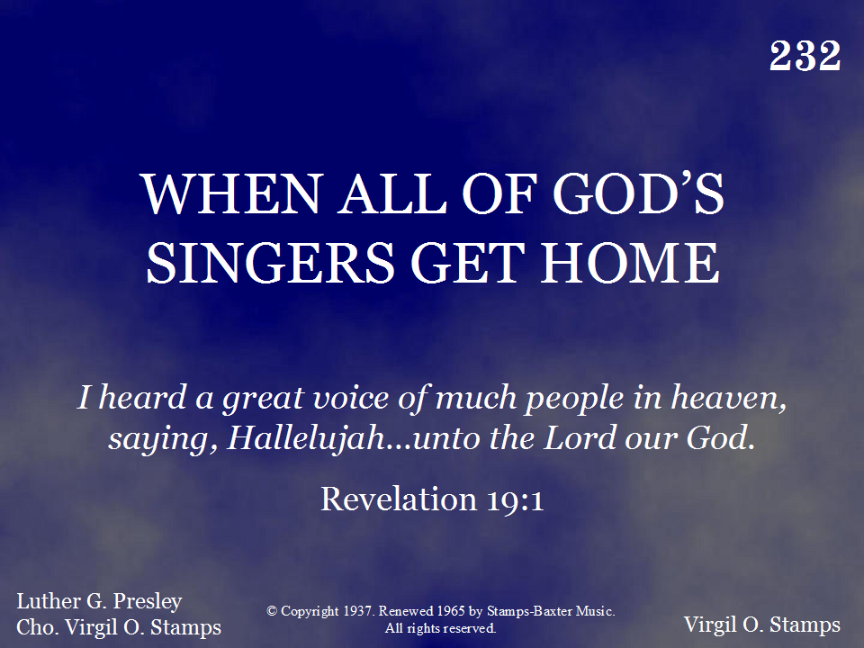
232 - When All Of God's Singers Get Home - Title

Slide 33
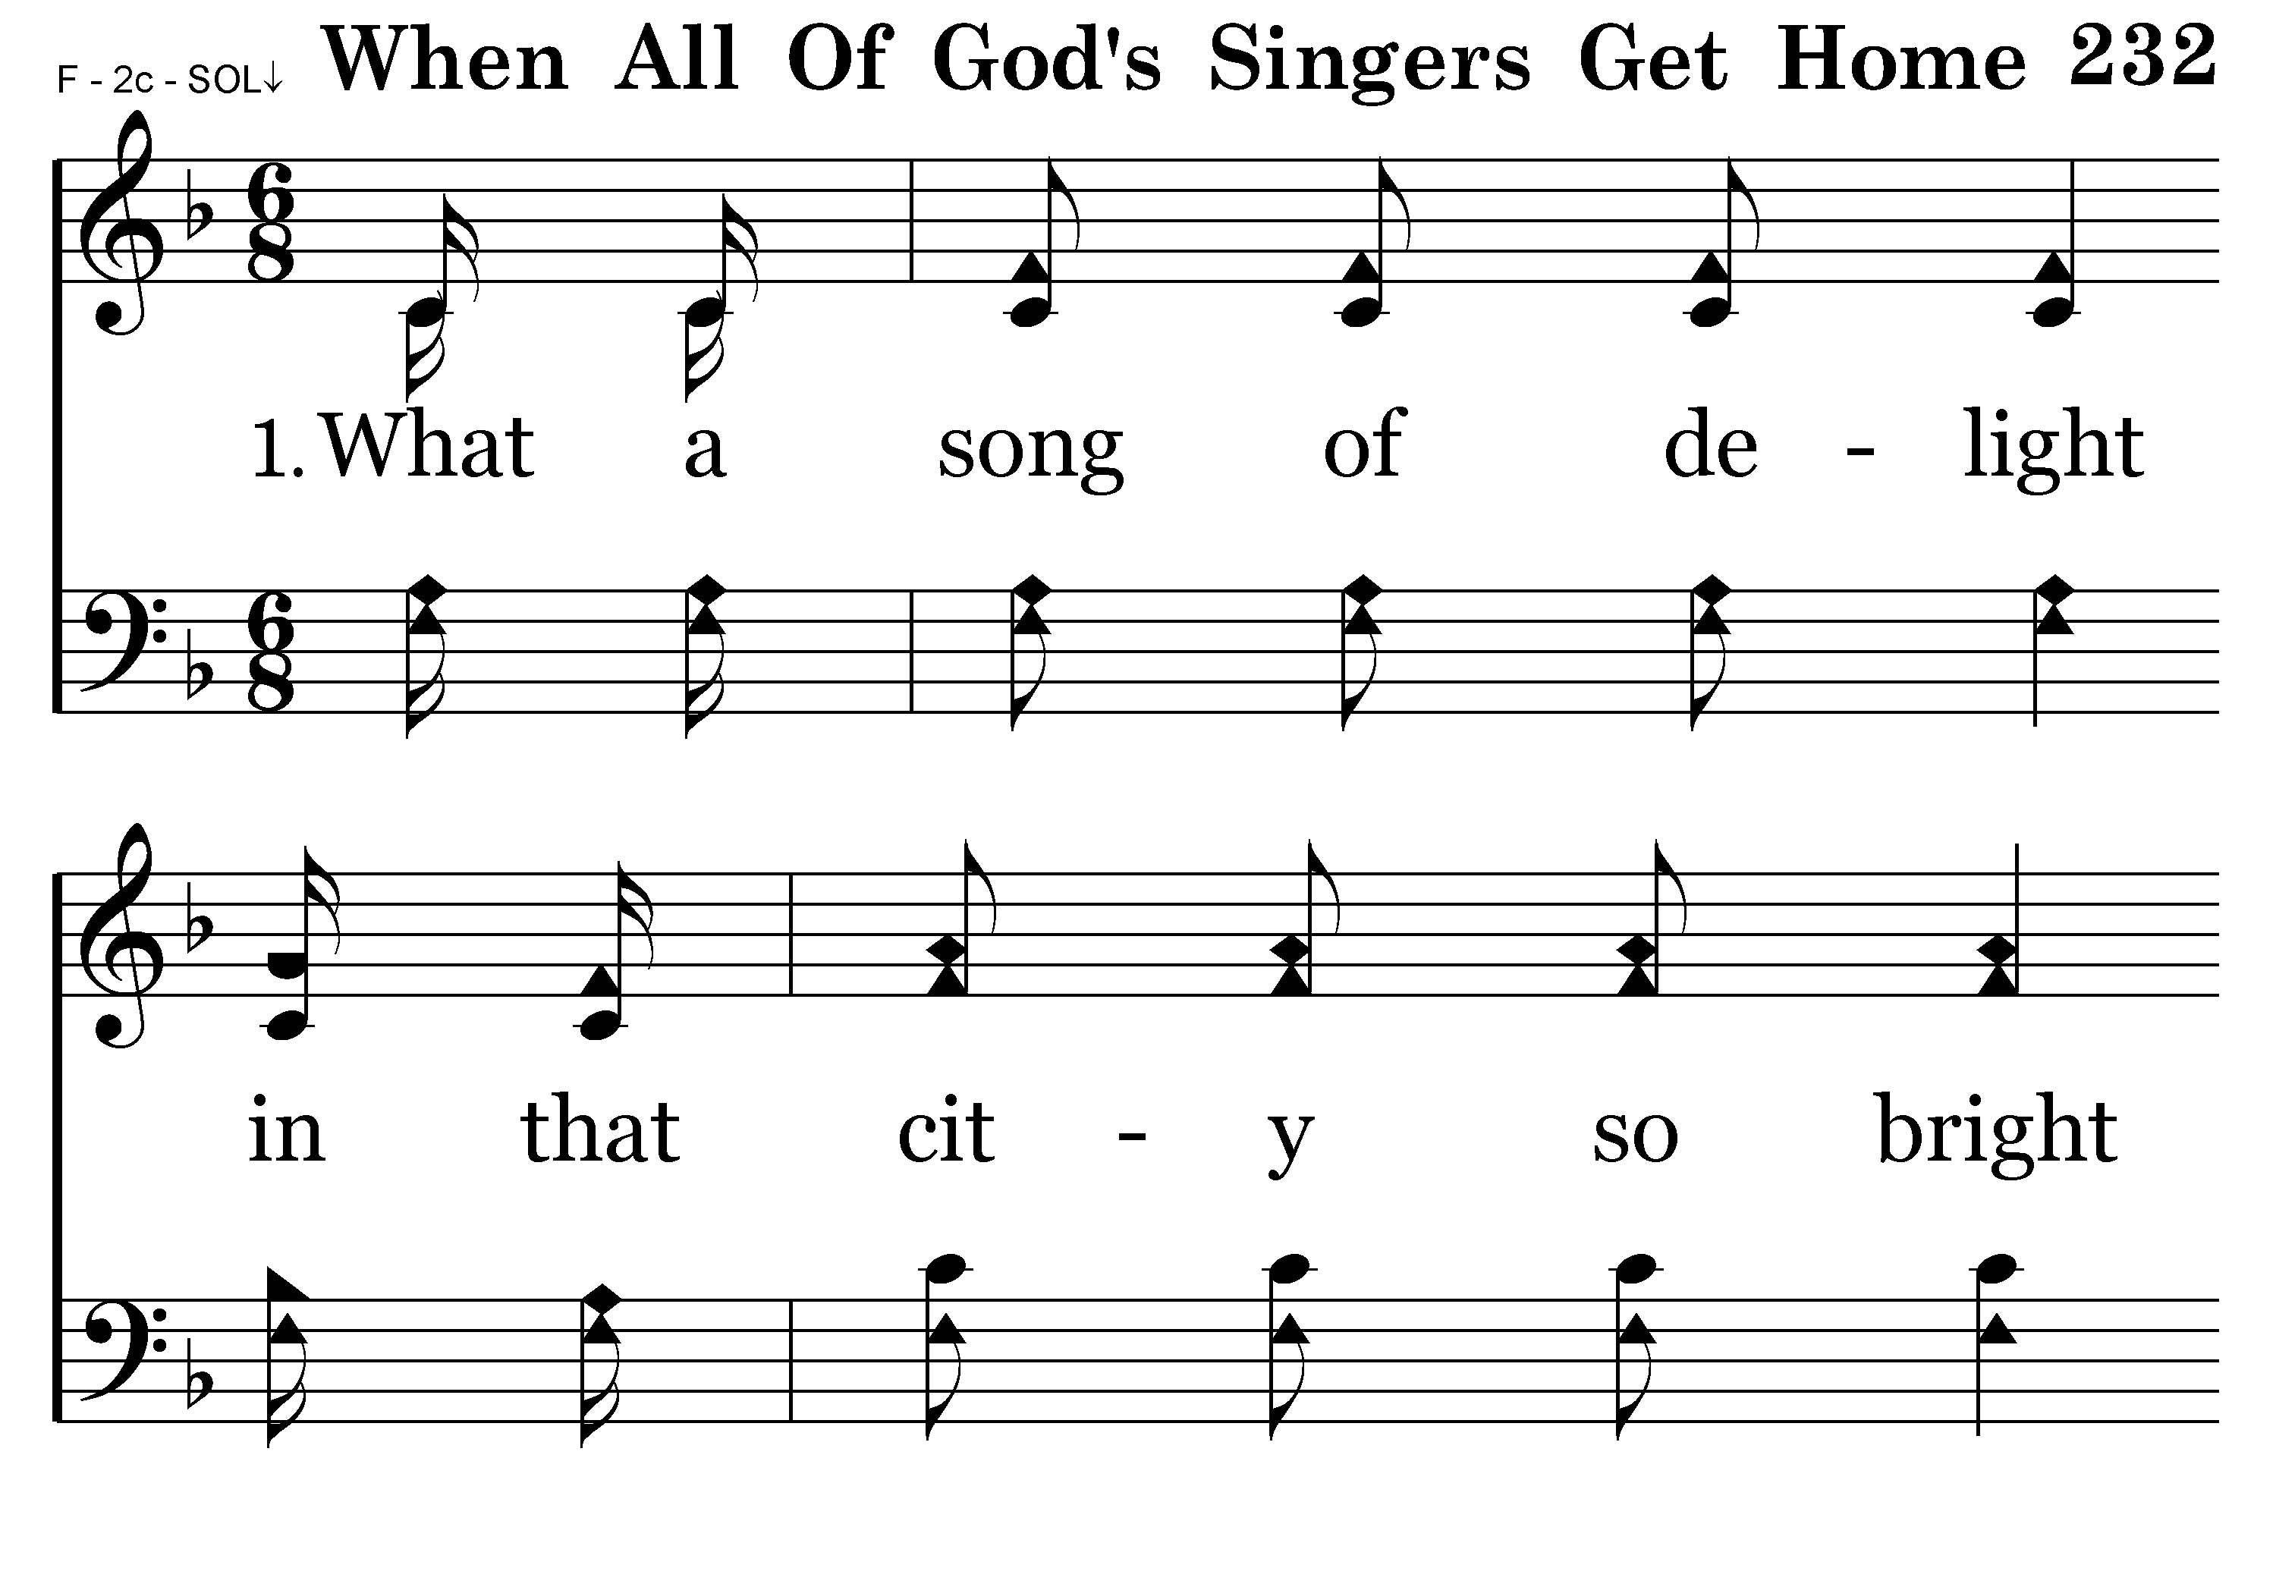
232 - When All Of God's Singers Get Home - 1.1

Slide 34
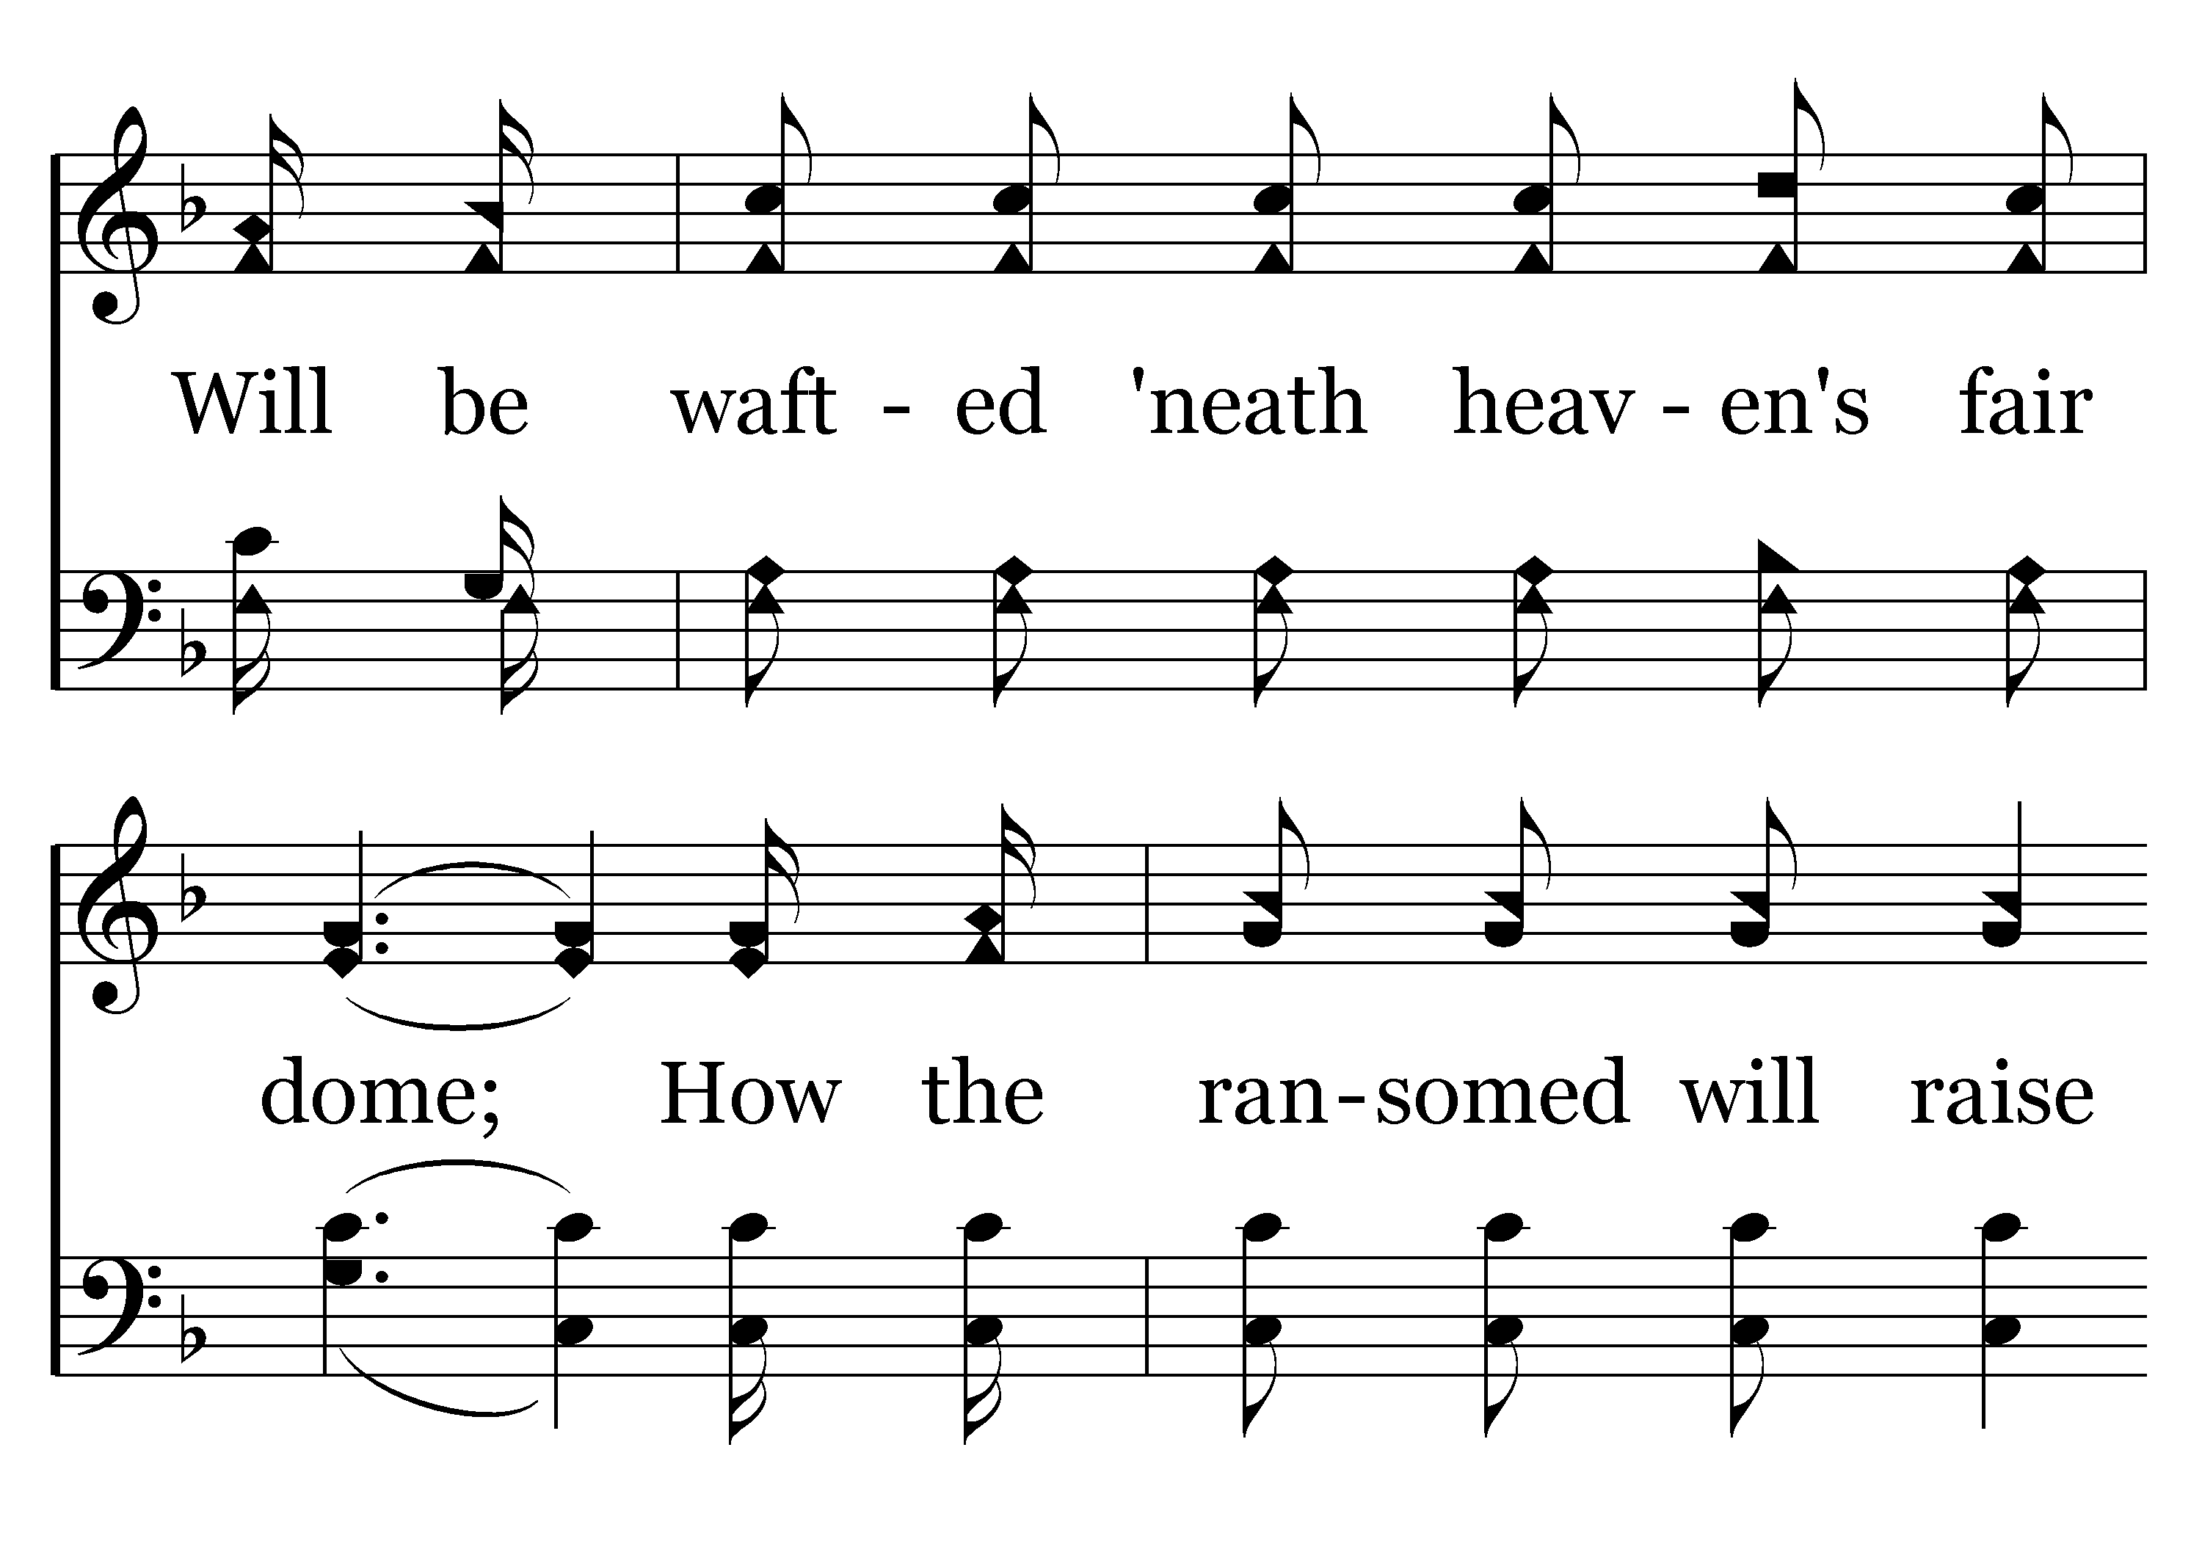
232 - When All Of God's Singers Get Home - 1.2

Slide 35
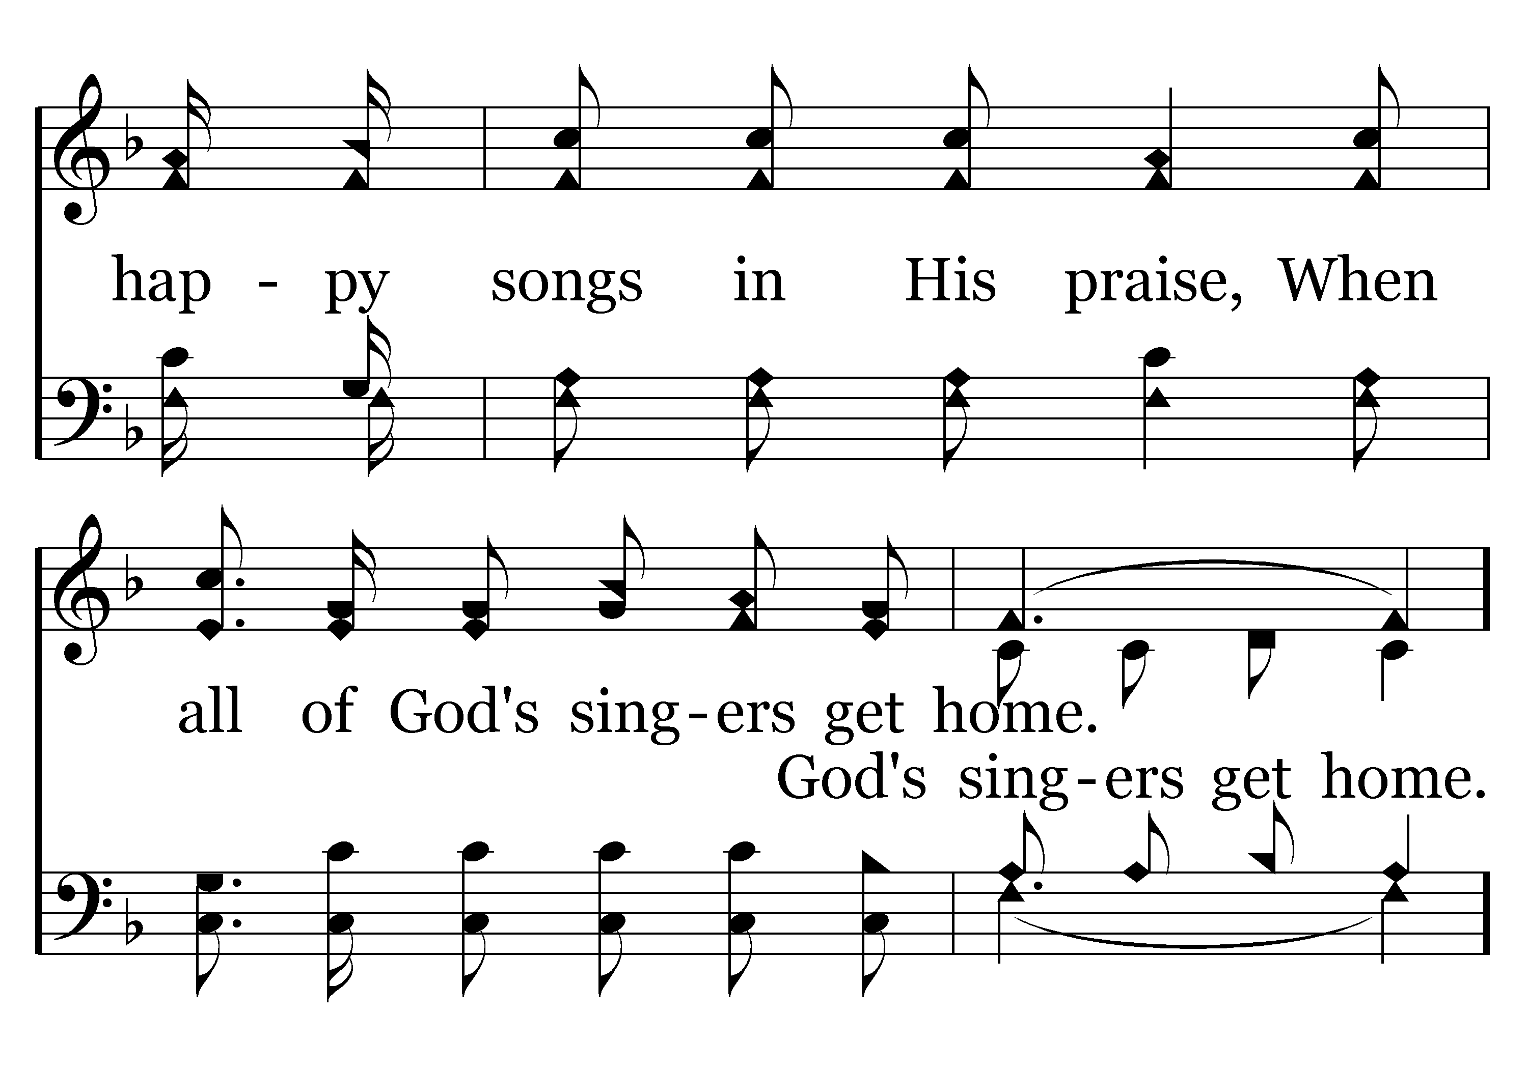
232 - When All Of God's Singers Get Home - 1.3

Slide 36
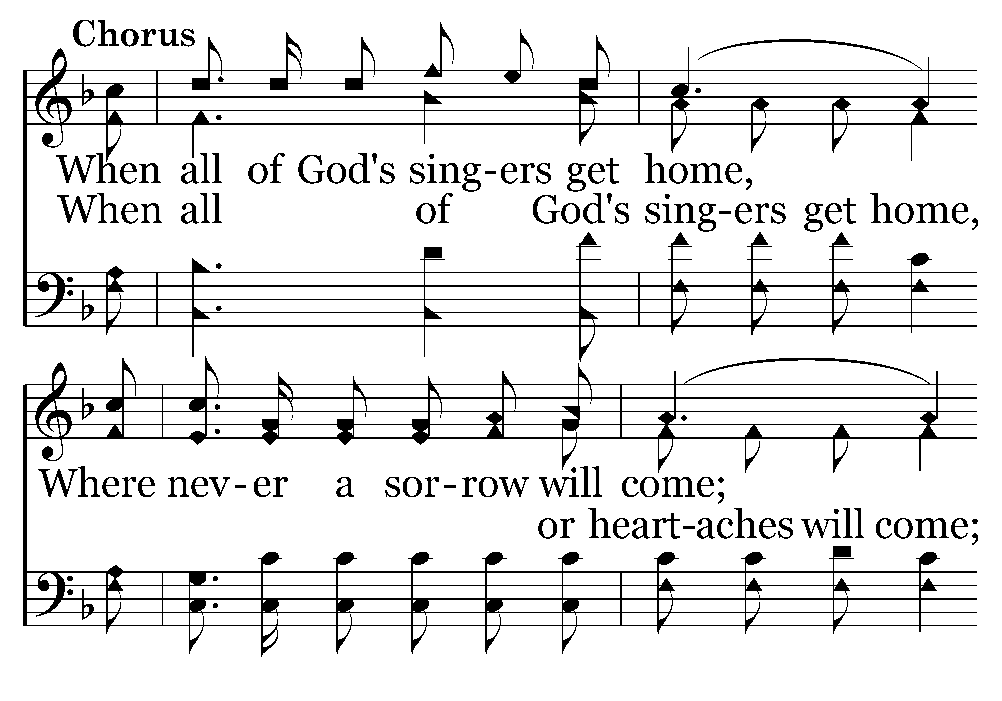
232 - When All Of God's Singers Get Home - C.1

Slide 37
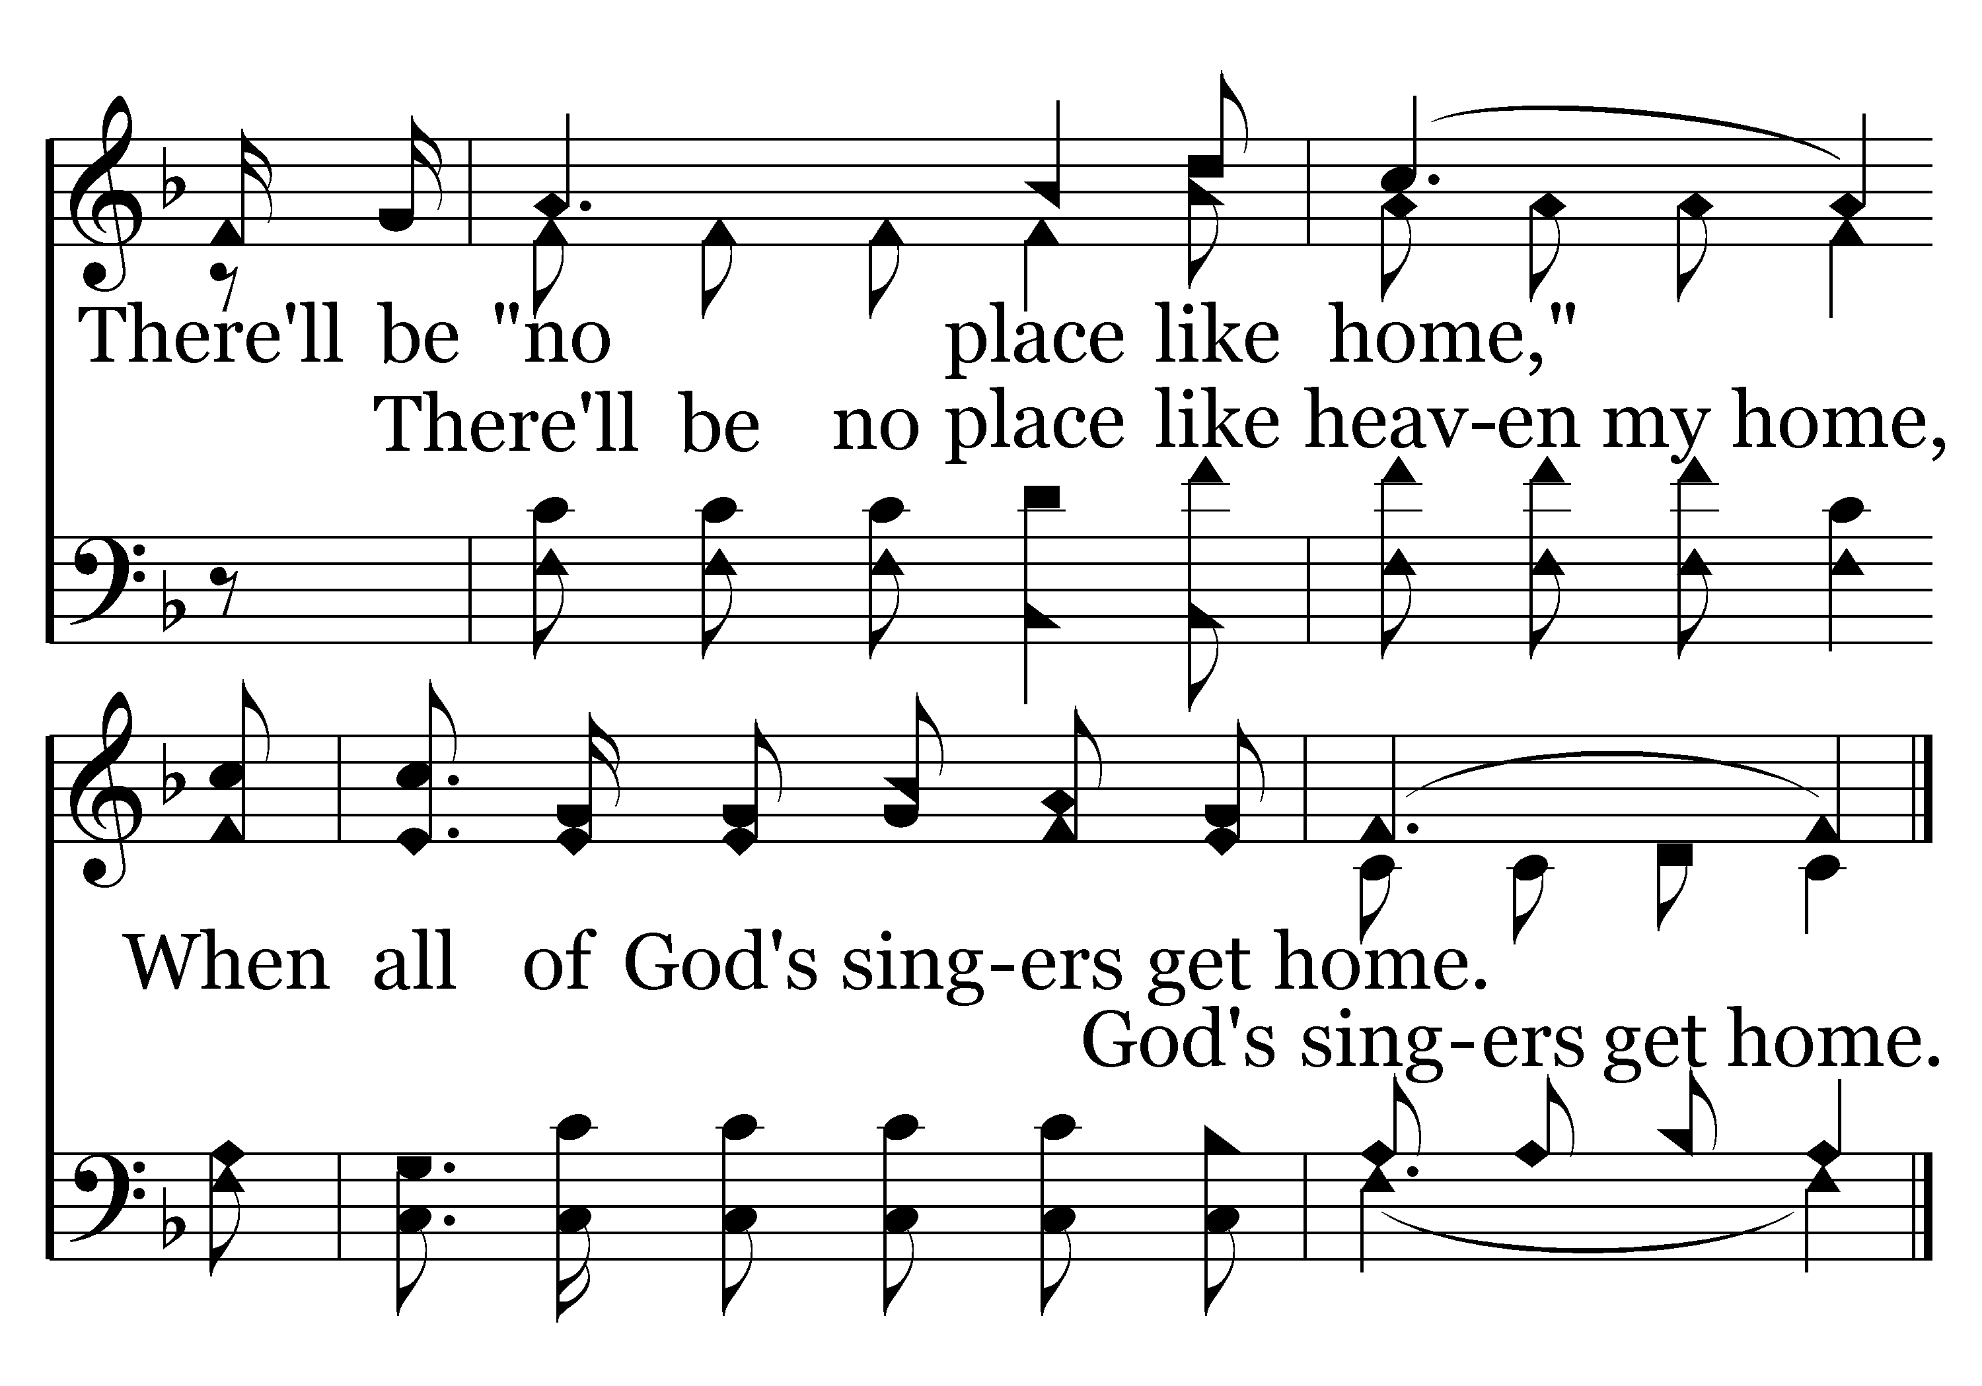
232 - When All Of God's Singers Get Home - C.2
End of Verse 1

Slide 38
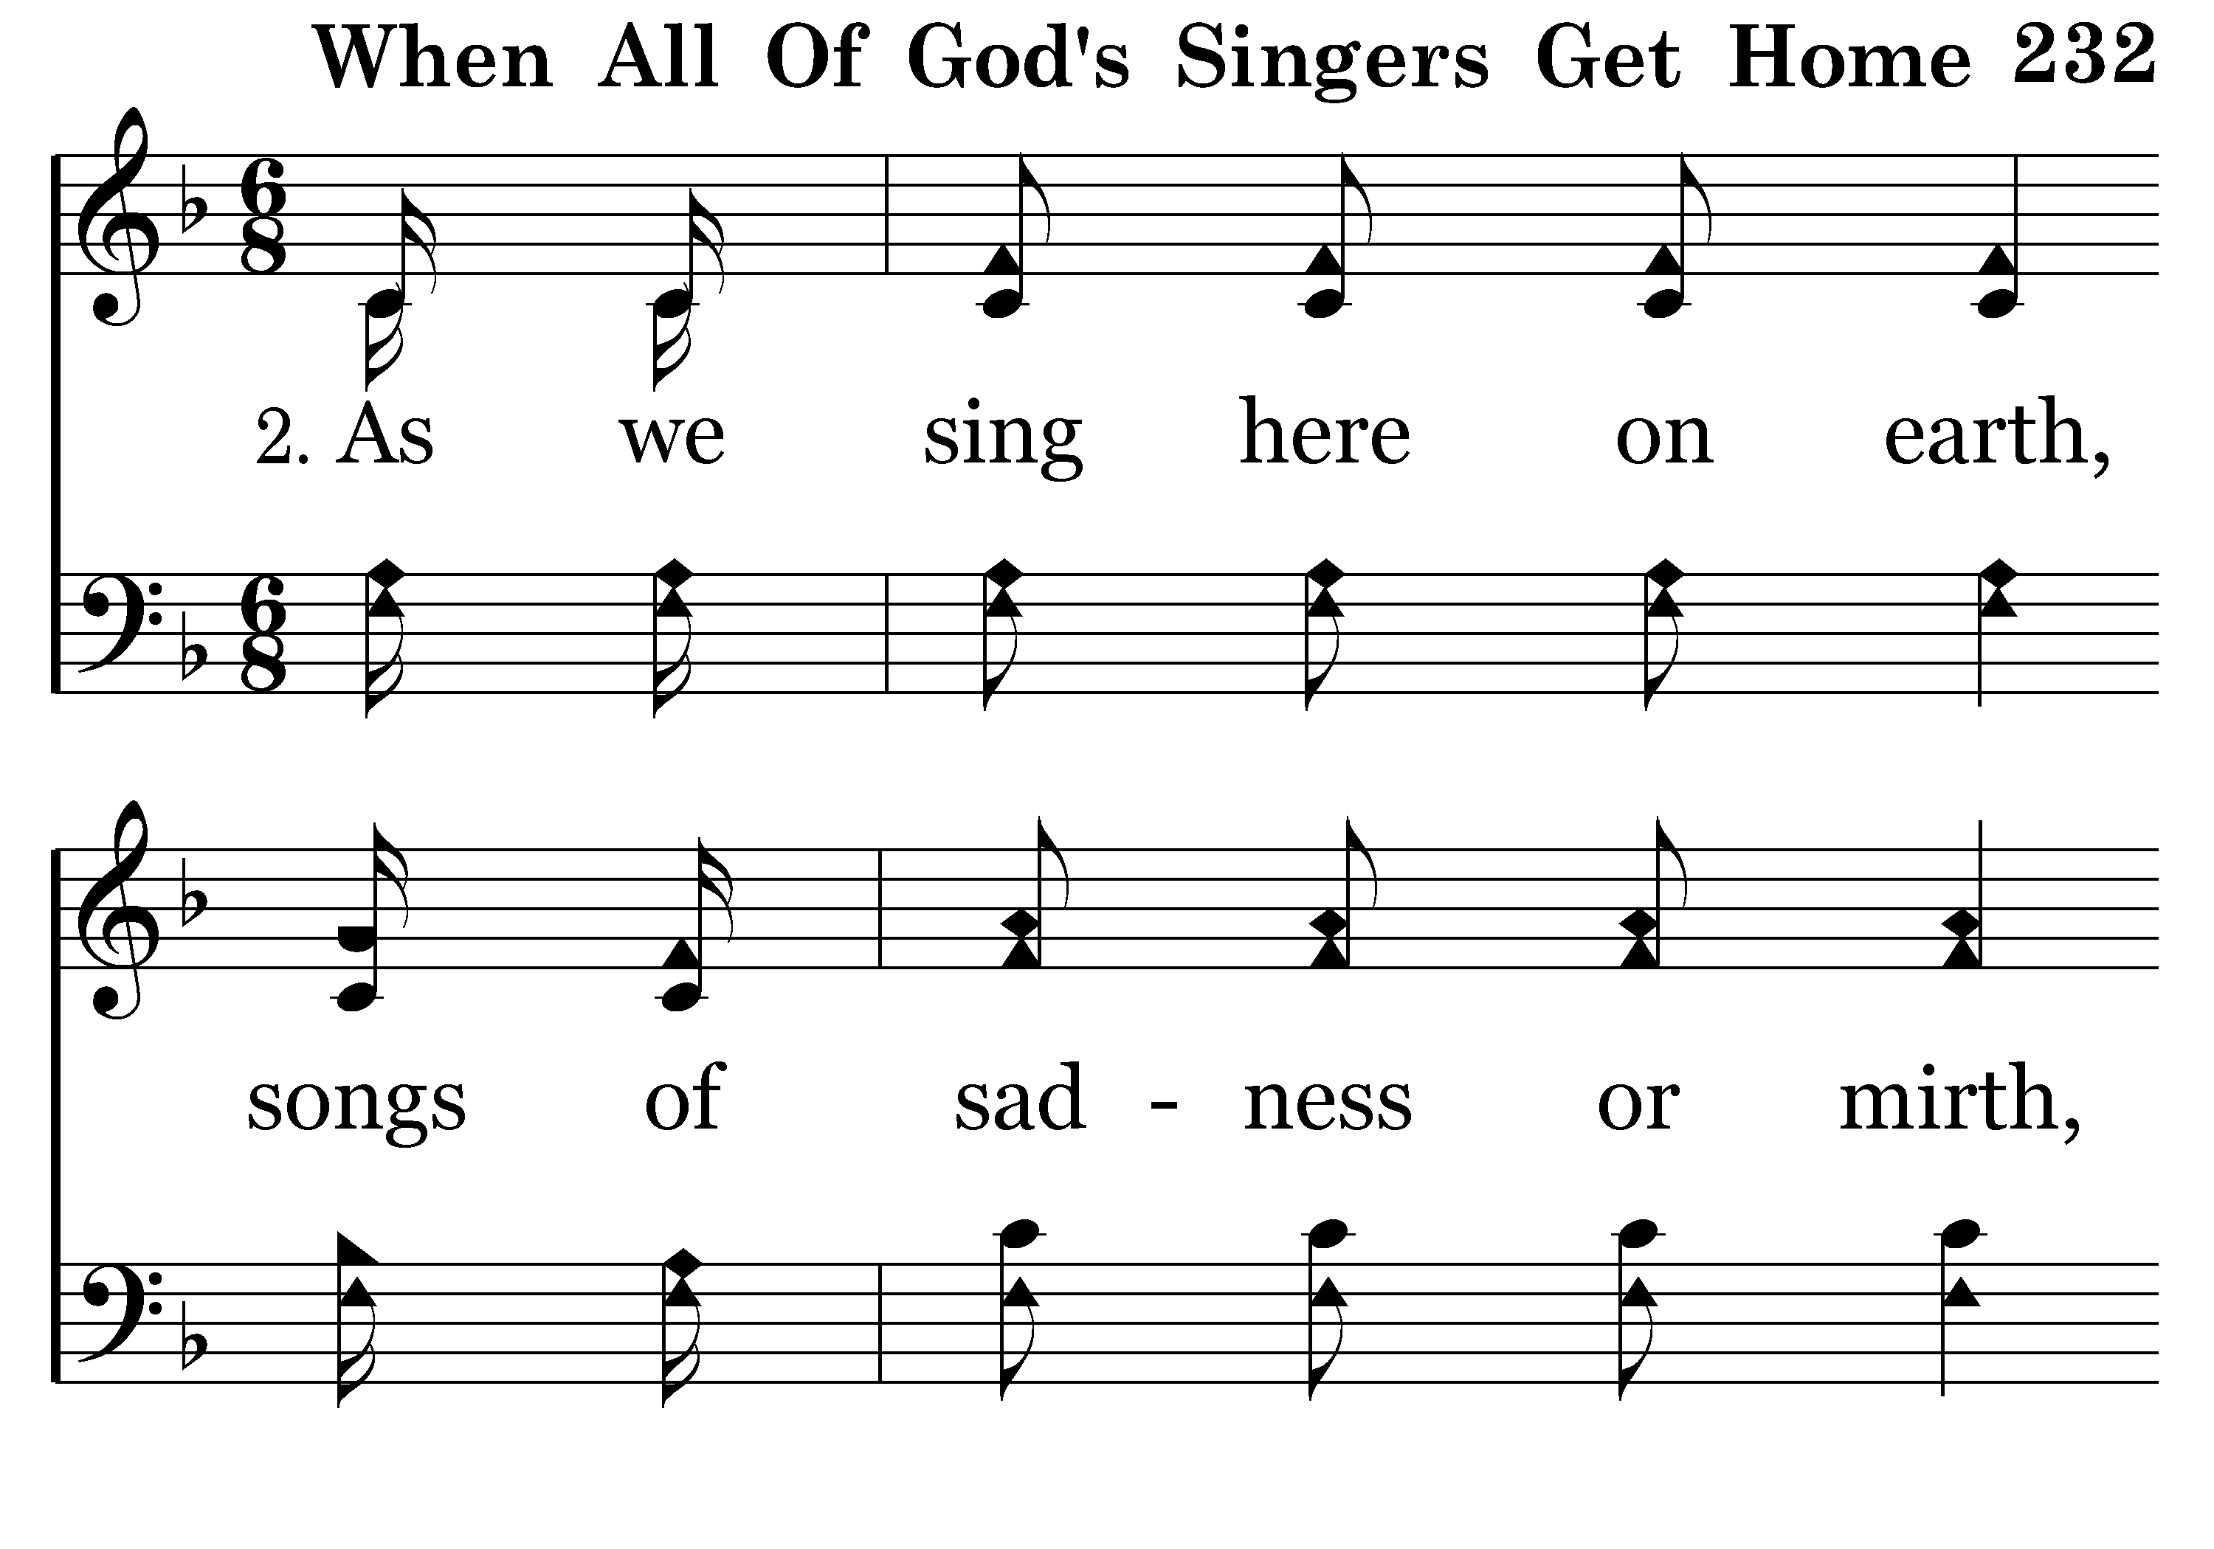
232 - When All Of God's Singers Get Home - 2.1

Slide 39
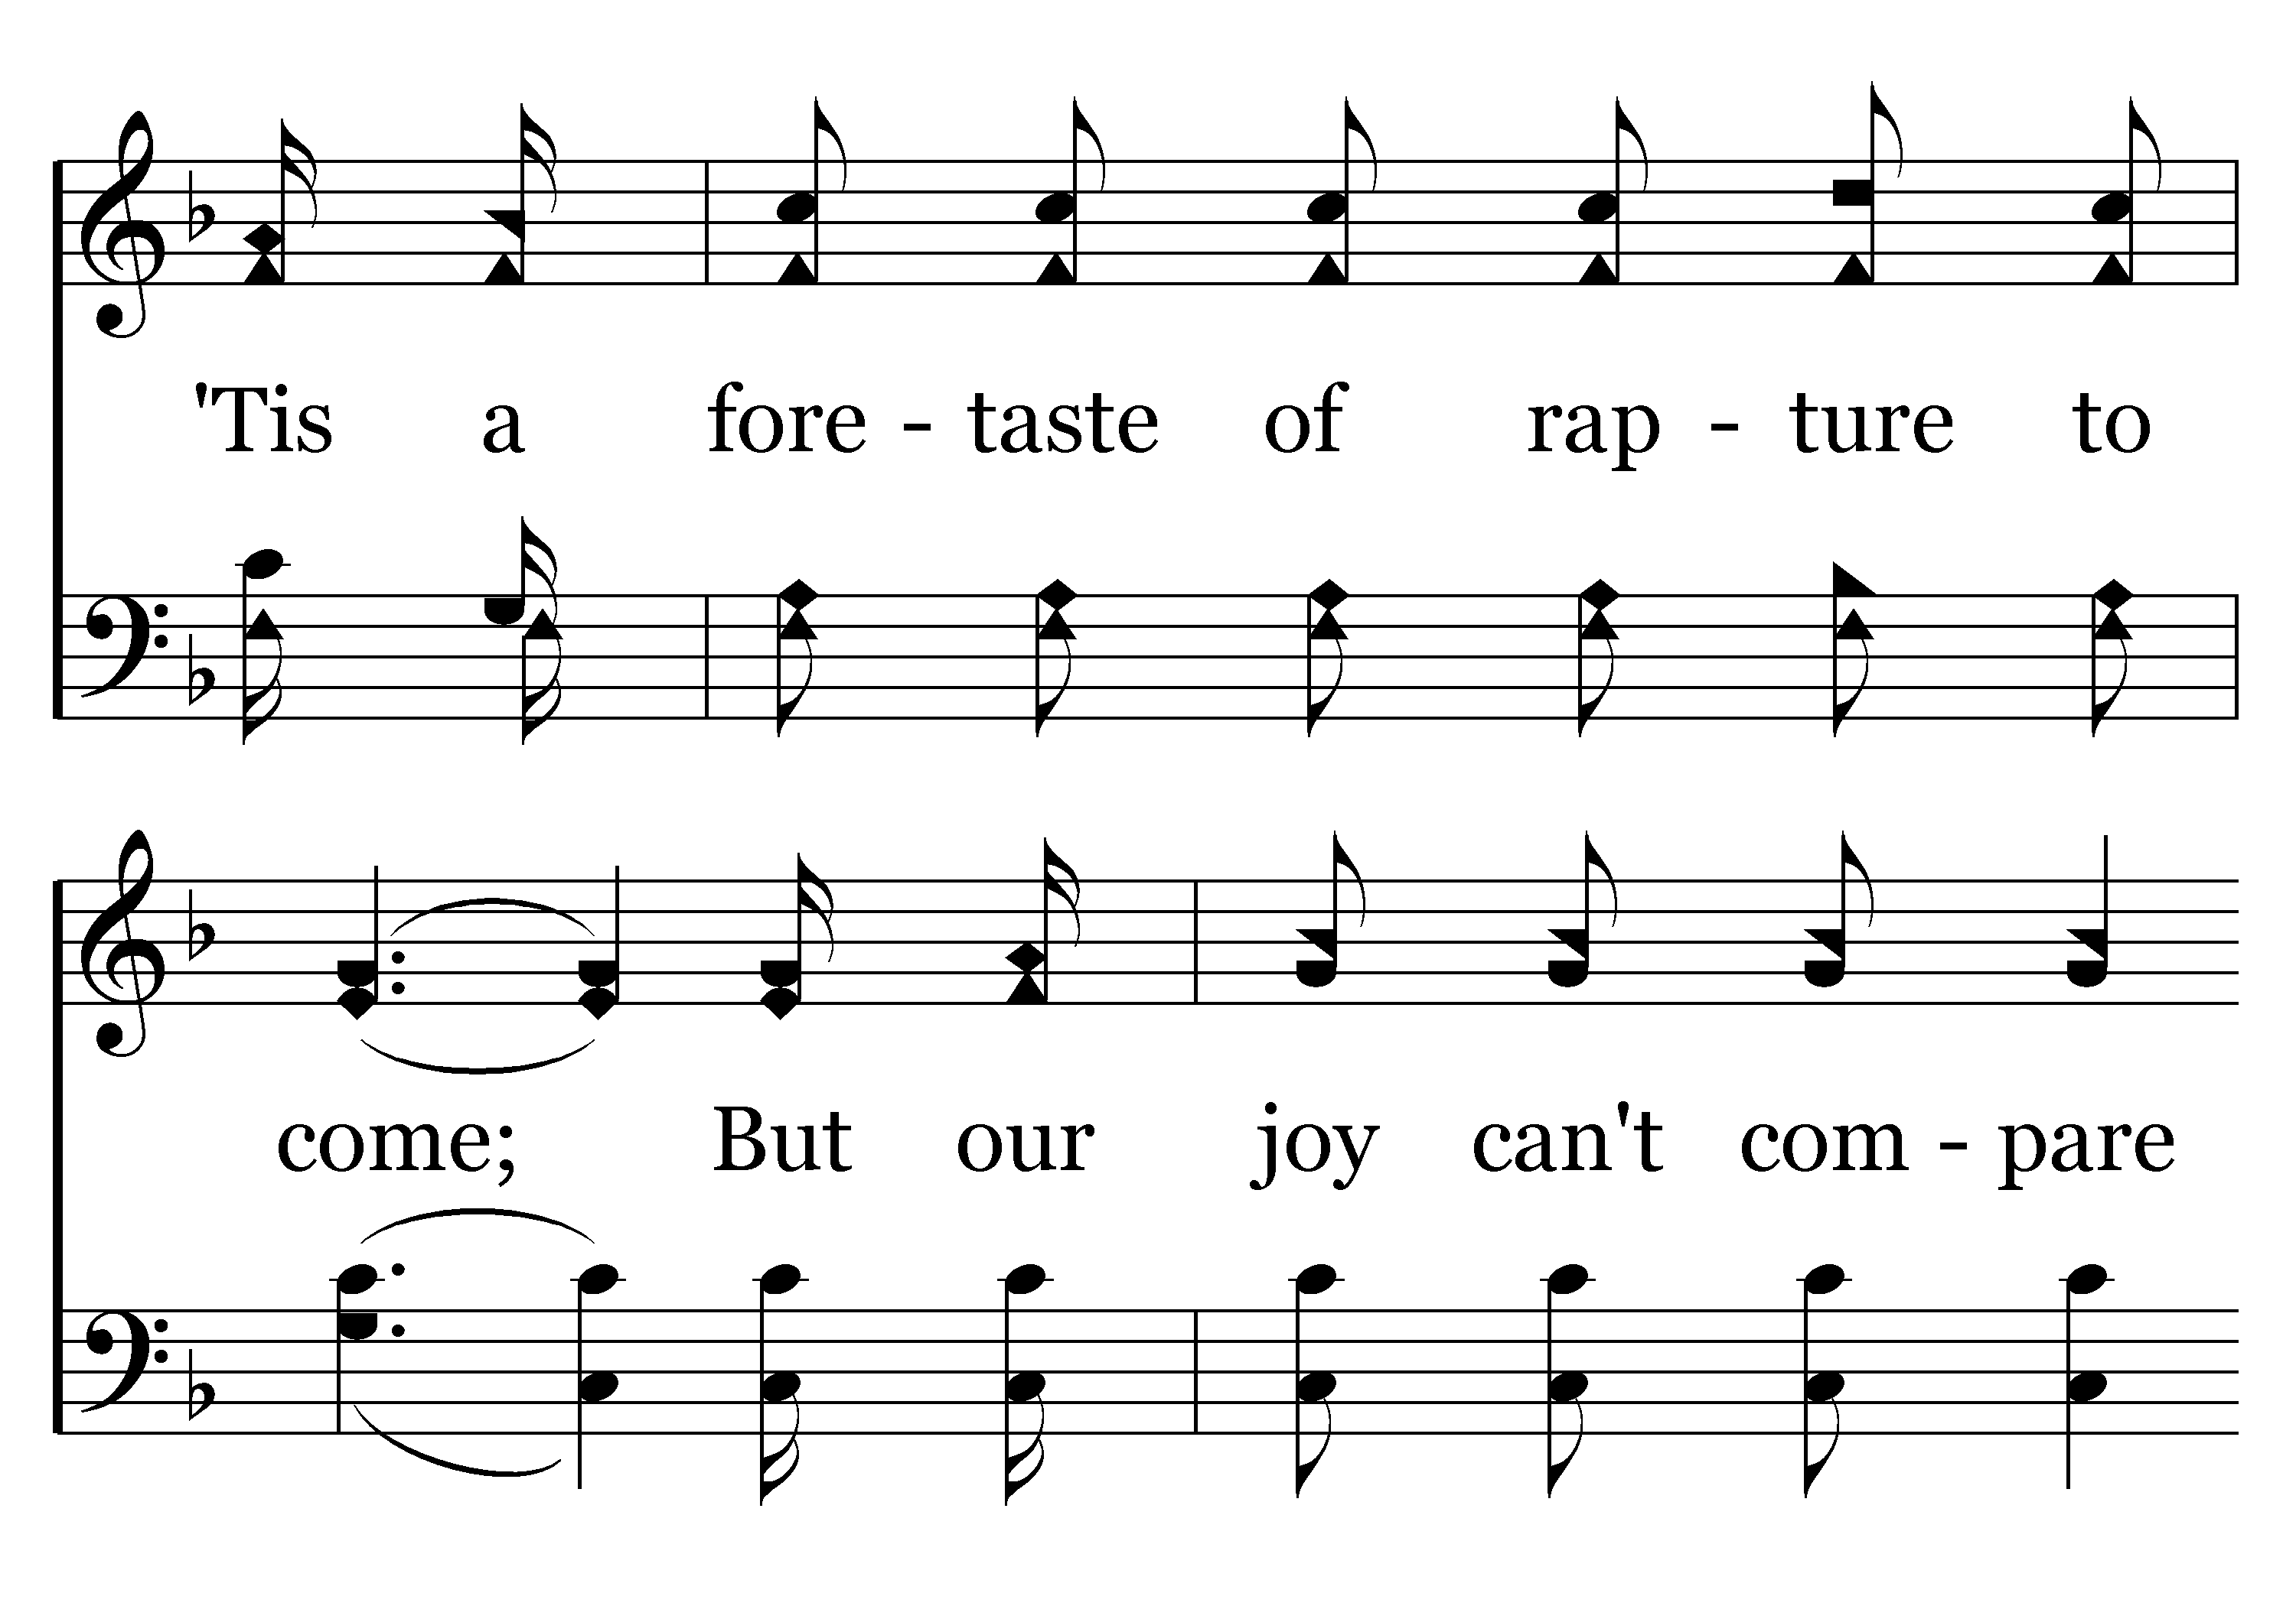
232 - When All Of God's Singers Get Home - 2.2

Slide 40
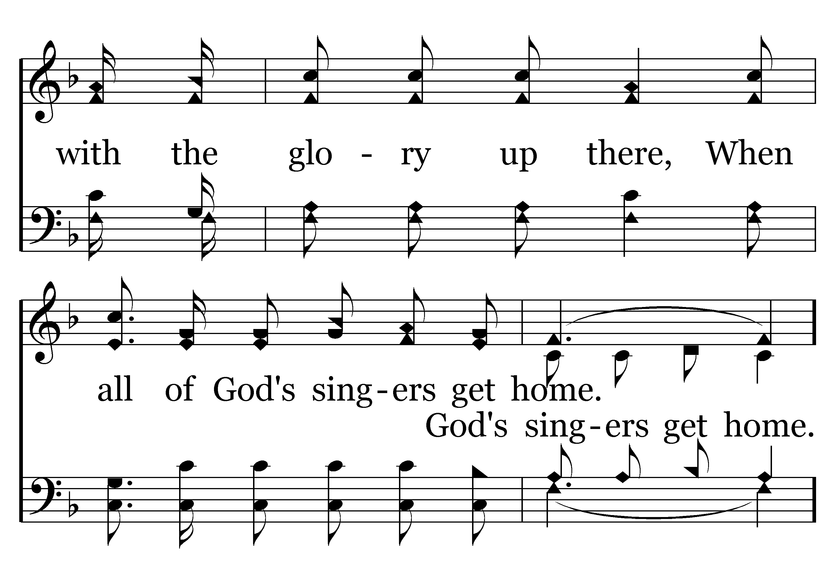
232 - When All Of God's Singers Get Home - 2.3

Slide 41
232 - When All Of God's Singers Get Home - C.1

Slide 42
232 - When All Of God's Singers Get Home - C.2
End of Verse 2

Slide 43
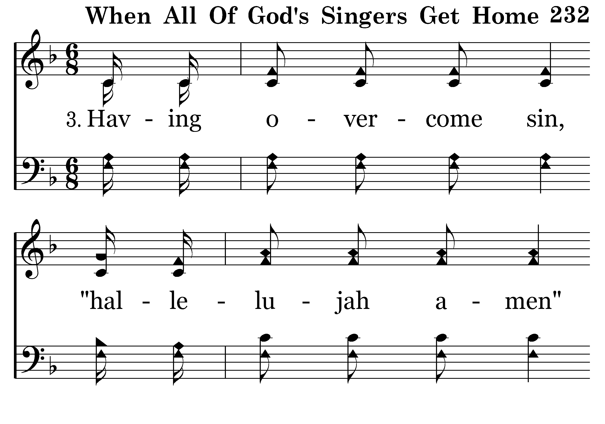
232 - When All Of God's Singers Get Home - 3.1

Slide 44
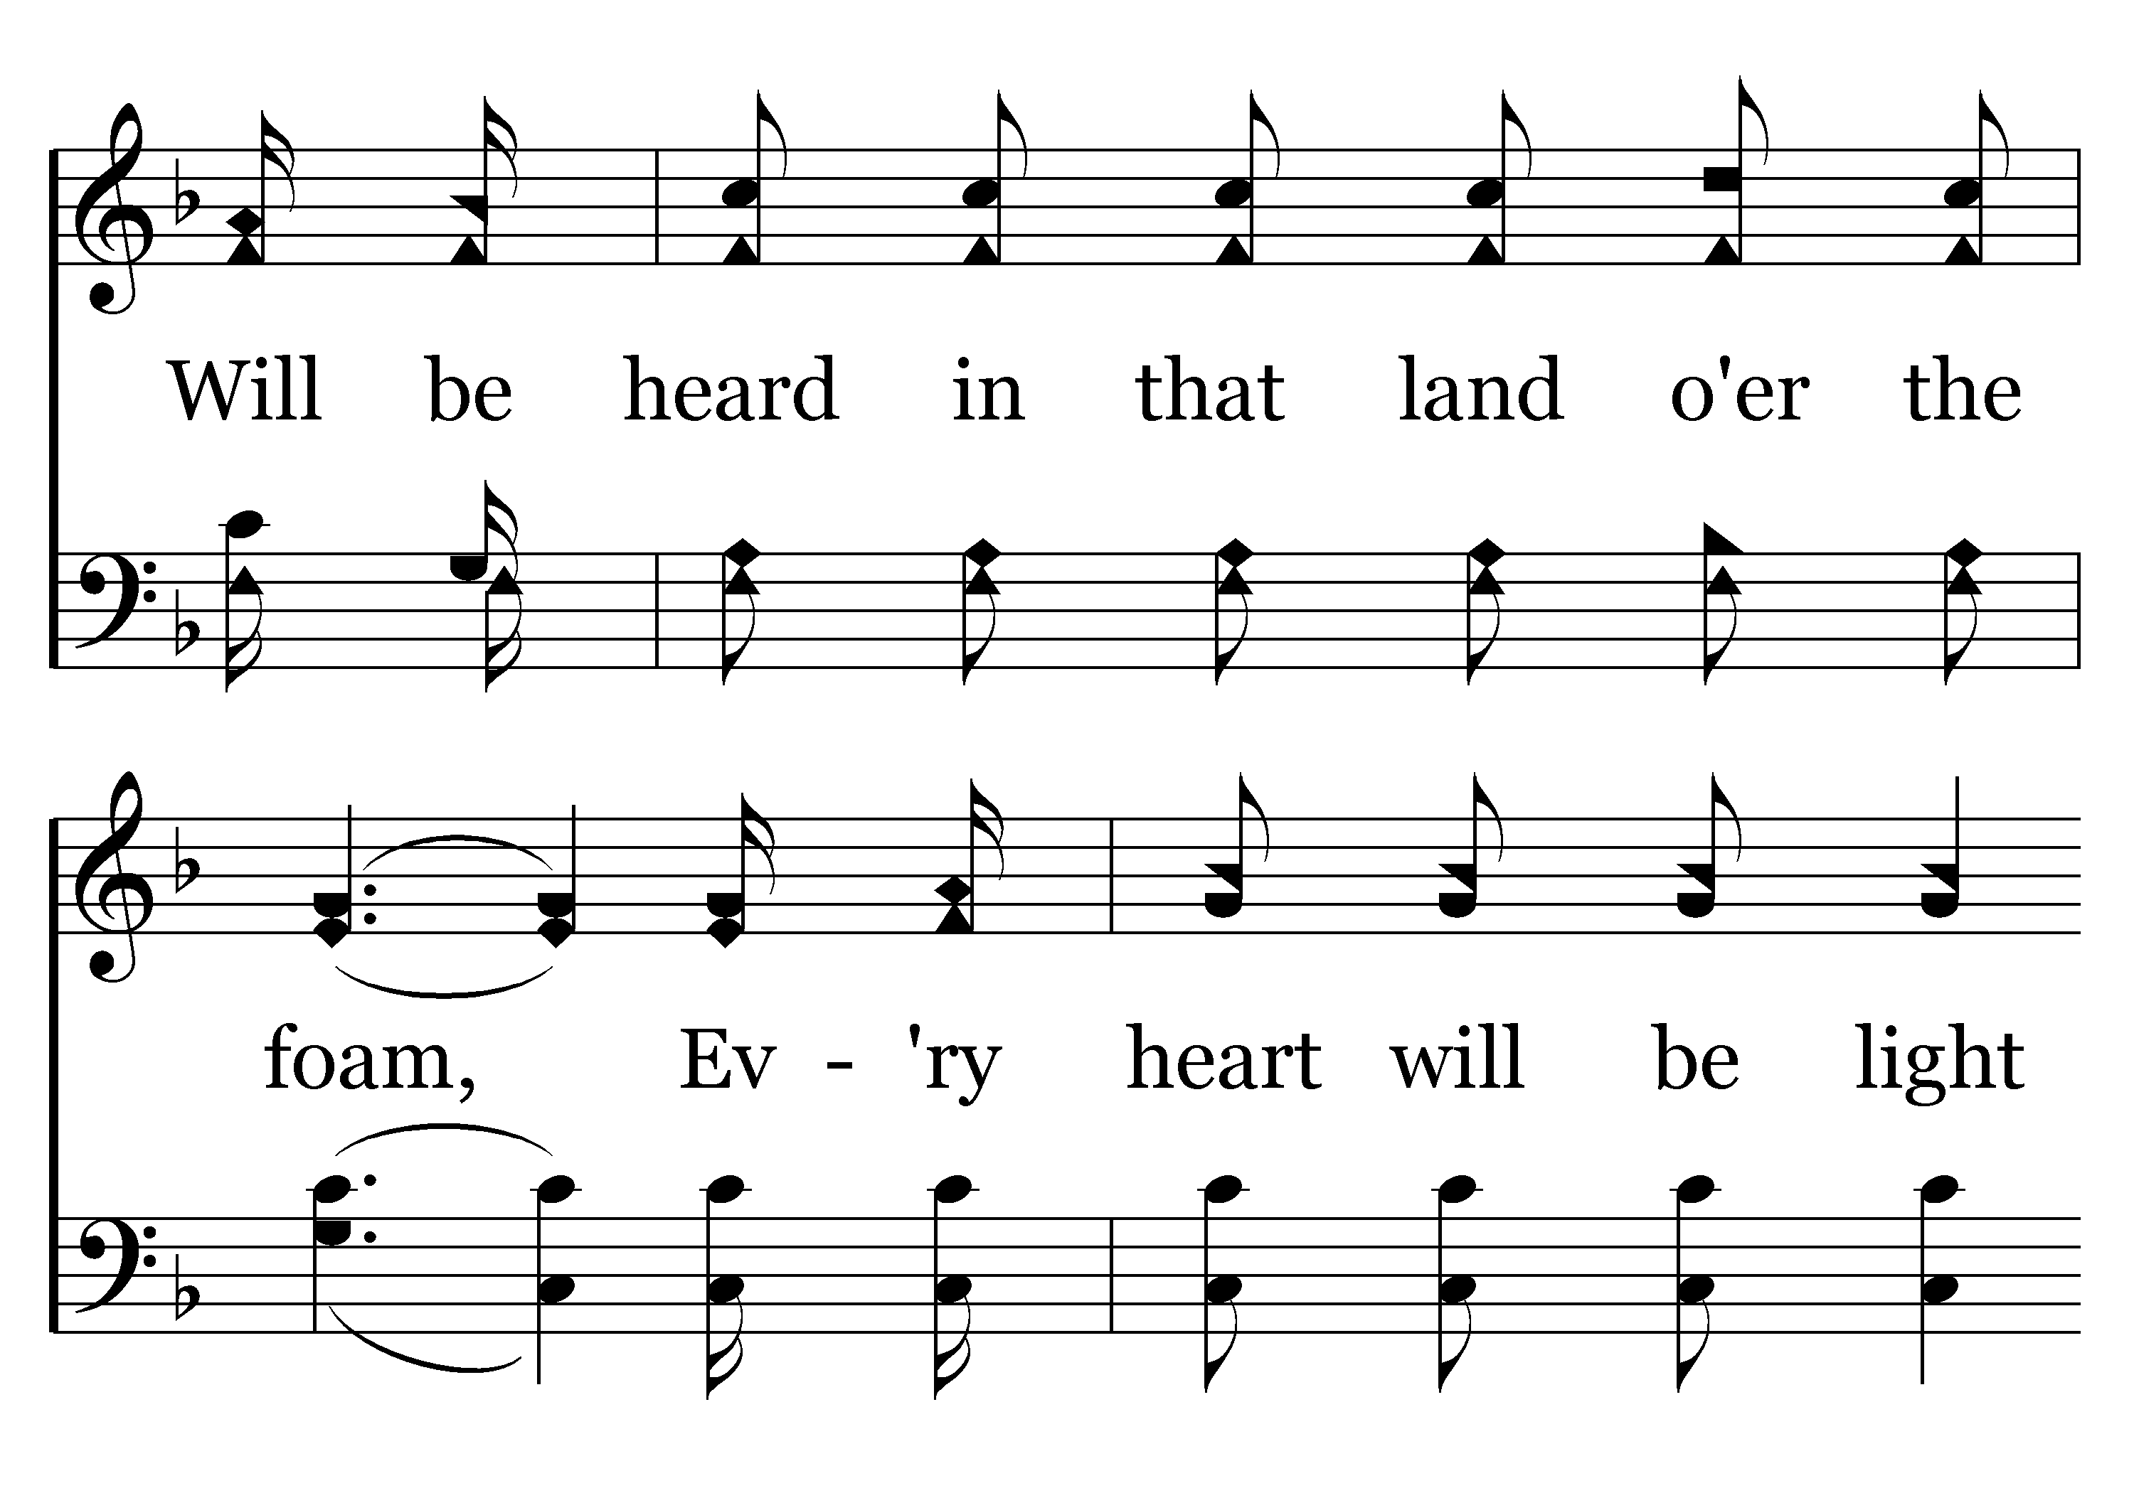
232 - When All Of God's Singers Get Home - 3.2

Slide 45
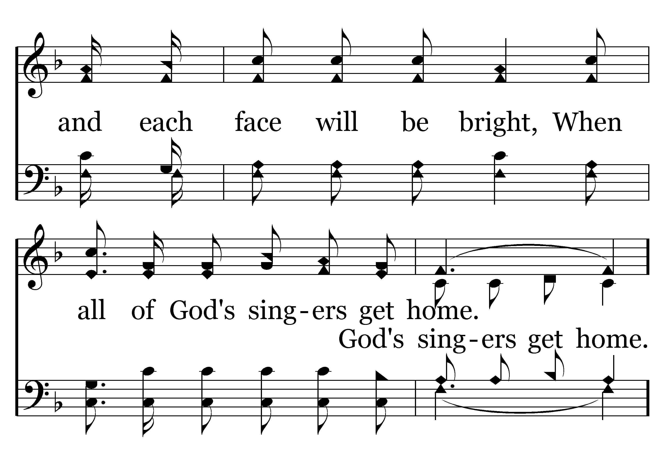
232 - When All Of God's Singers Get Home - 3.3

Slide 46
232 - When All Of God's Singers Get Home - C.1

Slide 47
232 - When All Of God's Singers Get Home - C.2
End of Song

Slide 49


Slide 50
Fervent Faith
Hebrews 11:6 (ESV)
And without faith it is impossible to please him, for whoever would draw near to God must believe that he exists and that he rewards those who seek him.

Slide 51
Fervent Faith
The Example of Abel: Righteousness (ver. 4)
Hebrews 11:4 (ESV)
4 By faith Abel offered to God a more acceptable sacrifice than Cain, through which he was commended as righteous, God commending him by accepting his gifts. And through his faith, though he died, he still speaks.

Slide 52
Fervent Faith
The Example of Abel: Righteousness (ver. 4)
1 John 3:7 (ESV)
7 Little children, let no one deceive you. Whoever practices righteousness is righteous, as he is righteous.

Slide 53
Fervent Faith
The Example of Abel: Righteousness (ver. 4)
Hebrews 11:4 (ESV)
4 By faith Abel offered to God a more acceptable sacrifice than Cain, through which he was commended as righteous, God commending him by accepting his gifts. And through his faith, though he died, he still speaks.

Slide 54

Fervent Faith
False
Sam Morris
“We take the position that a Christian’s sins do not damn the soul. The way a Christian lives has nothing whatever to do with the salvation of his soul. All the sins he may commit from idolatry to murder will not make his soul in any more danger.”

Slide 55
Fervent Faith
False
Bill Foster
“If I killed my wife and mother and debauched a thousand women, I couldn’t go to hell—in fact, I couldn’t go to hell if I wanted to.”

Slide 56
Fervent Faith
The Example of Abel: Righteousness (ver. 4)
1 Corinthians 6:9 (ESV)
9 Or do you not know that the unrighteous will not inherit the kingdom of God? Do not be deceived: neither the sexually immoral, nor idolaters, nor adulterers, nor men who practice homosexuality…

Slide 57
Fervent Faith
The Example of Enoch: Trust (ver. 5)
Hebrews 11:5 (ESV)
5 By faith Enoch was taken up so that he should not see death, and he was not found, because God had taken him. Now before he was taken he was commended as having pleased God.

Slide 58
Fervent Faith
The Example of Enoch: Trust (ver. 5)
Thayer’s Greek-English Lexicon of the New Testament.
Conviction of the truth of anything, belief; “in the N.T. of a conviction or belief respecting man’s relationship to God and divine things, generally with the included idea of trust.

Slide 59
Fervent Faith
The Example of Enoch: Trust (ver. 5)
Holman Illustrated Bible Dictionary
It conveys the idea of trust, a firm internal conviction regarding the truthfulness of someone or some claim.

Slide 60
Fervent Faith
The Example of Enoch: Trust (ver. 5)
• In needs, faith will trust in God’s providence (Matt. 6:33)
• In affliction, faith will trust in God’s deliverance (2 Cor. 1:8-10)
• In salvation, faith will trust in God’s grace (Rom. 8:1)
• In persecution, faith will trust in God’s vengeance (Rom. 12:17-21)

Slide 61
Fervent Faith
The Example of Enoch: Trust (ver. 5)
Hebrews 11:5 (ESV)
5 By faith Enoch was taken up so that he should not see death, and he was not found, because God had taken him. Now before he was taken he was commended as having pleased God.

Slide 62
Fervent Faith
The Example of Enoch: Trust (ver. 5)
Hebrews 11:5 (ESV)
5 By faith Enoch was taken up so that he should not see death, and he was not found, because God had taken him. Now before he was taken he was com-mended as having pleased God.

Slide 63
Fervent Faith
The Example of Noah: Obedience (ver. 7)
Hebrews 11:7 (ESV)
7 By faith Noah, being warned by God concerning events as yet unseen, in reverent fear constructed an ark for the saving of his household. By this he condemned the world and became an heir of the righteousness that comes by faith.

Slide 64
Fervent Faith
The Example of Noah: Obedience (ver. 7)
• First, Noah’s obedience was meticulous.
Merriam-Webster’s Collegiate Dictionary
“Marked by extreme or excessive care in the consideration or treatment of details.”

Slide 65
Fervent Faith
The Example of Noah: Obedience (ver. 7)
1 Samuel 15:22 (KJV)
22 And Samuel said, Hath the LORD as great delight in burnt offerings and sacrifices, as in obeying the voice of the LORD? Behold, to obey is better than sacrifice, and to hearken than the fat of rams.

Slide 66
Fervent Faith
The Example of Noah: Obedience (ver. 7)
• First, Noah’s obedience was meticulous.
• Meticulous obedience does not eradicate God’s grace.

Slide 67
Fervent Faith
The Example of Abraham: Sacrifice (vers. 8, 17)
Romans 4:12 (ESV)
12 and to make him the father of the circumcised who are not merely circumcised but who also walk in the footsteps of the faith that our father Abraham had before he was circumcised.

Slide 68
Fervent Faith
The Example of Abraham: Sacrifice (vers. 8, 17)
Hebrews 11:8 (ESV)
8 By faith Abraham obeyed when he was called to go out to a place that he was to receive as an inheritance. And he went out, not knowing where he was going.

Slide 69
Fervent Faith
The Example of Abraham: Sacrifice (vers. 8, 17)
Genesis 22:1-2 (ESV)
1 After these things God tested Abraham and said to him, “Abraham!” And he said, “Here I am.” 2 He said, “Take your son, your only son Isaac, whom you love, and go to the land of Moriah, and offer him there as a burnt offering on one of the mountains of which I shall tell you.”

Slide 70
Fervent Faith
The Example of Abraham: Sacrifice (vers. 8, 17)
Hebrews 11:18 (ESV)
18 of whom it was said, “Through Isaac shall your offspring be named.”

Slide 71
Fervent Faith
The Example of Abraham: Sacrifice (vers. 8, 17)
Genesis 22:3-4 (ESV)
3 So Abraham rose early in the morning, saddled his donkey, and took two of his young men with him, and his son Isaac. And he cut the wood for the burnt offering and arose and went to the place of which God had told him. 4 On the third day Abraham lifted up his eyes and saw the place from afar.

Slide 72
Fervent Faith
The Example of Abraham: Sacrifice (vers. 8, 17)
Genesis 22:5-6 (ESV)
5 Then Abraham said to his young men, “Stay here with the donkey; I and the boy will go over there and worship and come again to you.” 6 And Abraham took the wood of the burnt offering and laid it on Isaac his son. And he took in his hand the fire and the knife. So they went both of them together.

Slide 73
Fervent Faith
The Example of Abraham: Sacrifice (vers. 8, 17)
Hebrews 11:19 (ESV)
19 He considered that God was able even to raise him from the dead...

Slide 74
Fervent Faith
The Example of Abraham: Sacrifice (vers. 8, 17)
Genesis 22:7-8 (ESV)
7 And Isaac said to his father Abraham, “My father!” And he said, “Here I am, my son.” He said, “Behold, the fire and the wood, but where is the lamb for a burnt offering?” 8 Abraham said, “God will provide for himself the lamb for a burnt offering, my son.” So they went both of them together.

Slide 75
Fervent Faith
The Example of Abraham: Sacrifice (vers. 8, 17)
Genesis 22:9 (ESV)
9 When they came to the place of which God had told him, Abraham built the altar there and laid the wood in order and bound Isaac his son and laid him on the altar, on top of the wood.

Slide 76
Fervent Faith
The Example of Abraham: Sacrifice (vers. 8, 17)
Genesis 22:10 (ESV)
10 Then Abraham reached out his hand and took the knife to slaughter his son.

Slide 77
Fervent Faith
CHARACTERIZED BY:
Righteous Living
Trusting Heart
Meticulous Obedience
Willingness to Sacrifice

Slide 79
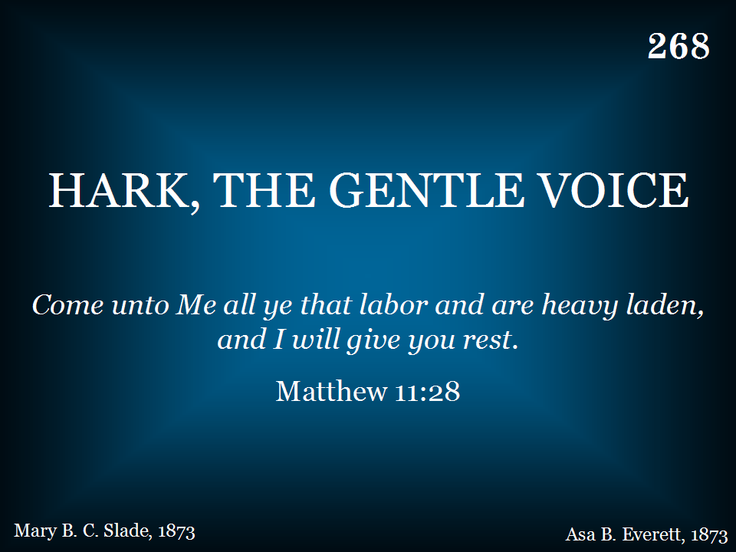
268 - Hark, The Gentle Voice - Title

Slide 80
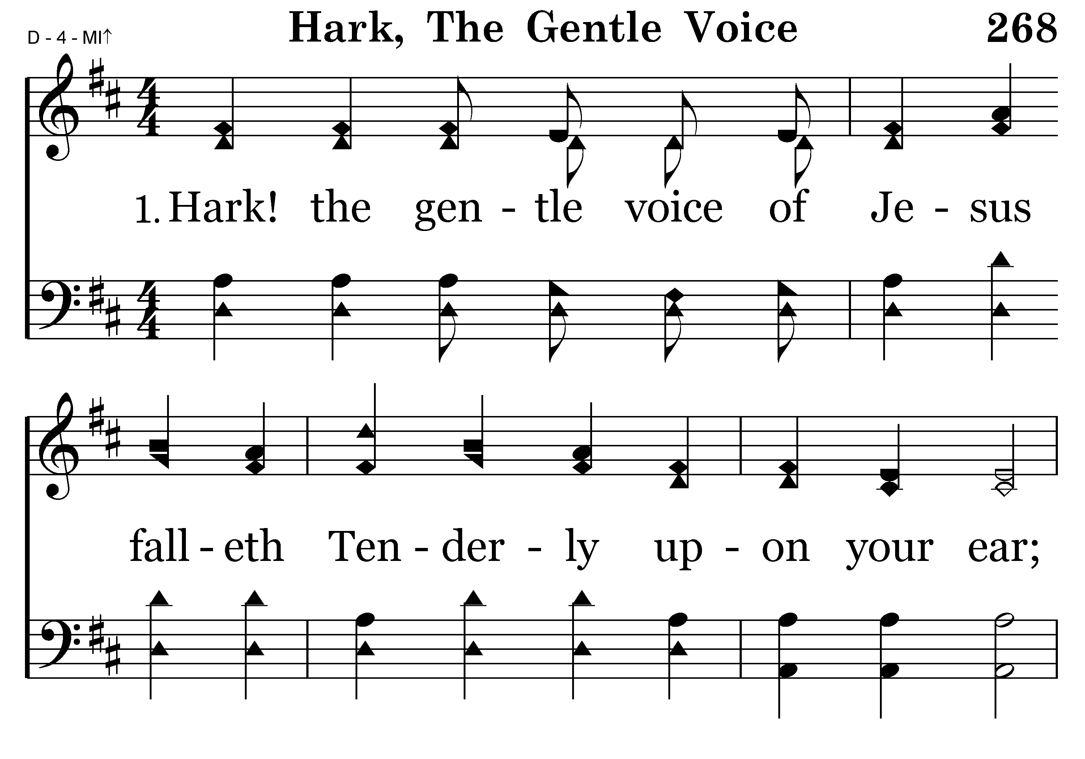
268 - Hark, The Gentle Voice - 1.1

Slide 81
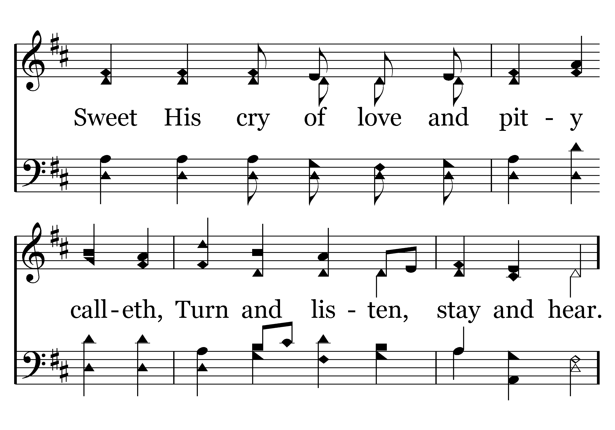
268 - Hark, The Gentle Voice - 1.2

Slide 82
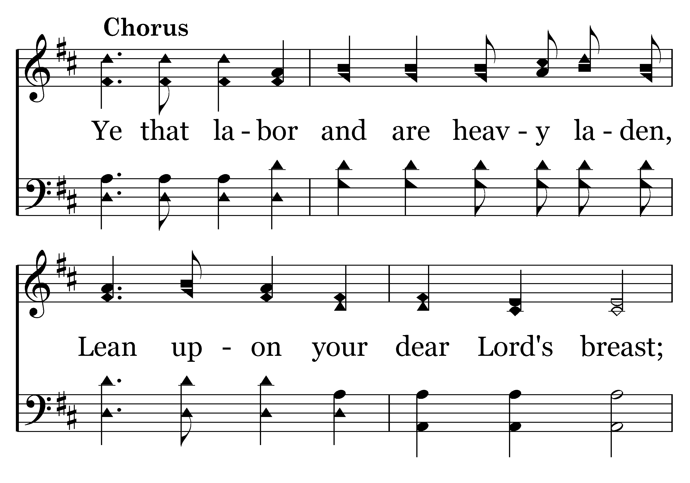
268 - Hark, The Gentle Voice - C.1

Slide 83
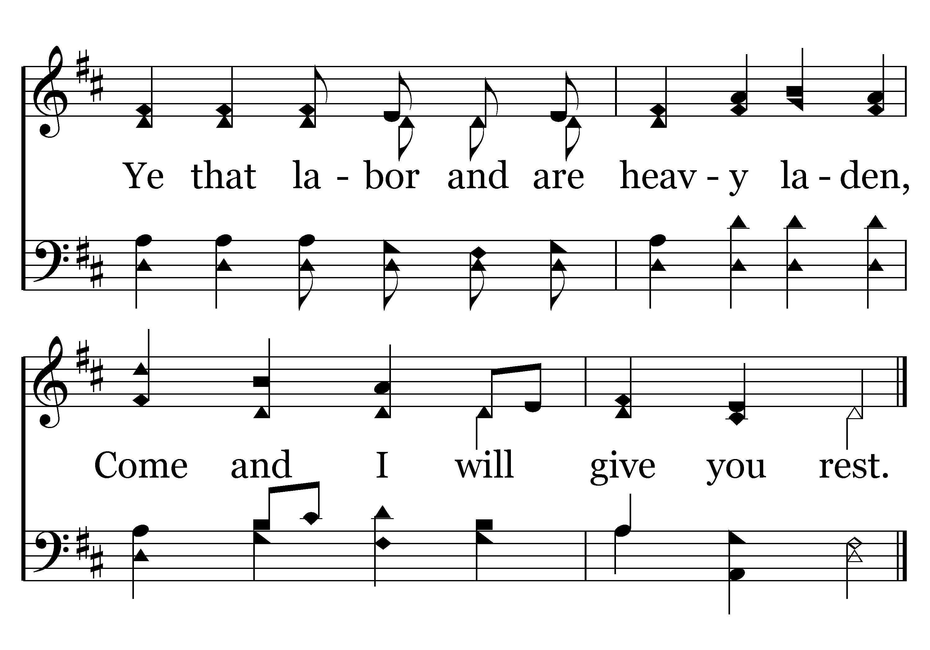
268 - Hark, The Gentle Voice - C.2
End of Verse 1

Slide 84
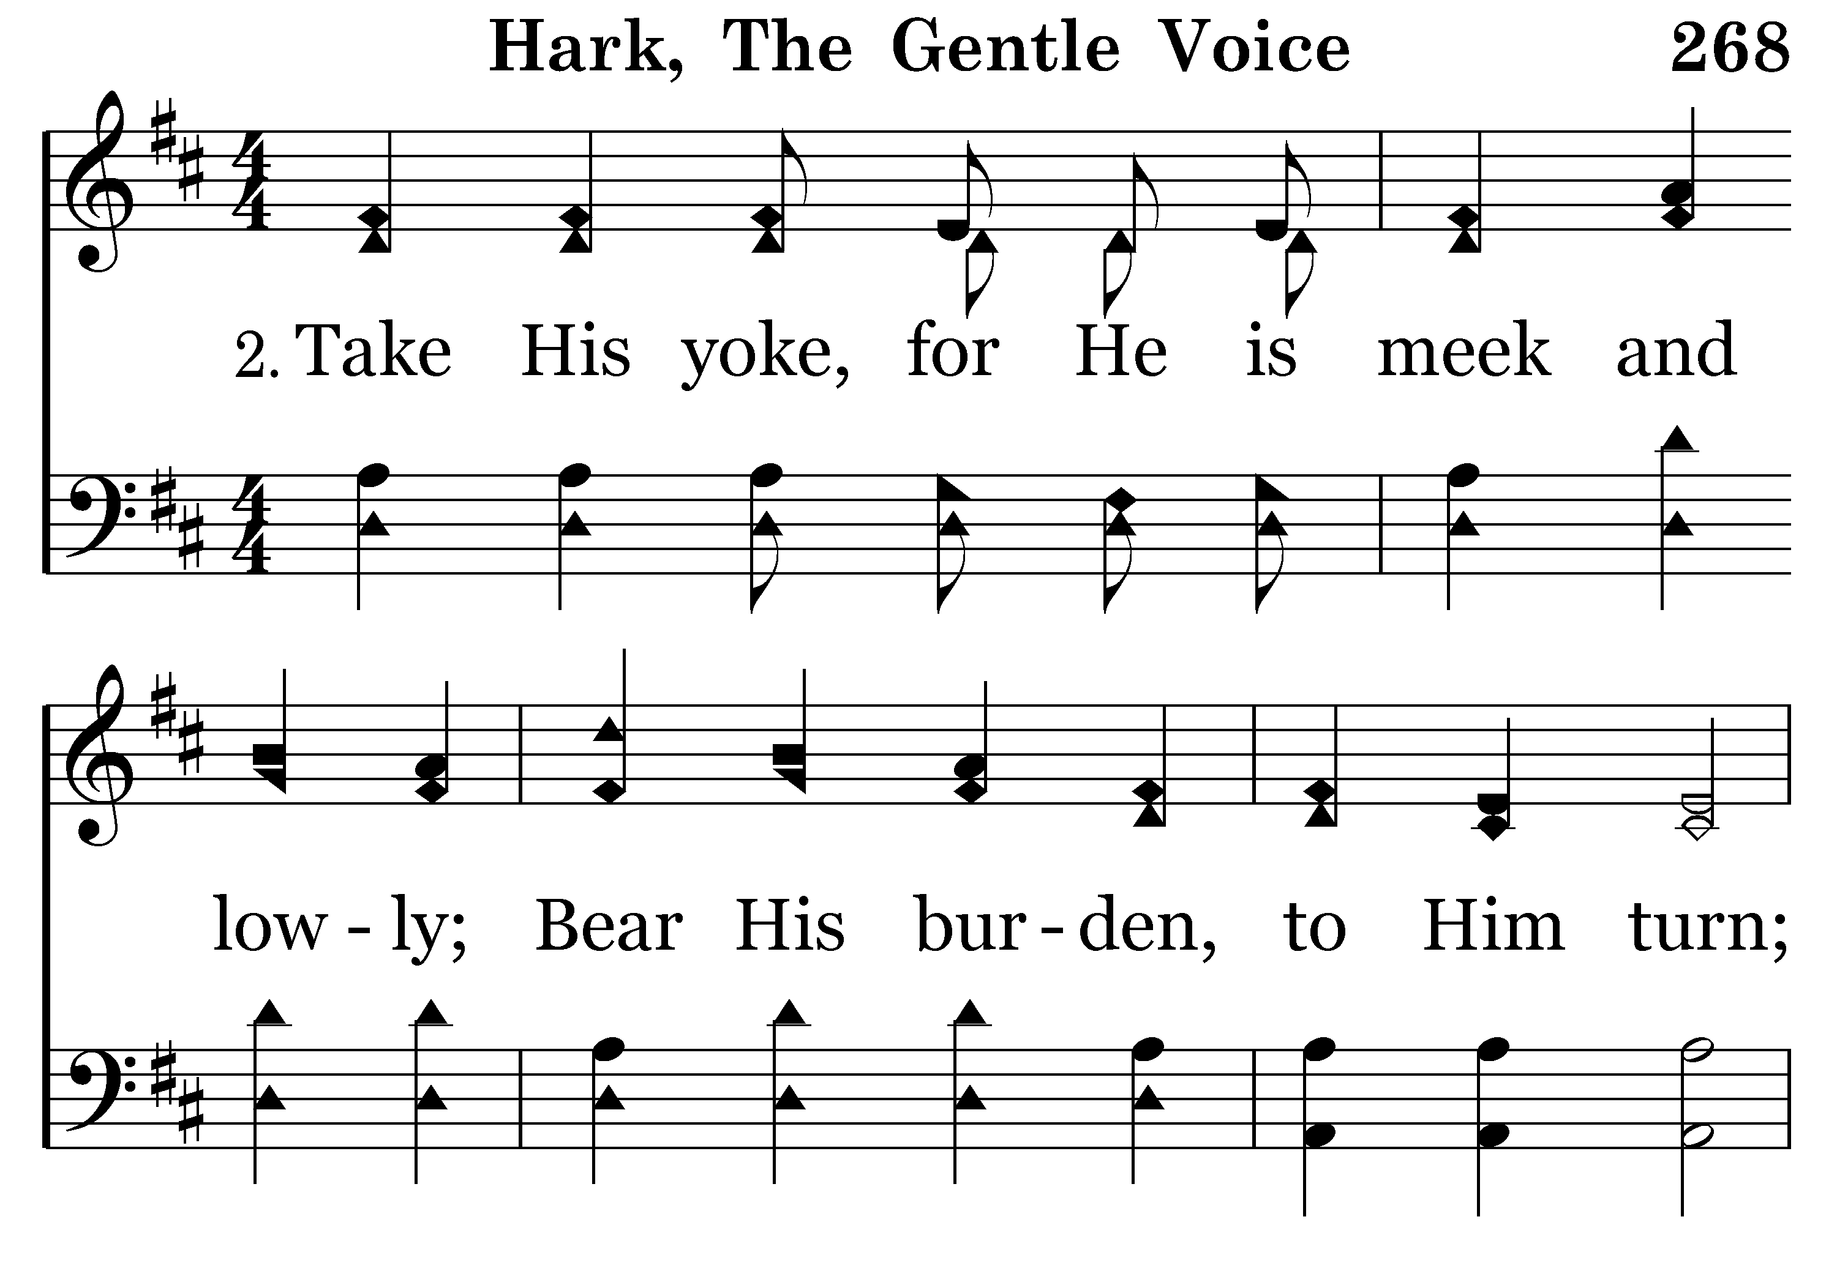
268 - Hark, The Gentle Voice - 2.1

Slide 85
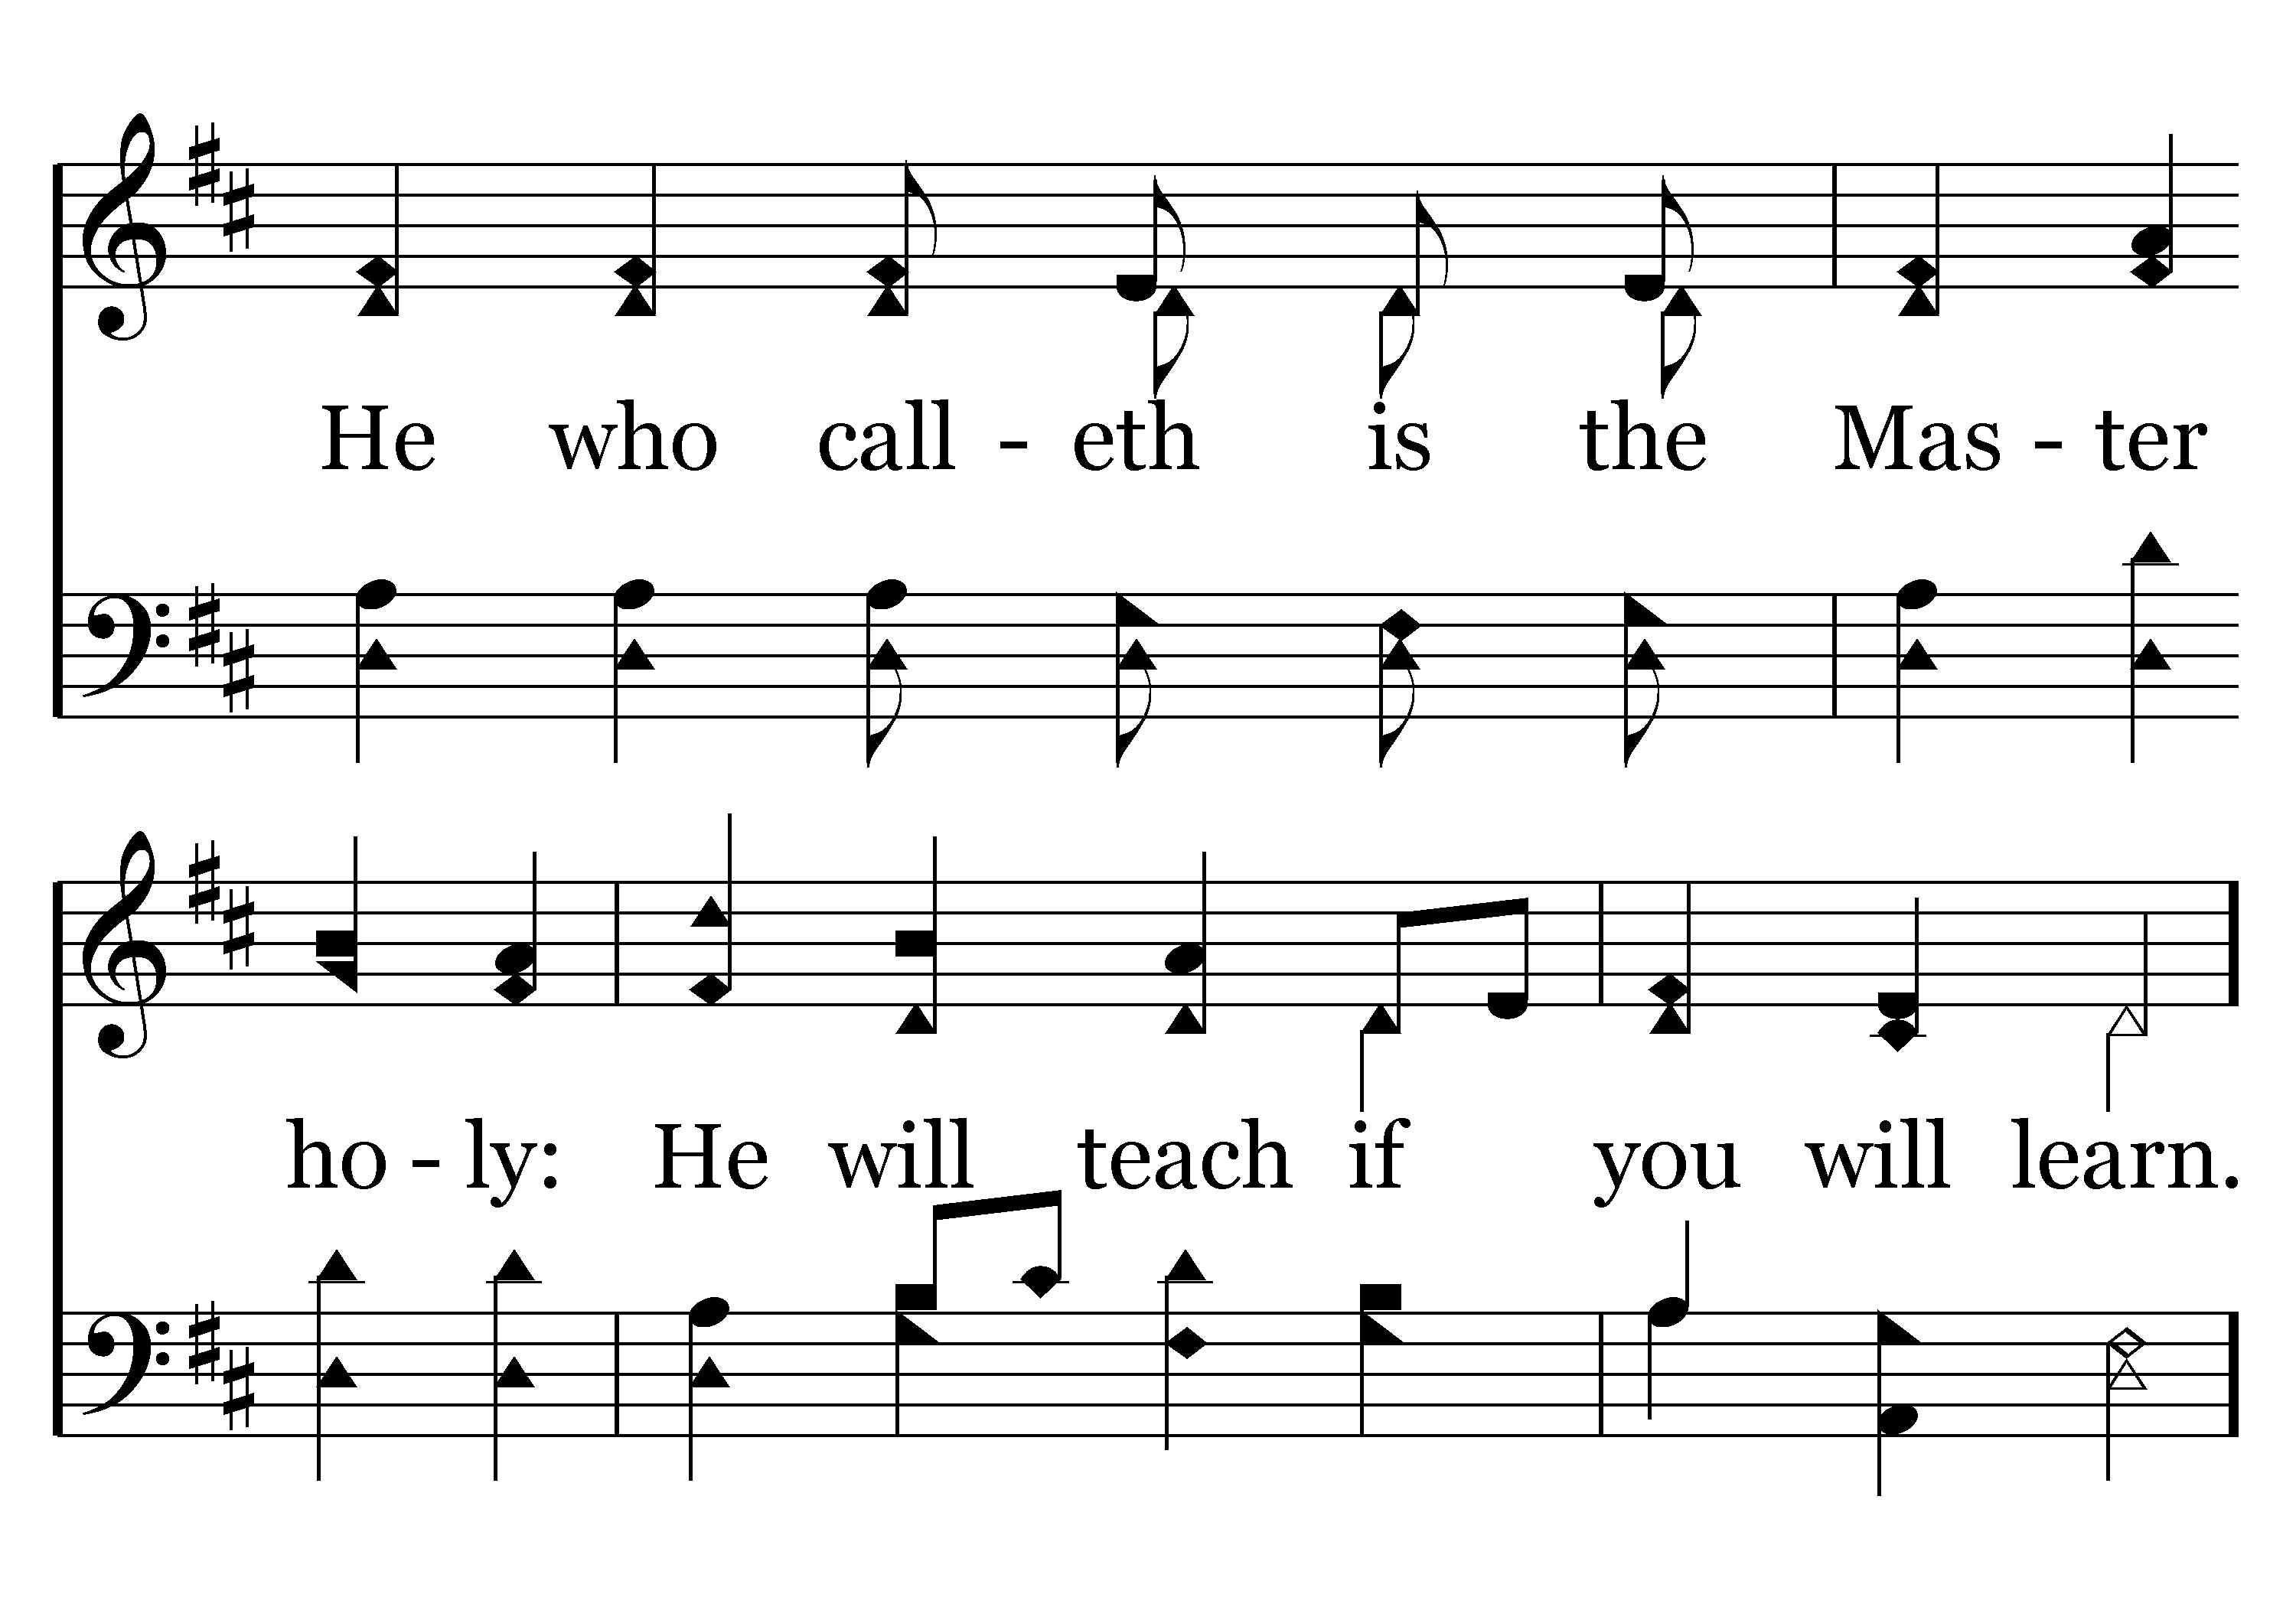
268 - Hark, The Gentle Voice - 2.2

Slide 86
268 - Hark, The Gentle Voice - C.1

Slide 87
268 - Hark, The Gentle Voice - C.2
End of Verse 2

Slide 88
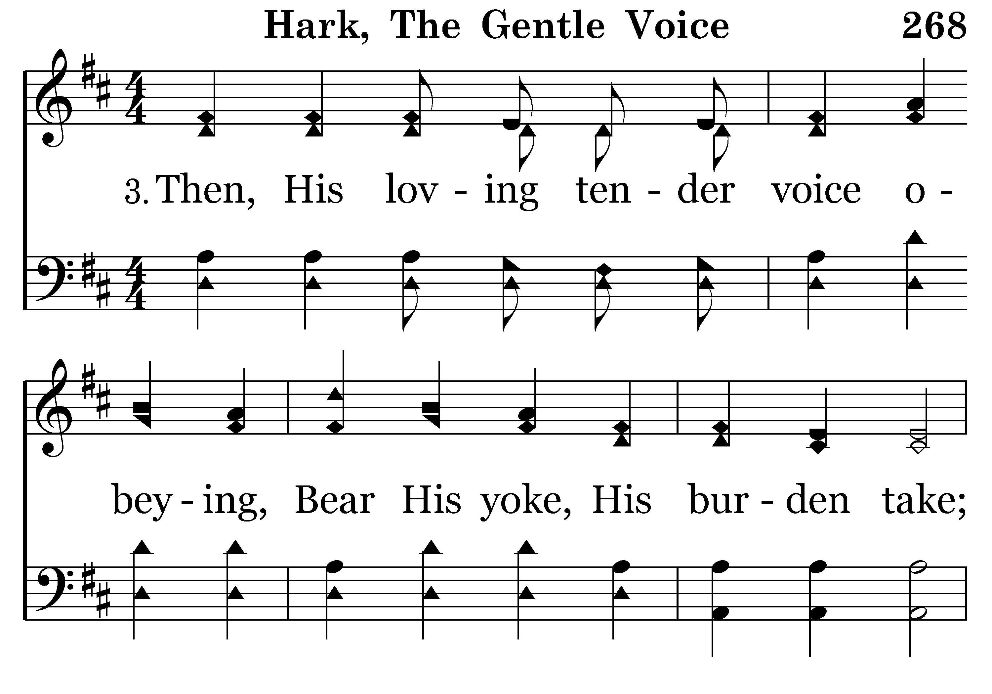
268 - Hark, The Gentle Voice - 3.1

Slide 89
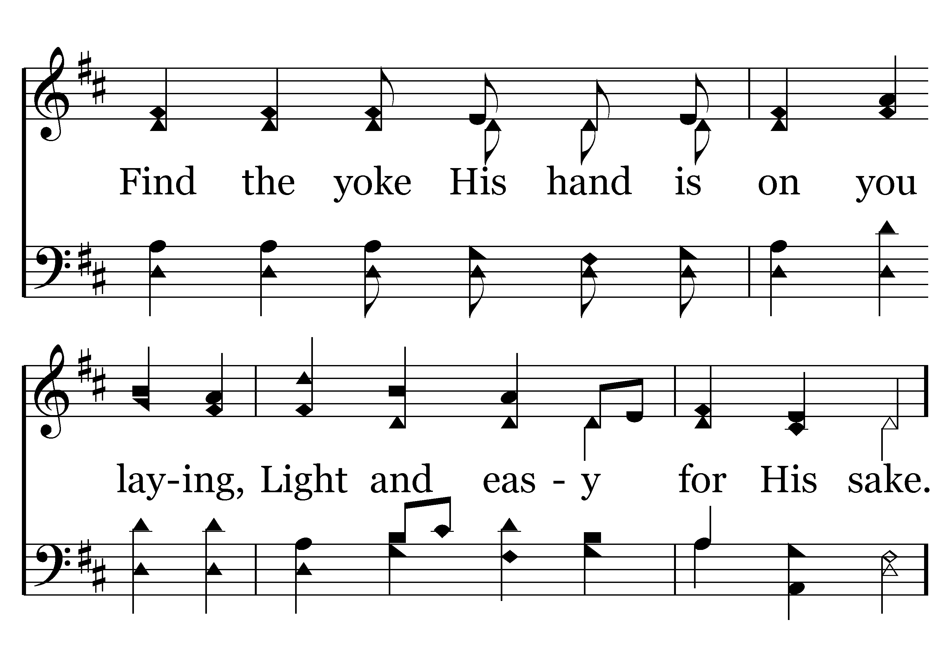
268 - Hark, The Gentle Voice - 3.2

Slide 90
268 - Hark, The Gentle Voice - C.1

Slide 91
268 - Hark, The Gentle Voice - C.2
End of Song

Slide 92
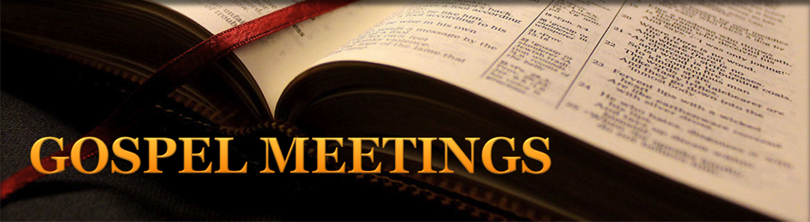
Oct. 6 – Sat at 6:00pm
Pisgah – Singing
Oct. 10-12 – Wed-Fri at 7:00pm
New Lebanon – Tyler Hall
Oct. 14-17 – Mon-Wed at 7:30pm
Kettering – Ken Weliever
Oct. 14-19 – Mon-Fri at 7:00pm
Bath Road – Dan McMahan
Oct. 14-19 – Mon-Fri at 7:00pm
Utica – Bobby Schrimsher

Slide 93
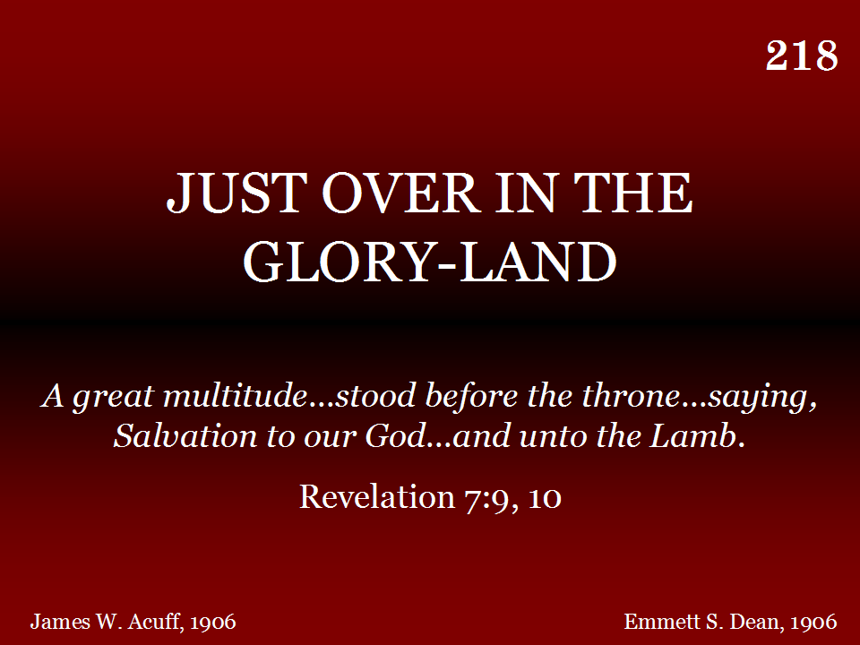
218 - Just Over In The Glory-Land - Title

Slide 94
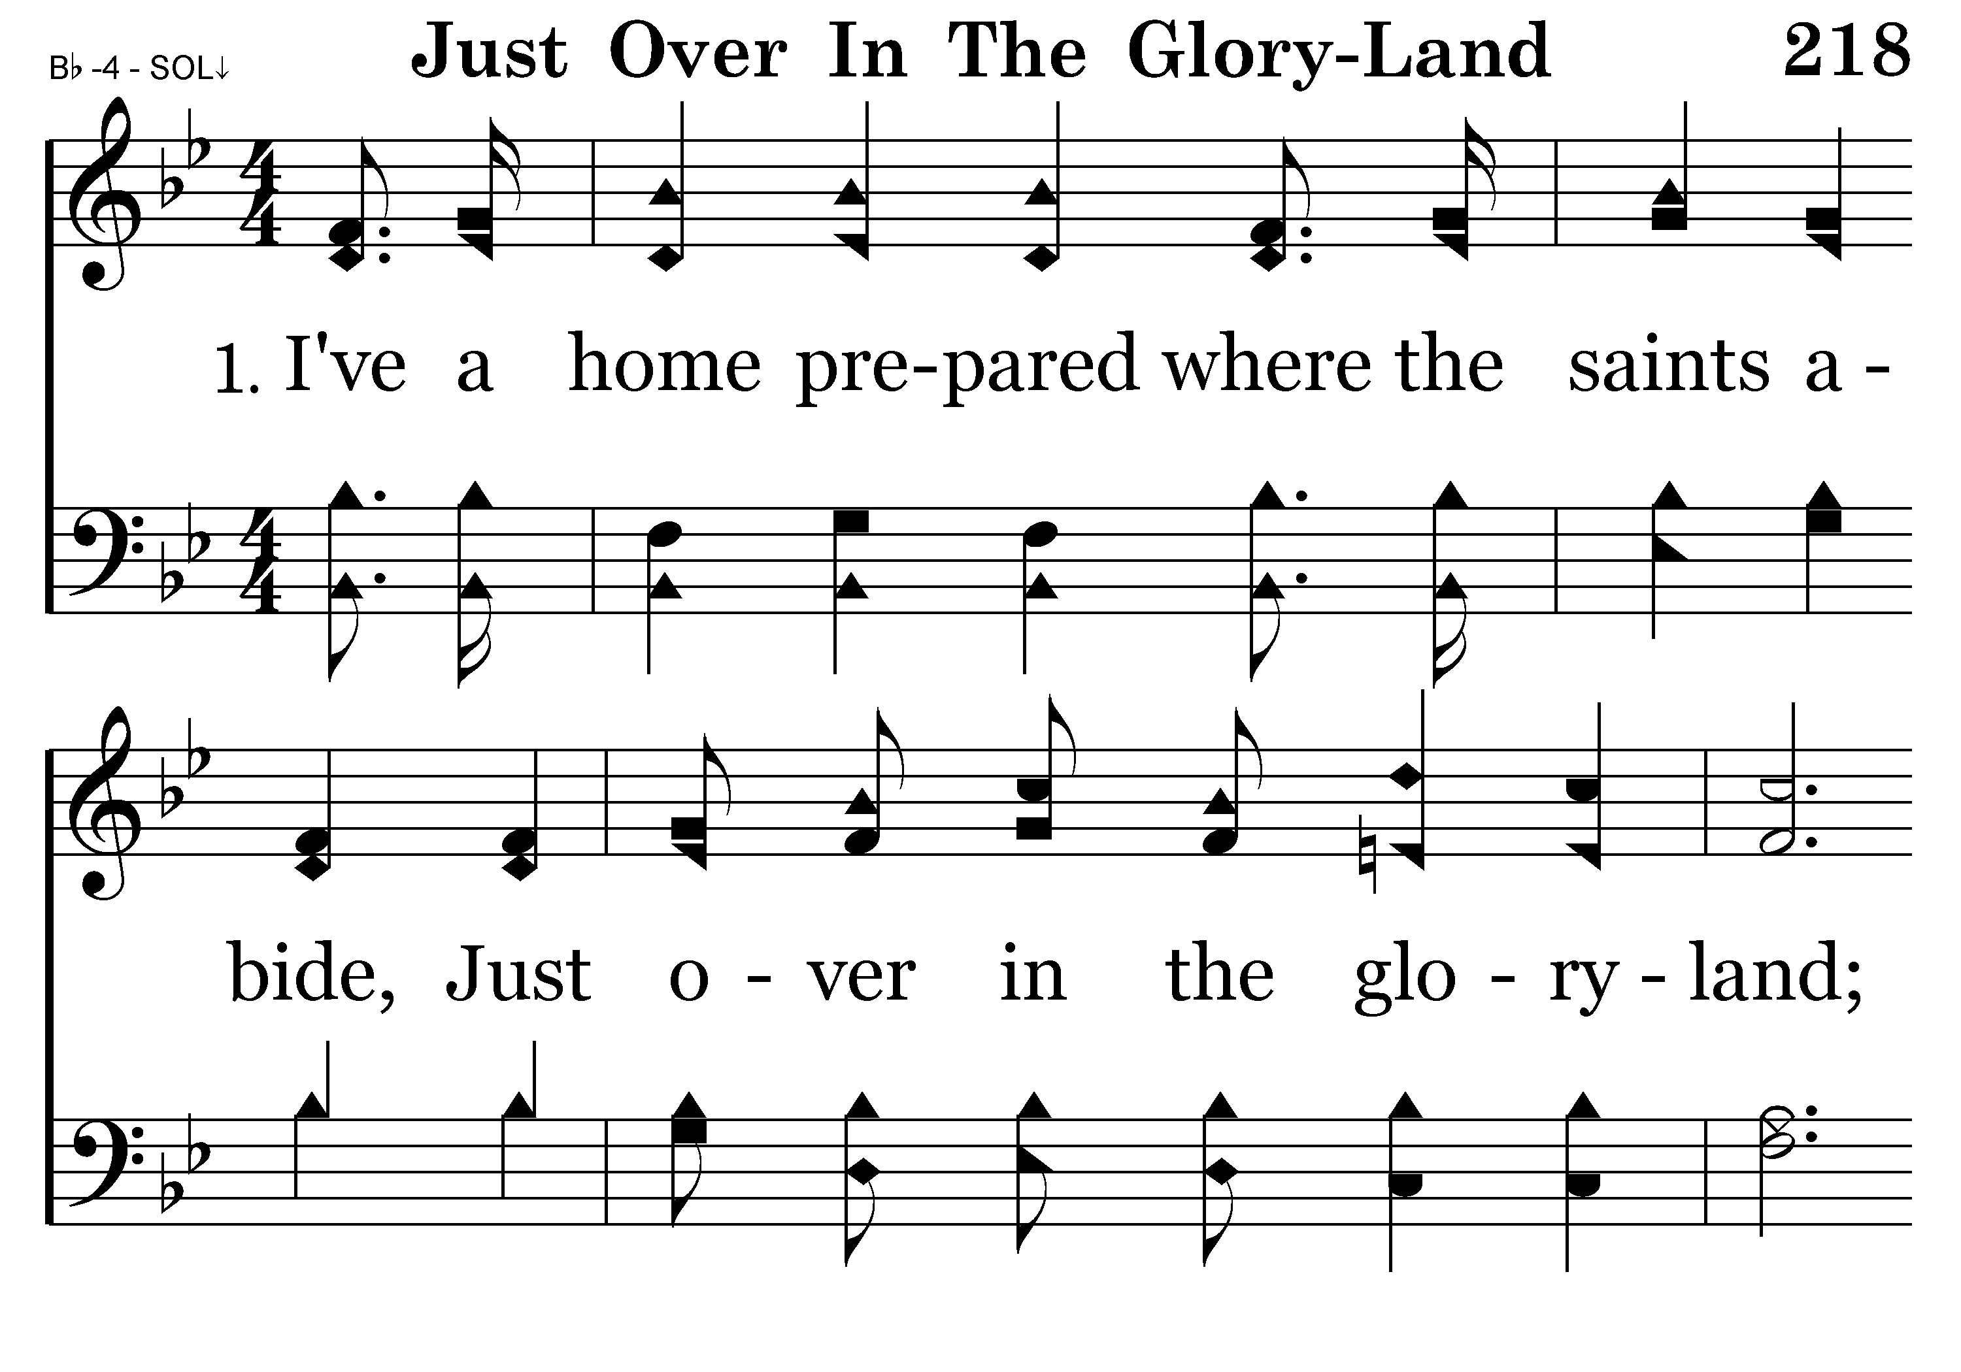
218 - Just Over In The Glory-Land - 1.1

Slide 95
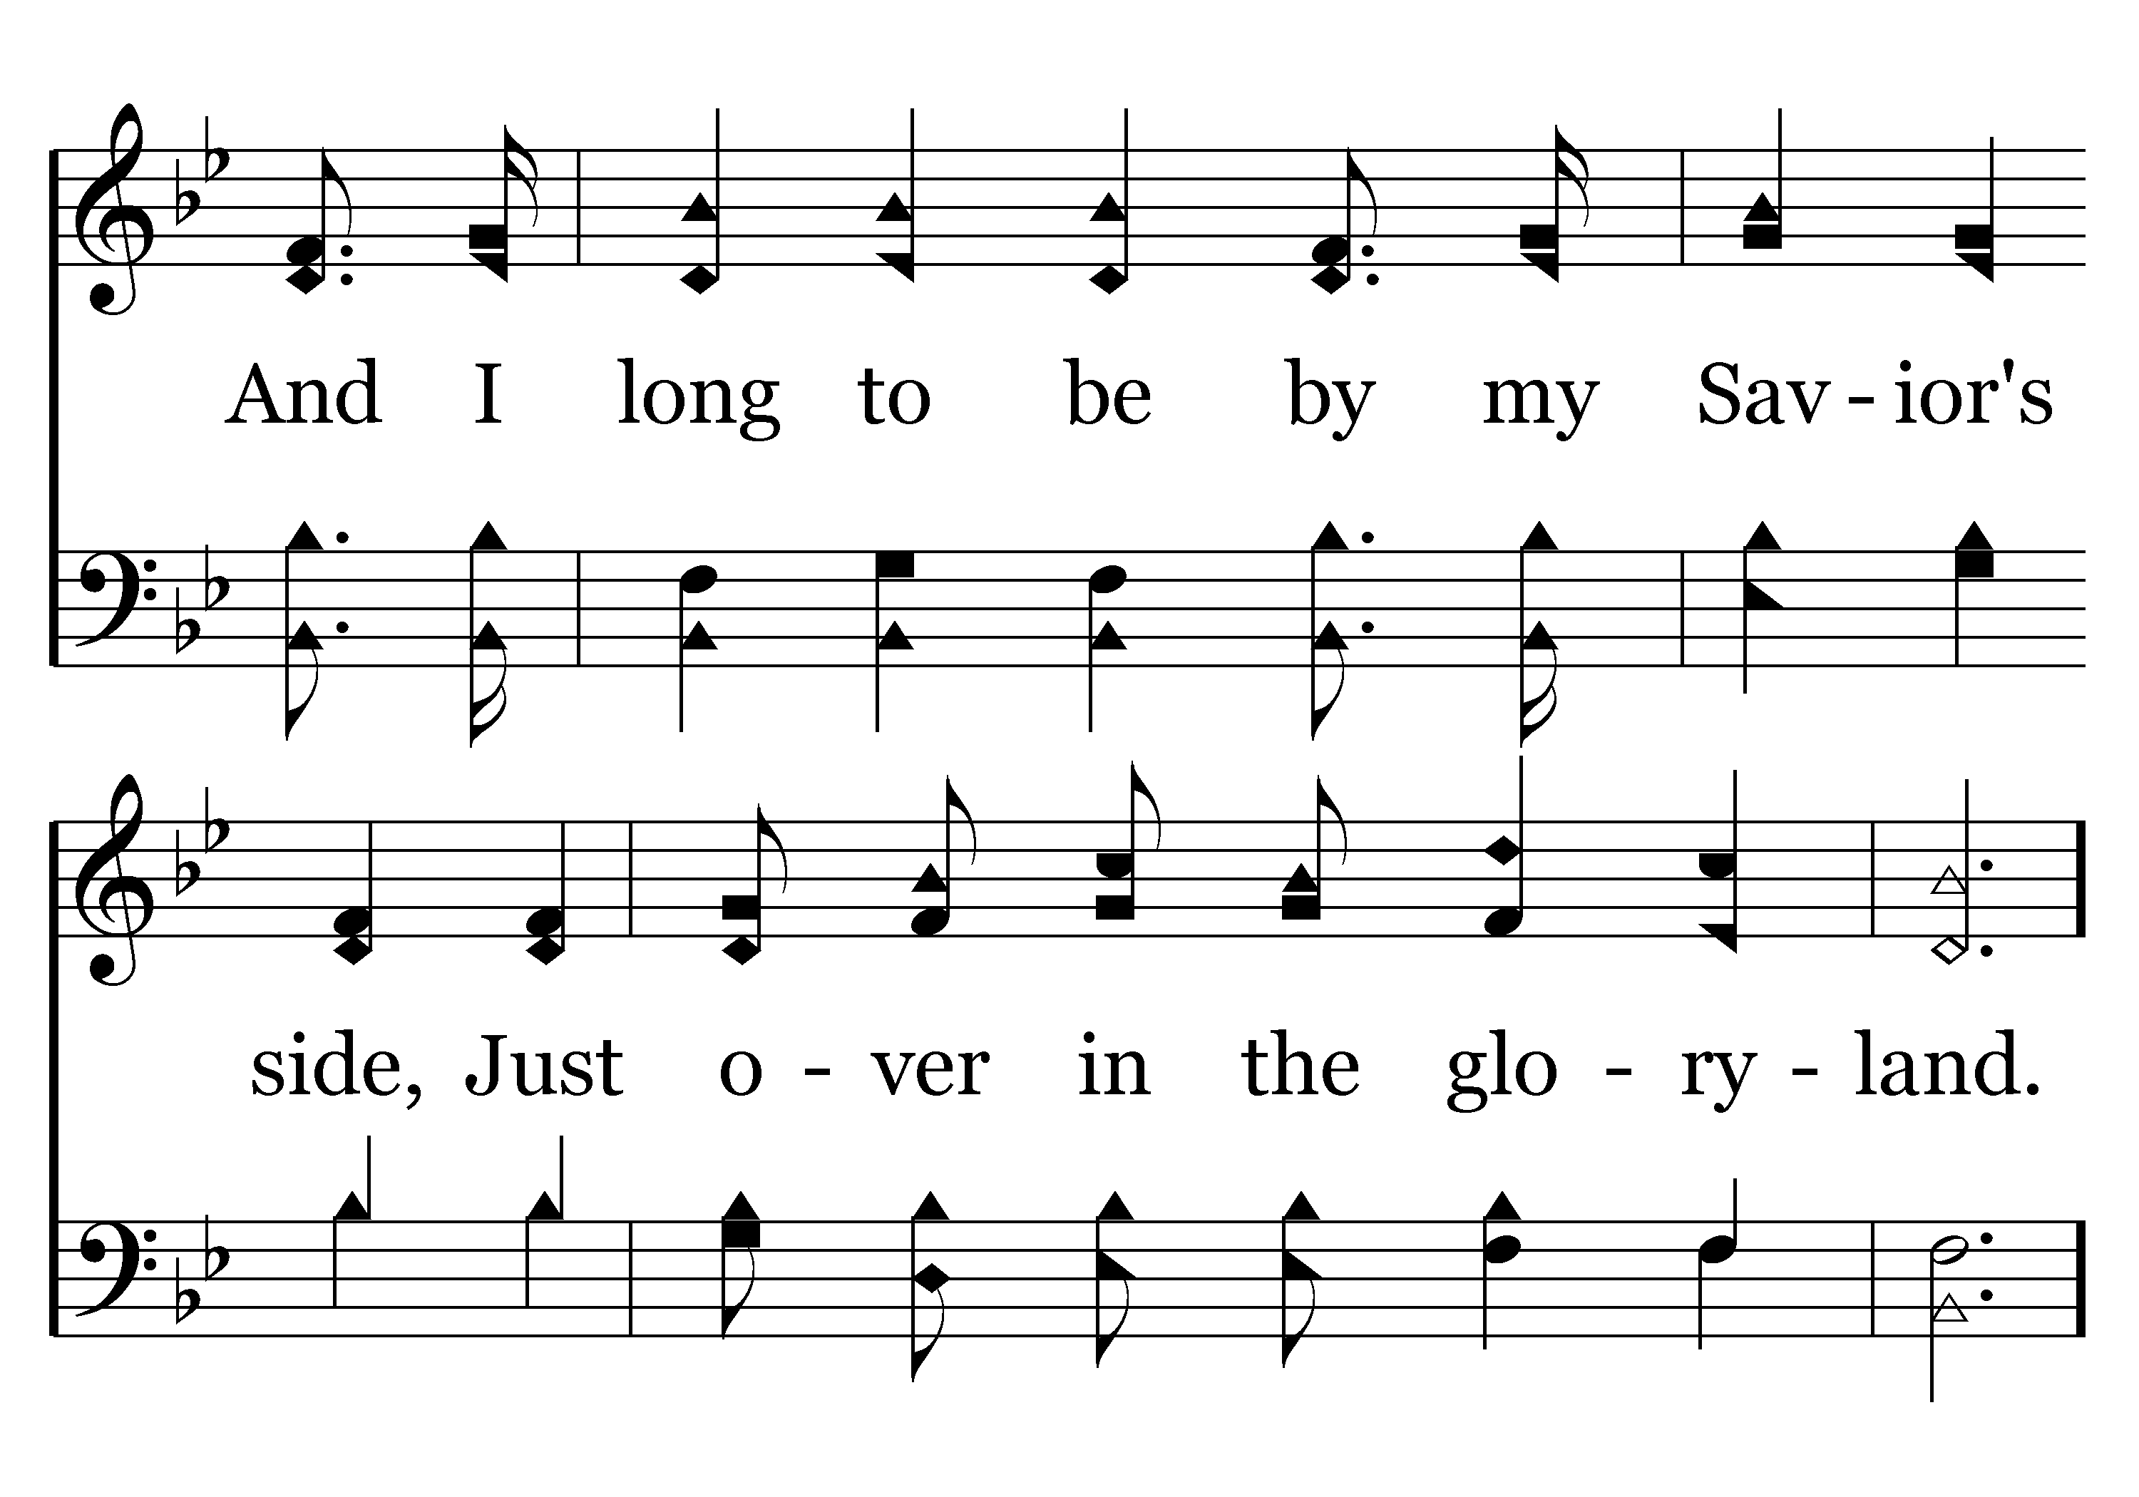
218 - Just Over In The Glory-Land - 1.2

Slide 96

218 - Just Over In The Glory-Land - C.1

Slide 97

218 - Just Over In The Glory-Land - C.2

Slide 98

218 - Just Over In The Glory-Land - C.3
End of Verse 1

Slide 99

218 - Just Over In The Glory-Land - 2.1

Slide 100

218 - Just Over In The Glory-Land - 2.2

Slide 101
218 - Just Over In The Glory-Land - C.1

Slide 102
218 - Just Over In The Glory-Land - C.2

Slide 103
218 - Just Over In The Glory-Land - C.3
End of Verse 2

Slide 104

218 - Just Over In The Glory-Land - 3.1

Slide 105

218 - Just Over In The Glory-Land - 3.2

Slide 106
218 - Just Over In The Glory-Land - C.1

Slide 107
218 - Just Over In The Glory-Land - C.2

Slide 108
218 - Just Over In The Glory-Land - C.3
End of Song

