Slide 2
“Do Not Be Afraid”
“For God has not given us a spirit of fear,
but of power and of love
and of a sound mind.”
2 Timothy 1:7

Slide 3
Claustrophobia – fear of confined spaces
Altophobia – fear of heights
Aviophobia – fear of flying
Hydrophobia – fear of water
Arachnophobia – fear of spiders
Ophidiophobia – fear of snakes
Glossophobia – fear of public speaking

Slide 4
Coulrophobia – fear of clowns
Dendrophobia – fear of trees
Phronemophobia – fear of thinking
Ecclesiophobia – fear of church
Homilophobia – fear of sermons
Panophobia – fear of everything

Slide 5
Repeated Admonitions
Not To Be Afraid
God told Abraham “Do not be afraid” (Gen. 15:1).
Moses told Israel “Do not be afraid” (Ex. 14:13).
God told the prophets not to be afraid
(Jer. 1:8; Ezek. 2:6).
Jesus often had to tell His disciples not to be afraid (Luke 5:10; Matt. 14:27, 17:7; Rev. 1:17).
We are not given a spirit of fear (2 Tim. 1:7), but sometimes we are still afraid.

Slide 6
1. Learn To Trust In God’s Care

Slide 7
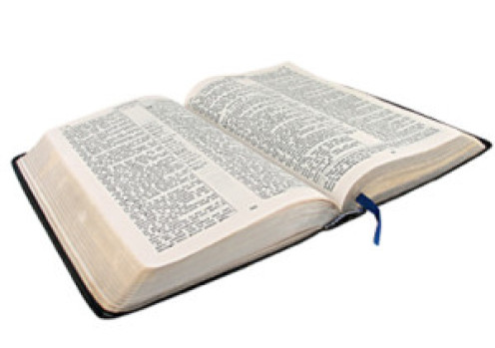
1. Learn To Trust In God’s Care
“Whenever I am afraid, I will trust in You.
In God (I will praise His word), in God I have put my trust; I will not fear. What can flesh do to me?”
Psalm 56:3-4

Slide 8
1. Learn To Trust In God’s Care
“When you lie down, you will not be afraid; yes, you will lie down and your sleep will be sweet.
Do not be afraid of sudden terror, nor of trouble from the wicked when it comes;
For the Lord will be your confidence, and will keep your foot from being caught.”
Proverbs 3:24-26

Slide 9
1. Learn To Trust In God’s Care
“Are not five sparrows sold for two copper coins? And not one of them is forgotten before God.
But the very hairs of your head are all numbered. Do not fear therefore; you are of more value than many sparrows.”
Luke 12:5-6

Slide 10
1. Learn To Trust In God’s Care
“What then shall we say to these things? If God is for us, who can be against us?”
Romans 8:31

Slide 11
2. Remember How God Has Protected Us in the Past

Slide 12
2. Remember How God Has Protected Us in the Past
“If you should say in your heart, ‘'These nations are greater than I; how can I dispossess them?’
You shall not be afraid of them, but you shall remember well what the Lord your God did to Pharaoh and to all Egypt.”
Deuteronomy 7:17-18

Slide 13
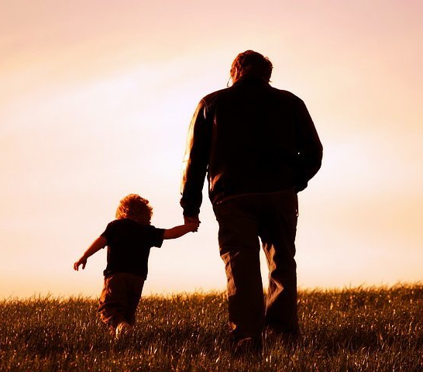
3. Learn To Live In God’s Presence

Slide 14
3. Learn To Live In God’s Presence
“Have I not commanded you? Be strong and of good courage; do not be afraid, nor be dismayed, for the Lord your God is with you wherever you go.”
Joshua 1:9

Slide 15
3. Learn To Live In God’s Presence
“I lay down and slept; I awoke, for the Lord sustained me.
I will not be afraid of ten thousands of people who have set themselves against me all around.”
Psalm 3:5-6

Slide 16
3. Learn To Live In God’s Presence
“Now the Lord spoke to Paul in the night by a vision, ‘Do not be afraid, but speak, and do not keep silent;
for I am with you, and no one will attack you to hurt you; for I have many people in this city.’”
Acts 18:9-10

Slide 17
3. Learn To Live In God’s Presence
“And when the servant of the man of God arose early and went out, there was an army, surrounding the city with horses and chariots. And his servant said to him, ‘Alas, my master! What shall we do?’
So he answered, ‘Do not fear, for those who are with us are more than those who are with them.’
And Elisha prayed, and said, ‘Lord, I pray, open his eyes that he may see.’ Then the Lord opened the eyes of the young man, and he saw. And behold, the mountain was full of horses and chariots of fire all around Elisha.”
2 Kings 6:15-17

Slide 18
4. Preparation

Slide 19
4. Preparation
“She is not afraid of snow for her household, for all her household is clothed with scarlet.”
Proverbs 31:21

Slide 20
4. Preparation
“Watch therefore, for you do not know what hour your Lord is coming...
Therefore you also be ready, for the Son of Man is coming at an hour you do not expect.”
Matthew 24:42, 44

Slide 21
4. Preparation
“Love has been perfected among us in this: that we may have boldness in the day of judgment; because as He is, so are we in this world.
There is no fear in love; but perfect love casts out fear, because fear involves torment. But he who fears has not been made perfect in love.”
1 John 4:17-18

Slide 22
5. Prayer
“Peace I leave with you, My peace I give to you; not as the world gives do I give to you. Let not your heart be troubled, neither let it be afraid.”
John 14:27

Slide 23

5. Prayer
We need to pray for peace - Phil. 4:6-7
We need to pray for boldness - Acts 4:29-31
We need to pray for strength - Ps. 55:4-5, 22

Slide 24
“Do Not Be Afraid”
“For God has not given us a spirit of fear,
but of power and of love
and of a sound mind.”
2 Timothy 1:7

