Slide 2
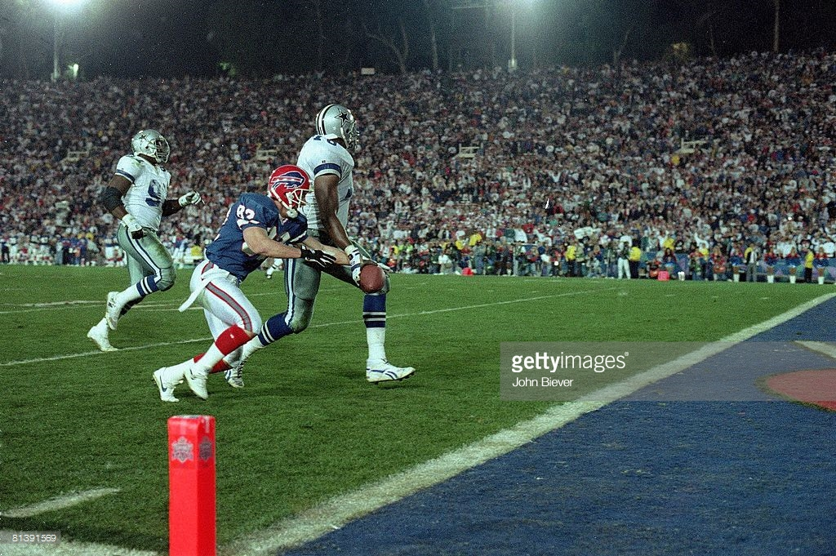
Almost… is Not Enough

Slide 3

Almost…
Lot’s Wife - Gen. 19:15-26
Moses - Deut. 3:23-28; 34:1-5
Rich Young Ruler - Mark 10:17-22
King Agrippa - Acts 26:27-28

Slide 4

Almost Saved?
Believe in Jesus - John 8:24
Repent of sins - Luke 13:3
Confess faith - Matthew 10:32-33
Baptized - Acts 2:38
Remain faithful - Rev. 2:10

