Slide 2
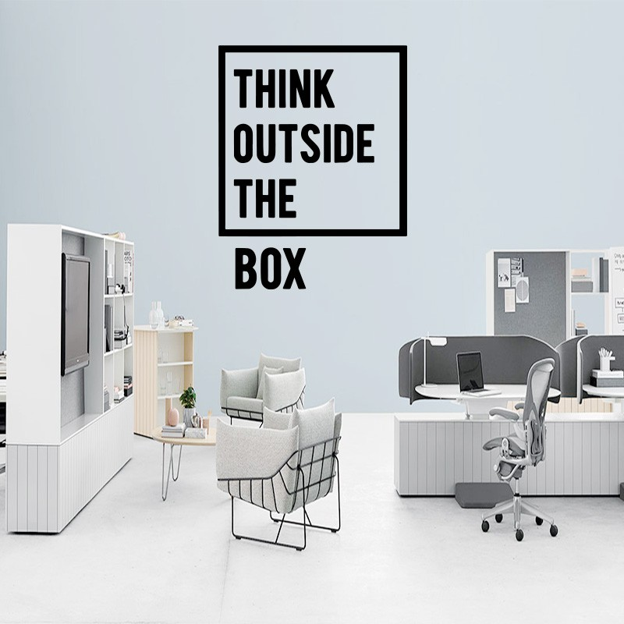

Slide 3

1. There is a Box

Slide 4
1. There is a Box
“Who serve the copy and shadow of the heavenly things, as Moses was divinely instructed when he was about to make the tabernacle. For He said, ‘See that you make all things according to the pattern shown you on the mountain.’”
Hebrews 8:5

Slide 5
1. There is a Box
“But God be thanked that though you were slaves of sin, yet you obeyed from the heart that form of doctrine to which you were delivered.”
Romans 6:17

Slide 6
1. There is a Box
“But God be thanked that though you were slaves of sin, yet you obeyed from the heart that form of doctrine to which you were delivered.”
Romans 6:17
“form” – TUPOS
“The representation or pattern of anything…
The metaphor is that of a cast or frame into which molten material is poured so as to take its shape. The Gospel is the mould; those who are obedient to its teachings become conformed to Christ, whom it presents” (Vine’s).

Slide 7
1. There is a Box
“For this reason I have sent Timothy to you, who is my beloved and faithful son in the Lord, who will remind you of my ways in Christ, as I teach everywhere in every church.”
1 Corinthians 4:17

Slide 8
2. We Must Stay In the Box

Slide 9
2. We Must Stay In the Box
“Then Jesus said to those Jews who believed Him, ‘If you abide in My word, you are My disciples indeed.’”
John 8:31

Slide 10
2. We Must Stay In the Box
“Imitate me, just as I also imitate Christ. Now I praise you, brethren, that you remember me in all things and keep the traditions just as I delivered them to you.”
1 Corinthians 11:1-2

Slide 11
2. We Must Stay In the Box
“Therefore, brethren, stand fast and hold the traditions which you were taught, whether by word or our epistle.”
2 Thessalonians 2:15
“Hold fast the pattern of sound words
which you have heard from me, in faith
and love which are in Christ Jesus.”
2 Timothy 1:13

Slide 12
2. We Must Stay In the Box
“Whoever transgresses and does not abide in the doctrine of Christ does not have God. He who abides in the doctrine of Christ has both the Father and the Son.”
2 John 9

Slide 13
3. God Is Serious About Us Staying In the Box
Nadab and Abihu - Lev. 10:1-3
Uzza and the Ark - 1 Chron. 13:9-10; 15:2, 13
King Uzziah - 2 Chron. 26:16-21

Slide 14
Some of God’s Divine Patterns (Boxes)
Matthew 19:3-6
Marriage is for life.
Marriage is between one man and one woman.
God establishes one’s gender.

Slide 15
Some of God’s Divine Patterns (Boxes)
The Church
Headship - Eph. 1:22-23
Leadership - 1 Cor. 14:34-35; 1 Tim. 2:12; 3:1-2
Worship - John 4:23-24
  singing, praying, teaching, giving, Lord’s Supper
Emphasis - Rom. 14:17; 1 Thess. 1:8
Membership - Acts 2:47

Slide 16
Some of God’s Divine Patterns (Boxes)
Man’s Salvation
Believe Jesus is the Christ - John 8:24
Repent of Our Sins - Acts 17:30
Confess Our Faith - Romans 10:9-10
Be Baptized - Mark 16:16
Remain Faithful - Hebrews 10:36-39

