Slide 2
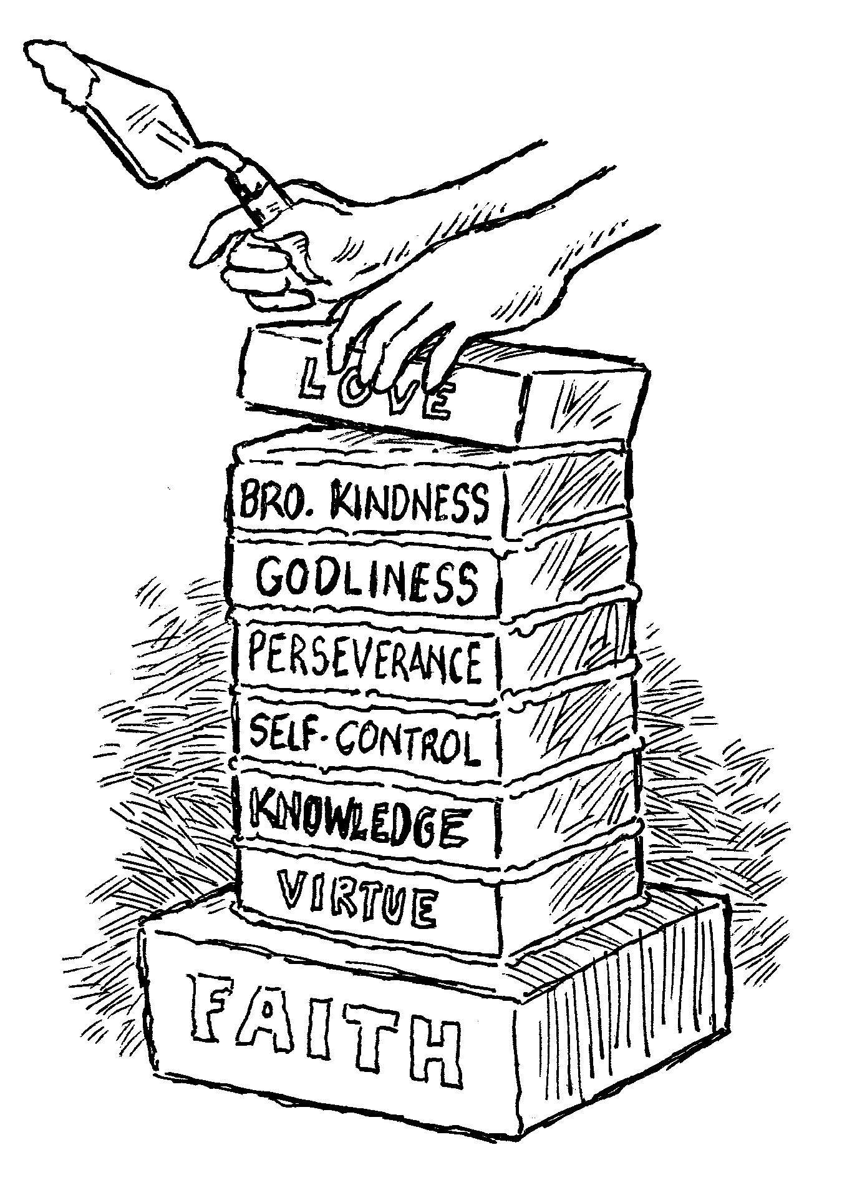
“If These Things Are Yours…”
2 Peter 1:5-11

Slide 3
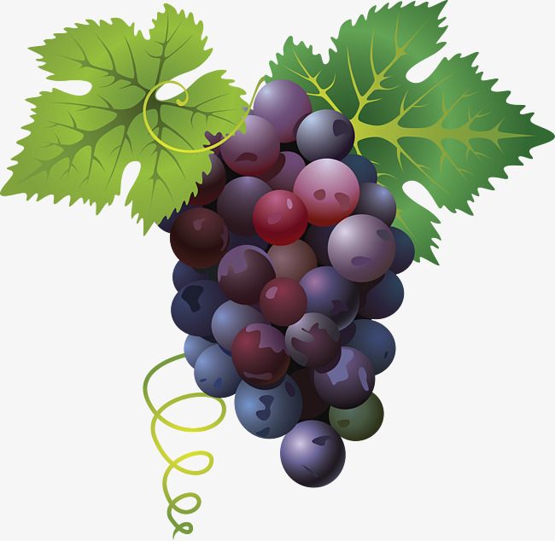
1. Fruitfulness
“For if these things are yours and abound, you will be neither barren nor unfruitful in the knowledge of our Lord Jesus Christ.”
2 Peter 1:8

Slide 4
1. Fruitfulness
“Barren”
Translated from the Greek word argos.
“lazy, shunning the labor which one ought to perform” (Thayer).
Used to describe those “standing idle in the marketplace” in the Parable of the Workers in the Vineyard (Matt. 20:3, 6).

Slide 5
1. Fruitfulness
“Unfruitful”
Translated from Greek word akarpos.
“not yielding what it ought to yield” (Thayer).
The Christian who fails to produce fruit will be removed and burned in the fire (John 15:2, 6).
The fruit is not the works of our own will or imagination, but those that come from a “knowledge of our Lord Jesus Christ.”

Slide 6
2. Clear Vision
“For he who lacks these things is shortsighted, even to blindness…”
2 Peter 1:9
Peter sank when he focused on his immediate surroundings (Matt. 14:30).
We are to lift up our eyes and see spiritual realities (John 4:35; Col. 3:1-2).

Slide 7
3. Good Memory
“…and has forgotten that he was cleansed from his old sins.”
2 Peter 1:9
Israel of old had numerous memorials.
Christians have a weekly memorial of the price that was paid to cleanse us of our sins (1 Cor. 11:23-26; Acts 20:7).

Slide 8

4. Sure Footing
“Therefore, brethren, be even more diligent to make your call and election sure, for if you do these things you will never stumble.”
2 Peter 1:10

Slide 9
4. Sure Footing
“Calling”
An invitation.
klesis - “a calling, is always used in the NT of that ‘calling’ the origin, nature and destiny of which are heavenly (the idea of invitation being implied); it is used especially of God’s invitation to man to accept the benefits of salvation” (Vine).
We are called by the gospel (2 Thess. 2:14).

Slide 10
4. Sure Footing
“Election”
eklogen – “the act of picking out, choosing” (Thayer).
Our response to God’s call comes before our election.
We are elected, or chosen, because we have decided to respond to God’s calling or invitation.

Slide 11
4. Sure Footing
“Sure”
Firm, stable, confident.
We do this be diligently adding the prescribed characteristics to our faith (vs. 5-7).

Slide 12
4. Sure Footing
“will never stumble”
ptaio – “to stumble, to fall into misery, become wretched” (Thayer).
This word does not mean to stumble, trip, or lose our footing along the way.
It means to fall in such a way as to be ruined and lost. To fail in the ultimate object of our life as a Christian – to reach Heaven (1 Pet. 1:9).

Slide 13
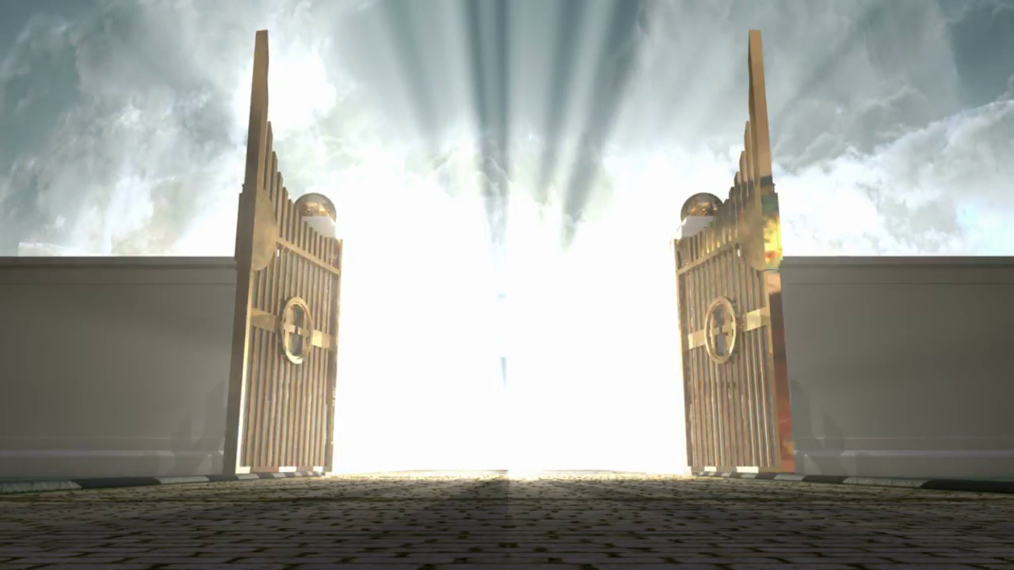
5. An Abundant Entrance
“For so an entrance will be supplied to you abundantly into the everlasting kingdom of our Lord and Savior Jesus Christ.”
2 Peter 1:11

Slide 14
5. An Abundant Entrance
“Abundant”
plousioos - “to be richly supplied” (Thayer).
The Greeks used this phrase to describe the welcome given to Olympic winners when they returned home.

Slide 15
5. An Abundant Entrance
“Everlasting Kingdom”
The kingdom is presently in existence, and Christians are a part of this kingdom (Col. 1:13).
However, there is an aspect of the kingdom which is yet to be realized (1 Peter 1:3-5).

Slide 16
The Rewards of Diligence
Fruitfulness
Clear Vision
Good Memory
Sure Footing
An Abundant Entrance

