Slide 2

What Happened To Hell?

Slide 3

What Happened To Hell?
False Doctrine: some teach Hell is only temporary.
Some deny the existence of Hell.
The subject has been trivialized in our culture.
All of this has taken the fear of God out of man (Matt. 10:28).

Slide 4
1. Hell is a Place of Punishment
“prepared for the devil and his angels” -
Matt. 25:41
“tormented day and night” - Rev. 20:10
“his portion with the unbelievers… beaten with many stripes” - Luke 12:45-48

Slide 5
2. Jesus Describes Hell
Fire - Luke 16:24; Rev. 20:10, 14-15
Worm Does Not Die - Mark 9:43-48
Outer Darkness - Matt. 8:12; 22:13; 25:30
Weeping and Gnashing of Teeth

Slide 6
3. Hell is Eternal
“And they will be tormented day and night forever and ever” - Rev. 20:10
“these will go away into everlasting punishment” - Matt. 25:46

Slide 7
4. Hell Has No Desire For Companionship
“Then he said, ‘I beg you therefore, father, that you would send him to my father's house, for I have five brothers, that he may testify to them, lest they also come to this place of torment.’”
Luke 16:27-28

Slide 8
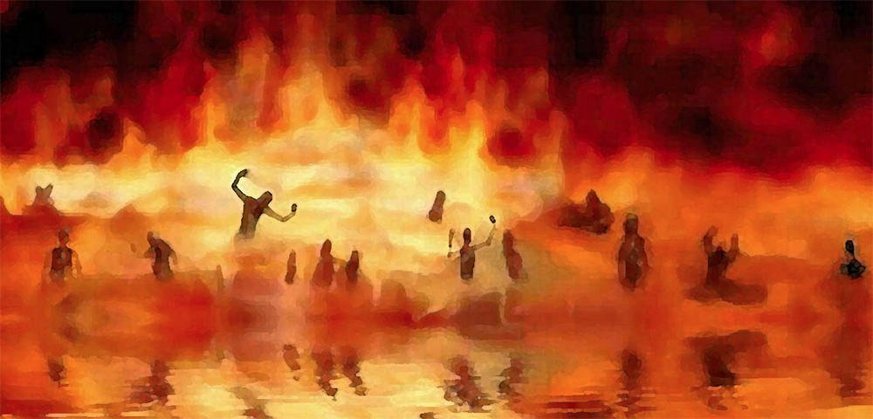
“And anyone not found written in the Book of Life was cast into the lake of fire” Rev. 20:15

