Slide 2
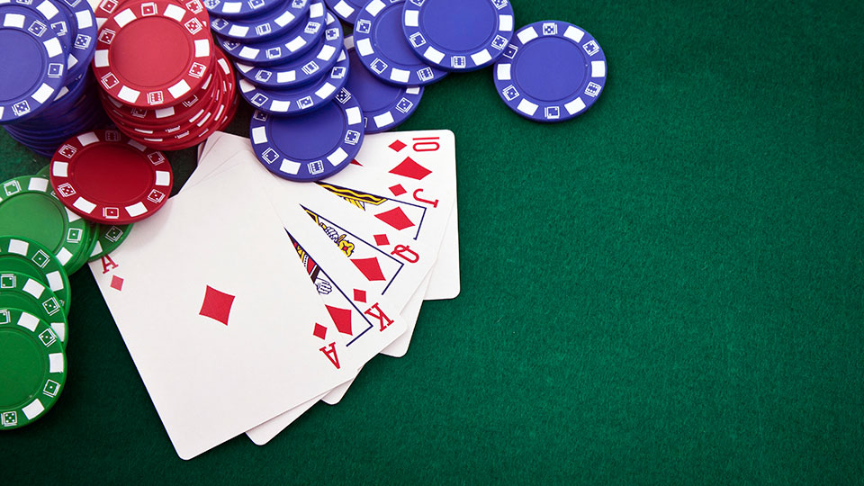
What Does the Bible
Say About
GAMBLING?

Slide 3

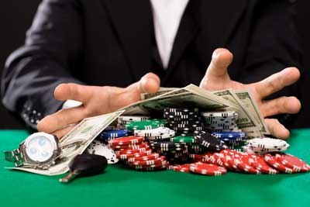

What is Gambling?
Gambling is the betting or staking of something of value, with the consciousness of risk and hope of gain, on the outcome of a game, a contest, or an uncertain event.

Slide 4
The Principle Is Sinful
Gambling violates the authorized means of gaining wealth.
Work
  Luke 10:7; Eph. 4:28; 2 Thess. 3:10
Commerce, exchange of goods
  Matt. 13:44; Acts 4:34-37; James 4:13
Gift - Eph. 4:28; Matt. 2:11; Acts 20:35
Inheritance - Num. 27:1-11; Luke 15:12

Slide 5
The Principle Is Sinful
Gambling violates the principle of stewardship.
  A steward is a manager overseeing the property of another, to whom he must give an account.
    1 Peter 4:10
    Psalm 24:1
    Acts 5:4

Slide 6
The Principle Is Sinful
Gambling violates the principle of brotherly love.
The only way to win at gambling is if others lose their wager.
We are to love our neighbor - Matt. 22:39
We are to do unto them as we want them to do unto us - Matt. 7:12
Love does no harm - Rom. 13:10

Slide 7

The Motivation Is Sinful
Greed
  1 Timothy 6:9-10
  Eccl. 5:10-12
Covetousness
  Luke 12:15
  Ephesians 5:3-7
  Colossians 3:5-6

Slide 8
The Fruits Are Sinful

Slide 9
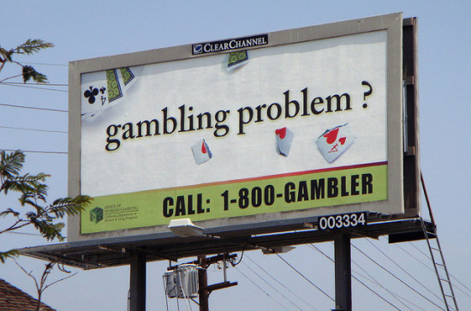
The Fruits Are Sinful
Gambling is addictive.

Slide 10
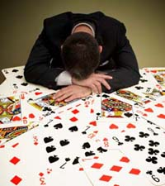
The Fruits Are Sinful
Gambling is addictive.
Gambling destroys lives.

Slide 11
The Fruits Are Sinful
Gambling is addictive.
Gambling destroys lives.
Gambling has evil companions.

Slide 12

The Fruits Are Sinful
Gambling is addictive.
Gambling destroys lives.
Gambling has evil companions.
Gambling contributes to crime
and other sins.

Slide 13
The Fruits Are Sinful
Gambling is addictive.
Gambling destroys lives.
Gambling has evil companions.
Gambling contributes to crime
and other sins.
Gambling destroys our influence.

Slide 14

What is Wrong With Gambling?
The Principle is Sinful
The Motivation is Sinful
The Fruits are Sinful

