Slide 1
The Martyr Complex

Slide 2
Definition
“In psychology a person who has a martyr complex, sometimes associated with the term victim complex, desires the feeling of being a martyr for his/her own sake, seeking out suffering or persecution because it either feeds a psychological need, or a desire to avoid responsibility.”

Slide 3

The Martyr Complex
Christians will face adversity (Not “might”, but “will”)
  1 Peter 5:8-11
Must not assume adversity guarantees our salvation.
  1 Corinthians 8

Slide 4
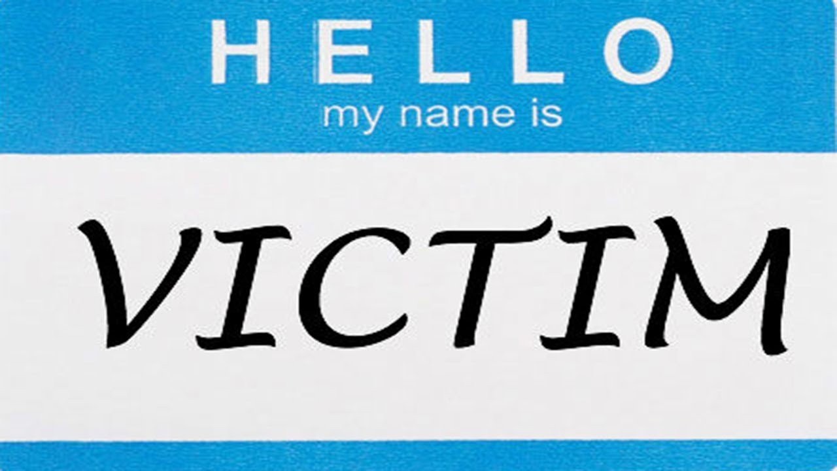
Playing Victim
Guaranteed adversity does not permit us to play “Victim”
  Matthew 6
Our feelings and ambitions can tempt us to misapply scripture (Galatians 6:3-4, 2 Corinthians 13:5-7)
  Sometimes, we might not always be “right”
  Believing that oppression means we’re “true” Christians

Slide 5
Mindfulness
Knowing what persecution is
  Disagreements are normal
  Being a Christian does not permit us to alter facts (Ephesians 4:17-18)
“Us vs Them” mentality (2 Timothy 2:23-26)
  Satan is trying to destroying us
  Still need to look as sinners as “lost” as opposed to “enemies”

Slide 6
Mindfulness (Cont.)
Do we really view ourselves worse off than sinners?
  Peter and the disciples (Acts 5:40-42)
  Israel complaining (Numbers 11:4-6)
Does the remission of sins make us above being human?
  Are we being a living sacrifice? Or are we seeking admiration?
  We need to realize our limitations (Galatians 6:2-9)

Slide 7
Final thoughts
Sufferings and labors will never make us worthy of Heaven
  What message do we send to sinners with an attitude of entitlement? (Luke 17:5-10)
  Matters of our personal conviction should be dealt with appropriately (Philippians 2:12)
Fear of persecution does not permit us to be unloving toward sinners. (Romans 12:17-21)
  The early Christians worked to pursue peace.
  So should we.

Slide 8


