Slide 2
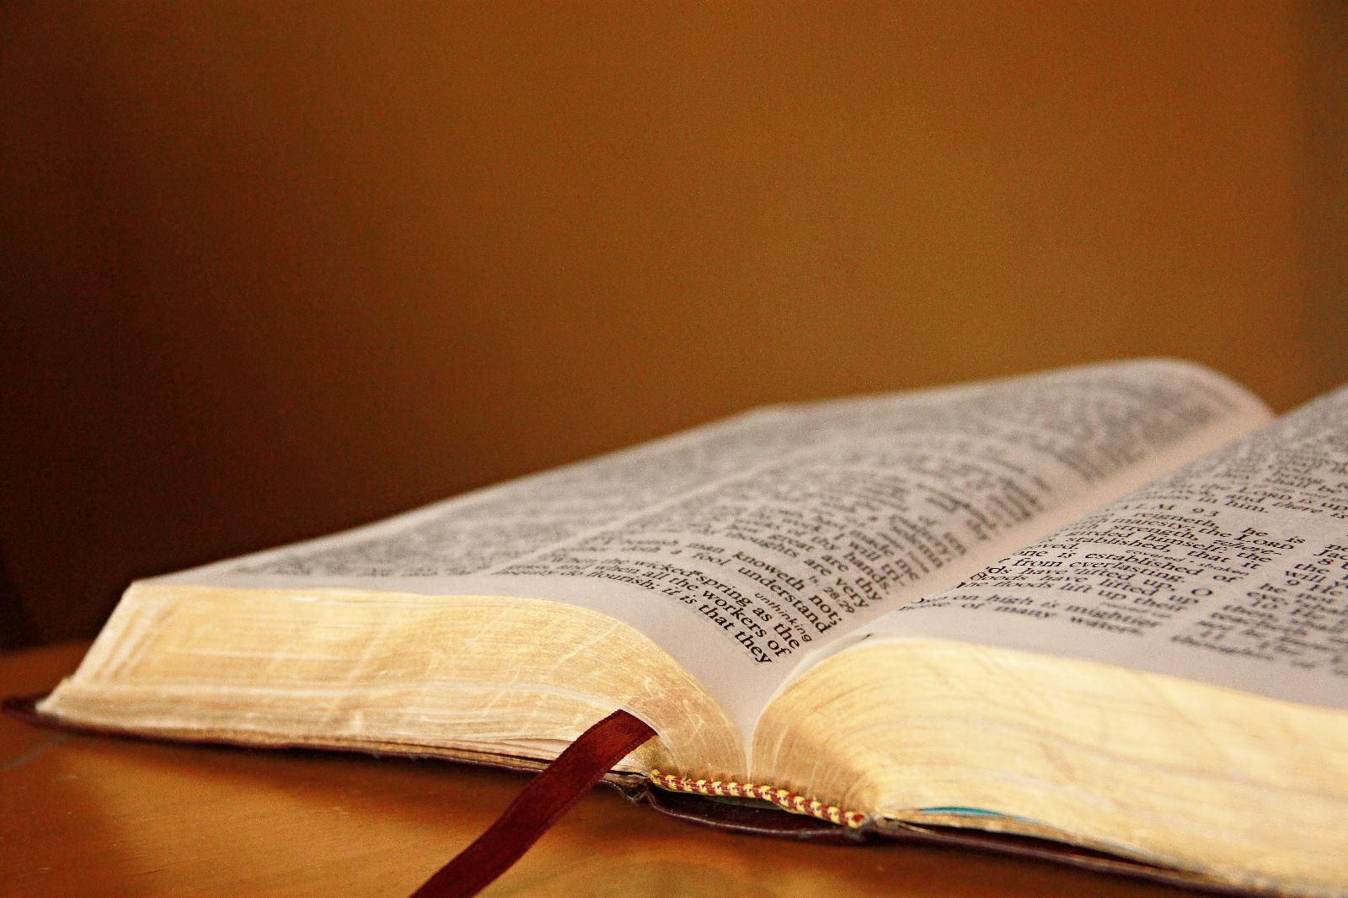
Do You Have the Hunger?

Slide 3
The Beatitudes
“Blessed are the poor in spirit…”
“Blessed are those who mourn…”
“Blessed are the meek…”
“Blessed are those who hunger and thirst for righteousness…”
Matthew 5:3-6

Slide 4
“Hunger and Thirst”
Hunger and thirst are desires that have to be fulfilled.
Esau sold his birthright for one meal because he felt starved - Genesis 25:29-34
Fasting forty days put the Lord in a position to be tempted - Matthew 4:1-3

Slide 5
“Righteousness”
Legal Sense: Justification, a right relationship with God - Romans 9:30-10:4
Moral Sense: Character and conduct that pleases God - Matthew 5:20
Social Sense: Treating others with justice and fairness - Proverbs 14:34

Slide 6
Those Who Had the Hunger
The Bereans - Acts 17:10-12
The Twelve Disciples - John 6:66-69
The Apostle Paul - Philippians 3:12-15

Slide 7
Why We Must Have the Hunger
It Is Only Natural - 1 Peter 2:1-3
It Doesn’t Come Naturally - Romans 10:3
If We Don’t Have the Hunger, We Won’t Make It - Luke 13:22-30

Slide 8
“And the Spirit and the bride say, ‘Come!’
And let him who hears say, ‘Come!’
And let him who thirsts come.
Whoever desires, let him take the water of life freely.” Revelation 22:17

