Slide 2
The Social Gospel

Slide 3
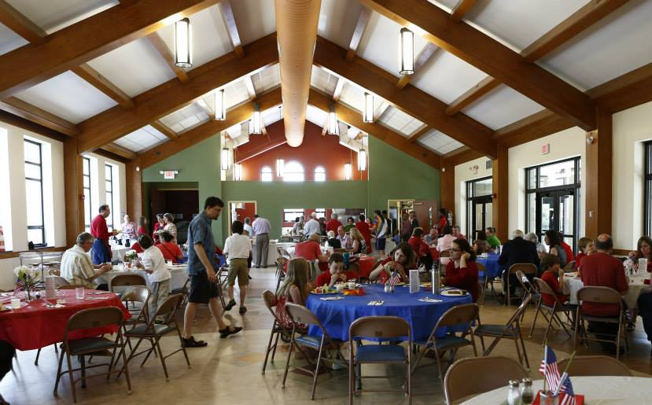
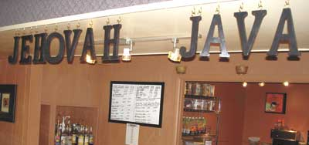
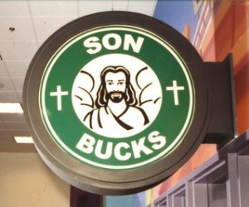



Slide 4
“Now make us a king to judge us like all the nations” (1 Sam. 8:5).
God’s people have always adopted the practices of the world around them.
So it is with the Social Gospel.

Slide 5
1. The Social Gospel is not Authorized
We must respect both the directions and the limitations of Scripture.
  Directions: “See that you make all things according to the pattern shown you…” (Heb. 8:5).
  Limitations: “Whoever transgresses and does not abide in the doctrine of Christ…” (2 John 9).

Slide 6
1. The Social Gospel is not Authorized
The New Testament gives the local church authority to…
  Spread the Gospel: 1 Timothy 3:15
  Edify the Members: Eph. 4:11-12
  Help Needy Members: Rom. 15:26

Slide 7
1. The Social Gospel is not Authorized
Where is the authority for the church to…
  Assemble: Heb. 10:25
  Preaching: 1 Tim. 3:15
  Sing: 1 Cor. 14:15
  Use Instruments ????
  Organized Sports ????
  Have Carnivals ????
  Have Dinners ????

Slide 8
2. The Social Gospel Degrades the Church
The Lord’s church is to be distinctive from the world (Eph. 3:8-11).
Jesus purchased the church with His shed blood (Acts 20:28).

Slide 9
3. The Social Gospel Cheapens the Cross
The message of the cross is God’s means of drawing the lost to salvation.
  John 12:32; 6:44-45
  Mark 16:15-16
  2 Thess. 2:13-14
  Romans 1:16

Slide 10
4. The Social Gospel Fails to Provide Edification
The church is edified by the teaching and preaching of the word of God, not by social events and activities.
  Acts 20:32
  Ephesians 4:11-12
  2 Timothy 3:16-17

Slide 11
Why We Do Not Participate in the Social Gospel
It is Not Authorized By God
It Degrades the Lord’s Church
It Cheapens the Message of the Cross
It Fails To Truly Edify the Church

