Slide 2
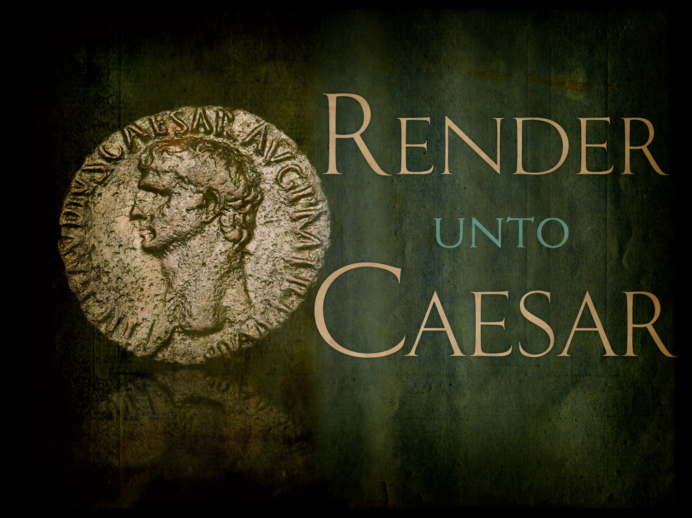

Slide 3
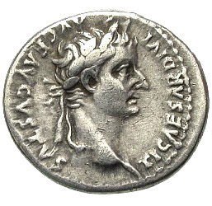
Matthew 22:19-21
“Show Me the tax money.” So they brought Him a denarius.
And He said to them, “Whose image and inscription is this?”
They said to Him, “Caesar’s.”

Slide 4

Man’s Responsibility to Civic Government
Obey Governing Authorities
  Rom. 13:1-5; 1 Pet. 2:13-14
Pay Our Taxes
  Rom. 13:6-7
Pray for Our Leaders
  1 Tim. 2:1-4
Render to Caesar the things that are Caesar’s.

Slide 5
Genesis 1:26-27
Then God said, “Let Us make man in Our image, according to Our likeness; let them have dominion over the fish of the sea, over the birds of the air, and over the cattle, over all the earth and over every creeping thing that creeps on the earth.”
So God created man in His own image; in the image of God He created him; male and female He created them.

Slide 6

Man’s Responsibility to God
Love God
  Matt. 22:35-40; 10:37; 1 John 5:3
Fear God
  Eccl. 12:13; Acts 10:34-35
Obey God
  Eccl. 12:13; John 14:15
Render to God the things that are God’s.

