Slide 2

Getting Good Advice

Slide 3
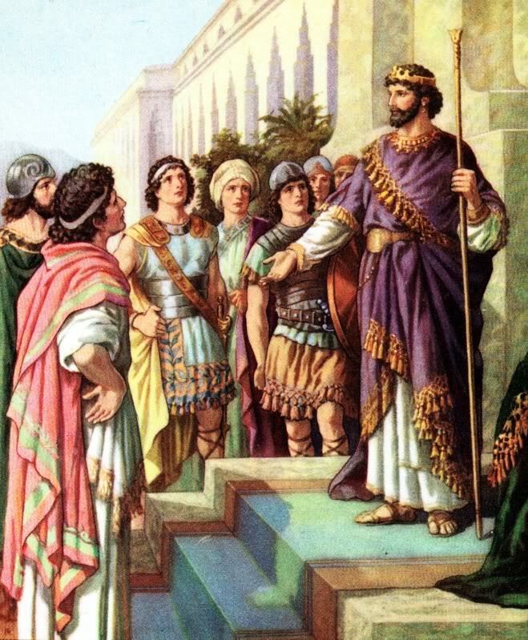
King Rehoboam
1 Kings 12:1-11
Rejected good advice.
Followed bad advice.
Paid dearly for his foolish decision.

Slide 4
1. Someone Who Has Wisdom
“Then I saw that wisdom excels folly as light excels darkness” (Eccl. 2:13).
“The lips of the wise disperse knowledge, but the heart of the fool does not do so” (Prov. 15:7).
“He who walks with wise men will be wise,
but the companion of fools will be destroyed” (Prov. 13:20).

Slide 5
1. Someone Who Has Wisdom
How do we know who is wise?
By their fruits you will know them (Matt. 7:20).
“The mouth of the righteous brings forth wisdom…” (Prov. 10:31).
“…but with the humble is wisdom” (Prov. 11:2).

Slide 6
2. Someone Who Listens
“He who answers a matter before he hears it, it is folly and shame to him” (Prov. 18:13).
“So then, my beloved brethren, let every man be swift to hear, slow to speak, slow to wrath” (James 1:19).

Slide 7
3. Someone Who Gets All the Facts
“The first one to plead his cause seems right, until his neighbor comes and examines him” (Prov. 18:17).
“Does our law judge a man before it hears him and knows what he is doing?” (John 7:51).

Slide 8
4. Someone Who Respects God’s Word

Slide 9
4. Someone Who Respects God’s Word
“The fear of the Lord is the beginning of knowledge…”
(Prov. 1:7)
“The fear of the Lord is the beginning of wisdom…”
(Prov. 9:10)

Slide 10
4. Someone Who Respects God’s Word
“The fear of the Lord is the beginning of knowledge…”
(Prov. 1:7)
“The fear of the Lord is the beginning of wisdom…”
(Prov. 9:10)
“The fool has said in his heart, ‘There is no God’” (Ps. 14:1).

Slide 11
4. Someone Who Respects God’s Word
“The fear of the Lord is the beginning of knowledge…”
(Prov. 1:7)
“The fear of the Lord is the beginning of wisdom…”
(Prov. 9:10)
“The fool has said in his heart, ‘There is no God’” (Ps. 14:1).
Who should we listen to?

Slide 12
4. Someone Who Respects God’s Word
“Forever, O Lord, Your word is settled in heaven” (Ps. 119:89).
“I have more understanding than all my teachers, for Your testimonies are my meditation. I understand more than the ancients, because I keep Your precepts” (Ps. 119:99-100).
“But on this one will I look: on him who is poor and of a contrite spirit, and who trembles at My word” (Is. 66:2).

Slide 13
Getting Good Advice
Someone Who Has Wisdom
Someone Who Will Listen
Someone Who Will Get All the Facts
Someone Who Respects God’s Word

