Slide 2

Where Is Your Heart?

Slide 3
The Bible Heart
Translated from the Greek word kardia.
“denotes the seat and center of all physical and spiritual life… the fountain and seat of the thoughts, passions, desires, appetites, affections, purposes, endeavors… of the understanding… of the will and character” (Thayer).
“Often including the intellect as well as the affections and will” (Fausset’s Bible Dictionary).

Slide 4
The Bible Heart
Intellect
think with our heart (Matt. 9:4; 15:19)
reason in our heart (Mark 2:8)
understand with our heart (Matt. 13:15)
believe in our heart (Rom. 10:10)

Slide 5
The Bible Heart
Affection or Emotion
grieve in our heart (Gen. 6:6)
despise in our heart (2 Sam. 6:16)
broken heart (Ps. 34:18)
love with our heart (Matt. 22:37)
sorrow in our heart (John 16:6)
rejoice in our heart (Acts 2:26)

Slide 6
The Bible Heart
Will
defiance and rebellion (Jer. 5:23)
obedience (Rom. 6:17)
desire (Rom. 10:1)
purpose (2 Cor. 9:7)
thoughts and intents (Heb. 4:12)

Slide 7
God Wants Our Heart
Man is more than willing to go through the motions in his service unto God.

Slide 8
God Wants Our Heart
Man is more than willing to go through the motions in his service unto God.
“These people draw near to Me with their mouth, and honor Me with their lips, but their heart is far from Me.”
Matthew 15:8

Slide 9
God Wants Our Heart
Man is more than willing to go through the motions in his service unto God.
“‘And yet for all this her treacherous sister Judah has not turned to Me with her whole heart, but in pretense,’ says the Lord.”
Jeremiah 3:10

Slide 10
God Wants Our Heart
Man must willingly and completely surrender his entire heart unto God.
“And you shall love the Lord your God with all your heart, with all your soul, with all your mind, and with all your strength.’ This is the first commandment.”
Mark 12:30

Slide 11
God Wants Our Heart
If God doesn’t have our heart, He really doesn’t have us at all!

Slide 12
God Wants Our Heart
If God doesn’t have our heart, He really doesn’t have us at all!
“Keep your heart with all diligence, for out of it spring the issues of life.”
Proverbs 4:23

Slide 13
God Wants Our Heart
If God doesn’t have our heart, He really doesn’t have us at all!
“No one can serve two masters; for either he will hate the one and love the other, or else he will be loyal to the one and despise the other. You cannot serve God and mammon.”
Matthew 6:24

Slide 14
God Sees Our Heart

Slide 15
God Sees Our Heart
“But the Lord said to Samuel, ‘Do not look at his appearance or at his physical stature, because I have refused him. For the Lord does not see as man sees; for man looks at the outward appearance, but the Lord looks at the heart.’”
1 Samuel 16:7

Slide 16
God Sees Our Heart
“…and all the churches shall know that I am He who searches the minds and hearts. And I will give to each one of you according to your works.”
Revelation 2:23
“And there is no creature hidden from His sight, but all things are naked and open to the eyes of Him to whom we must give account.”
Hebrews 4:13

Slide 17
God Sees Our Heart
“Woe to you, scribes and Pharisees, hypocrites! For you are like whitewashed tombs which indeed appear beautiful outwardly, but inside are full of dead men’s bones and all uncleanness.
Even so you also outwardly appear righteous to men, but inside you are full of hypocrisy and lawlessness.”
Matthew 23:27-28

Slide 18
God Sees Our Heart
“Do not let your adornment be merely outward — arranging the hair, wearing gold, or putting on fine apparel —
rather let it be the hidden person of the heart, with the incorruptible beauty of a gentle and quiet spirit, which is very precious in the sight of God.”
1 Peter 3:3-4

Slide 19
God Sees Our Heart
“As for you, my son Solomon, know the God of your father, and serve Him with a loyal heart and with a willing mind; for the Lord searches all hearts and understands all the intent of the thoughts. If you seek Him, He will be found by you; but if you forsake Him, He will cast you off forever.”
1 Chronicles 28:9

Slide 20
Our Heart Will Be Revealed
We can fool some people regarding our true self, but we cannot fool God.
God searches our heart to give us according to our ways (Jer. 17:10).
However, the hidden man of the heart will eventually be revealed for everyone to see.
  Galatians 6:7-8
  Numbers 32:23

Slide 21
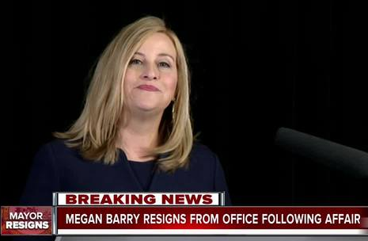
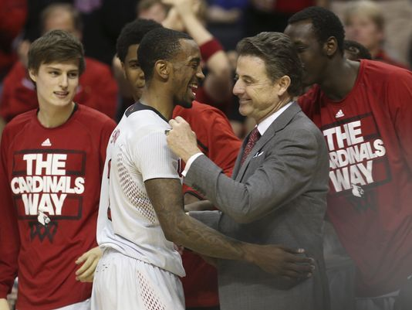
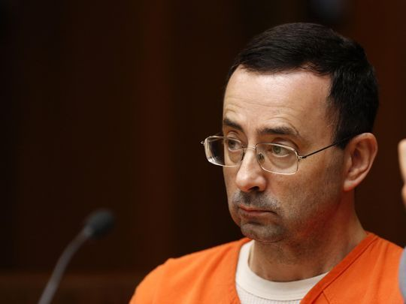

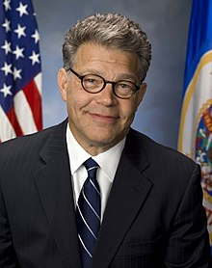
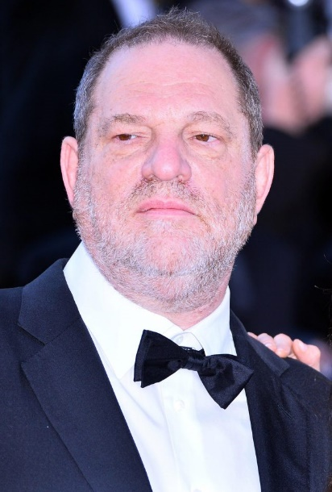
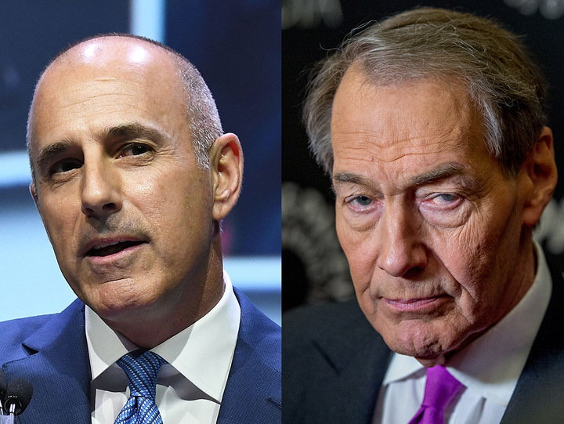
“Be sure your sin will find you out.”
Numbers 32:23

Slide 22
Our Heart Can Be Changed
Our heart can be changed for the worse!
  Hebrews 3:12-13
Our heart can be changed for the better!
  Our heart can be purified by our personal repentance (Matt. 23:25-26; James 4:8).
  Our heart can be cleansed from sin by God’s forgiveness (Ps. 51:10).
  Our heart can be renewed (Ezek. 36:25-27).

Slide 23

The Bible Heart
God Wants Our Heart
God Sees Our Heart
Our Heart Will Be Revealed
Our Heart Can Be Changed

