Slide 2

How We Know the Bible is Complete

Slide 3

“The entirety of Your word is truth, and every
one of Your righteous judgments endures forever” (Ps. 119:160).
“Every word of God is pure; He is a shield to those who put their trust in Him” (Prov. 30:5).
“All Scripture is given by inspiration of God, and is profitable for doctrine, for reproof, for correction, for instruction in righteousness” (2 Tim. 3:16).
What confidence can we have
that the 66 books of the Bible
constitute the entirety of God’s
revelation?

Slide 4
The Old Testament Looked Forward To More Revelation
A Prophet Like Moses
  Deuteronomy 18:15-19
  Moses was unique in that he was the mediator of a covenant.
  Another would come like Moses who would speak the words of God.
  The Old Testament closes without this Prophet appearing.

Slide 5
The Old Testament Looked Forward To More Revelation
A New Covenant
  Jeremiah 31:31-34
  The Old Testament closes without the giving of this new covenant.
  The new covenant was given through Christ (Heb. 8:6-13).
  Jesus is God’s spokesman for these “last days” (Heb. 1:1-2).

Slide 6
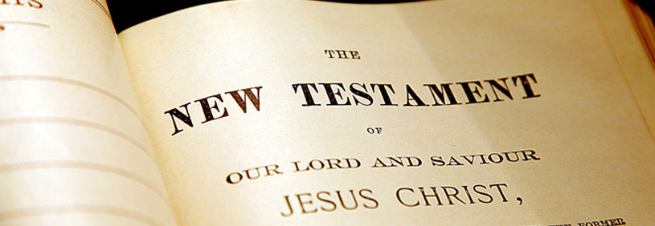
In stark contrast, the New Testament does not look forward to more revelation!

Slide 7
1. The Apostles were guided into all truth.
“But the Helper, the Holy Spirit, whom the Father will send in My name, He will teach you all things, and bring to your remembrance all things that I said to you” (John 14:26).
“I still have many things to say to you, but you cannot bear them now. However, when He, the Spirit of truth, has come, He will guide you into all truth; for He will not speak on His own authority, but whatever He hears He will speak; and He will tell you things to come” (John 16:12-13).

Slide 8
2. The Scriptures furnish us unto all good works.
“All Scripture is given by inspiration of God, and is profitable for doctrine, for reproof, for correction, for instruction in righteousness, that the man of God may be complete, thoroughly equipped for every good work” (2 Timothy 3:16-17).
All Scripture is Inspired
All Scripture is Profitable
All Scripture is All-Sufficient

Slide 9
3. God has given us all things that pertain to life and godliness.
“Grace and peace be multiplied to you in the knowledge of God and of Jesus our Lord, as His divine power has given to us all things that pertain to life and godliness, through the knowledge of Him who called us by glory and virtue” (2 Peter 1:2-3).

Slide 10
3. God has given us all things that pertain to life and godliness.
“Grace and peace be multiplied to you in the knowledge of God and of Jesus our Lord, as His divine power has given to us all things that pertain to life and godliness, through the knowledge of Him who called us by glory and virtue” (2 Peter 1:2-3).
This knowledge is found
in God’s word (Eph. 3:3-5).

Slide 11
4. The faith has been
“once for all” delivered.
“Beloved, while I was very diligent to write to you concerning our common salvation, I found it necessary to write to you exhorting you to contend earnestly for the faith which was once for all delivered to the saints” (Jude 3).

Slide 12
4. The faith has been
“once for all” delivered.
“Beloved, while I was very diligent to write to you concerning our common salvation, I found it necessary to write to you exhorting you to contend earnestly for the faith which was once for all delivered to the saints” (Jude 3).
Jesus was offered “once.”
Hebrews 9:28; 1 Peter 3:18
Does He need to be offered
again?

Slide 13
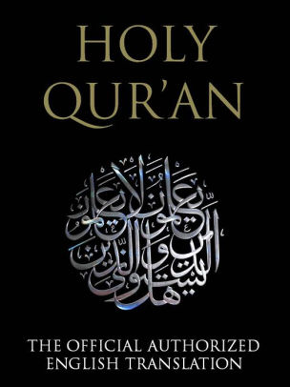
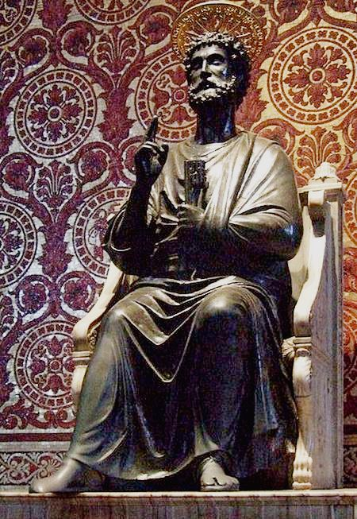
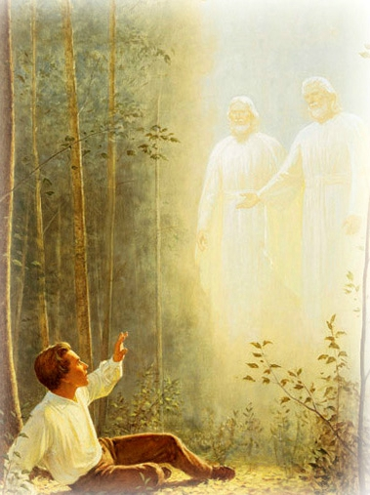
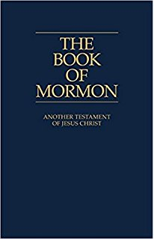
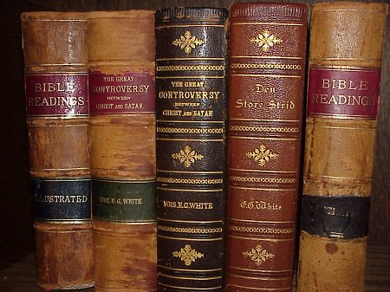
The Bible is complete.
We can have confidence that we have all of God’s word.
We must reject the claims of extra-biblical revelation.

