Slide 2
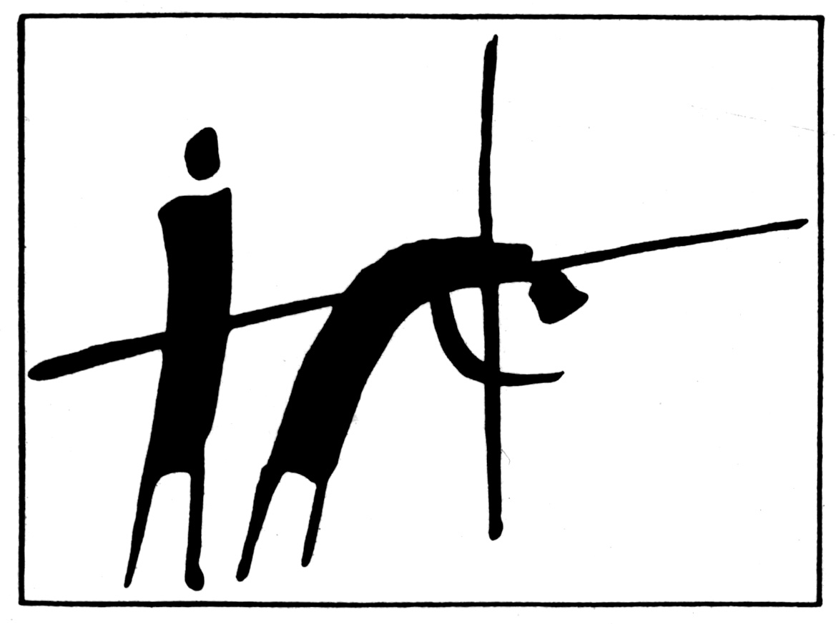
Simon of Cyrene

Slide 3
Simon of Cyrene
Then they compelled a certain man, Simon a Cyrenian, the father of Alexander and Rufus, as he was coming out of the country and passing by, to bear His cross.
Mark 15:21

Slide 4
Where was Cyrene?
A city in northern Africa along the coast of the Mediterranean Sea (modern day Tripoli, Libya).
There were citizens from Cyrene present at Pentecost (Acts 2:10).
The city was represented by a synagogue in Jerusalem (Acts 6:9).
Christians from Cyrene took the gospel to the Gentiles in Antioch (Acts 11:20).
One of the prophets in the church in Antioch was Lucius of Cyrene (Acts 13:1).

Slide 5
Lessons We Can Learn From
Simon of Cyrene
The cross of Jesus often places unexpected burdens upon people.
The cross of Jesus offers unexpected blessings to people.
We never know what a day will bring.
We must bear a cross if we are going to follow Jesus.

