Slide 2
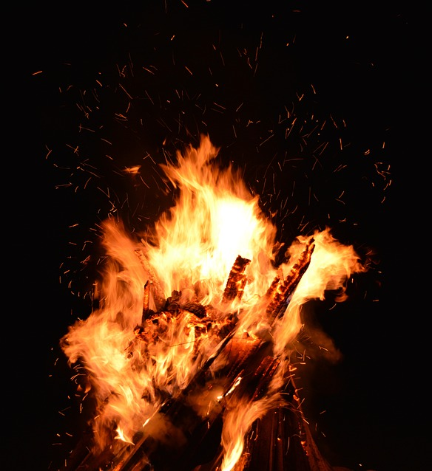
Zeal
What Happened To The Fire?

Slide 3
What Is Zeal?
The word zeal is translated from the Greek word zelos.
“Strive, desire, exert oneself earnestly, to be deeply concerned” (Arndt & Gingrich).
Zealous is translated from zeloo.
“To burn with zeal, to be heated, to boil… to desire earnestly, pursue… to strive after, busy oneself about” (Thayer).

Slide 4
How To Properly Express
Our Zeal
“Do not let your heart envy sinners, but be zealous for the fear of the Lord all the day” (Prov. 23:17).
The Jews were lost because they had a zeal for God, but not according to knowledge (Rom. 10:1-3).

Slide 5
How To Properly Express
Our Zeal
Worship
Evangelism
Bible Study
Doing Good

Slide 6
Where Zeal Comes From
How to Light the Fire!
Fear of Judgment - 2 Cor. 5:9-11
Love of Christ - 2 Cor. 5:14, 17-20
Worship - Heb. 10:24-25
Hearing God’s Word - Luke 24:27-33
Encouragement From Others
  Acts 11:22-24; 2 Cor. 9:2
The Success of the Gospel - Acts 15:3

