Slide 2
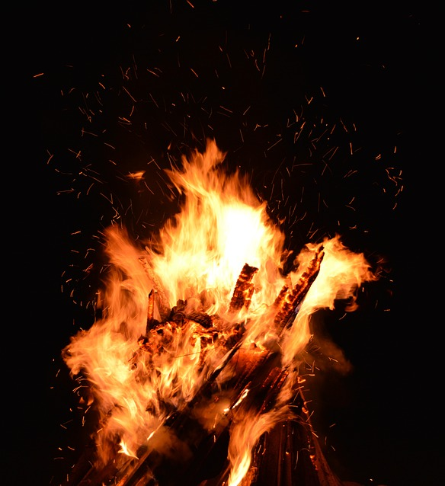
Zeal
What Happened To The Fire?

Slide 3
What Is Zeal?
The word zeal is translated from the Greek word zelos.
“Strive, desire, exert oneself earnestly, to be deeply concerned” (Arndt & Gingrich).
Zealous is translated from zeloo.
“To burn with zeal, to be heated, to boil… to desire earnestly, pursue… to strive after, busy oneself about” (Thayer).

Slide 4
What Is Zeal?
The English word zeal comes from the Greek word zelos.
“Intense ardor in the pursuit of some end; passionate eagerness in favor of a person or cause; earnest enthusiasm (for something or someone) as displayed in action” (World Book Dictionary).

Slide 5
What Is Zeal?
“let us run with endurance the race that is set before us” (Heb. 12:1)
“fight the good fight of faith” (1 Tim. 6:12)
“always abounding in the work of the Lord” (1 Cor. 15:58)
“whatever your hand finds to do, do it with your might” (Eccl. 9:10)

Slide 6
How To Properly Express
Our Zeal
“Do not let your heart envy sinners, but be zealous for the fear of the Lord all the day” (Prov. 23:17).
“But it is good to be zealous in a good thing always” (Gal. 4:18).

Slide 7
How To Properly Express
Our Zeal
The Jews were lost because they had a zeal for God, but not according to knowledge (Rom. 10:1-3).
Paul had the same problem (Acts 22:3; Gal. 1:14; Phil. 3:6).

Slide 8
How To Properly Express
Our Zeal
Worship
  John 4:23-24
  Matthew 15:8
  Ephesians 5:19

Slide 9
How To Properly Express
Our Zeal
Worship
Evangelism
  John 4:28-29
  Acts 8:4
  Acts 9:31
  Acts 11:22-24

Slide 10
How To Properly Express
Our Zeal
Worship
Evangelism
Bible Study
  Acts 17:11
  1 Thessalonians 2:13
  2 Timothy 2:15

Slide 11
How To Properly Express
Our Zeal
Worship
Evangelism
Bible Study
Doing Good
  Titus 2:14
  John 15:2, 6
  Matthew 25:30

Slide 12
Zeal
What Happened To The Fire?

