Slide 2
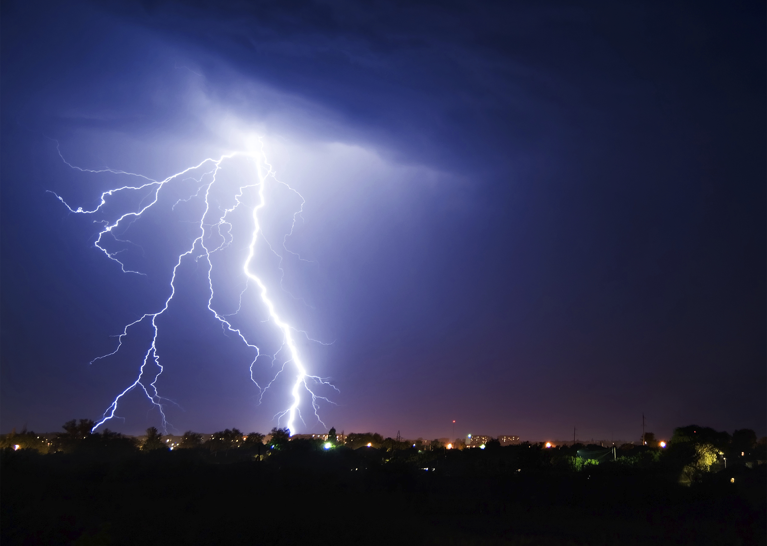
Respecting the Power of God’s Word

Slide 3
The Spoken Word of Deity
Has Great Power!
God spoke the physical creation into existence
(Ps. 33:6-9).
The Centurion’s servant was healed at the Lord’s word (Matt. 8:7-13).
The physical elements obeyed the voice of our Lord (Mark 4:38-41).
Lazarus rose from the dead at the Lord’s verbal command (John 11:43-44).

Slide 4
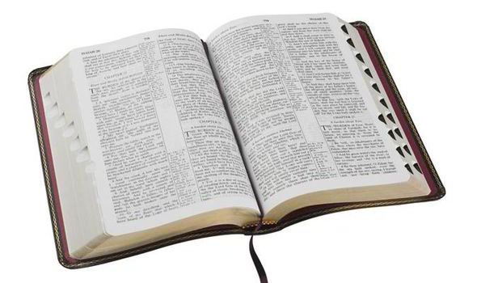
1. Written Word is Sufficient

Slide 5
1. Written Word is Sufficient
“All Scripture is given by inspiration of God, and is profitable for doctrine, for reproof, for correction, for instruction in righteousness, that the man of God may be complete, thoroughly equipped for every good work”
2 Timothy 3:16-17

Slide 6
1. Written Word is Sufficient
The sufficiency of God’s written word is shown in the repeated warnings not to add to or take away from the word.
  Rev. 22:18-19; Deut. 4:2; Prov. 30:5-6
God’s Word does not answer every possible question we may have (Deut. 29:29), but it does give us every answer and every piece of evidence
we need (John 20:30-31).

Slide 7
1. Written Word is Sufficient
Convert the Lost - Rom. 1:16
  We don’t need to resort to tricks, gimmicks, etc.
Govern the Church - 1 Tim. 3:14-15
  Instructions regarding the organization, work, worship, membership, etc.
Guide our Personal Lives - Ps. 119:105
  God’s word gives us all things
  that pertain to life and godliness
  (2 Pet. 1:3).

Slide 8
2. Written Word is Relevant
Neither God nor His Word have changed.
  Psalm 119:89
The needs of man have not changed.
  Romans 3:23; 6:23
The needs of society have not changed.

Slide 9
2. Written Word is Relevant
Neither God nor His Word have changed.
  Psalm 119:89
The needs of man have not changed.
  Romans 3:23; 6:23
The needs of society have not changed.
Crime and Punishment (Eccl. 8:11)
Role of Civil Government (Rom. 13:1-6)
Prejudice (Rom. 2:11)
Welfare Abuse (2 Thess. 3:10)
Drugs and Alcohol (abstinence - Prov. 23:29-35)
Teen Pregnancy (abstinence - 1 Cor. 6:18, Heb. 13:4)
Homosexuality (1 Cor. 6:9-10)
Same-Sex Marriages (Matt. 19:4-6)
Divorce (Matt. 19:9)
Family Problems (Col. 3:18-21)
Terrorism (Rom. 12:18)

Slide 10
3. Written Word is Punitive
The penalty for sin is death (Gen. 2:17; 3:19)
Nadab and Abihu (Lev. 10:1-2)
Uzza and the ark (1 Chron. 13:7-10; 15:2, 13)
Our works will be judged (Eccl. 12:13-14)
According to the words of the Lord (John 12:48)

Slide 11
3. Written Word is Punitive
“Therefore we must give the more earnest heed to the things we have heard, lest we drift away.
For if the word spoken through angels proved steadfast, and every transgression and disobedience received a just reward,
how shall we escape if we neglect so great a salvation, which at the first began to be spoken by the Lord, and was confirmed to us by those who heard Him”
Hebrews 2:1-3

Slide 12

We cannot walk in the fear of the Lord without reverencing and respecting
His written word.

