Slide 2
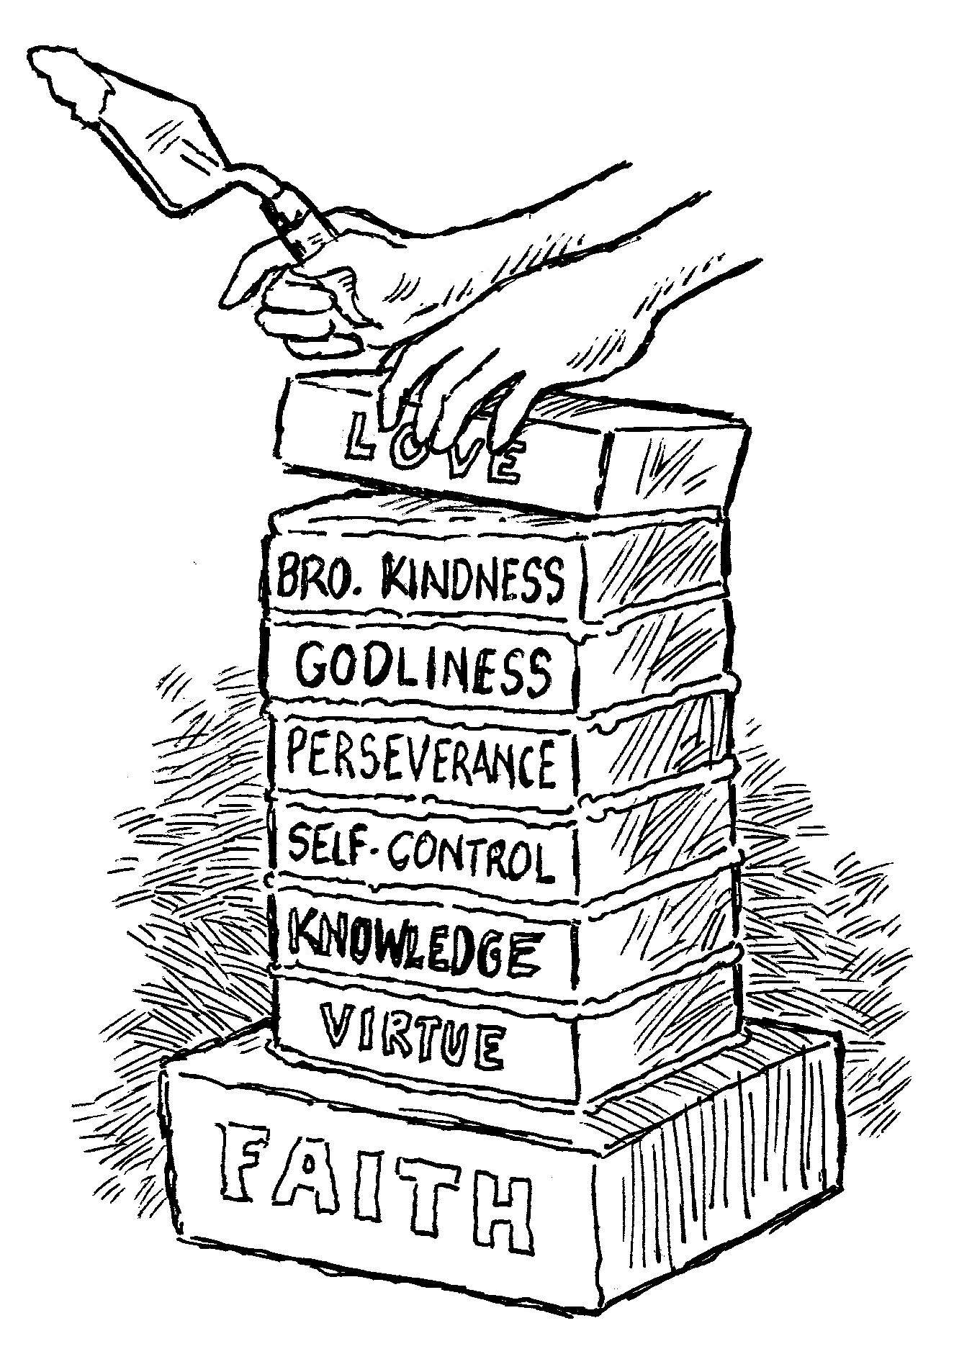
add to your faith…
Love
2 Peter 1:5-7

Slide 3
Love / Charity
Eros refers to physical or sexual love. This word does not appear in the New Testament.
Storge refers to the bond and affection shared between family members.
Philia refers to the emotional love and affection one feels for another.
Agape is “active goodwill.”
  Rarely used in secular Greek, but is the most commonly used word for love in the New Testament.

Slide 4
Love / Charity
Agape - “is not an impulse from the feelings, it does not always run with the natural inclinations, nor does it spend itself only upon those for whom some affinity is discovered. Love seeks the welfare of all, and works no ill to any. Love seeks opportunity to do good to all men, and especially toward them that are of the household of faith” (Vine).

Slide 5
Love Described - 1 Cor. 13:4-7
suffers long
is kind
does not envy
does not parade itself, is not puffed up
does not behave rudely
does not seek its own
is not provoked
thinks no evil
does not rejoice in iniquity, but rejoices in the truth
bears all things
believes all things
hopes all things
endures all things

Slide 6
Learning How To Love
God teaches us how to love (1 Thess. 4:9).
“Beloved, let us love one another, for love is of God; and everyone who loves is born of God and knows God. He who does not love does not know God, for God is love” (1 John 4:7-8).

Slide 7
Learning How To Love
Love is expressed in action.
“In this the love of God was manifested toward us, that God has sent…” (1 John 4:9).
“God so loved the world that He gave…”
(John 3:16).

Slide 8
Learning How To Love
Love is motivated by goodwill, not by emotion or merit.
“In this is love, not that we loved God, but that He loved us and sent His Son to be the propitiation for our sins” (1 John 4:10).
Romans 5:6-8

Slide 9
Learning How To Love
Love must be shown to everyone.
“Beloved, if God so loved us, we also ought to love one another” (1 John 4:11).
God (Matt. 22:37)
Neighbor (Matt. 22:39)
Enemies (Matt. 5:43-48)

Slide 10
Learning How To Love
We are taught by God how to love others.
God does not teach us to only love our friends. He teaches us by His example to love those who curse us, hate us, use us, and persecute us.
It is in the obtaining of this virtue that we can become partakers of the divine nature.
When we learn how to love others the way God loves them, we are learning how to act like God.

Slide 11
“By which have been given to us exceedingly great and precious promises, that through these you may be partakers of the divine nature…”
2 Peter 1:4

