Slide 2
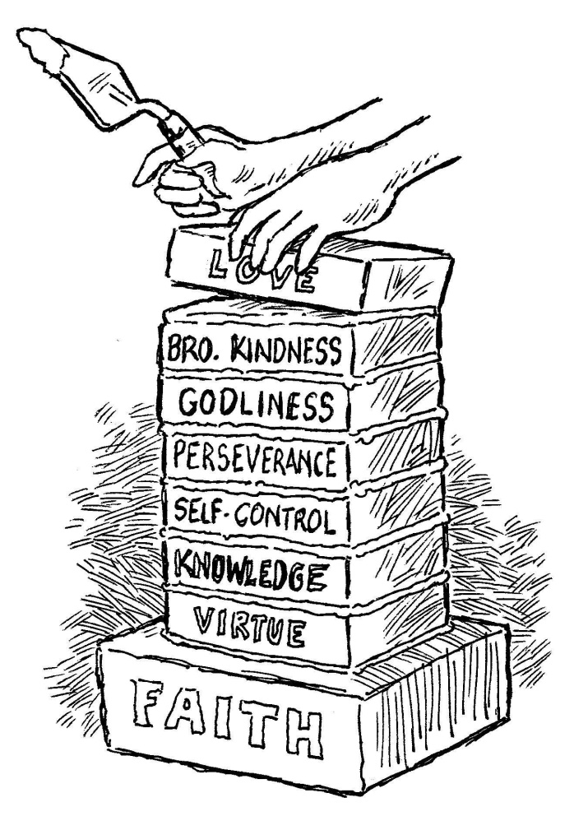
add to your faith…
Brotherly
Kindness
2 Peter 1:5-7

Slide 3
Brotherly Kindness
Translated from the Greek word philadelphia.
“It is a compound of philos, affection or kindness or to wish one well, and adelphos, brother.”
“The love of brothers (or sisters), brotherly love; in the N.T. the love which Christians cherish for each other as ‘brethren’” (Thayer)
It is affection and kindness directed specifically towards our brethren.

Slide 4
Importance of Brotherly Kindness
Proves our love for God.
  1 John 4:20-5:1
Identifies us as disciples of Christ.
  John 13:34-35
Binds believers together.
  Col. 2:2; 3:14; 1 Cor. 12:25-26

Slide 5
How We Obtain
Brotherly Kindness
We are taught by God.
  1 Thess. 4:9
Jesus shows us how to treat others.
  John 14:9
  Matt. 9:35-36; 11:5
  Luke 9:51-56; 22:50-51; 23:34

Slide 6
How Brotherly Kindness Is Shown
Being Kind and Affectionate To Our Brethren
  Rom. 12:10; Acts 2:46; 4:32
Giving Preference To Our Brethren
  Rom. 12:10; Phil. 2:3-4
Helping Our Brethren In Need
  Rom. 12:13; Gal. 6:10; 1 John 3:17-18
Sympathizing With Our Brethren
  Rom. 12:15; 1Cor. 12:25-26; Gal. 6:2

Slide 7
How Brotherly Kindness Is Shown
Correcting and Restoring Our Brethren
  Gal. 6:1; James 5:19-20; Matt. 7:3-5
Forgiving Our Brethren
  Individually - Eph. 4:32; Col. 3:13
  Congregationally - 2 Cor. 2:6-8

