Slide 2
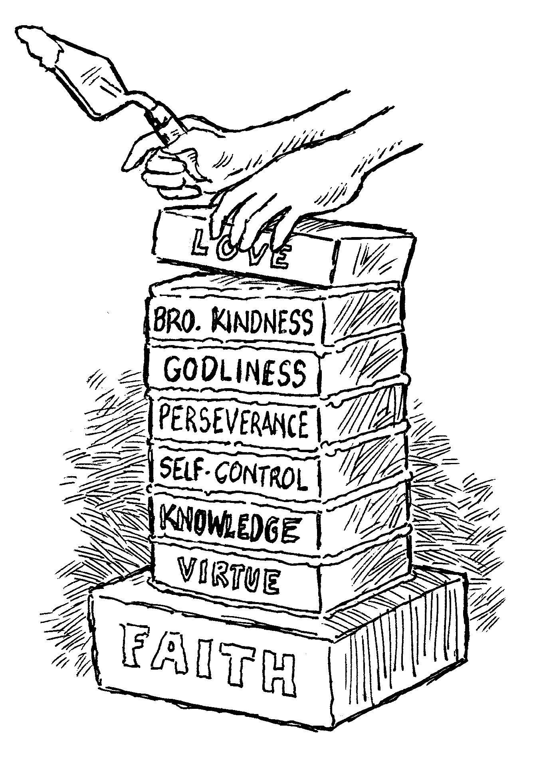
add to your faith…
Godliness
2 Peter 1:5-7

Slide 3
Godliness
Eusebeia is a compound word:
eu – “well,” sebomai – “to be devout”
“reverence, respect; piety towards God” (Thayer).
“that piety which, characterized by a Godward attitude, does that which is well-pleasing to Him” (Vine).

Slide 4
Godliness
Godliness is not “God-likeness.”
Should be understood as “God-towardness.”
Godliness is a reverence towards God that has grown out of a feeling of dependence upon God and a deep regard for His majesty and glory, which expresses itself in our worship, our attitudes, and our manner of life.

Slide 5
Godliness
Godliness brings the reality of God into every other characteristic mentioned by Peter:
  We are virtuous (courageous),
  We strive to obtain knowledge,
  We deny self and practice self-control,
  We persevere despite the hardships...
Because We Reverence GOD!

Slide 6
Why We Need Godliness
Nadab and Abihu were destroyed because they were irreverent before God.
  Lev. 10:1-3; Ps. 89:7; Heb. 12:28-29
Eli and his sons were cut off from God because of their lack of reverence.
  1 Sam. 2:12-17, 22, 27-29; 3:13

Slide 7
Godliness Develops the Proper Attitudes Towards the Things of God
The Church
  Matt. 16:18; Acts 20:28; Eph. 5:25-27
The Truth
  Ps. 119:89; Rev. 22:18-19
Our Fellow Man
  Gen. 9:6; 1 Pet. 2:17
Marriage and Sexuality
  Matt. 19:4-6; Heb.13:4; Rom. 9:20

Slide 8

How To Develop Godliness
Bible Study
  1 Tim. 6:3; Titus 1:1
Worship
  Ps. 18:3; Rev. 4:11; 5:12
Prayer
  Matt. 6:9-13; Phil. 4:6;
  1 Pet. 5:7
“exercise yourself toward godliness”
1 Timothy 4:7

