Slide 1
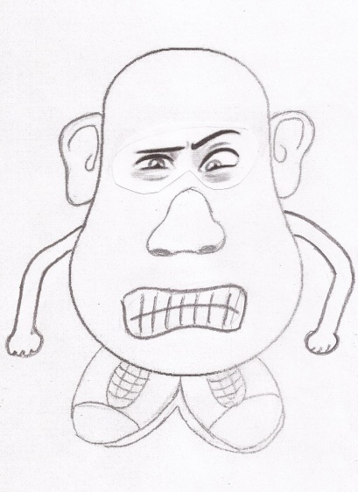
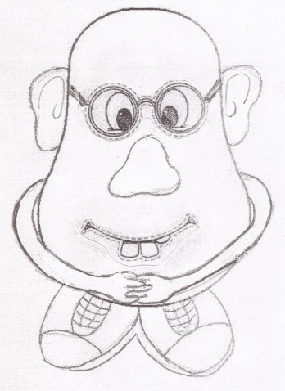
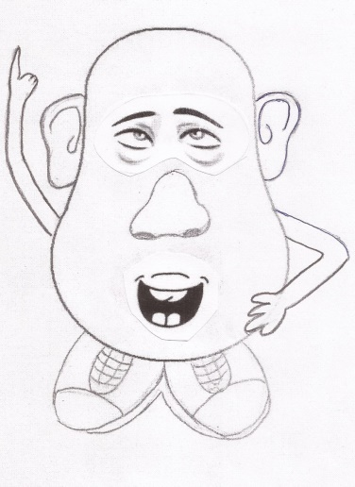
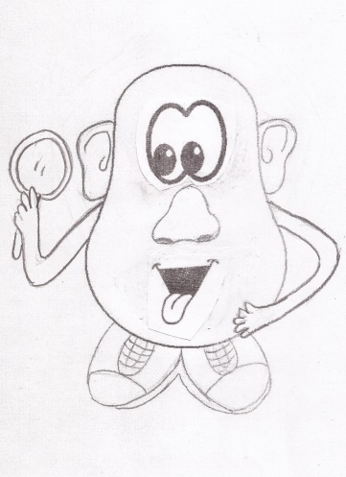
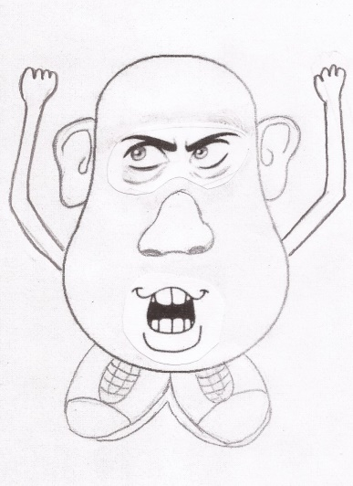
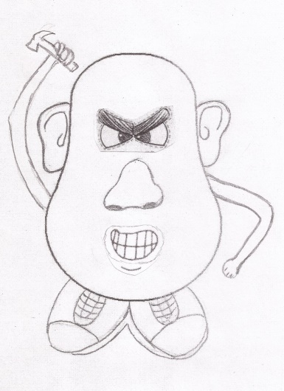
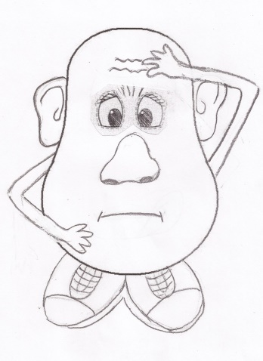
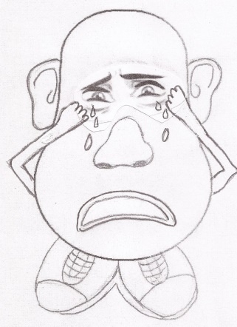
Beware
of the Tator Family

Slide 2
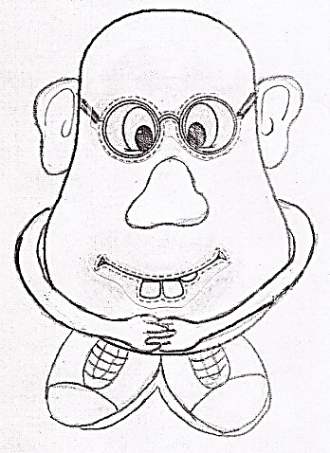
Beware of
Spec-Tator
Here’s the Problem!
What’s the Solution?
Sit and watch!
Complain and criticize!
Offer no help!
1 Cor. 15:58
Eccl. 10:18
Prov. 13:4
Active
Worker for the Lord
Always abounding

Slide 3
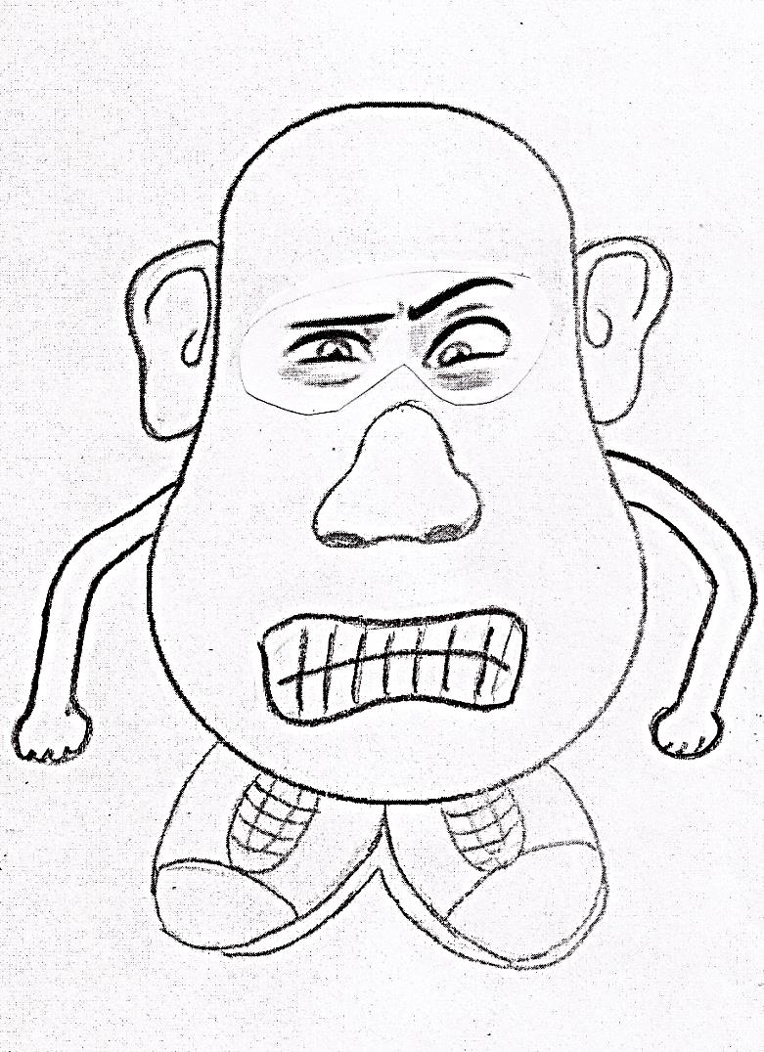
Beware of
Agi-Tator
Here’s the Problem!
What’s the Solution?
Trouble-maker
Harsh false accusations
Turning br. from the faith
Rom. 14:19
Eph. 4:29
Acts 13:8-10
Show Peacefulness and Edification.
Impart grace.

Slide 4
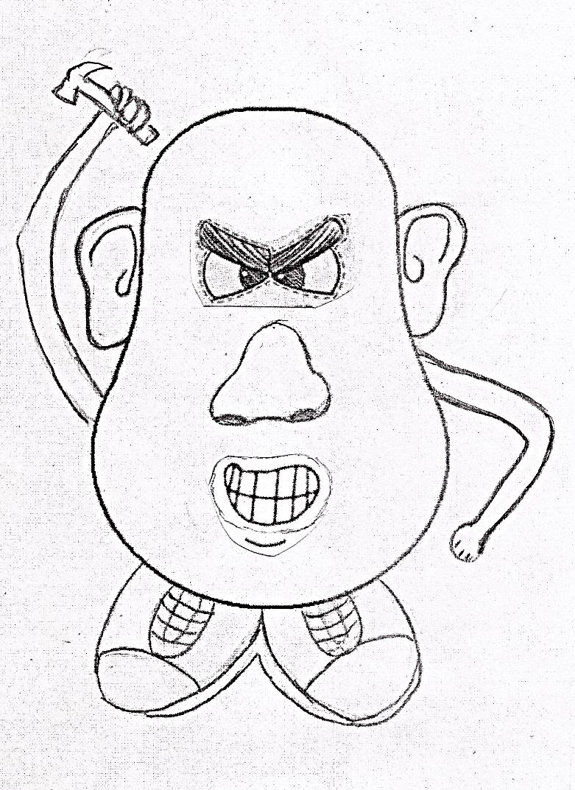
Beware of
Devas-Tator
Here’s the Problem!
What’s the Solution?
Shows no love or kindness
Sour attitude
Never a kind word
Uses Tongue as a living fire of destruction.
Tit. 3:1-2
Eph. 4:32
Jas. 3:6
Speak kindness.
Be Tenderhearted, gentle, humble and
Forgiving.

Slide 5
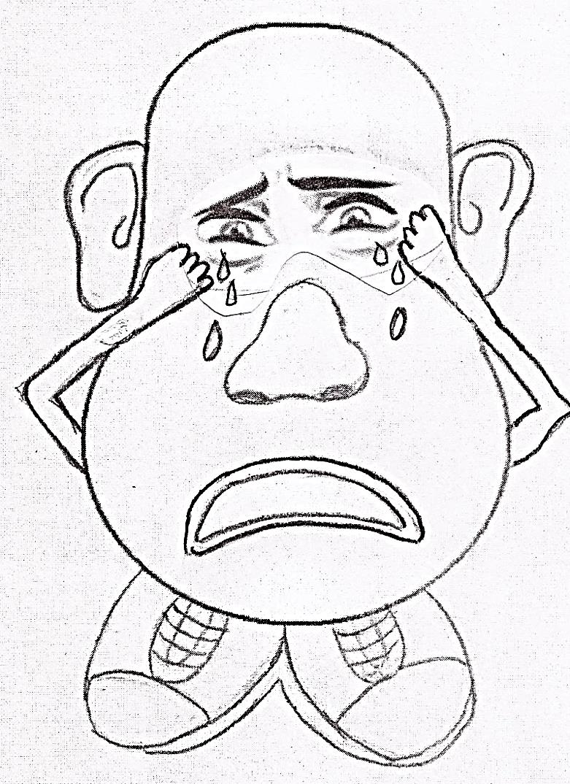
Beware of
Lamen-Tator
Here’s the Problem!
What’s the Solution?
Easily offended, holds grudges, prideful,
1 Cor. 10:13
Phil. 4:11
Ex. 5:1-22; 14:11-22; 15:22; 16:1-4
Show Brotherly kindness and love.

Slide 6
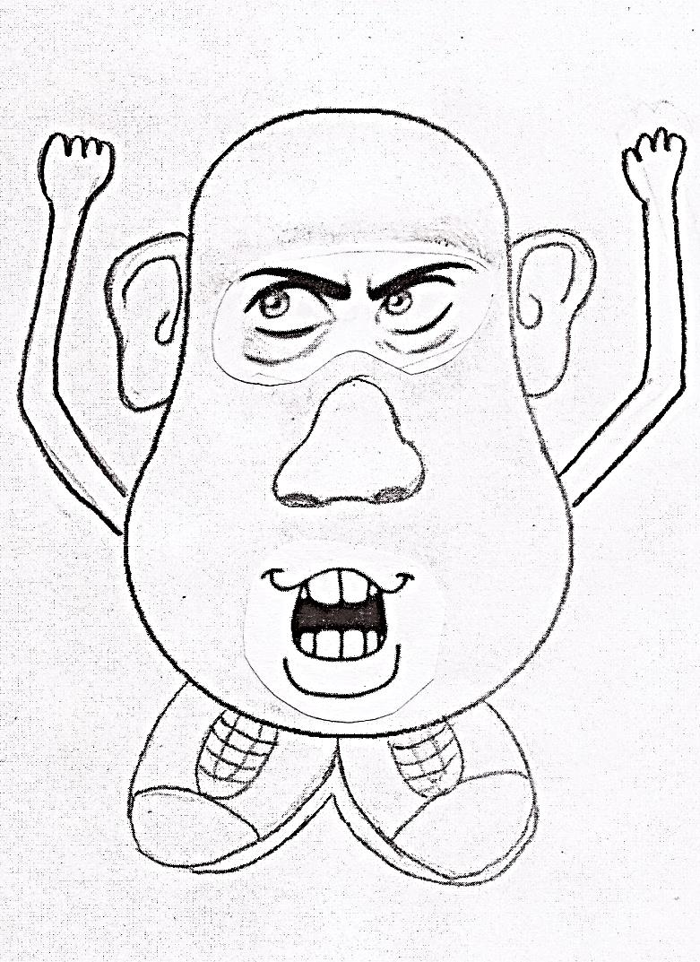
Beware of
Dic-Tator
Here’s the Problem !
What’s the Solution?
Full of Pride and Arrogance, desires leadership and rule of the church.
3 Jn. 1:11,
Prov. 29:23;
3 Jn. 1:9-10,
Prov. 16:18;
Follow not evil.
Show humility.
Show servitude.

Slide 7
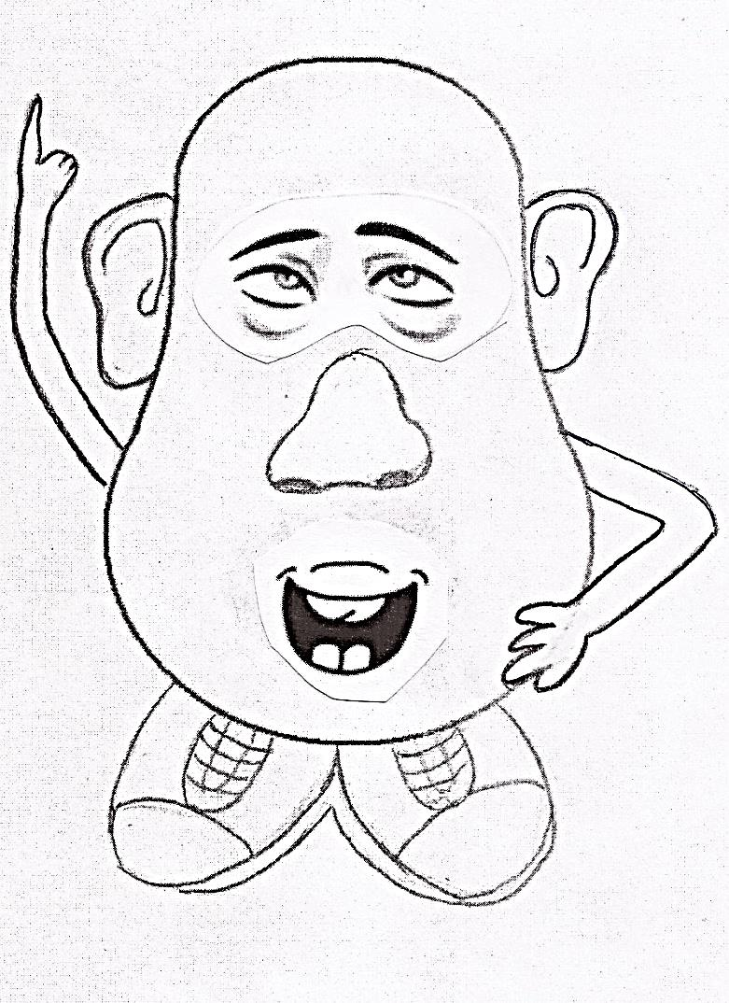
Beware of
Commen-Tator
Here’s the Problem!
What’s the Solution?
Knows it all and glorifies self.
1 Pet. 4:11
Prov. 17:7;
Mk.12:38-40
Speak only as God would have us to speak.
Give God the glory.

Slide 8
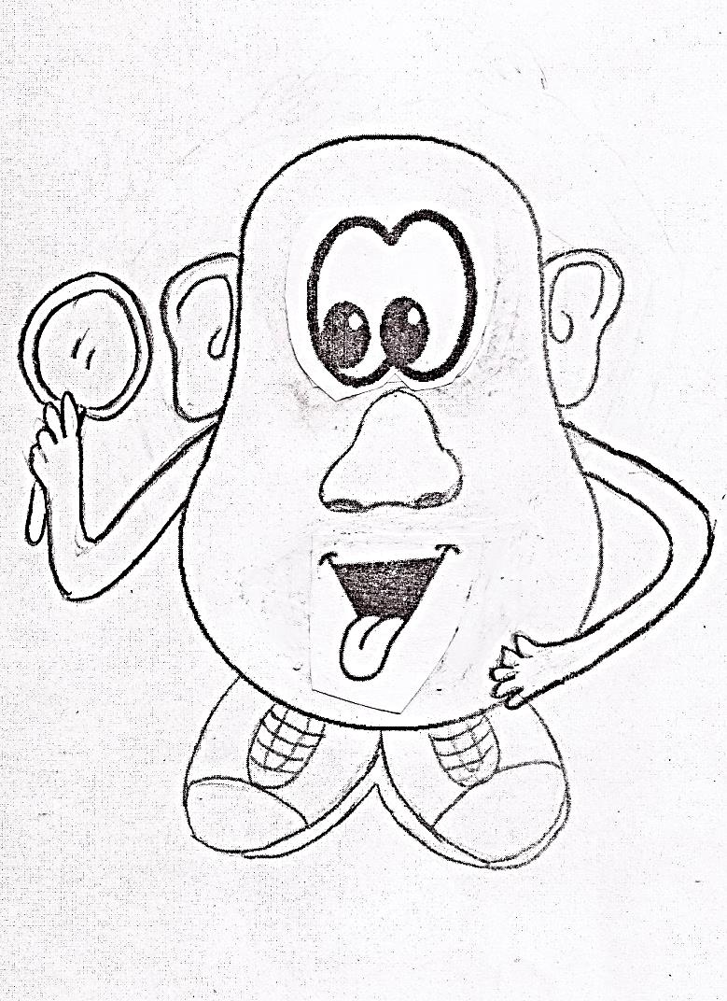
Beware of
Imi-Tator
Here’s the Problem!
What’s the Solution?
Follows the crowd, seldom studies for self
1 Cor. 11:1-2
Matt. 6:33;
Acts 17:11-12
2 Tim. 2:15
Mk 15:15
Eph. 4:14
Work out your own salvation, seek first the kingdom. Search the scriptures daily.

Slide 9
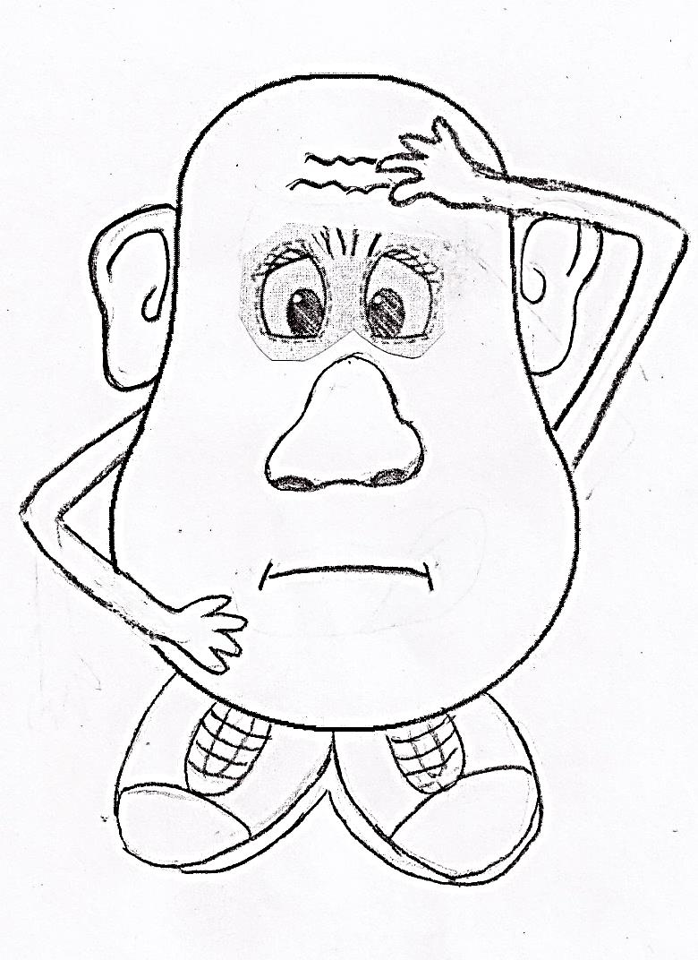
Beware of
Hesi-Tator
Here’s the Problem!
What’s the Solution?
Knows what to do…but won’t concede to God’s ways. Almost persuaded.
No commitment
Acts 4:12
2 Cor. 6:2
Acts 24:25; 26:28;
Salvation is in God alone.
Obey Now.

Slide 10
Have you seen
the Tator Family ?

Slide 11
What have we learned?
Be steadfast, unmovable, abounding for the Lord!
Be Peaceful and build up the church!
Be kind, tenderhearted, loving, humble and forgiving!
Be Happy and content!
Be respectful and considerate to God’s law!
Speak the truth always!
Imitate Godliness!
Be Obedient and Faithful to God’s Word!

