Slide 1
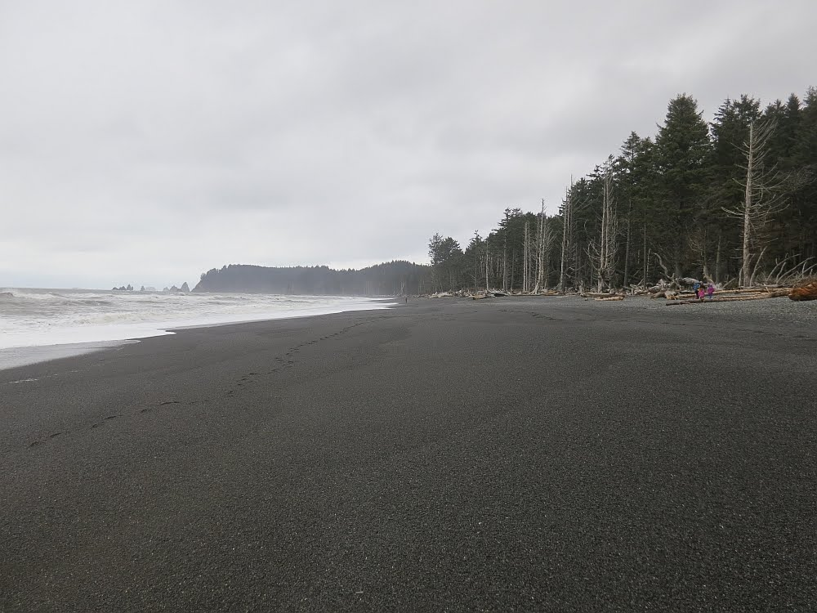
We ALL Can Make a Difference

Slide 2

Joshua –
A Great Leader
Joshua 24:31
“Israel served the Lord all the days of Joshua, and all the of the elders who outlived Joshua and had known all the works that the Lord did for Israel”.

Slide 3
Joshua –
A Great Leader
Joshua Was A:
      Man of Humility
      Man of Faith and Trust in God
      Man of God’s Word

Slide 4
Joshua –
A Great Leader
Joshua Was A:
      Man of Prayer
      Man who put God First

Slide 5
Joshua –
A Great Leader
Fear the Lord
Serve Him in Sincerity and in Faithfulness
Put away the gods
You are not able to serve the Lord, for He is a holy God…a Jealous God
Incline your heart
Far be it from us that we should forsake the Lord
No, But we will serve the Lord
The Lord our God we will serve, and his voice we will obey

Slide 6
Joshua –
A Great Leader
Joshua 24:31
“Israel served the Lord all the days of Joshua, and all the of the elders who outlived Joshua and had known all the works that the Lord did for Israel”.

Slide 7
Joshua –
A Great Leader
Where Will The Next Generation Be?
“As for me and my house, We will Serve the Lord”
“There arose another generation after them that Did Not Know the Lord”

Slide 8


