Slide 2
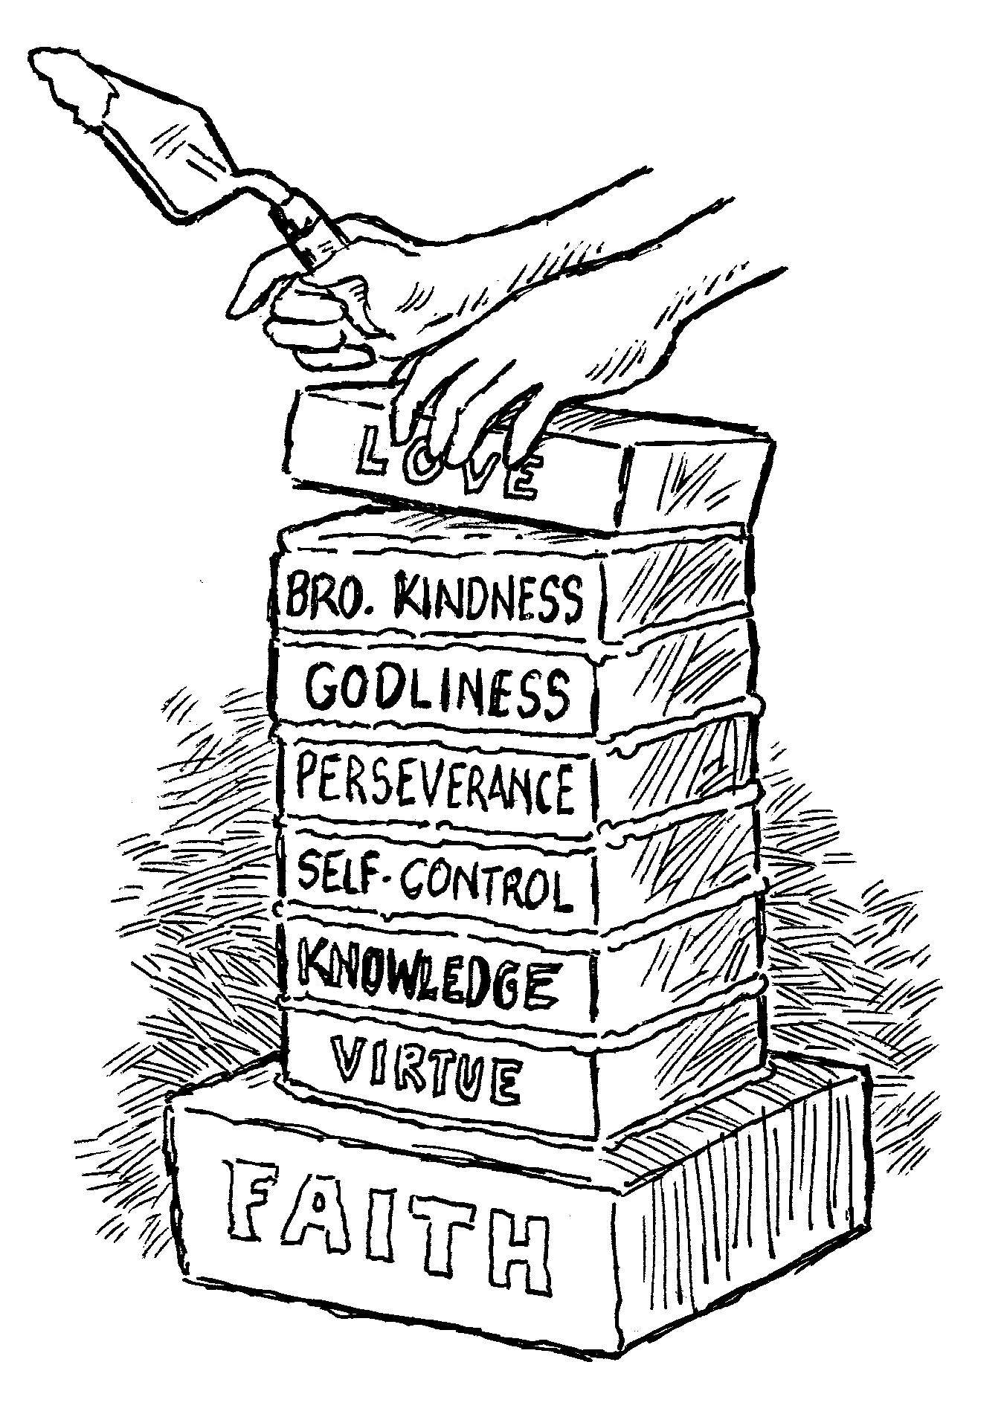
add to your faith…
Perseverance
2 Peter 1:5-7

Slide 3
Perseverance
Hupomone is a compound word:
hupo – “under,” meno – “to abide.”
“An abiding under” (Vine).
“Steadfastness, constancy, endurance. The character of a man who is not swerved from his deliberate purpose and his loyalty to faith and piety by even the greatest of trials and sufferings” (Thayer).

Slide 4

Perseverance
Patience is the ability to wait, which is necessary because we must wait on the Lord.
Perseverance is the ability to bear under hardships, to keep from giving up. It is a resolute determination to steadfastly move on toward the goal no matter what the obstacles. The ability to remain constant in what we are doing.

Slide 5
Why We Need Perseverance
Because of Self-Control
  Proverbs 23:17-18
Because the Way is Difficult
  Matthew 7:13-14
Because We Are Not There Yet
  Hebrews 10:36-39; 2 Peter 1:10-11
Because Persecutions Will Come
  2 Timothy 3:12; John 15:19-21

Slide 6
How Perseverance Works
The passive side of perseverance is endurance:
the ability to patiently bear under trials and persecutions.
  Romans 12:12
  2 Timothy 2:3
  Matthew 13:20-21

Slide 7

How Perseverance Works
The active side of perseverance is persistence:
the ability to keep moving forward.
Running a Race
  Hebrews 12:1
Doing Good
  Romans 2:7-10; Galatians 6:9
Bearing Fruit
  Luke 8:15; James 5:7-8

Slide 8
How To Develop Perseverance
By Persevering
  James 1:2-4; Romans 5:3-4
Following the Right Examples
  James 5:10-11
Faith in the Reward
  Romans 8:18; 2 Corinthians 4:16-18
Dedication
  2 Timothy 3:12-17

Slide 9
Perseverance
The devil will do whatever he can to discourage us and cause us to quit on the Lord.
The way is hard, the days are long and the toil is tiresome, but our soul is too precious and Heaven is too great for us to quit.
“And we desire that each one of you show the same diligence to the full assurance of hope until the end, that you do not become sluggish, but imitate those who through faith and patience inherit the promises” (Heb. 6:11-12).

Slide 10
Perseverance
“It is not the patience which can sit down and bow its head and let things descend upon it and passively endure until the storm is past… It is the spirit which can bear things, not simply with resignation, but with blazing hope; it is not the spirit which sits statically enduring in the one place, but the spirit which bears things because it knows that these things are leading to a goal of glory; it is not the patience which grimly waits for the end, but the patience which radiantly hopes for the dawn…”
William Barclay, “New Testament Words”

