Slide 2
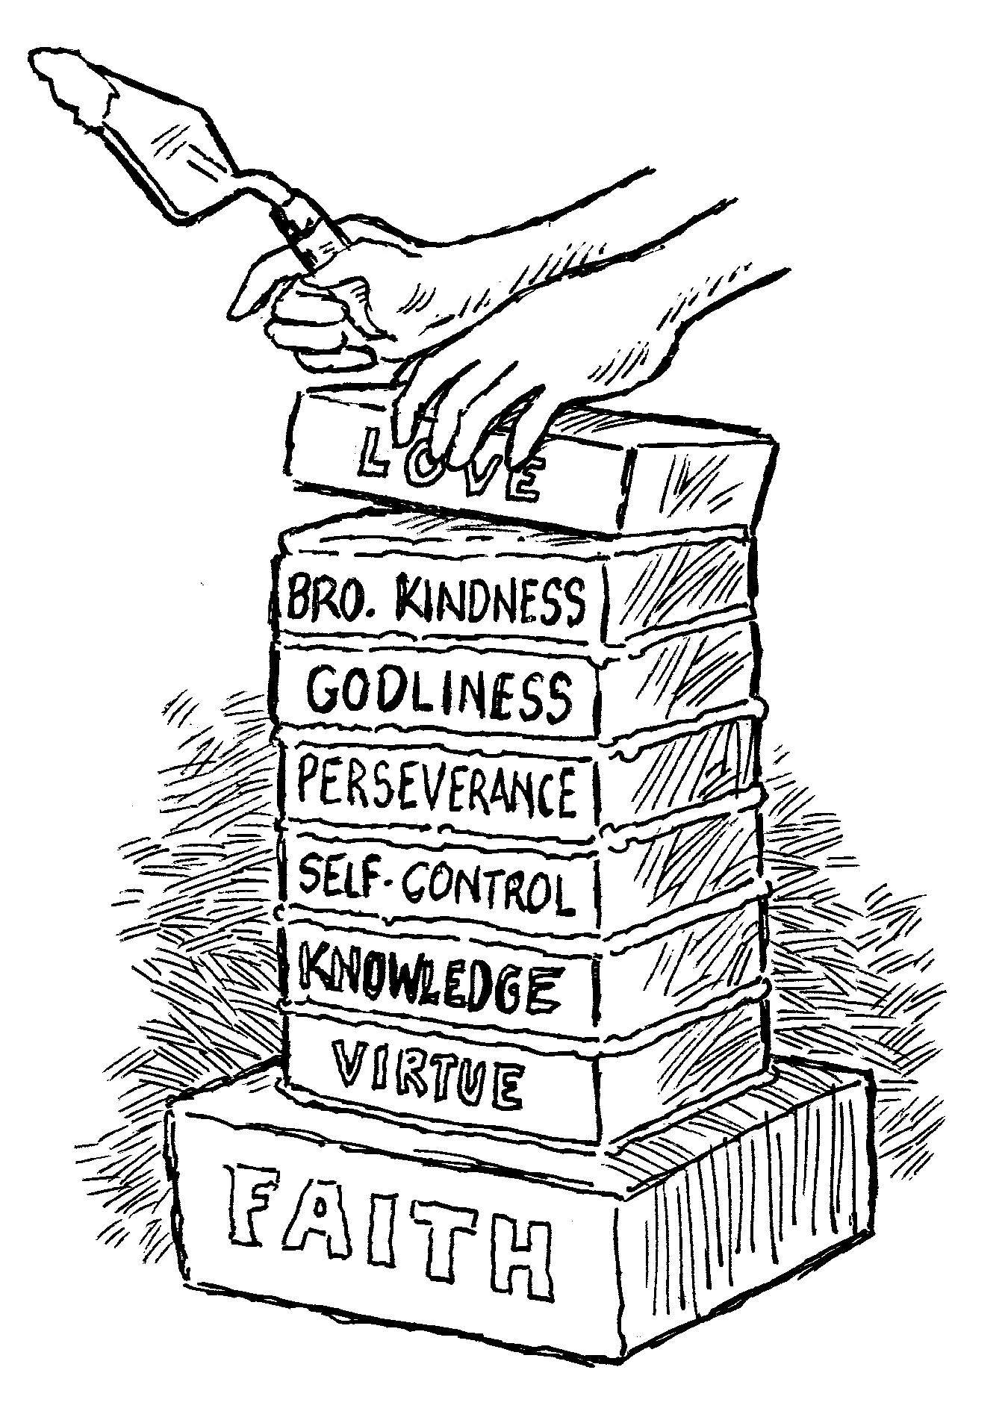
add to your faith…
Knowledge
2 Peter 1:5-7

Slide 3
Knowledge
Insight, understanding, comprehension, knowing, grasping.
A clear understanding of fact, truth, and duty.
Knowledge must be sought with diligence.
  Matt. 11:29; 28:20; Eph. 5:17; Heb. 5:12-14

Slide 4
Virtue and Knowledge
Courage (virtue) without knowledge can be misguided and dangerous (Rom. 10:1-3).
Knowledge without courage is useless (James 4:17).
Knowledge gives our virtue proper guidance, while virtue gives our knowledge usefulness and validation.

Slide 5
The Tragedy of Ignorance
Separates Us From the Life of God
  Eph. 4:17-18; John 6:63, 68
Causes Us To Live In Lust
  Eph. 4:19-24; 1 Pet. 1:13-15
Will Believe and Live in Error
  Matt. 22:29

Slide 6
The Tragedy of Ignorance
We Will Twist the Scriptures
  2 Pet. 3:16; 2 Tim. 2:15
Results in Eternal Destruction
  Hosea 4:6; Acts 17:30-31

Slide 7
The Importance of Knowledge
Unlocks the Shackles of Sin
  John 8:31-36; Rom. 6:16-18; 2 Pet. 2:20
Prohibits Sin in Our Life
  Ps. 119:11; Matt. 4:1-11
Increases Our Spiritual Strength, Stability and Fruitfulness
  Ps. 1:1-3; Col. 1:9-11
Grace and Peace Will Be Multiplied Unto Us
  2 Pet. 1:2

Slide 8
We Must Give All Diligence To…
Seek Knowledge: “The heart of him who has understanding seeks knowledge…” (Prov. 15:14)
Acquire Knowledge: “The heart of the prudent acquires knowledge…” (Prov. 18:15).
Receive Knowledge: “For if we sin willfully after we have received the knowledge of the truth…”
(Heb. 10:26).
Grow In Knowledge: “But grow in the grace and knowledge of our Lord and Savior Jesus Christ…”
(2 Pet. 3:18).
Abound In Knowledge: “And this I pray, that your love may abound still more and more in knowledge and all discernment” (Phil. 1:9).

