Slide 1

Faces of Faith
Hebrews 12:1
A Known Faith
Hebrews 11:1

Slide 2

Faces of Faith
Hebrews 12:1
Two Truths about Faith…
We must believe that God exists
We must believe that God is a rewarder of those who diligently seek Him.

Slide 3
Faces of Faith
Hebrews 12:1
Determination
Obedience
Courage
Virtue
Conviction
Value
Sacrifice
Giving
Best
Commitment
Genuine

Slide 4
Faces of Faith
Hebrews 12:1
Faith…
is very personal
the substance of things hoped for
the evidence of things not seen

Slide 5
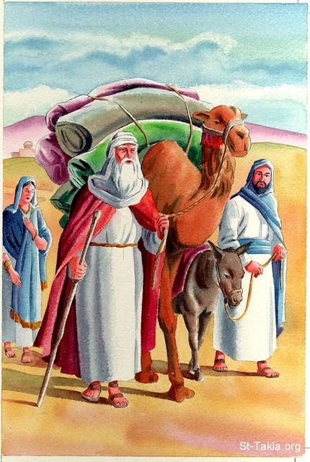
Abraham’s Faith
Hebrews 11:8
Hebrews 11:9-10
Hebrews 11:13-16
Hebrews 11:17-19
A Known Faith
is Obedient

Slide 6
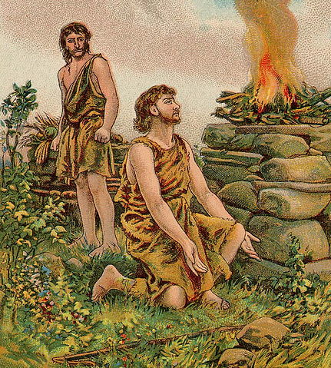
Abel’s Faith
Hebrews 11:4
Genesis 4:4
A Known Faith
Gives Its Best to God

Slide 7
Faces of Faith
Hebrews 12:1
A Known Faith
Is Obedient
Gives Its Best to God
Hebrews 11:1

