Slide 2

Establishing Bible Authority

Slide 3
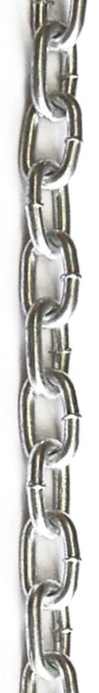
God’s Chain of Authority
God has all authority.
God has given all authority to His Son.
  Matt. 28:18; Heb. 1:1-2
Jesus gave authority to His apostles.
  John 16:12-13
Inspired men wrote the Word of God.
  2 Tim. 3:16-17

Slide 4
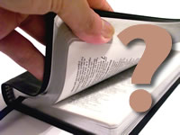
How To Establish Bible Authority
How can we learn of God’s authority for us from the Bible?
How can we establish the fact that God has authorized something?
How can we understand what the
Bible tells us to do?
How can we properly apply the
teaching of the Bible to our
lives today?

Slide 5
1. Direct Statement or Command
A direct statement, because it is found in God’s Word, has the force of a divine decree.
It represents that which God has communicated to man and must be believed and trusted.
In the beginning, God created the heavens and the earth (Gen. 1:1).
Jesus is God’s Son (Matt. 17:5).

Slide 6
1. Direct Statement or Command
The Bible also contains positive commands and negative prohibitions.
Obedience to these commands certainly shows we are acting within God’s authority.
All must repent (Acts 17:30).
Weekly contribution (1 Cor. 16:2).
Flee sexual immorality (1 Cor. 6:18).
Keep yourself from idols (1 John 5:21).

Slide 7
2. Approved Apostolic Example
The beliefs and practices of the early church, under the guidance of the inspired apostles, were meant to be seen as a pattern to be followed by every Christian of every generation.
“Brethren, join in following my example, and note those who so walk, as you have us for a pattern” (Phil. 3:17).

Slide 8
3. Necessary Inference
A necessary inference is an essential conclusion drawn from a statement, command or example found in the Bible.
It is when we aren’t told something specifically, but we realize it must be true by drawing a conclusion from what we are told.
John 5:17-18
John 8:58-59
Matthew 22:31-32

Slide 9
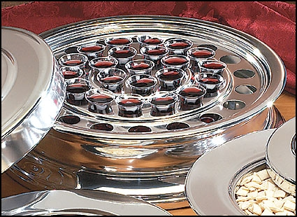
The Lord’s Supper

Slide 10
The Lord’s Supper
Statement or Command
We are commanded to partake of the Lord’s Supper (1 Cor. 11:23-26).
Through statements we learn it is a memorial of the Lord’s body and blood.

Slide 11
The Lord’s Supper
Approved Example
We are to partake of the Lord’s Supper on the first day of the week (Acts 20:6-7).

Slide 12
The Lord’s Supper
Necessary Inference
Every week has a first day, so we understand the disciples at Troas met every first day of the week to partake of the Lord’s Supper (Acts 20:7).
The Jews understood the command to keep the Sabbath meant every Sabbath Day (Ex. 31:13-14).
We know the bread used in the Lord’s Supper must be unleavened bread. That is all Jesus would have had during Passover (Luke 22:1, 15, 19).

Slide 13
Establishing Bible Authority

