Slide 1


Slide 2
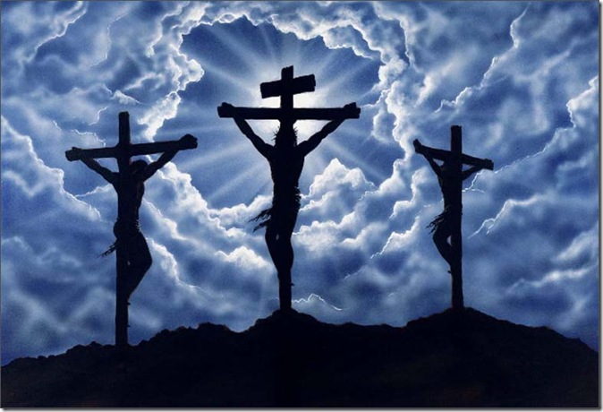
Why 3 crosses?

