Slide 2
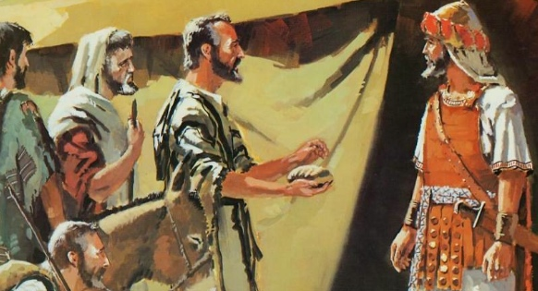
The Treaty With the Gibeonites
Joshua 9

Slide 3
Instructions Regarding the Inhabitants of Canaan
Exodus 23:27-33
They were not to make any treaty with the inhabitants of the land, nor were they to allow them to dwell in the land.
  Israel was to be a holy nation, separated from the gods of the heathen nations.
  Israel was God’s instrument of punishment against these nations for their sin (Deut. 9:4-5).

Slide 4
Lessons We Need To Learn
The Importance of Seeking God’s Counsel - v. 14
  Prov. 3:5-8; 2 Tim. 3:16-17
We Must Be Sober and Alert
  Rev. 12:9; 1 Pet. 5:8
There Are Some “Treaties” We Should Not Make
  2 Cor. 6:14-18; 1 Pet. 4:1-4
We Must Honor Our Word - vs. 18-19
  2 Sam. 21:1-2; Matt. 5:33-37; Ps. 15:4

Slide 5
Lessons We Need To Learn
We Need To Seek God’s Counsel - v. 14
  Prov. 3:5-8; 2 Tim. 3:16-17
We Must Be Sober and Alert
  Rev. 12:9; 1 Pet. 5:8
There Are “Treaties” We Should Not Make
  2 Cor. 6:14-18; 1 Pet. 4:1-4
We Must Honor Our Word - vs. 18-19
  2 Sam. 21:1-2; Matt. 5:33-37; Ps. 15:4
“For whatever things were written before were written for our learning, that we through the patience and comfort of the Scriptures might have hope” (Rom. 15:4).
“Now all these things happened to them as examples, and they were written for our admonition, upon whom the ends of the ages have come” (1 Cor. 10:11).

