Slide 2
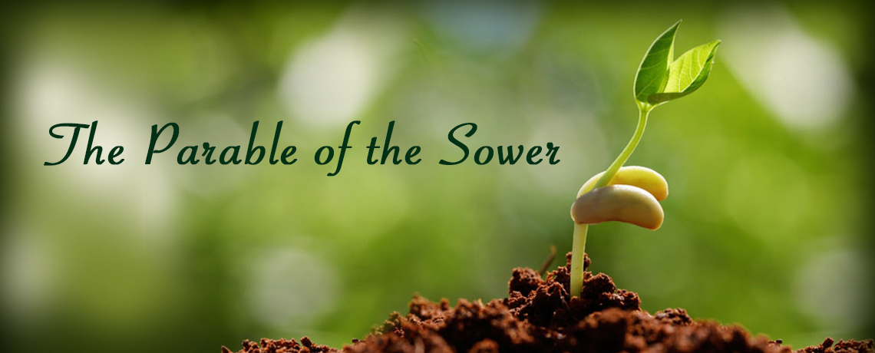
Matthew 13:1-9, 18-23

Slide 3
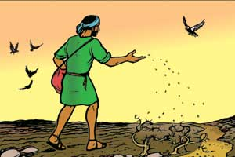
What is a Parable?
From the Greek word parabole which refers to something that is cast alongside something else for comparison.
“Jesus teaching in parables involved various comparisons of known relationships, things and processes to communicate spiritual truths otherwise unknown to mankind.”
“An earthly story with a
heavenly meaning.”
“If you can understand this –
you can understand that.”

Slide 4
The Effectiveness of the Seed
The seed is the word of God (Luke 8:11).
God’s word has the power to beget spiritual life.
  1 Peter 1:23; Rom. 1:16
We cannot change the message of the gospel to entice more people to accept it.

Slide 5
The Condition of Man’s Heart
The condition of one’s heart determines what they will do with God’s word.
Jesus warns us to “take heed how you hear”
(Luke 8:18).
James instructs us to receive God’s word properly (James 1:21-22).

Slide 6
Satan Works To Harden Man’s Heart Against God’s Word
The wayside ground was hard and unable to receive the seed.
Some hearts are like this.
  Eph. 4:17-19; 1 Tim. 4:2
Satan plays a role in blinding
and hardening man’s heart.
  2 Cor. 4:3-4

Slide 7
God’s Word Cannot Thrive In Shallow Hearts
The stony ground was a thin layer of soil over a layer of rock.
This represents the person who receives the word with joy, but stumbles as soon as he faces persecution for making this decision.
Emotion is important, but our faith must be based upon strong convictions,
not feelings.
We must develop a strong faith
(1 Pet. 2:1-2).

Slide 8
God’s Word Cannot Be Fruitful In A Crowded Heart
The thorny ground was soil full of weeds.
This represents the heart that is crowded with:
  “the cares of this world and the deceitfulness of riches”
  “the pleasures of life”
  “the desire for other things”
  (Matt. 13:22; Mark 4:19; Luke 8:14)

Slide 9
Good Hearts Are Fruitful
They understand the word (Matt. 13:23).
They accept the word (Mark 4:20).
They keep the word (Luke 8:15).
They are diverse in their fruitfulness.
  “some a hundredfold, some sixty, some thirty”

Slide 10
“Therefore hear the parable of the sower”
Matthew 13:18

