Slide 2
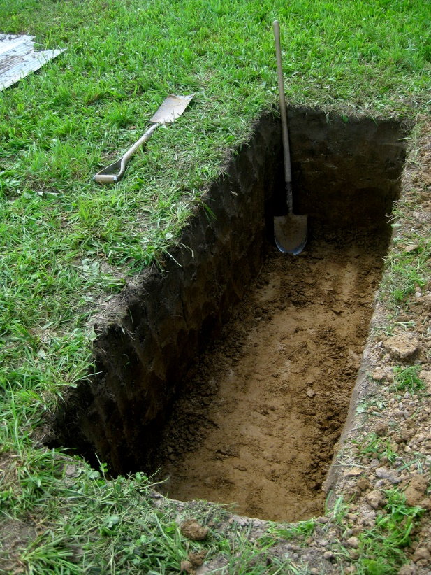
“If a man dies, shall he live again?”
Job 14:14
The philosophies of men do not offer any comfort.
  Atheism, Greco-Roman Philosophies
The false religions of the world do not offer any help.
  Hinduism, Buddhism,
  Modern Jewish

Slide 3
“If a man dies, shall he live again?”
Job 14:14
Jesus said man exists after death (Matt. 22:23-33).
Jesus said there will be a resurrection (John 5:28-29).
Jesus said He is the resurrection and the life (John 11:21-26).

Slide 4
First Corinthians 15
The Resurrection

Slide 5
1. The Evidence of the Resurrection of Jesus vs. 1-11
It was a part of the gospel which they had accepted (vs. 1-4).
It was validated by numerous eyewitnesses (vs. 5-11).
  Such evidence stands in court.
  Truth is established by two or three witnesses (Deut. 19:15).

Slide 6
2. Consequences of Jesus Not Rising from the Dead vs. 12-19
Our preaching is empty.
Our faith is also empty.
The apostles are false witnesses.
Our faith is futile, we are still in our sins.
Those dead in Christ have perished.
Christians are the most pitiful people in the world.

Slide 7
3. The Guarantee of Our Future Resurrection vs. 20-28
Jesus is the “firstfruits” of the resurrection of the dead (v. 20).
Adam brought us death, Jesus brings us the resurrection from the dead (vs. 21-23).
When Jesus returns, He will raise us from the dead (v. 24).
At that time, Jesus will completely destroy death (vs. 25-28).

Slide 8
4. The Moral Consequences of Denying the Resurrection of the Dead vs. 29-34
“Let us eat and drink, for tomorrow we die” (v. 32).
All doctrinal error is dangerous!
“Do not be deceived: ‘Evil company corrupts good habits.’” (v. 33).

Slide 9
5. The Nature of Our Resurrection vs. 35-49
God brings life out of death (v. 36).
God gives everything the kind of body it needs to survive and thrive (vs. 37-41).
There is an order (vs. 42-49).
  Corruption ➔ Incorruption
  Dishonor ➔ Glory
  Weakness ➔ Power
  Natural ➔ Spiritual

Slide 10
6. The Victory Obtained in Our Resurrection vs. 50-58
At the resurrection…
Death will be forced to release every person in its grasp.
The prophecies predicting the defeat of death will be fulfilled (Is. 25:8; Hosea 13:14).
The greatest power exerted by sin (death) will finally be defeated.
We will share in the Lord’s victory over sin and death.

Slide 11
Job asked:
  “If a man dies, shall he live again?” (Job 14:14)
Jesus answered:
  “I am the resurrection and the life. He who believes in Me, though he may die, he shall live. And whoever lives and believes in Me shall never die. Do you believe this?” (John 11:25-26).

