Slide 1
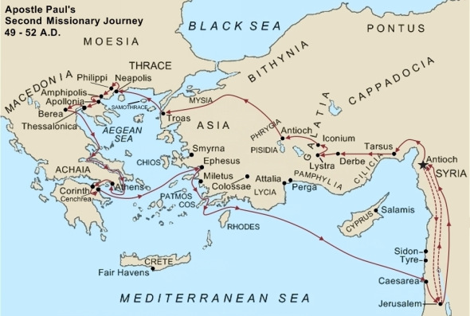
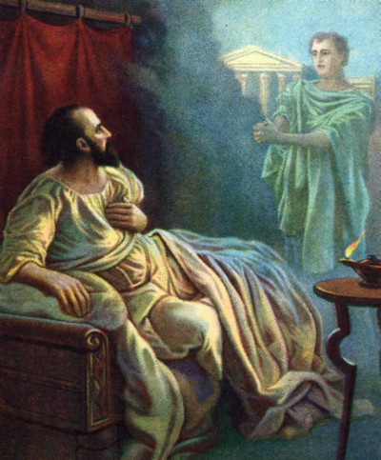
Responding To The Macedonian Call
Acts 16:6-10

Slide 2
Lessons From the Macedonian Call
Where we want to go isn’t always where we are needed.
The lost are in need of help.
We need to respond immediately.
We are qualified to do this work.
The work is rewarding.

