Slide 2
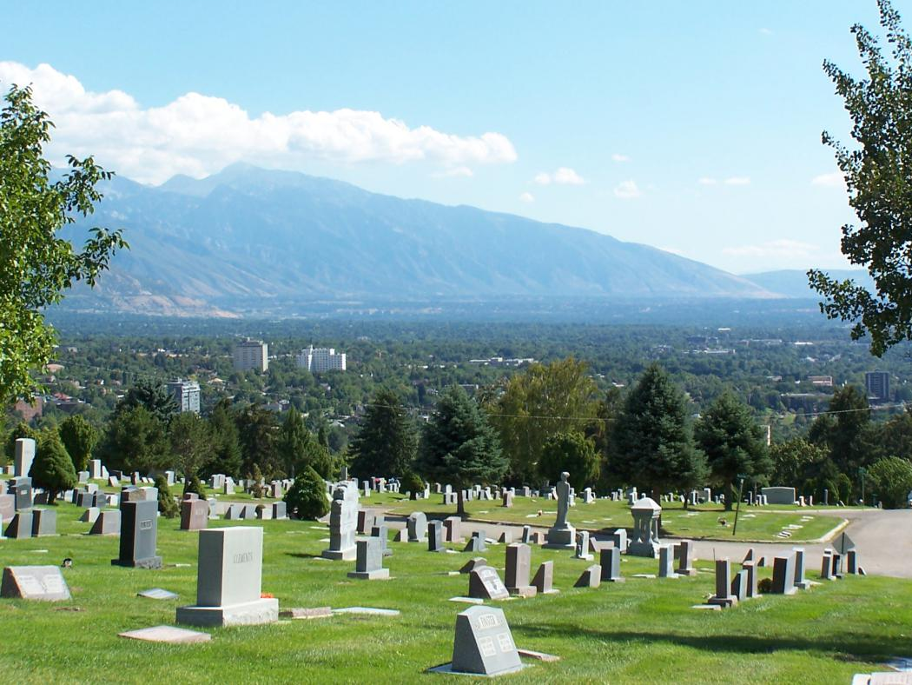
Where Are the Dead?

Slide 3
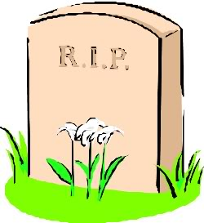
1. Death
All of us will die - Heb. 9:27
Death is a separation of man’s physical body and his eternal soul - James 2:26; Eccl. 12:7

Slide 4
2. Hades
A place in the spiritual realm.
The place of departed spirits.
Called “Sheol” in the Old Testament (Hebrew), called “Hades” in the New Testament (Greek).
The King James Version uses the English word “Hell” to translate both hades and gehenna.

Slide 5
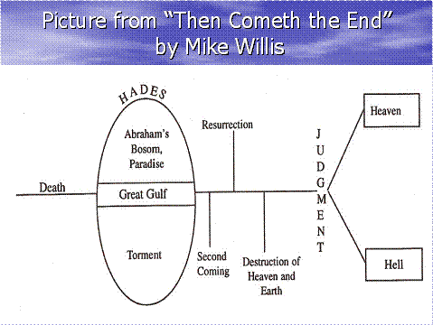
What we know about Hades
Luke 16:19-31
A place for both the righteous and the wicked.
The righteous are in “Abraham’s
Bosom,” the wicked are in “Torment.”
The righteous man was comforted.
The wicked man was tormented.
There was a great gulf fixed
between the two, no one could
pass from one to the other.

Slide 6
3. The Return of Christ
Resurrection of the Dead
  John 5:28-29; 1 Thess. 4:13-18
Destruction of the Heaven and Earth
  2 Peter 3:10-13
Judgment
  Revelation 20:11-15
Eternity Begins
  Matthew 25:46

Slide 7
Resurrection of the Dead
Destruction of the Heaven and Earth
Judgment
Eternity Begins

