Slide 2
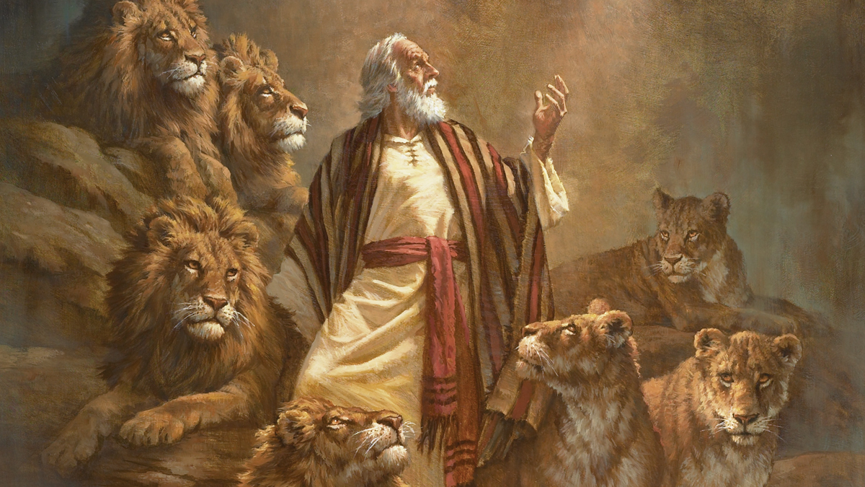
Dare To Be A Daniel

Slide 3
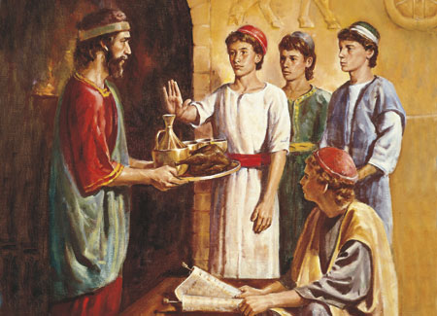
1. Daniel Was A Man Of Purpose
Daniel 1:8
Despite his youth, and the pressures to conform, Daniel chose to live by the standards set forth in God’s law regardless of the cost.
God wants us to serve Him
with purpose.
Matt. 6:33; 22:37-40

Slide 4
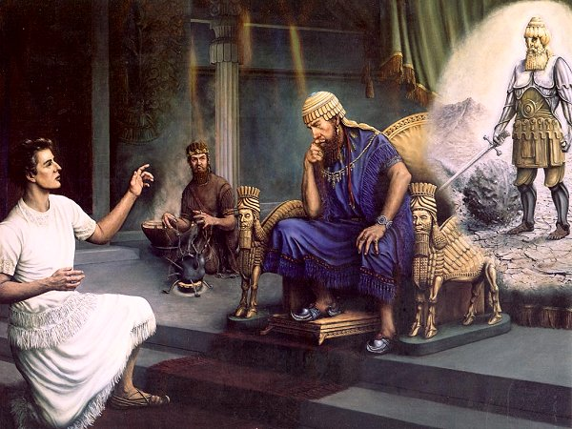
2. Daniel Was A Man Of Principle
He refused to eat the king’s meat and drink his wine (Dan. 1:8).
He refused to take credit for God’s power
(Dan. 2:26-28).
He refused to accept
the king’s gifts
(Dan. 5:13-17).
He refused to stop
praying (Dan. 6:10).

Slide 5
3. Daniel Was A Man Of Purity
Daniel refused to defile himself (Dan. 1:8).
Daniel was faultless in his service (Dan. 6:1-4).
God wants us to be pure regarding our responsibilities to our fellowman.
  Rom. 13:1-3; Eph. 6:5-8
God wants us to be morally
pure.
  1 Peter 1:15-16; 3:2; 4:1-4

Slide 6
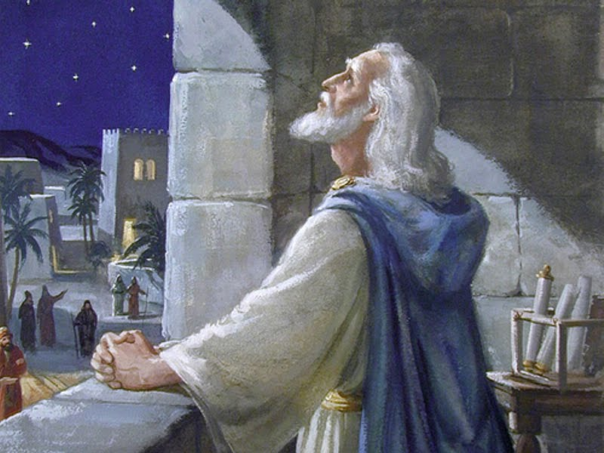
4. Daniel Was A Man Of Prayer
Daniel’s prayer life (Dan. 6:10).
He “knelt down” in prayer.
He prayed “three times” a day.
He “gave thanks.”
He prayed “as was his custom
since early days.”

Slide 7
Dare To Be A Daniel
We do not have to wait until we are older, nor do we have to wait until circumstances are better, to serve the Lord acceptably.
We can start doing so today by being men and women of Purpose, Principle, Purity and Prayer.

