Slide 1
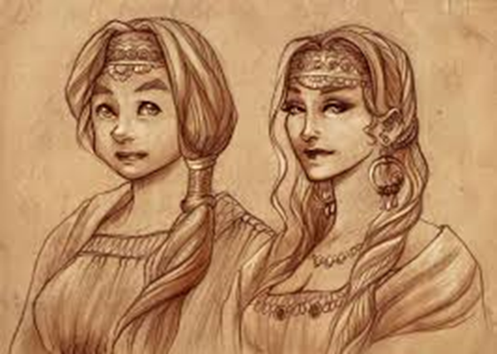
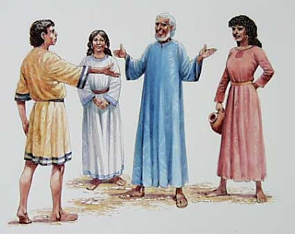
Leah, wife of Jacob

Slide 2
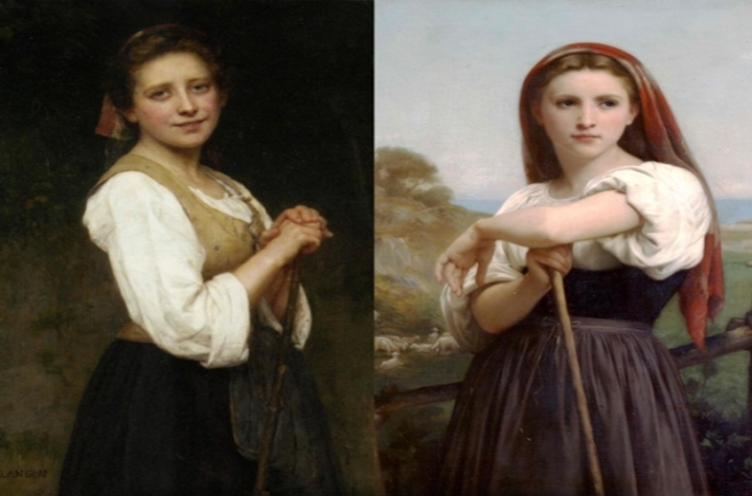
Second Place
Rachel was more beautiful than Leah
  (Genesis 29: 17)
Jacob did not love Leah like Rachel
  (Genesis 29: 23-25)
So where was God?
  Did God not love Leah as much as Rachel? Did he think of her any less than Rachel?
  Are we so different today?

Slide 3
No Favoritism from God
Leah had done no wrong to be favored less (John 9:1-5)
Peter was reluctant at first to preach (Acts 10:34-35)
God’s gift has been offered to all (John 3:16)
So, favoritism showed by God’s children is a serious offense! (James 2:8-9)

Slide 4
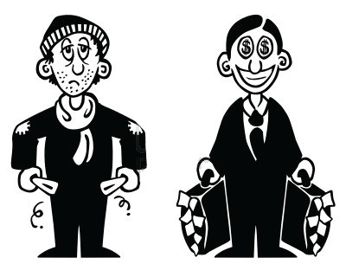
To be envious….
There are times when someone has it better
than us. (Matthew 25:25-26)
  So, must we always compare our weaknesses to
  other’s strengths?

Slide 5
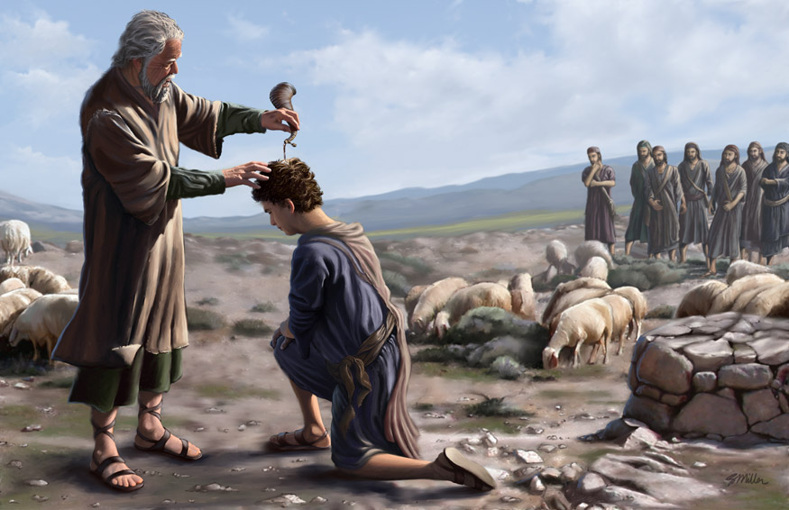
To be envious….
The people overlooked are often valuable assets for the Lord. (1 Samuel 16:2-12)
God does not overlook your suffering. (Matthew 10:29-31)

Slide 6
Do Not Envy
God has purpose for you (Genesis 29:31-35)
  Jesus is an heir of Jacob, but through Leah, not Rachel.
  But Joseph is a great example of godliness; a son of Rachel.

Slide 7
Do Not Envy
Do not be like Joseph’s brothers (Genesis 37:5-11)
  Rachel did nothing wrong; was not exempt from suffering
  Likewise, Joseph was the favorite son; did he deserve the treatment from his brothers?

Slide 8
Lessons
Be grateful for what you do have
  Leah did just that!
  Too many only compare their blessings to other people’s.
We must learn to be content
  Life won’t be fair or perfect for any of us.
  There will always be people, even in the church, who won’t fully appreciate you.
Show your care for all of God’s children

Slide 9
Invitation
God offers salvation for all
  How many reject it? How many are still searching for worldly approval?

