Slide 2
The dangers of immodest dress

Slide 3
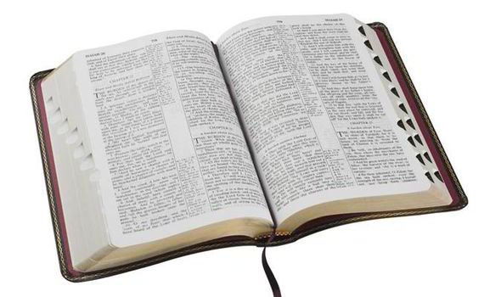
1 Timothy 2:9-10
“In like manner also, that the women adorn themselves in modest apparel, with propriety and moderation, not with braided hair or gold or pearls or costly clothing, but, which is proper for women professing godliness, with good works.”

Slide 4
1 Timothy 2:9-10
“In like manner also, that the women adorn themselves in modest apparel, with propriety and moderation, not with braided hair or gold or pearls or costly clothing, but, which is proper for women professing godliness, with good works.”

Slide 5
1 Timothy 2:9-10
“In like manner also, that the women adorn themselves in modest apparel, with propriety and moderation, not with braided hair or gold or pearls or costly clothing, but, which is proper for women professing godliness, with good works.”

Slide 6
1 Timothy 2:9-10
“In like manner also, that the women adorn themselves in modest apparel, with propriety and moderation, not with braided hair or gold or pearls or costly clothing, but, which is proper for women professing godliness, with good works.”

Slide 7
1 Timothy 2:9-10
“In like manner also, that the women adorn themselves in modest apparel, with propriety and moderation, not with braided hair or gold or pearls or costly clothing, but, which is proper for women professing godliness, with good works.”

Slide 8
Dress Code Rules for Visitors of Ohio Inmates
All prisons in Ohio follow a dress code. The dress code is in place for the order, safety and security of visitors, inmates and staff, and is strictly adhered to. Failure to follow the dress code will result in your visit being denied. We suggest you always bring a change of clothes with you and leave them in your car. This enables you to quickly change if a staff member objects to an article of clothing you are wearing and prevents you from potentially missing out on a visit.

Slide 9
Dress Code Rules for Visitors of Ohio Inmates
All visitors must wear appropriate undergarments, underwear, bra, slip etc.
Underwear should not be visible during visits.
No clothes should expose the midriff, back, shoulders, cleavage, thighs or sides.
Sleeveless clothing, including halter tops, tank tops, tube tops, and low-cut clothing that exposes the stomach, underwear, buttocks or chest is not allowed.
Dresses, shorts, skirts, culottes etc., must not have a hem or slit above the middle of the knee.
Wrap skirts, dresses, and break away pants are not allowed.

Slide 10
Dress Code Rules for Visitors of Ohio Inmates
Clothing with holes, rips, or cut outs that expose skin are not allowed.
Tight/form fitting clothing such as spandex, leggings, Lycra, including tight jeans, tight pants, leotards, unitards, or clothing that is see through, sheer or netted is not allowed.
Excessive jewelry is not allowed, and may make the metal detector go off and require a more intrusive search.
Clothing with gang symbols, or that is associated as gang-wear is prohibited.
If your clothing contains offensive language or images you will not be allowed to visit.

Slide 11
Dress Code Rules for Visitors of Ohio Inmates
Clothing with holes, rips, or cut outs that expose skin are not allowed.
Tight/form fitting clothing such as spandex, leggings, Lycra, including tight jeans, tight pants, leotards, unitards, or clothing that is see through, sheer or netted is not allowed.
Excessive jewelry is not allowed, and may make the metal detector go off and require a more intrusive search.
Clothing with gang symbols, or that is associated as gang-wear is prohibited.
If your clothing contains offensive language or images you will not be allowed to visit.
“The dress code is in place for the order, safety and security of visitors, inmates and staff, and is strictly adhered to. Failure to follow the dress code will result in your visit being denied.”

Slide 12
It Sends the Wrong Message
Some clothing is designed to send a message.
“the attire of a harlot” (Prov. 7:10)
Clothing that reveals the flesh or form of the “midriff, back, shoulders, cleavage, chest, thighs, sides, stomach, buttocks” sends a message to those who see it.
Such clothing is dangerous in that it poses a threat to one’s purity and one’s safety.

Slide 13
Causes One To Be A Stumbling Block
We are held responsible for the things we stare at and the thoughts we have.
  2 Sam. 11:2; 12:7, 13; Matt. 5:27-29
However, God will also hold us responsible for giving people something to stare at and lust after.
  Matt. 18:6-7

Slide 14
It Is Rebellion Against God

Slide 15
It Is Rebellion Against God
“Or do you not know that your body is the temple of the Holy Spirit who is in you, whom you have from God, and you are not your own? For you were bought at a price; therefore glorify God in your body and in your spirit, which are God’s.”
1 Cor. 6:19-20

Slide 16
It Is Rebellion Against God
“Then the eyes of both of them were opened, and they knew that they were naked; and they sewed fig leaves together and made themselves coverings” (Genesis 3:7).
“Also for Adam and his wife
the Lord God made tunics of
skin, and clothed them” (v. 21).

Slide 17
The Dangers of immodest dress
It sends the wrong message
It causes one to be a stumbling block
It is rebellion against god

