Slide 2
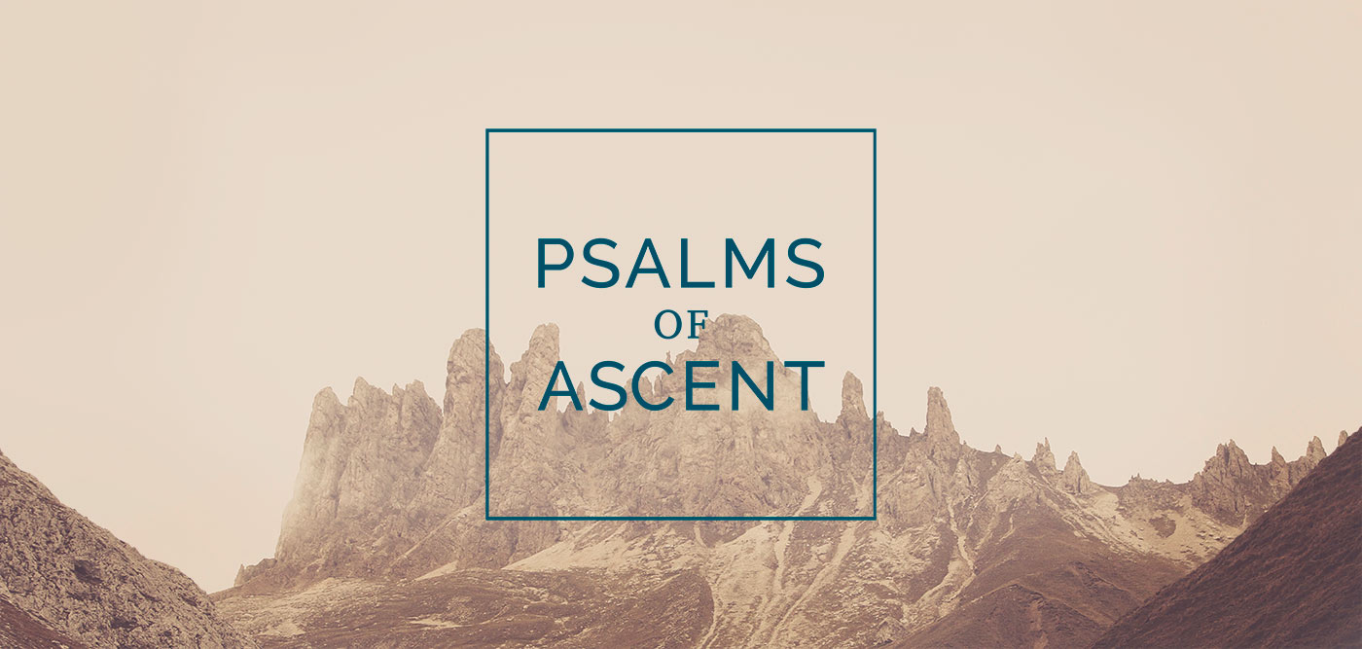
Psalms 120-134

Slide 3
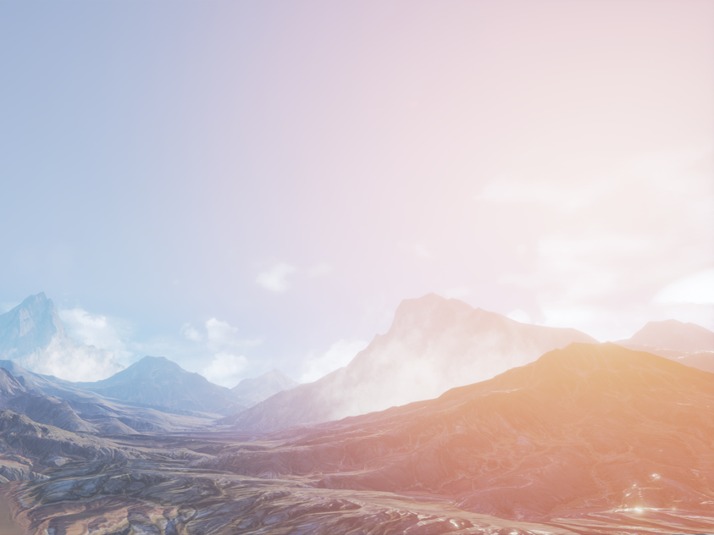
The Psalms of Ascent
Four are attributed to David (122, 124, 131, 133).
One is attributed to Solomon (127).
Ten are anonymous.
The Hebrew word translated “ascent” is a verb meaning “to go up.”

Slide 4
The Psalms of Ascent
Sung by the Jews as they made their journey to worship at Jerusalem during the three annual feasts: Passover, Pentecost, and Tabernacles.
Written by the Jews who were returning from Babylonian captivity.
Sung by the priests and Levites as they walked up the steps into the Temple.
Indicate a spiritual “going up” that Jews were expected to make as they grew in their faith.

Slide 5
Traveling to Jerusalem
“I will lift up my eyes to the hills - from whence comes my help? My help comes from the Lord, Who made heaven and earth” (Ps. 121:1-2).
“Those who trust in the Lord are like Mount Zion, which cannot be moved, but abides forever. As the mountains surround Jerusalem, so the Lord surrounds His people from this time forth and forever” (125:1-2).

Slide 6
Coming into God’s Presence
“I was glad when they said to me, ‘Let us go into the house of the Lord’” (Ps. 122:1).
Psalm 132 commemorates David’s efforts to secure a resting place for the Ark of the Covenant; Zion, from which God will be a blessing to His people.
We must approach God with a humble and trusting attitude (Ps. 131).

Slide 7
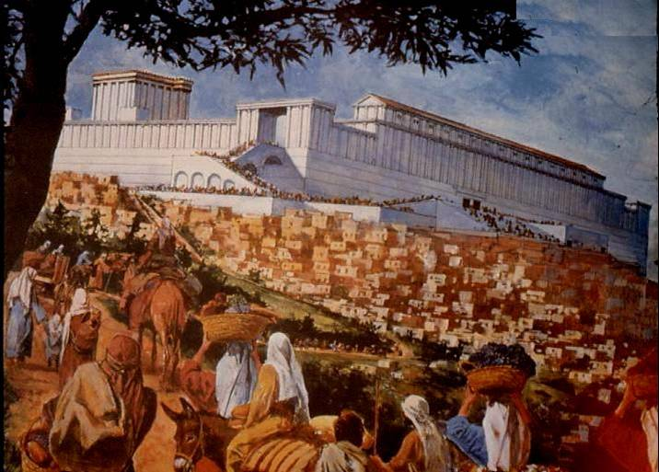
Worshiping with our Family
Children are a heritage, a reward, and a source of strength (Ps. 127:3-5).
The wife is a fruitful vine at the center of the home (Ps. 128:3).
Grandchildren (v. 6).
“Behold, thus shall the
man be blessed who
fears the Lord” (v. 4).

Slide 8
Unity of Believers
“Behold, how good and how pleasant it is for brethren to dwell together in unity!” (Ps. 133:1).
John 17:20-21
Ephesians 4:3-6

Slide 9
Appeals we make unto God
Peace (Ps. 120:1-2, 6-7)
Mercy (Ps. 123:1-4)
Deliverance (Ps. 124, 129)
Joy (Ps. 126:5)
Forgiveness (Ps. 130:1-4)

Slide 10
A Parting Word
Psalm 134
Behold, bless the Lord, all you servants of the Lord, who by night stand in the house of the Lord!
Lift up your hands in the sanctuary, and bless the Lord.
The Lord who made heaven and earth bless you from Zion!

Slide 11
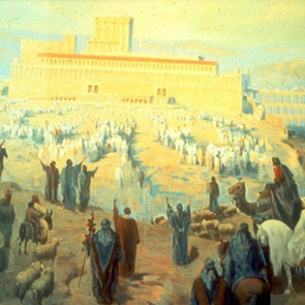
Learning from the Ascent Psalms
Among other things, these Psalms reveal the thoughts God wants us to have in our hearts as we assemble with the saints to worship Him.

