Slide 2
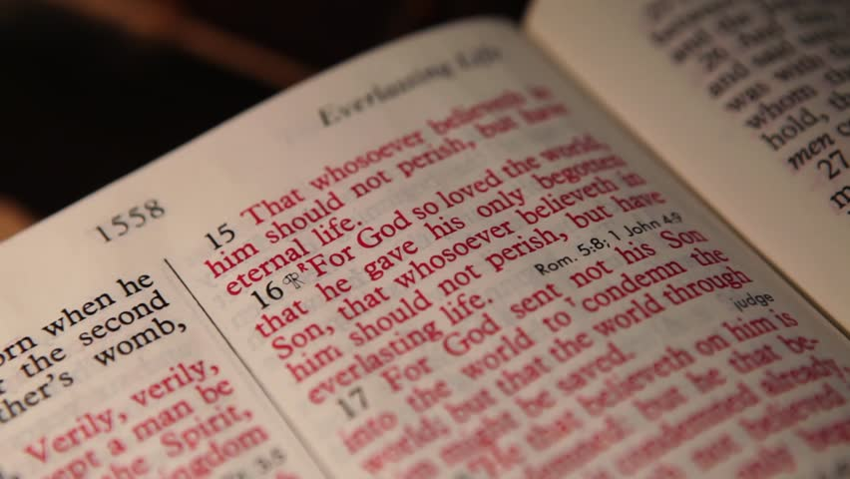
John 3:16
The Greatest Verse in the Bible

Slide 3
“For God so loved the world, that he gave his only begotten Son, that whosoever believeth in him should not perish, but have everlasting life.” John 3:16; KJV
The Greatest Being: God
The Greatest Motive: So Loved
The Greatest Scope: The World
The Greatest Gift: His Only Begotten Son
The Greatest Invitation: Whosoever Believes
The Greatest Deliverance: Should Not Perish
The Greatest Promise: Have Everlasting Life

Slide 4
“For God so loved the world, that he gave his only begotten Son, that whosoever believeth in him should not perish, but have everlasting life.” John 3:16; KJV
If we believe Jesus is the Son of God, and that His words are truth, we should obey Him.
Jesus said we are to repent (Luke 13:3), confess our faith (Matt. 10:32) and be baptized (Mark 16:16).
If we believe in Jesus, and obey Him like we should, we will escape the punishment for our sins and receive everlasting life.

