Slide 2
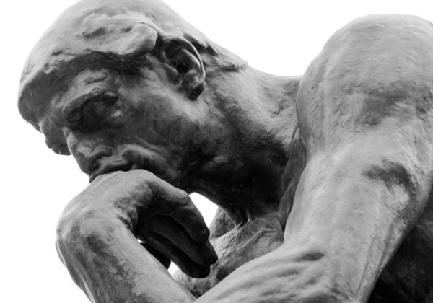
The Conscience of Man

Slide 3
What is the Conscience?
“a knowledge or sense of right and wrong, with a compulsion to do right; moral judgment that opposes the violation of a previously recognized ethical principle and that leads to feelings of guilt if one violates such a principle.”
Webster’s Dictionary, 302

Slide 4
What is the Conscience?
“a person’s inner awareness of conforming to the will of God or departing from it, resulting in either a sense of approval or condemnation.”
Nelson’s Bible Dictionary

Slide 5
The Conscience is a Personal Guide
Our conscience guides us in making proper decisions (Rom. 2:15; 13:5; John 8:7-9)
However, our personal conscience is not the source of truth (Acts. 24:16; 26:9)
The conscience is only a safe guide if it has been trained according to the standards set forth in God’s word (Eph. 5:17; Rom. 12:2; Titus 2:11-12)

Slide 6
How To Handle A Troubled Conscience

Slide 7



How To Handle A Troubled Conscience

Slide 8
Cleansing A Troubled Conscience

Slide 9
Cleansing A Troubled Conscience
When I kept silent, my bones grew old through my groaning all the day long.
For day and night Your hand was heavy upon me; my vitality was turned into the drought of summer.
I acknowledged my sin to You, and my iniquity I have not hidden. I said, “I will confess my transgressions to the Lord,” and You forgave the iniquity of my sin.
Psalm 32:3-5

Slide 10
Cleansing A Troubled Conscience
“How much more shall the blood of Christ, who through the eternal Spirit offered Himself without spot to God, cleanse your conscience from dead works to serve the living God?”
Hebrews 9:14
“Let us draw near with a true heart in full assurance of faith, having our hearts sprinkled from an evil conscience and our bodies washed with pure water”
Hebrews 10:22

Slide 11
Cleansing A Troubled Conscience
“There is also an antitype which now saves us – baptism (not the removal of the filth of the flesh, but the answer of a good conscience toward God), through the resurrection of Jesus Christ.”
1 Peter 3:21

Slide 12

Ignoring A Troubled Conscience
Ignoring our troubled conscience can cause us to shipwreck our faith (1 Tim. 1:18-20).
Violating our conscience will wound or damage our conscience (1 Cor. 8:4-13).
If our conscience becomes seared (1 Tim. 4:2) we are disqualified (Titus 1:15-16) and it will not be possible to bring us to repentance (Heb. 6:4-6).

Slide 13
Ignoring A Troubled Conscience
Ignoring our troubled conscience can cause us to shipwreck our faith (1 Tim. 1:18-20).
Violating our conscience will wound or damage our conscience (1 Cor. 8:4-13).
If our conscience becomes seared (1 Tim. 4:2) we are disqualified (Titus 1:15-16) and it will not be possible to bring us to repentance (Heb. 6:4-6).
It is extremely important that we handle our troubled conscience in the proper manner!

