Slide 2
Jesus Has Great Power
Mark 5-7

Slide 3
Jesus Has Great Power
Power Over
  Mark 5:1-20
Power Over
  Mark 5:21-34
Power Over
  Mark 5:35-43
Power Over the
  Mark 6:34-52
Power Over
  Mark 7:24-30

Slide 4
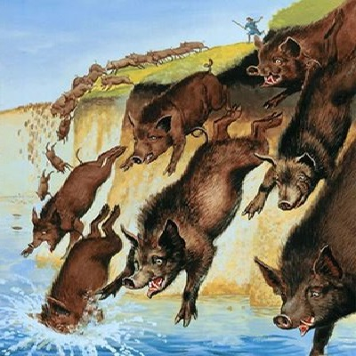
Jesus Has Great Power
Power Over Demons
  Mark 5:1-20
Power Over
  Mark 5:21-34
Power Over
  Mark 5:35-43
Power Over the
  Mark 6:34-52
Power Over
  Mark 7:24-30

Slide 5
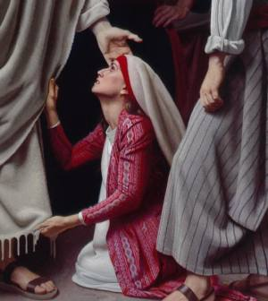
Jesus Has Great Power
Power Over Demons
  Mark 5:1-20
Power Over Sickness
  Mark 5:21-34
Power Over
  Mark 5:35-43
Power Over the
  Mark 6:34-52
Power Over
  Mark 7:24-30

Slide 6
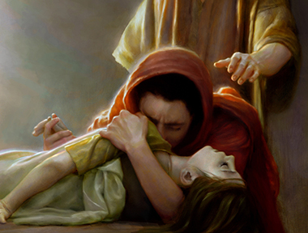
Jesus Has Great Power
Power Over Demons
  Mark 5:1-20
Power Over Sickness
  Mark 5:21-34
Power Over Death
  Mark 5:35-43
Power Over the
  Mark 6:34-52
Power Over
  Mark 7:24-30

Slide 7
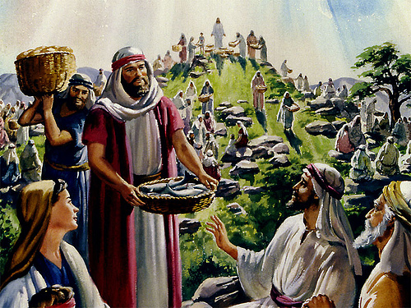
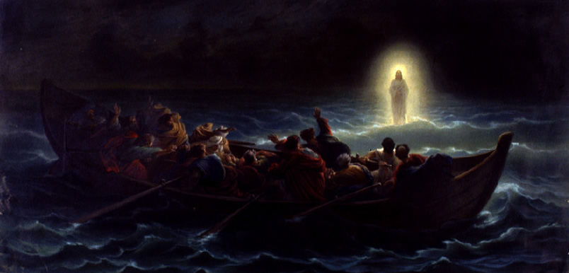
Jesus Has Great Power
Power Over Demons
  Mark 5:1-20
Power Over Sickness
  Mark 5:21-34
Power Over Death
  Mark 5:35-43
Power Over the Elements
  Mark 6:34-52
Power Over
  Mark 7:24-30

Slide 8
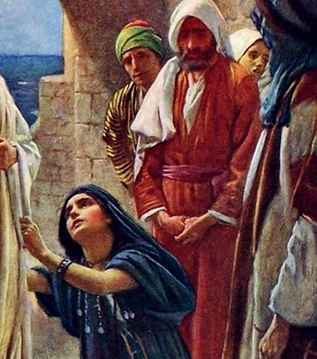
Jesus Has Great Power
Power Over Demons
  Mark 5:1-20
Power Over Sickness
  Mark 5:21-34
Power Over Death
  Mark 5:35-43
Power Over the Elements
  Mark 6:34-52
Power Over Distance
  Mark 7:24-30

Slide 9
John 20:30-31
And truly Jesus did many other signs in the presence of His disciples, which are not written in this book;
But these are written that you may believe that Jesus is the Christ, the Son of God, and that believing you may have life in His name.

