Slide 2

What We Must Confess About Jesus

Slide 3
What We Must Confess About Jesus
That if you confess with your mouth the Lord Jesus and believe in your heart that God has raised Him from the dead, you will be saved. For with the heart one believes unto righteousness, and with the mouth confession is made unto salvation.
Romans 10:9-10

Slide 4
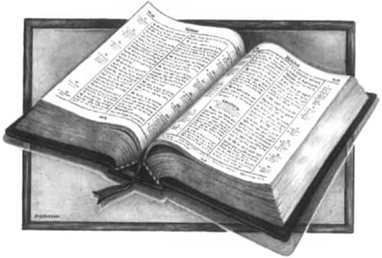
We Must Confess…
Jesus is the Christ - Matt. 16:16
Jesus is the Son of God - Matt. 16:16
Jesus Came in the Flesh - 1 John 4:2-3
Jesus is Lord - 1 Tim. 6:12-13

