Slide 2
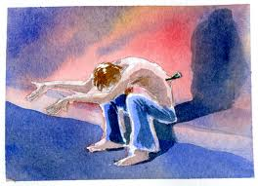
“My Grace Is Sufficient For You”
2 Corinthians 12:7-10

Slide 3
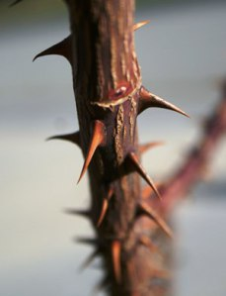
Paul’s Thorn in the Flesh
The word “thorn” is translated from the Greek word skolops.
“withered at the front, i.e. a point or prickle; figuratively, a bodily annoyance or disability” (Strong’s).
The wording indicates this was a painful and humiliating hindrance to Paul which he wanted to have removed.

Slide 4
Paul Prayed It Would Depart
parakaleo – an urgent petition
  “pleaded” (NKJV, ESV)
  “besought” (KJV)
  “entreated” (NASB)
Once was not enough. Paul was persistent in prayer regarding this matter.
Like the Lord in the Garden of Gethsemane, Paul prayed three times (Matt. 26:38-44).

Slide 5
Paul Needed the Thorn
As Saul of Tarsus, he was a very arrogant man (1 Tim. 1:13).
He was called to be an apostle at a special time and in a special way.
He possessed all the authority and power that came with being an apostle.
His personal efforts helped spread the gospel across the Roman Empire.
He was allowed to hear and see things most men are not allowed to experience (2 Cor. 12:2-4, 7).

Slide 6
Paul Needed the Thorn
buffet – kolafizoo “to strike with the fist, give one a blow with the fist” (Thayer).
  The figure goes from being stuck with a sharp thorn to being beaten with a fist!
messenger of Satan – God allows Satan to afflict His people (Job 1-2; James 1:12-13).
However, God not only controls this, He is also able to use such afflictions to His purpose and for His glory.

Slide 7
“My Grace is Sufficient For You”
grace – unmerited favor
We often associate the word “grace” with our salvation, but the Bible does not limit the word to this particular blessing.
“Grace” is when God gives man something, not because man has earned it or deserves it, but because it pleases God to give it.
Anything God gives us to help us can be said to come by His grace.

Slide 8
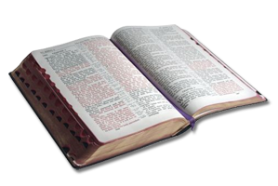
“My Grace is Sufficient For You”
“In Him we have redemption through His blood, the forgiveness of sins, according to the riches of His grace which He made to abound toward us in all wisdom and prudence.”
Ephesians 1:7-8

Slide 9
“My Grace is Sufficient For You”
“And the grace of our Lord was exceedingly abundant, with faith and love which are in Christ Jesus.”
1 Timothy 1:14

Slide 10
“My Grace is Sufficient For You”
“And God is able to make all grace abound toward you, that you, always having all sufficiency in all things, may have an abundance for every good work.”
“…and by their prayer for you, who long for you because of the exceeding grace of God in you.
2 Cor. 9:8, 14

Slide 11
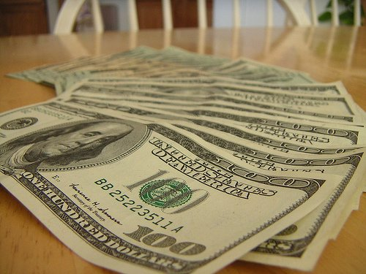
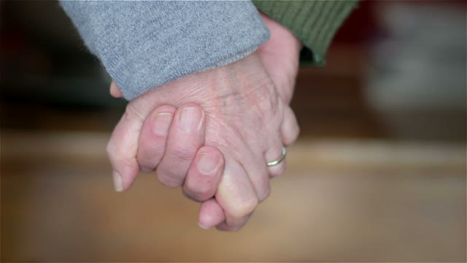
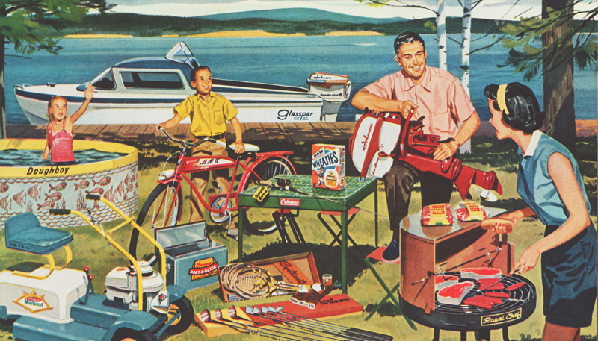

God has never promised…

Slide 12
God has never promised…
“My Grace is Sufficient For You”

Slide 13
The Lord’s Strength is Perfected in Weakness
Often times, it is not until we are made weak that we seek God’s help in our lives.
The Prodigal Son had to hit rock bottom before he “came to himself” and returned to his father’s house (Luke 15:17).
When are we depending upon God the most, praying most fervently, seeking His mercy and help?
Is it not when we are weak that we are allowing the Lord to be strong in our lives?

Slide 14

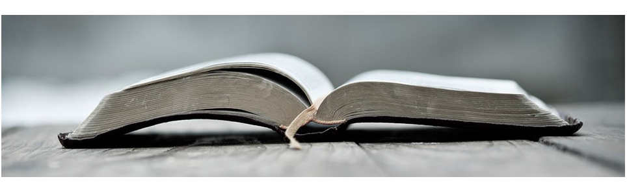
The thorns come.
There is a reason for the thorns.
God’s grace is there to help us with the thorns.

