Slide 2
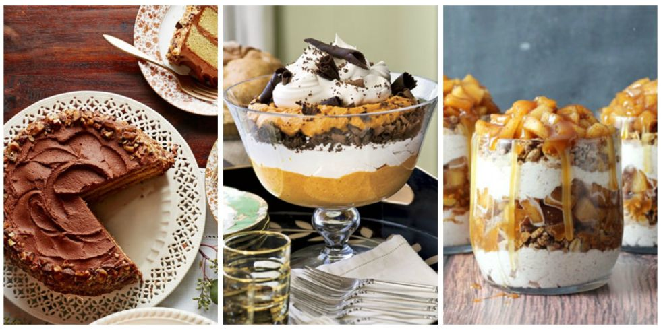
Saving The Best For Last

Slide 3
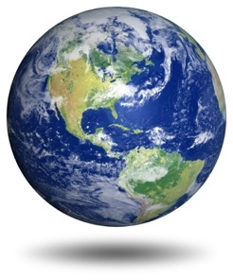
1. Creation
Day One - light
Day Two - firmament (air, sky)
Day Three - dry land, plants
Day Four - sun, moon, stars
Day Five - fish, birds
Day Six - land animals, man

Slide 4
1. Creation
Man was the pinnacle of God’s creation.
Made in the image of God (Gen. 1:26-27).
Given dominion over God’s creation (v. 28).
Given stewardship of God’s creation (2:15).

Slide 5
2. Dispensations of God’s Grace
Patriarchal – God dealt with man directly through the heads of the family.
Law of Moses – God guarded the nation of Israel through the Law given on Mt. Sinai.
Gospel Age – forgiveness of sins is possible through the shed blood of Jesus Christ.

Slide 6
2. Dispensations of God’s Grace
The Gospel Age is the Best
Better than Law of Moses (Heb. 8:6).
Better High Priest (Heb. 7:25-27).
Better sacrifice (Heb. 9:11-14).
The reality of the shadow (Heb. 10:1).

Slide 7
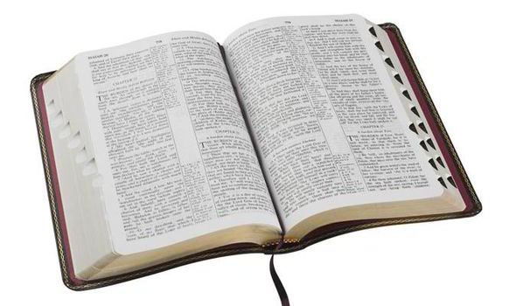
3. Revelation
The last revelation has come through one greater than the fathers and Moses (Heb. 1:1-2).
God’s will was a mystery in ages past, but has been made known to us (Eph. 3:3-7).
The apostles were guided into all truth when they wrote the New Testament (John 16:12-13).
We have everything we need (2 Tim. 3:16-17; 2 Pet. 1:3).

Slide 8
4. Reward of the Faithful
Mark 10:28-31
Faithful Christians, who have sacrificed in order to follow Jesus, receive many great blessings in this life.
However, the best blessing will come at the end.
  “…and in the age to come, eternal life”

Slide 9
5. Greatness in the Kingdom
Matthew 20:20-28
Greatness in the Lord’s kingdom is determined in a way that is opposite that of the world.
  In the world, greatness is found in the ability to exert authority and demand service.
  In the kingdom, greatness is found in the willingness to serve others.
The best belongs to those who will make themselves last.

Slide 10
Saving The Best For Last
Creation
Dispensation of God’s Grace
Revelation
The Reward for the Faithful
Greatness in the Kingdom

