Slide 2
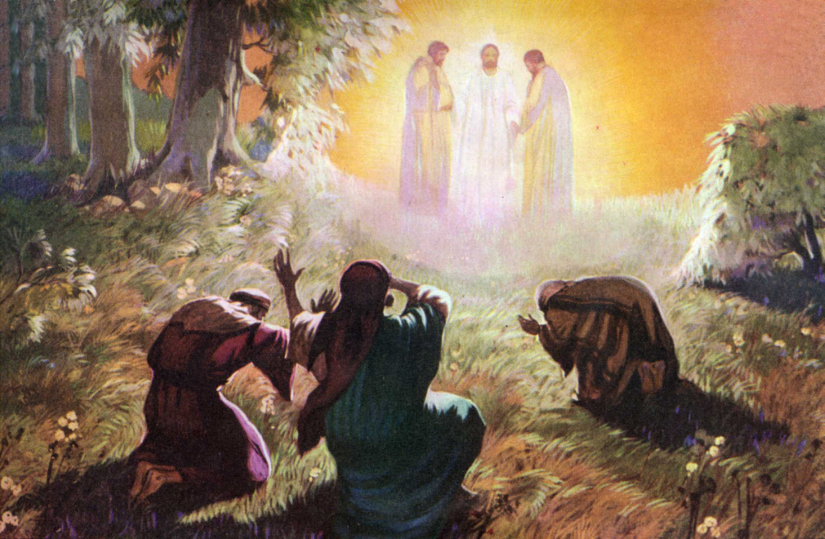
The Transfiguration of Jesus

Slide 3

He was transfigured before them
metamorphoo “to change into another form, to transfigure, transform” (Thayer’s Greek Lexicon).
From which we get the English word “metamorphosis.”

Slide 4
He was transfigured before them
“His face shone like the sun, and His clothes became as white as the light” (Matt. 17:2).
“His clothes became shining, exceedingly white, like snow, such as no launderer on earth can whiten them” (Mark 9:3).
“As He prayed, the appearance of His face was altered, and His robe became white and glistening” (Luke 9:29).

Slide 5
Moses and Elijah
They are speaking with Jesus regarding His death (Luke 9:31).
Moses represents the Law. Elijah represents the prophets.
Jesus came to fulfill the law and the prophets (Matt. 5:17), and these two men appear to Him to help Him do that with His approaching death.

Slide 6
Peter’s Request
Peter acknowledged that it was good for him and the other disciples to be there, and asked to make three tabernacles for Jesus, Moses and Elijah.
God overshadowed them in a bright cloud and said, “This is My beloved Son, in whom I am well pleased. Hear Him!”

Slide 7
Existence After Physical Death
Moses had died 1,400 years before this event, and Elijah was taken up nearly 900 years prior, yet they both still existed.
So do our loved ones, and so will we (1 Thess. 4:13-18).

Slide 8
God Confirmed Jesus is His Son
2 Peter 1:16-19
The prophecies concerning Jesus as the Messiah and the Son of God were confirmed with many miracles, including this episode seen by Peter, James and John.

Slide 9
Three Prophecies In God’s Statement
The Jews were looking for the Christ
  John 1:41, 4:25
They were looking for the Prophet
  John 1:21, 6:14
They were uncertain of the identity of the suffering servant of Isaiah 53
  Acts 8:32-34

Slide 10
Three Prophecies In God’s Statement
“This is My beloved Son”
  Psalm 2 - Jesus is the Messiah King, the Son of God
“In whom I am well pleased”
  Isaiah 42:1, 53:10 - Jesus is the Suffering Servant that Isaiah saw, bearing the sins of the people
“Hear Him”
  Deut. 18:15-19 - Jesus is the Prophet who would come after Moses and speak for God

Slide 11

For He received from God the Father honor and glory when such a voice came to Him from the Excellent Glory: “This is My beloved Son, in whom I am well pleased.”
And we heard this voice which came from heaven when we were with Him on the holy mountain.
And so we have the prophetic word confirmed, which you do well to heed as a light that shines in a dark place, until the day dawns and the morning star rises in your hearts.
2 Peter 1:17-19

