Slide 1
Praise Him in the Storm
Psalm 107:23-32

Slide 2
Psalm 107:23-32 (ESV)
23 Some went down to the sea in ships, doing business on the great waters; 24 they saw the deeds of the LORD, his wondrous works in the deep. 25 For he commanded and raised the stormy wind, which lifted up the waves of the sea.

Slide 3
Psalm 107:23-32 (ESV)
26 They mounted up to heaven; they went down to the depths; their courage melted away in their evil plight; 27 they reeled and staggered like drunken men and were at their wits' end. 28 Then they cried to the LORD in their trouble, and he delivered them from their distress.

Slide 4
Psalm 107:23-32 (ESV)
29 He made the storm be still, and the waves of the sea were hushed. 30 Then they were glad that the waters were quiet, and he brought them to their desired haven. 31 Let them thank the LORD for his steadfast love, for his wondrous works to the children of man!

Slide 5
Psalm 107:23-32 (ESV)
32 Let them extol him in the congregation of the people, and praise him in the assembly of the elders.

Slide 6
Psalm 107:1-3 (ESV)
1 Oh give thanks to the LORD, for he is good, for his steadfast love endures forever! 2 Let the redeemed of the LORD say so, whom he has redeemed from trouble 3 and gathered in from the lands, from the east and from the west, from the north and from the south.

Slide 7
Psalm 107:25 (ESV)
25 For he commanded and raised the stormy wind, which lifted up the waves of the sea.

Slide 8
Psalm 34:17 (ESV)
17 When the righteous cry for help, the LORD hears and delivers them out of all their troubles.

Slide 9
Stormy Winds Bring Opportunities to…
Demonstrate Our Faith

Slide 10
1 Peter 1:6-7 (ESV)
6 In this you rejoice, though now for a little while, if necessary, you have been grieved by various trials, 7 so that the tested genuineness of your faith--more precious than gold that perishes though it is tested by fire--may be found to result in praise and glory and honor at the revelation of Jesus Christ.

Slide 11
Psalm 34:19 (ESV)
19 Many are the afflictions of the righteous, but the LORD delivers him out of them all.

Slide 12
1 Peter 4:12 (ESV)
12 Beloved, do not be surprised at the fiery trial when it comes upon you to test you, as though something strange were happening to you.

Slide 13
James 1:12 (ESV)
12 Blessed is the man who remains steadfast under trial, for when he has stood the test he will receive the crown of life, which God has promised to those who love him.

Slide 14
Stormy Winds Bring Opportunities to…
Demonstrate Our Faith

Slide 15
1 Peter 1:6-7 (ESV)
6 In this you rejoice, though now for a little while, if necessary, you have been grieved by various trials, 7 so that the tested genuineness of your faith--more precious than gold that perishes though it is tested by fire--may be found to result in praise and glory and honor at the revelation of Jesus Christ.

Slide 16
Stormy Winds Bring Opportunities to…
Demonstrate Our Faith
Demonstrate God’s Faithfulness

Slide 17
Psalm 9:10 (ESV)
10 And those who know your name put their trust in you, for you, O LORD, have not forsaken those who seek you.

Slide 18
Genesis 8:1 (ESV)
1 But God remembered Noah and all the beasts and all the livestock that were with him in the ark. And God made a wind blow over the earth, and the waters subsided.

Slide 19
2 Corinthians 12:9-10 (ESV)
9 But he said to me, "My grace is sufficient for you, for my power is made perfect in weakness." Therefore I will boast all the more gladly of my weaknesses, so that the power of Christ may rest upon me. 10 For the sake of Christ, then, I am content with weaknesses, insults, hardships, persecutions, and calamities. For when I am weak, then I am strong.

Slide 20
Stormy Winds Bring Opportunities to…
Demonstrate Our Faith
Demonstrate God’s Faithfulness
Deepen Our Faith

Slide 21
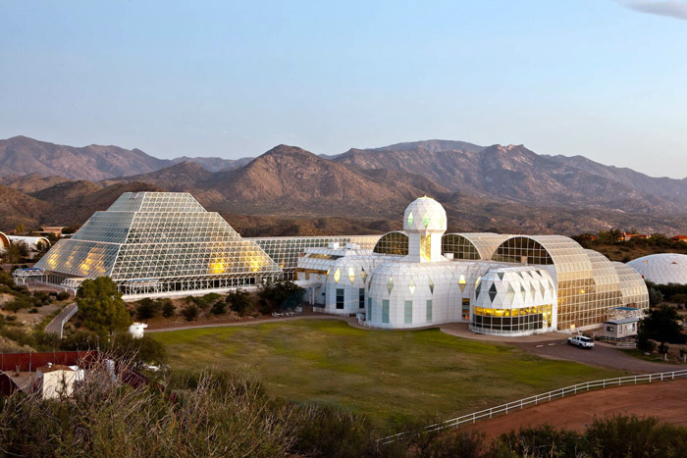

Slide 22
Jeremiah 17:7-8 (ESV)
7 "Blessed is the man who trusts in the LORD, whose trust is the LORD. 8 He is like a tree planted by water, that sends out its roots by the stream, and does not fear when heat comes, for its leaves remain green, and is not anxious in the year of drought, for it does not cease to bear fruit."

Slide 23
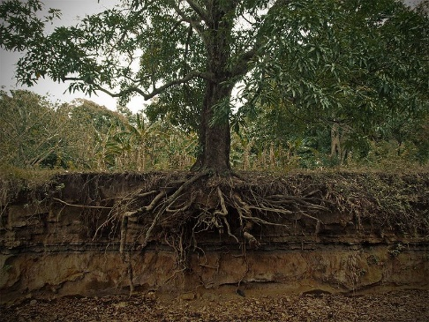
Mark 4:16-17 (ESV)
16 And these are the ones sown on rocky ground: the ones who, when they hear the word, immediately receive it with joy. 17 And they have no root in themselves, but endure for a while; then, when tribulation or persecution arises on account of the word, immediately they fall away.

Slide 24
Romans 5:3-5 (ESV)
3 Not only that, but we rejoice in our sufferings, knowing that suffering produces endurance, 4 and endurance produces character, and character produces hope, 5 and hope does not put us to shame, because God's love has been poured into our hearts through the Holy Spirit who has been given to us.

Slide 25
James 1:2-4 (ESV)
2 Count it all joy, my brothers, when you meet trials of various kinds, 3 for you know that the testing of your faith produces steadfastness. 4 And let steadfastness have its full effect, that you may be perfect and complete, lacking in nothing.

Slide 26
Stormy Winds Bring Opportunities to…
Demonstrate Our Faith
Demonstrate God’s Faithfulness
Deepen Our Faith

Slide 27
Matthew 14:22-33 (ESV)
22 Immediately he made the disciples get into the boat and go before him to the other side, while he dismissed the crowds. 23 And after he had dismissed the crowds, he went up on the mountain by himself to pray. When evening came, he was there alone, 24 but the boat by this time was a long way from the land, beaten by the waves, for the wind was against them.

Slide 28
Matthew 14:22-33 (ESV)
25 And in the fourth watch of the night he came to them, walking on the sea. 26 But when the disciples saw him walking on the sea, they were terrified, and said, "It is a ghost!" and they cried out in fear. 27 But immediately Jesus spoke to them, saying, "Take heart; it is I. Do not be afraid."

Slide 29
Matthew 14:22-33 (ESV)
28 And Peter answered him, "Lord, if it is you, command me to come to you on the water." 29 He said, "Come." So Peter got out of the boat and walked on the water and came to Jesus. 30 But when he saw the wind, he was afraid, and beginning to sink he cried out, "Lord, save me."

Slide 30
Matthew 14:22-33 (ESV)
31 Jesus immediately reached out his hand and took hold of him, saying to him, "O you of little faith, why did you doubt?" 32 And when they got into the boat, the wind ceased. 33 And those in the boat worshiped him, saying, "Truly you are the Son of God."

Slide 31
Praise Him in the Storm
Psalm 107:23-32

