Slide 2

The Practical Function of Hope
Ephesians 1:15-19

Slide 3
“What is the hope?”
First Peter 1:3-4
The SOURCE of our hope - Jesus Christ.
How to OBTAIN our hope - being born again.
The BASIS of our hope - the resurrection.
The OBJECT of our hope - Heaven.

Slide 4
The Practical Function of Our Hope

Slide 5

The Practical Function of Our Hope
Hope Purifies Our Life
  1 John 3:1-3; Matt. 5:8; Prov. 4:23

Slide 6

The Practical Function of Our Hope
Hope Purifies Our Life
  1 John 3:1-3; Matt. 5:8; Prov. 4:23
Hope Anchors Our Soul
  Heb. 6:17-19, 2:1; 1 Tim. 1:19-20

Slide 7
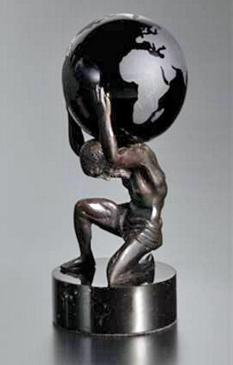
The Practical Function of Our Hope
Hope Purifies Our Life
  1 John 3:1-3; Matt. 5:8; Prov. 4:23
Hope Anchors Our Soul
  Heb. 6:17-19, 2:1; 1 Tim. 1:19-20
Hope Keeps Us Patient
  Rom. 8:24-25; Heb. 10:36-39

Slide 8

The Practical Function of Our Hope
Hope Purifies Our Life
  1 John 3:1-3; Matt. 5:8; Prov. 4:23
Hope Anchors Our Soul
  Heb. 6:17-19, 2:1; 1 Tim. 1:19-20
Hope Keeps Us Patient
  Rom. 8:24-25; Heb. 10:36-39
Hope Provides Opportunities
  1 Pet. 3:15, 4:2-4, 12-16

Slide 9
Contrast of Hope
Some people have a “living hope.”
1 Peter 1:3
These people have obeyed the gospel and are living faithful to the Lord.
Some people have “no hope.”
Eph. 2:12
These people have either not obeyed the gospel or have drifted away from the Lord.
Which one are you?

