Slide 2

Discipleship 101

Slide 3
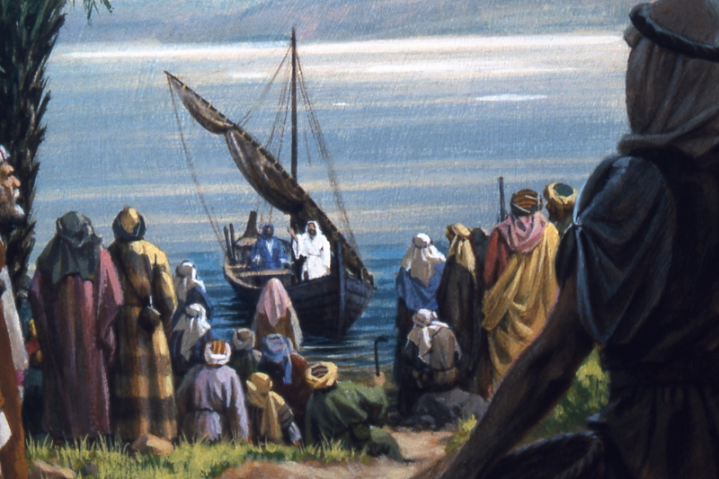
The Demands of Discipleship
Luke 5:1-11

Slide 4
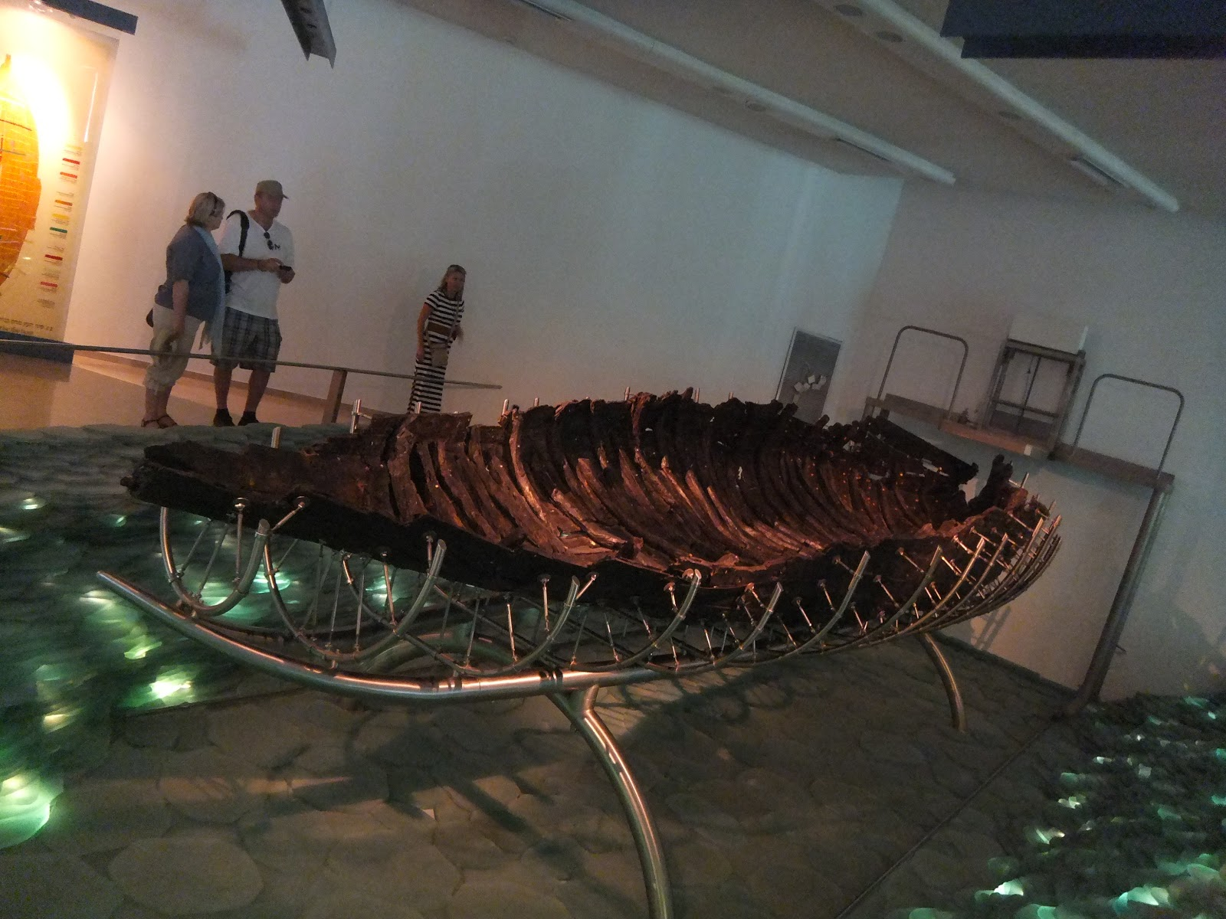

Slide 5
The Demands of Discipleship
Disciples must obey, even when they don’t understand (vs. 4-5).
Disciples must be aware of their own sinfulness (vs. 6-10).
Disciples must overcome their fear (v. 10).
Disciples seek to make other disciples (v. 10).
Disciples will forsake all for their Master (v. 11).
Luke 5:1-11

Slide 6

What Must I Do To Be Saved?
Believe Jesus is the Son of God (John 8:24)
Repent of your sins (Luke 13:3)
Confess your faith (Matthew 10:32-33)
Be baptized (Mark 16:16)

