Slide 1
b

Slide 2

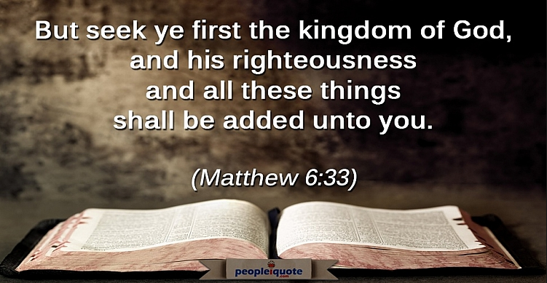

Slide 3
Seek Ye First – Matt 6:33
Read and Memorize – Psalms 119:1-16
Pray – 1 Thes. 5:17
Fellowship One with Another – Proverbs 27:17

