Slide 2

Studies in the
Sermon on the Mount

Slide 3
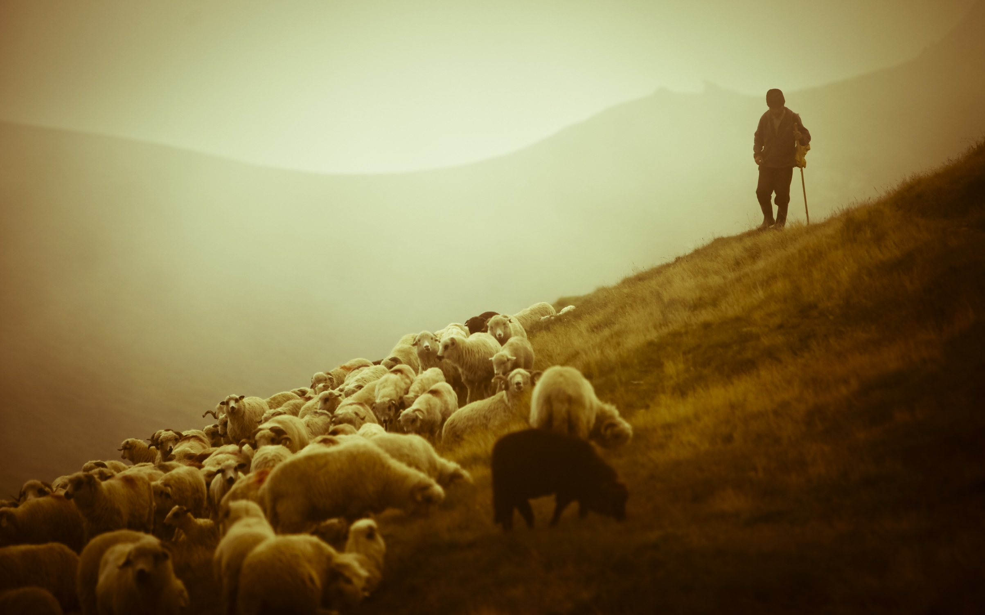
Beware of False Prophets
Matthew 7:15-20

Slide 4

“Beware”
“to be wary or careful; to be on one’s guard against” (Webster’s)
“to turn one’s mind or attention to a thing by being on one’s guard against it” (Vine’s).

Slide 5
“Beware”
False prophets were not a theoretical possibility - they were a reality!
Warnings of false prophets abound in both the Old and New Testament.
There were those who, through their influence and teaching, would prevent souls from entering the gate and walking the way that leads to life.

Slide 6
They would try to make things easier!
We naturally like the easier paths.
Israel sought those who would speak “smooth things” (Is. 30:8-10).
Paul warned of brethren who would want their ears tickled (2 Tim. 4:3-4), and teachers who would accommodate them (Rom. 16:18).

Slide 7
Spotting A False Prophet

Slide 8

Spotting A False Prophet
“You will know them by their fruits”
Their Life (1 Timothy 4:12-16)
Their Teaching (Deut. 18:20-22)

Slide 9
Spotting A False Prophet
“You will know them by their fruits”
Their Life (1 Timothy 4:12-16)
Their Teaching (Deut. 18:20-22)
We must “test the spirits” (1 John 4:1).
We must examine what we are being taught by searching the Scriptures (Acts 17:11).
Those who bring other doctrines are not to be supported (2 John 9-11).

Slide 10
Protecting Ourselves

Slide 11
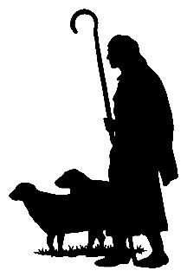
Protecting Ourselves
Elders are to protect the local church from “savage wolves” who would come in and seek to destroy the flock (Acts 20:28-30).
Elders must exhort, convict and stop the mouths of those who contradict the faithful word (Titus 1:9-11).

Slide 12
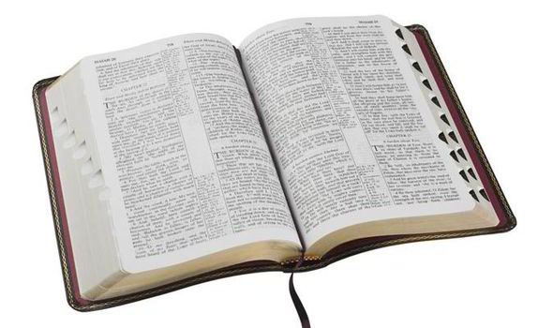
Protecting Ourselves
We must know the truth (Eph. 4:11-15)
We must love the truth (2 Thess. 2:10)
We must diligently seek the kingdom (Matt. 7:7-8)
We must love God more than man (Rom. 3:4)

