Slide 2

Studies in the
Sermon on the Mount

Slide 3
Two Ways
Matthew 7:13-14
LIFE
DESTRUCTION

Slide 4
God’s Word Offers Man A Choice
The Bible informs man of God’s existence and authority (Gen. 1:1).
God will hold man accountable for his actions.
God appeals to man’s intellect (Is. 1:18).
Jesus calls upon us to make a choice regarding which gate we will enter!

Slide 5
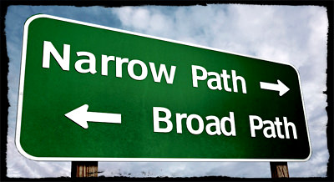
There Are Only Two Choices

Slide 6
There Are Only Two Choices
Two Gates
  wide or narrow
Two Ways
  broad, wide or narrow, difficult, hard
Two Destinations
  destruction or life
Two Groups of Travelers
  many or few

Slide 7
We must consider both the demands and the results of our choice!
The gate that leads to destruction is easy to enter. Non-restrictive; requires no sacrifices.

Slide 8
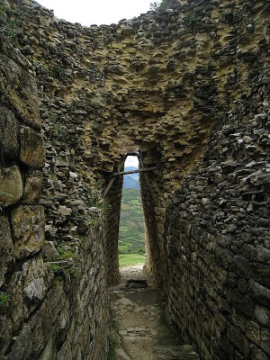
We must consider both the demands and the results of our choice!
The gate that leads to destruction is easy to enter. Non-restrictive; requires no sacrifices.
The narrow gate represents our recognition of the Lord’s authority.
We must deny ourselves in order to enter (Matt. 16:24).

Slide 9
We must consider both the demands and the results of our choice!
The way that leads to destruction is easy to walk because it is wide. It is inclusive of all sin and rebellion against God.
The way that leads to life is difficult. It is a life of obedient submission to the authority of Christ.

Slide 10
We must consider both the demands and the results of our choice!
The popular path leads to destruction. This is an eternity in Hell, which is described as…
Fire is not quenched and worm does not die (Mark 9:43-48).
Outer darkness, weeping and gnashing of teeth (Matt. 8:12).
Eternal punishment (Matt. 25:46; Rev. 20:10).

Slide 11
We must consider both the demands and the results of our choice!
The difficult way leads to life. This is an eternity in Heaven.
Heaven is a place where there is no more sin, pain or sorrow.
A place of rest.
Jesus describes it as “life” - not the afterlife. Life does not truly begin until we get there!

Slide 12
We must consider both the demands and the results of our choice!
There are many on the path that leads to destruction, while there are few who will actually find the gate that leads to life.
Why is this? Few people will take the time and effort to consider the road they are on and where it will lead. They are living in the moment and enjoying the walk, not looking at the big picture.

Slide 13
Two Ways
Which one are you on?
LIFE
DESTRUCTION

